Slide 1
Auditing the Human–LLM Autonomy Gap in Clinical Ethics
Taposh Dutta Roy · Rebecca Weintraub Brendel, MD, JD
Center for Bioethics, Harvard Medical School
50 clinical-ethics vignettes · 175 expert ratings · 8 models × 10 runs · IRB26-0146
Notes:
One-line framing: we built a structured instrument for patient autonomy, gave it to trained bioethics reviewers and to eight current language models on the same 50 cases, and compared what they did with it.

Slide 2
THE PROBLEM
Models are already answering health questions.
1
Exposure has moved from General Purpose to Clinical
The debate is about purpose-built clinical AI under regulatory review. The models are developed for general-purpose chat models with no clinical indication.
2
Evaluation looks elsewhere
Benchmarks measure factual accuracy, exam performance, and refusal. Whether a model treats a patient as an agent has almost no empirical literature.
3
Human judgment is also undocumented
How clinicians actually weigh values, facts, deliberation, and enacted agency is sparsely described. The Appelbaum model says what ought to count, not what practitioners do.
So we measured one dimension properly, on both sides.

Slide 3
THE INSTRUMENT
The Autonomy Index: 13 items, four domains, two modifiers
Values Awareness
Factual Understanding
Rational Deliberation
Intentional Action
4 items
3 items
3 items
3 items
Clarity, stability, framework awareness, and recognition of the care team
Recall of the condition and options, risk comprehension, applicability to self
Coherence, trade-off reasoning, consistency with stated values
Strength of intention, plan-fulness, follow-through feasibility
Reported alongside, never subtracted from the score
External Constraint Index (ECI) and Support Provided Index (SPI), 0–100. Folding them into the composite would convert structural disadvantage into diminished measured autonomy, which is the error the framework exists to avoid.
Every item also offers N/A — insufficient information in the case to judge. Remember this option.
Notes:
Flag the N/A option here so the abstention finding later does not come out of nowhere. N/A is a substantive response, distinct from a score of 0.

Slide 4
DESIGN
One instrument, two sources of judgment, the same 50 cases
89
→
50
→
175
→
3,431
vignettes
selected
human ratings
model scorings
Published case reports and public-domain material, screened for genuine ethical tension
Stratified on March model scores across five score tiers and three disagreement strata
30 bioethics-trained reviewers, median 3 per vignette, blind to model output
8 current models × 10 runs, identical prompt, provider pinned, July 2026
Both sources performed an identical task
Same vignette text, same 13 items, same response scale including N/A, same aggregation rule. Differences are attributable to the rater, not to stimulus, instrument, or response format. Human ratings are a reference standard, not ground truth — the design cannot say who is right where they differ.

Slide 5
THREE FINDINGS
What the study shows
Human Reviewers show higher autonomy than models
Human Reviewers show more variability than Models
Humans decline to score what the vignette does not show; current models never do.
The direction is unanimous across eight models from six developers, and unchanged across a model generation.

Slide 6
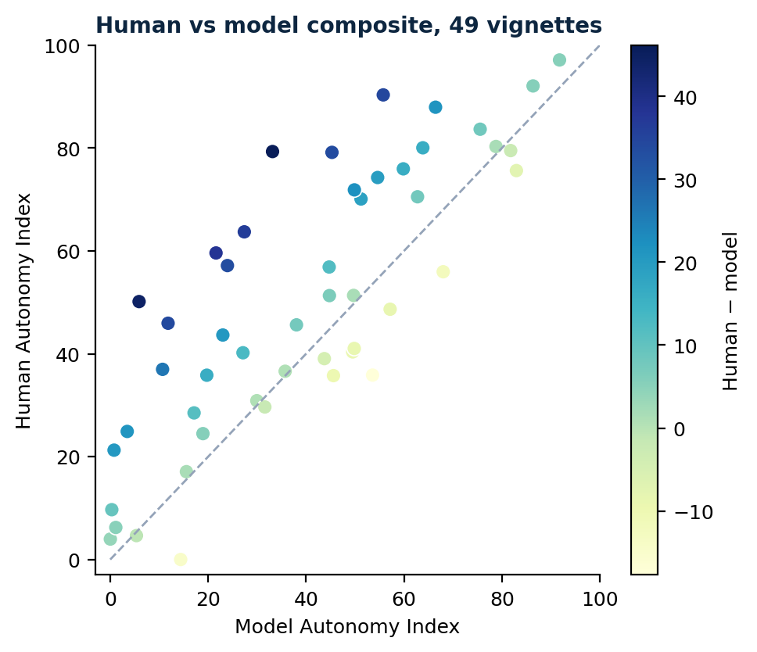
FINDING 1A
They order the cases alike
Pearson r = 0.81
Spearman ρ = 0.80 · r = 0.78 restricted to the 43 vignettes with three or more ratings
Roughly two-thirds of the variance in pooled model scores is shared with the human scores. Models and reviewers substantially agree on which cases depict more and less autonomous decision-making.
That is agreement on ordering. It says nothing about how much autonomy either source thinks any case depicts — which is where they part company.
Dashed line is identity. Points above it are cases where reviewers scored higher.

Slide 7
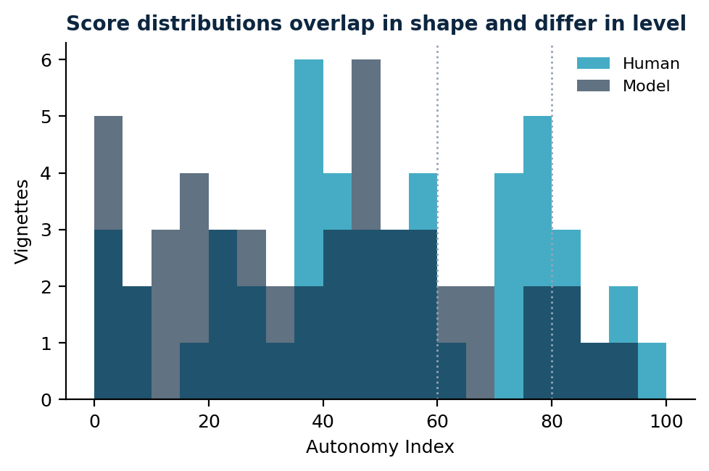
FINDING 1B
And they sit about eleven points apart
Human mean
50.2
Model mean
39.4
Paired difference
+10.8
95% CI
6.3 to 15.4
Effect size dz
0.68
Human higher on
37 of 49
Not interchangeable on absolute scores: Bland–Altman limits of agreement run from −20 to +42, and the case-to-case variation in the gap (SD ≈ 15) is larger than the gap itself.
Notes:
The paired vignette-level estimate is the headline. The mixed-model estimate under the equal-weighting specification is +9.4 (SE 1.6); both are reported.

Slide 8
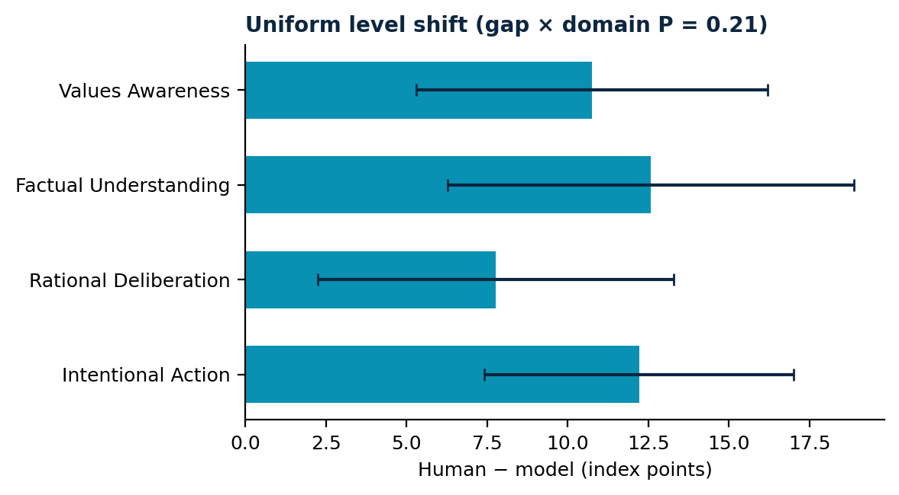
FINDING 1C
The discount is applied to the whole construct
Gap × domain: χ²(3) = 4.5, P = 0.21
The interaction is null, so the ordering of the four domain gaps is not interpretable. What the data support is a level shift across the construct, not a stricter threshold on any one ability.
This is the stronger result. A gap concentrated in Factual Understanding would look like a different bar for adequate comprehension; one in Intentional Action, a different bar for evidence of planning. A uniform shift is neither.
Both sources also share the shape of the profile — Values Awareness highest, Factual Understanding lowest. What separates them is level, not structure.

Slide 9
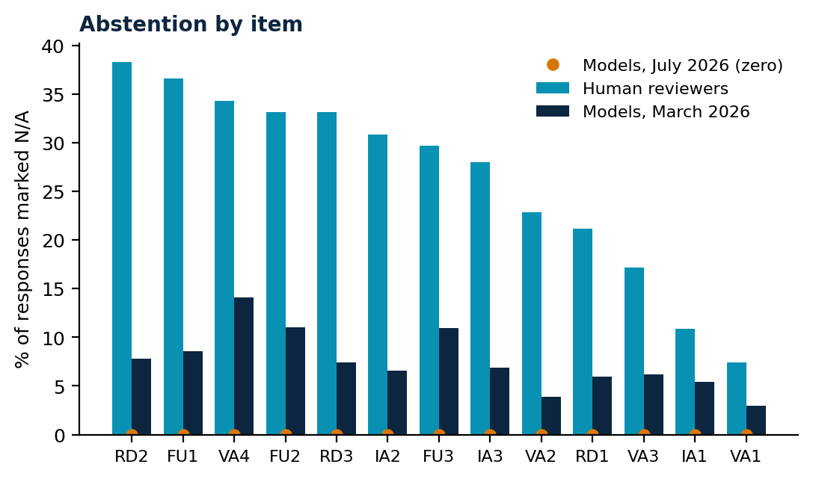
FINDING 2
Reviewers said “not enough information.” Models never did.
26.5%
0
Human
July models
of item responses
in 3,431 scorings
The March 2026 generation abstained on 7.5% of responses, concentrated in four of nine models. The capability was there one generation ago and is gone now.
Human abstention is orderly, not careless: highest on what must be inferred (trade-off reasoning 38%), lowest on what the case states outright (value clarity 7%), and uncorrelated with the case’s autonomy level (r = 0.10).
Notes:
This is the finding that needs no reference-standard assumption. It does not depend on humans being right.

Slide 10
WHY IT MATTERS
A system that never reports insufficient
information cannot flag the cases where a
clinician should go and ask.
Which is exactly the circumstance in which a capacity-support tool would earn its place.
Two readings, and this design cannot separate them: models may judge the vignettes to contain sufficient evidence where reviewers do not, or models may be disposed to answer any well-formed request. The operational implication is the same either way.

Slide 11
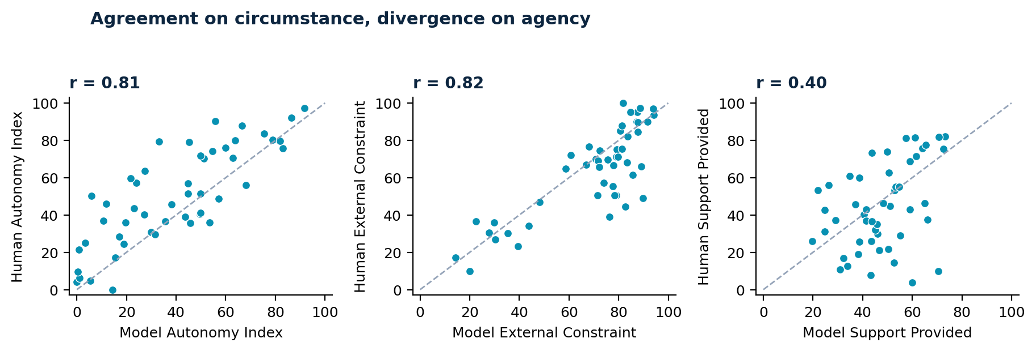
FINDING 3
They agree on the circumstances and disagree about the person
ECI and SPI were rated by the same reviewers, from the same vignettes, in the same sitting, on the same response format. If the divergence on autonomy came from models reading the cases differently or answering more conservatively in general, it would show up here too. It does not.
Neither modifier moderates the gap (ECI r = 0.07; SPI r = 0.20). The March-generation claim that models discount autonomy most under heavy constraint does not replicate and is withdrawn.

Slide 12
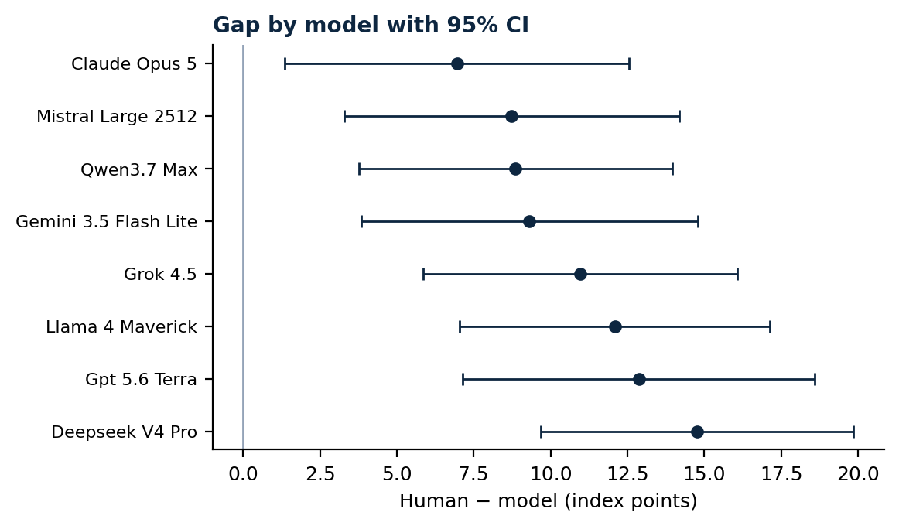
ROBUSTNESS
Every model, same direction — but not the same size
Eight models from six developers, proprietary and open-weight, all show the effect and every confidence interval excludes zero.
The spread is not trivial, though: +7.0 for the closest model against +14.8 for the widest, a factor of two on an eleven-point effect. Model choice narrows the difference. It does not remove it.
Self-consistency varies far more than level does — mean within-vignette SD runs from 0.7 to 10.6 points across the eight. A displaced but stable model and a noisy one call for different responses in deployment.

Slide 13
ROBUSTNESS
A model generation moved the level by 0.2 points
Composite 39.6 → 39.4
paired P = 0.90
Nine models replaced by eight successors from the same developer set. No domain moves significantly. Agreement with the human reference is unchanged at r = 0.78.
The capability gains between these generations did not touch the disposition under study. The one thing that clearly did change — abstention — moved the wrong way.

Slide 14
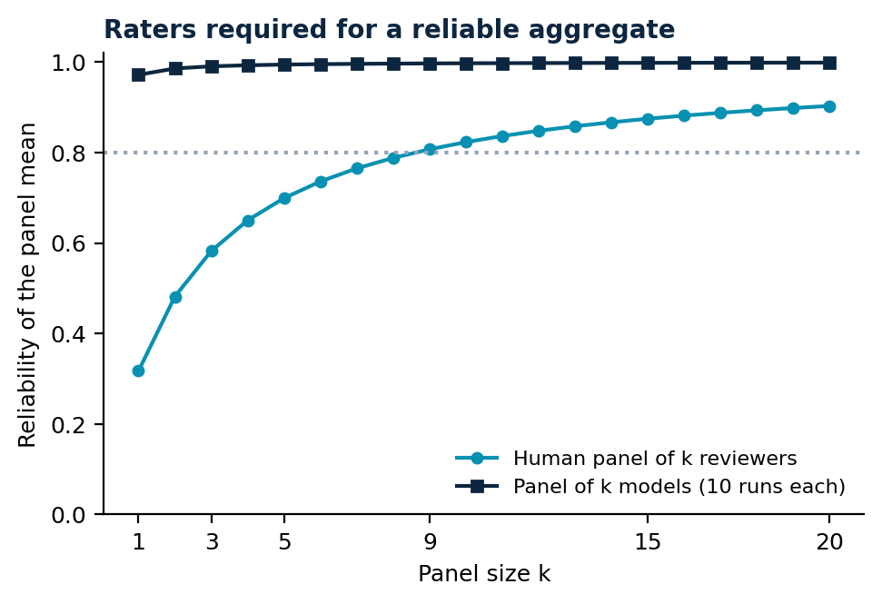
THE OTHER HALF OF THE PICTURE
The human reference is a band, not a point
One model beats nine reviewers
A single model’s 10-run mean reaches reliability 0.97. Reaching 0.80 with human reviewers takes roughly nine per case.
Reviewers disagree widely
Mean between-reviewer SD 16.4 points, mean range 28.2, one case spanning 74.
The panel usually sits inside
The model panel mean falls within the observed human range on 15 of 26 comparable cases (58%). The gap bites on the rest.
Rater identity is approximated by session; exact components await a rater-linked export.

Slide 15
IMPLICATIONS
What follows for deployment
The error runs toward paternalism
An autonomy-support aid on current systems would under-recognize patient agency, most where models already judge it weak — where the stakes for the patient are highest.
Human oversight, not substitution
In capacity-sensitive decisions, calibrate toward the range of defensible human judgment rather than its central tendency.
Restore calibrated abstention
Declining to score for insufficient evidence should be a first-class model behavior, not something lost between releases.
Selection is a mitigation, not a remedy
The best-aligned model halves the gap. None reaches parity.
The instrument fixes what is being measured. It does not adjudicate who measures it well — reviewers are a reference standard, not ground truth.

Slide 16
HONEST LIMITS
What this does not establish, and what would settle it
Design
Reference standard
What would settle it
The 50 cases were stratified on model scores, not sampled at random, so correlations are range-inflated and cross-range trends carry a regression artifact.
Static written vignettes cannot capture an interactive bedside assessment.
Reviewers knew a machine comparison was coming.
Convenience sample, concentrated in consultation-liaison psychiatry (17 of 36 stating a specialty).
US recruitment only; nationality was not collected, so the standard likely encodes US norms of autonomy.
No reviewer identifier survives de-identification, so rater variance is session-approximated.
A rater-linked export: exact variance components and a completion-missingness model.
Replication on a randomly drawn sample of the 89-case corpus.
An ablation that withholds specific evidence and watches whether models abstain.

Slide 17
Models rank clinical cases the way trained
ethicists do, score them about eleven points
lower, and never say they cannot tell.
Taposh Dutta Roy · taposh_duttaroy@hms.harvard.edu
Analysis code, response-scale decoding evidence, and a verification harness that checks every published number against the data are released with the paper.
Human data collected under IRB26-0146, Harvard Longwood Campus IRB.

