Slide 1
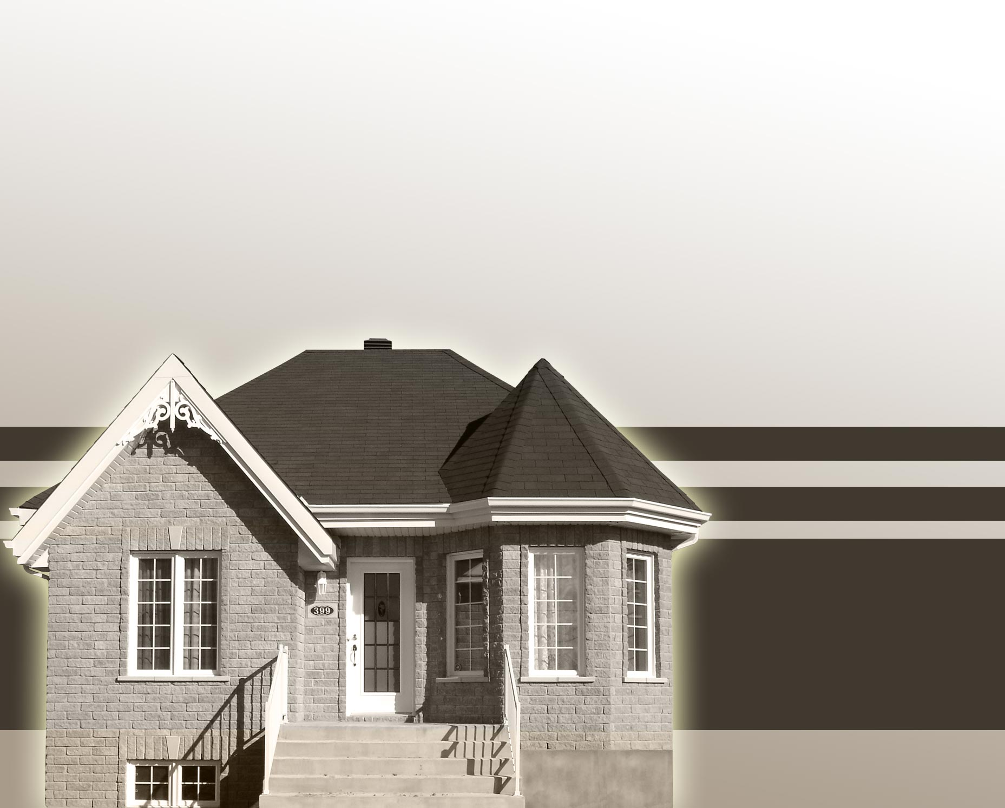
Home Affordability Calculator
Taposh Dutta Roy
Preeti Lal

Slide 2

Background
People want to buy the best house they can afford.
Without spreading themselves thin.
Everyone has different criteria.

Slide 3
Common Criteria/Concerns
Georgraphic location
Size of the house
Schools
Demographics of neighbors
Distance from work

Slide 4
Common Constraints
Income
Existing commitments
Monthly expenses
Daycare/School costs
Car loans
Student Loans

Slide 5
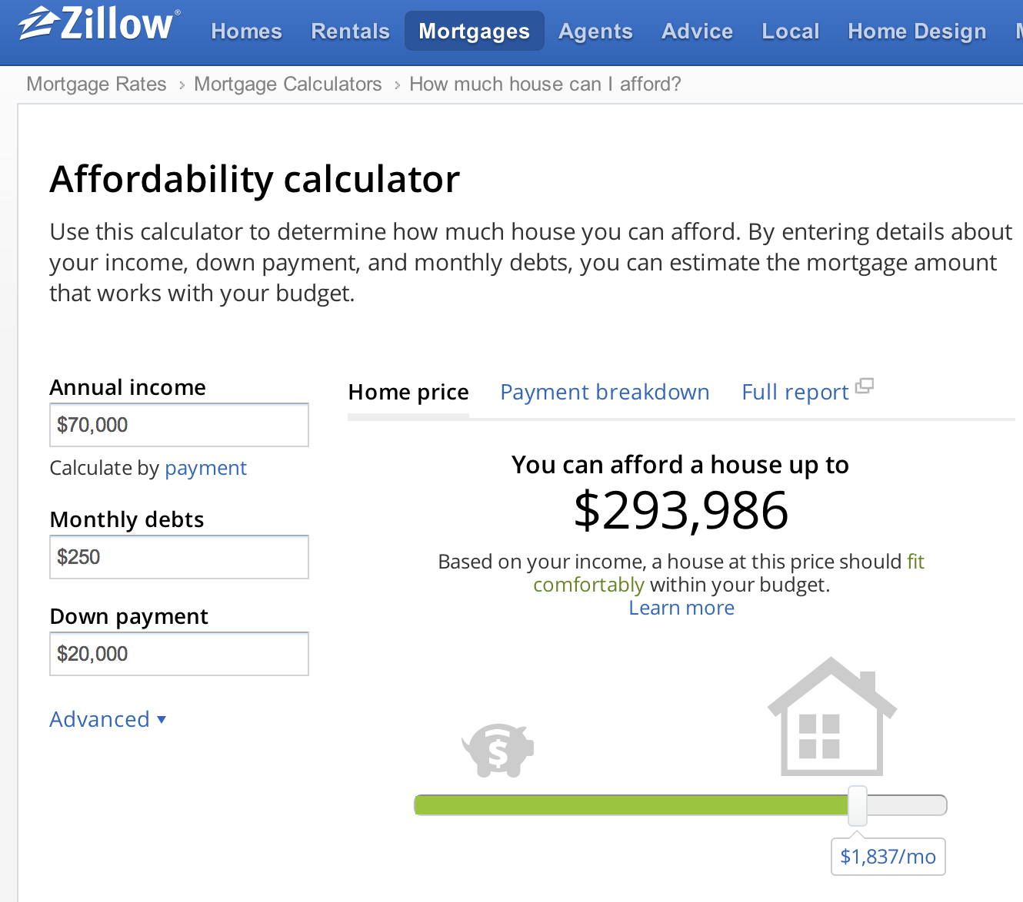
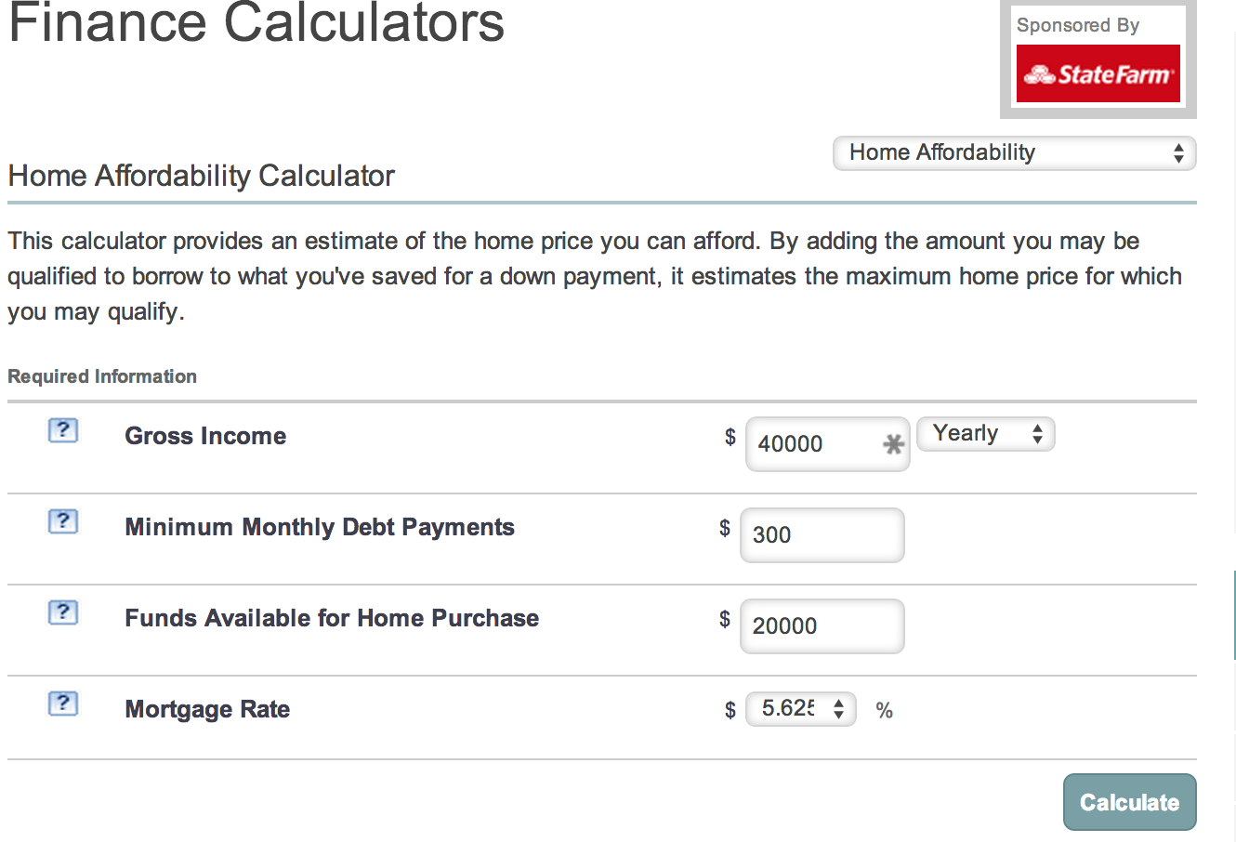
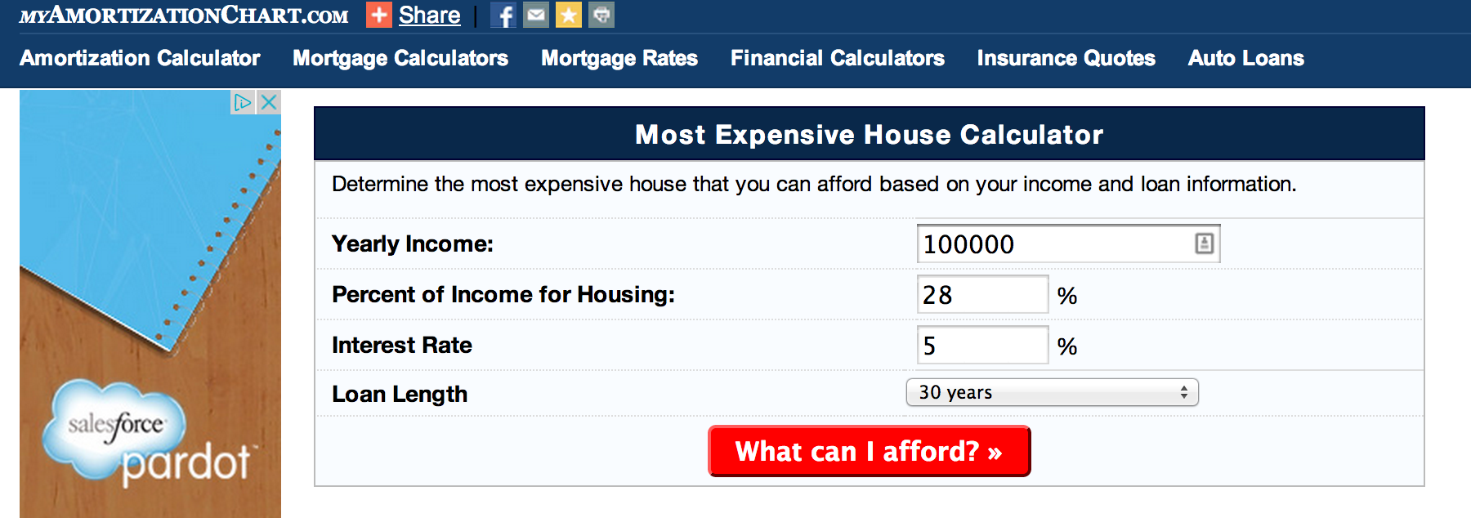
Existing Tools

Slide 6
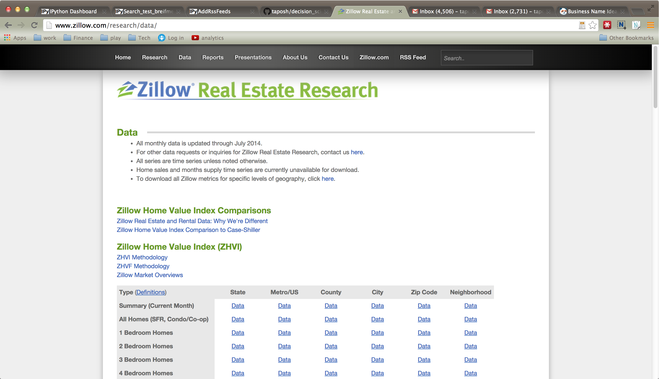
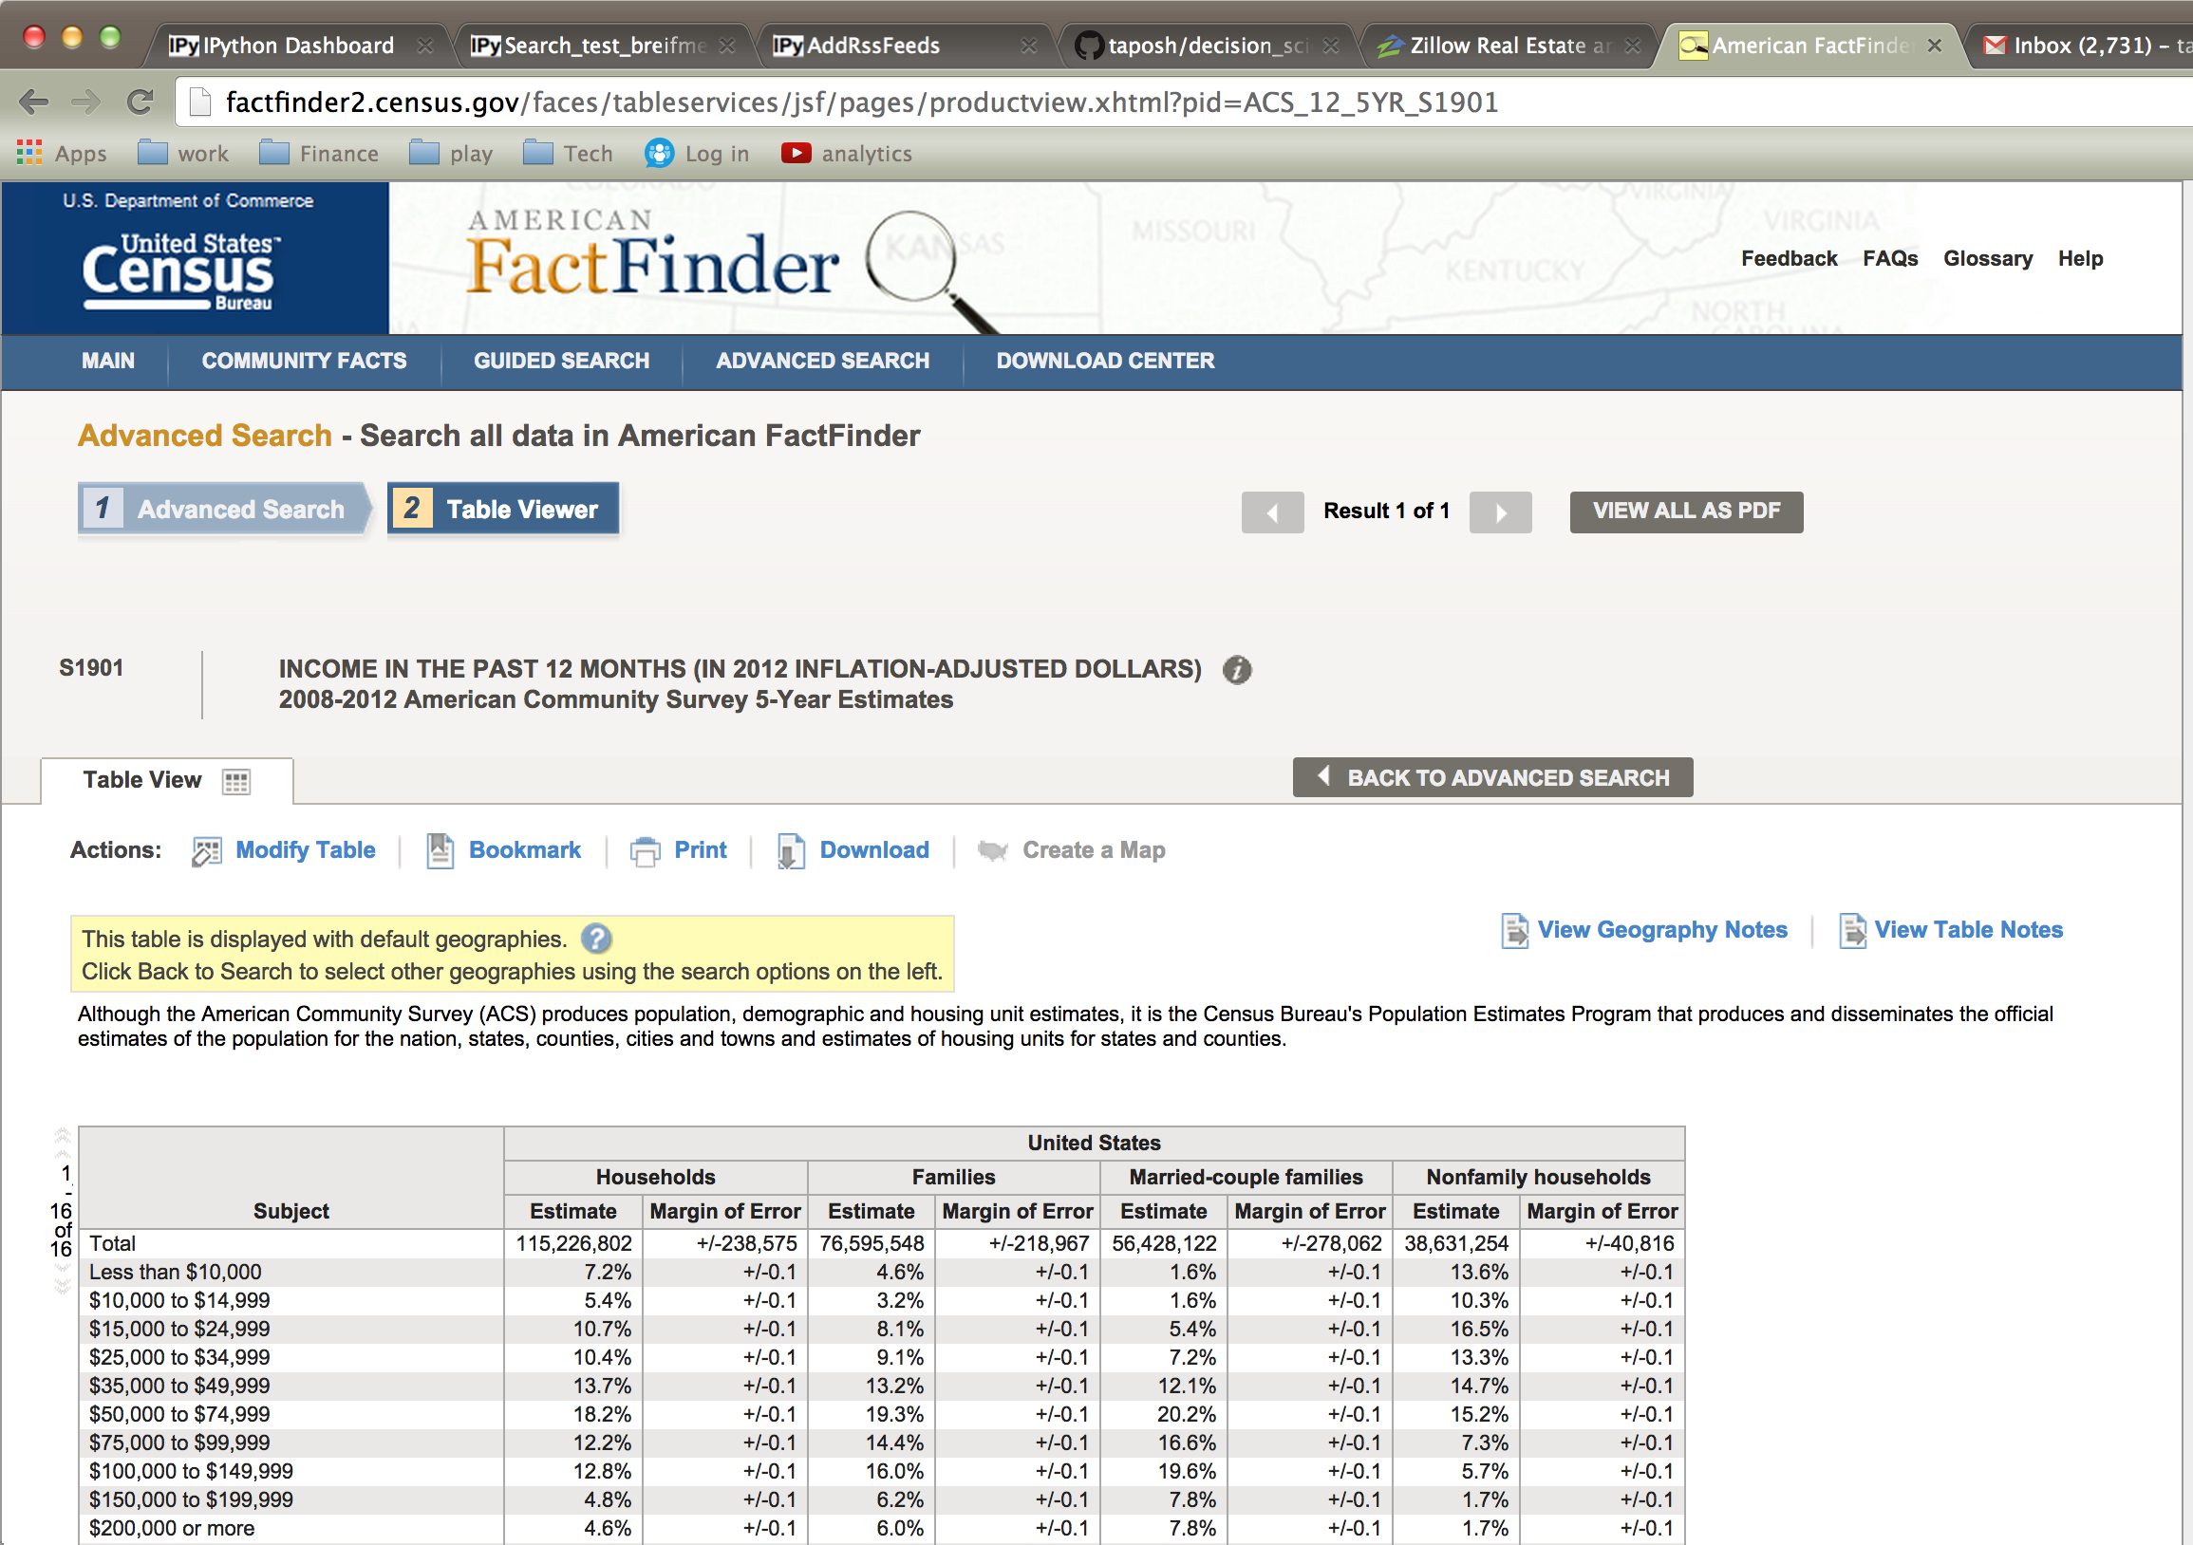
Our Model
Uses data from:
Zillow
Bankrate
Census
Uses Optimization.

Slide 7
Unique Value Proposition
Feature | Existing models | Our model
Calculate maximum house price | ☑ | ☑
Compare price to target area | ☒ | ☑
Suggest alternate areas | ☒ | ☑

Slide 8
Data
Got the data for median prices:
2 bedroom houses
3 bedroom houses
4 bedroom houses
Cleaned it.
Formatted it.
Limited it.

Slide 9
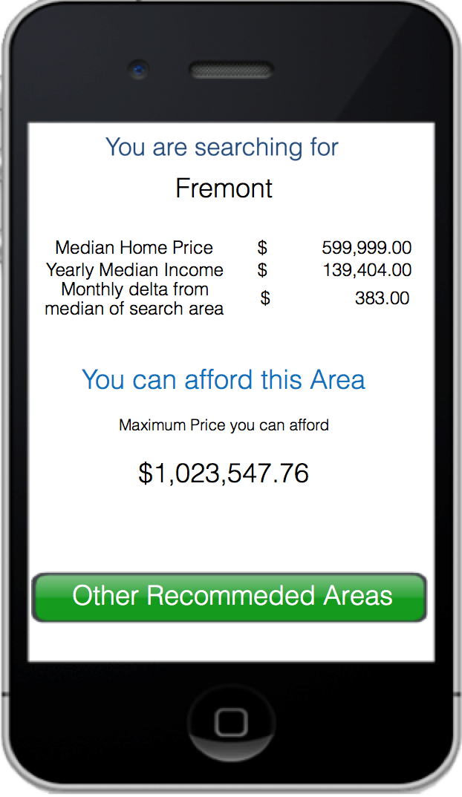

Slide 10
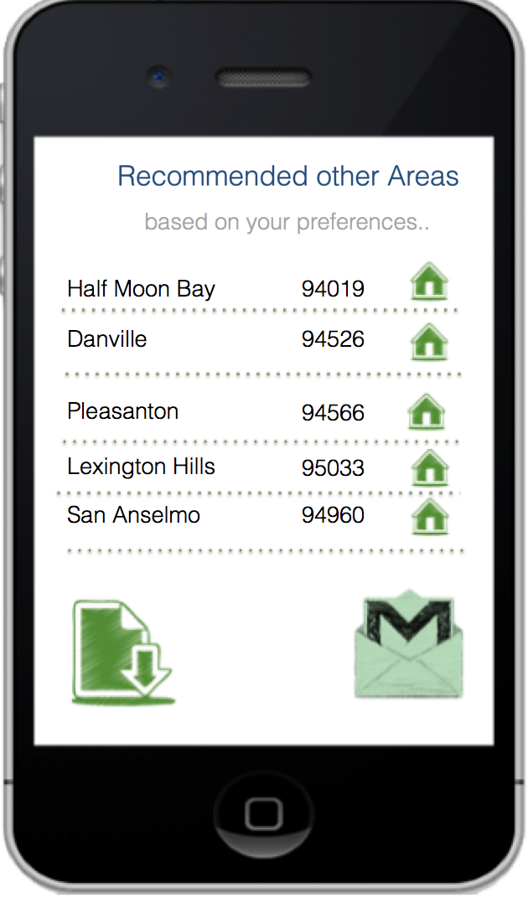

Slide 11
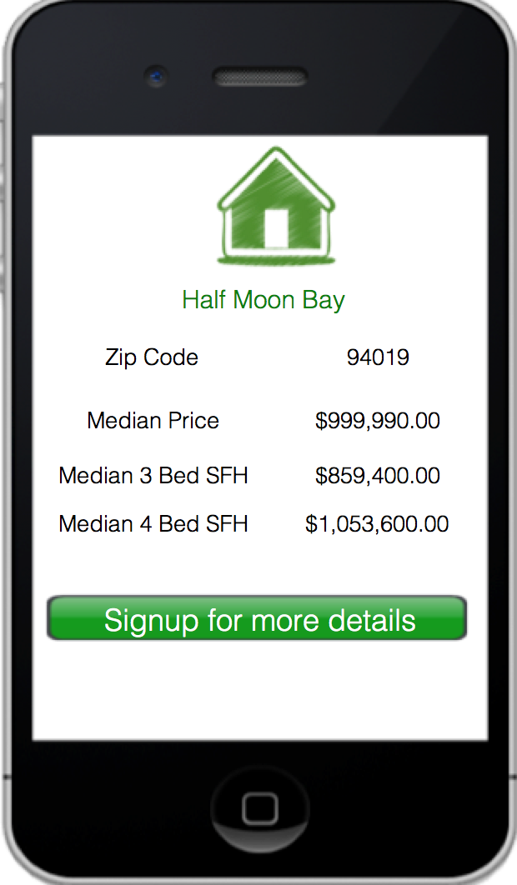

Slide 12
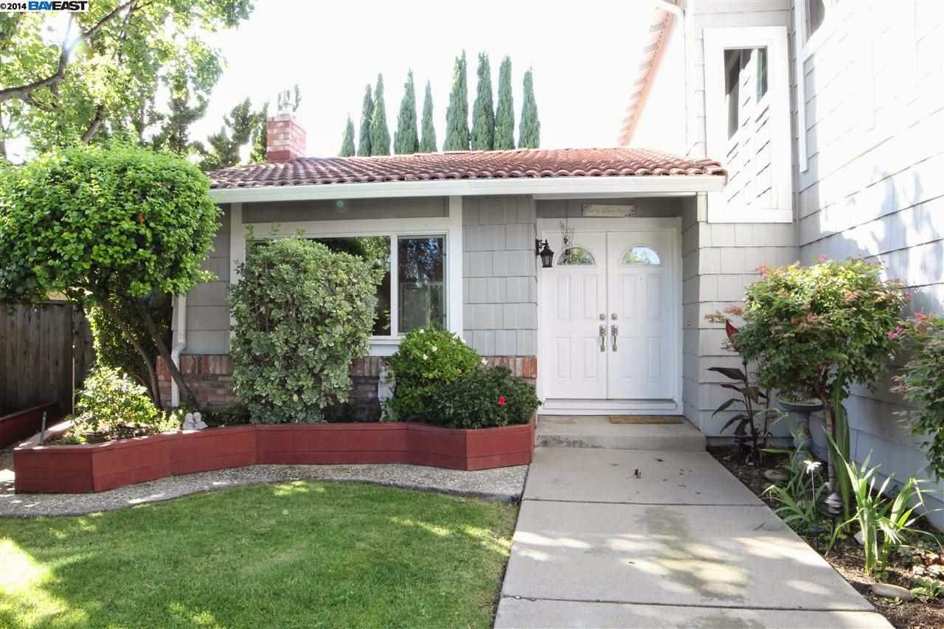
Our Model

Slide 13
Questions?

