Slide 1
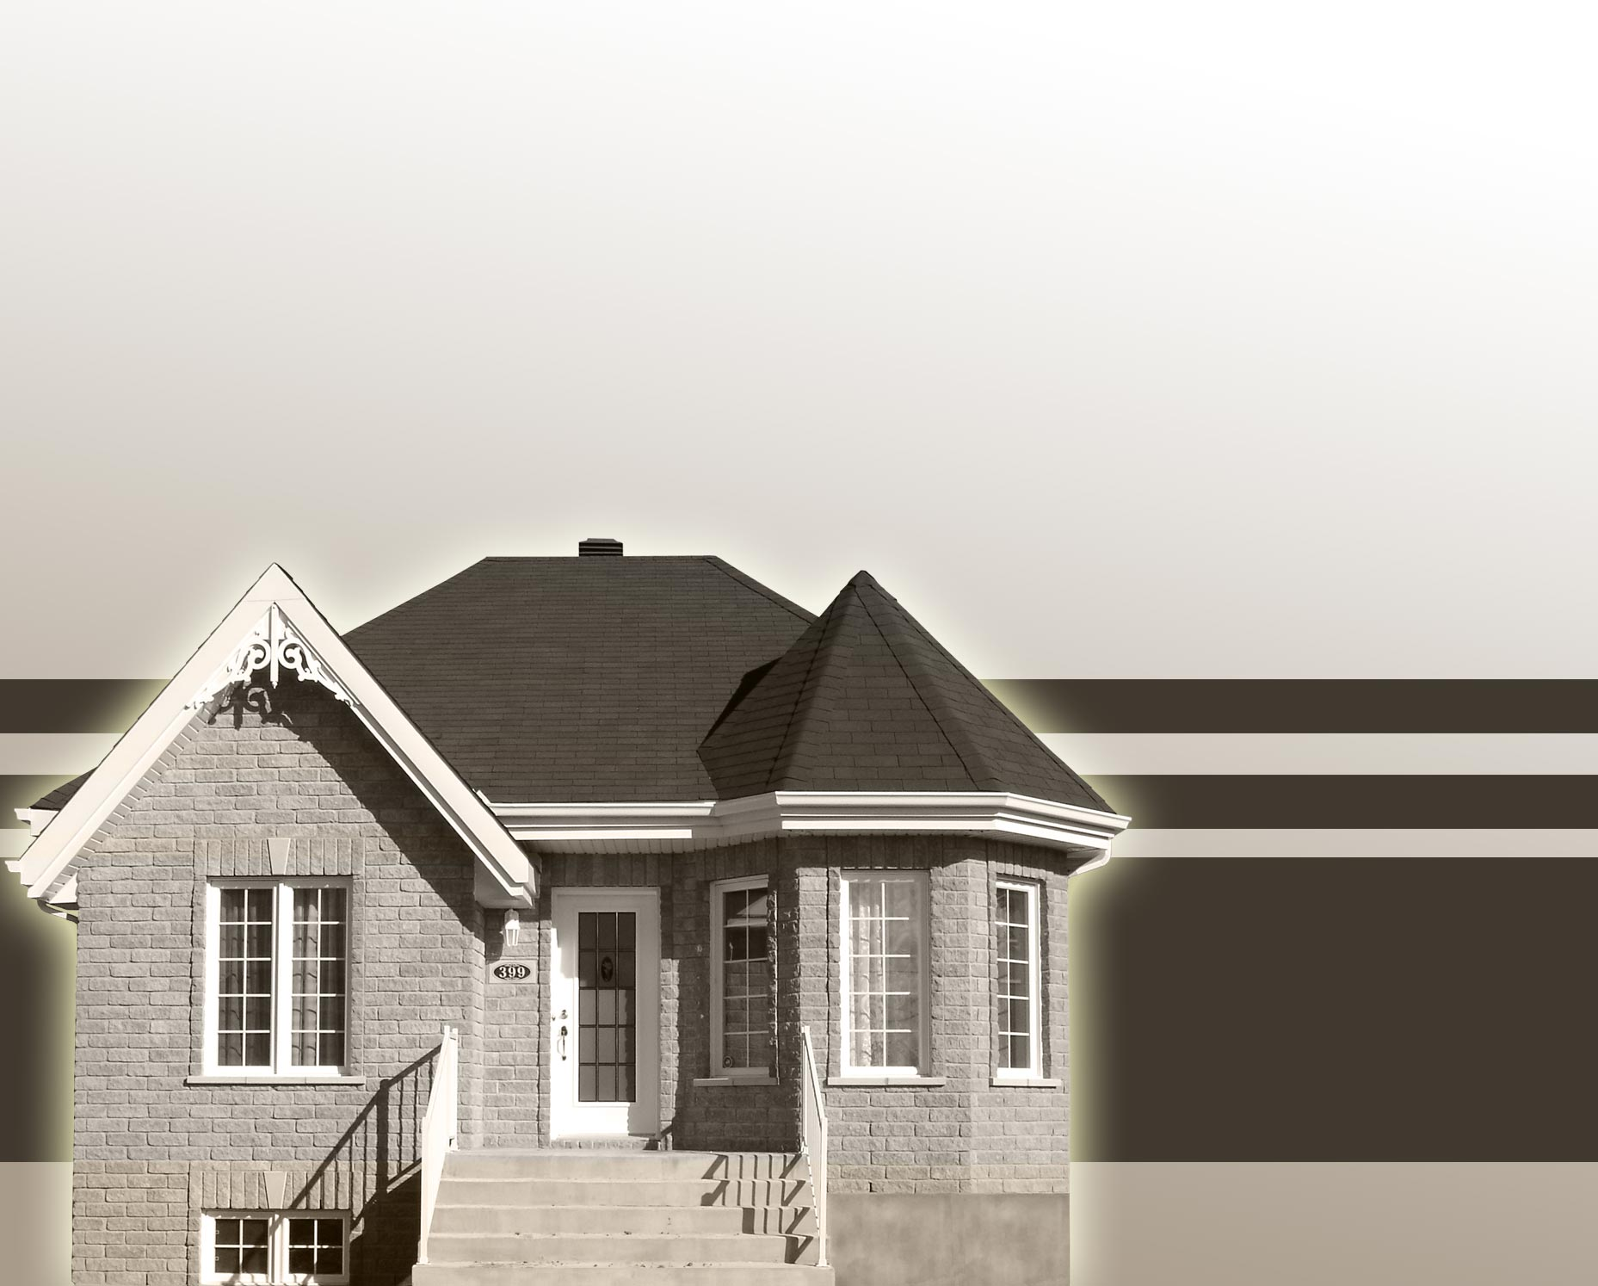
Home Affordability Calculator
Taposh Dutta Roy
Preeti Lal

Slide 2

Background
People want to buy the best house they can afford.
Without spreading themselves thin.
Everyone has different criteria.

Slide 3
Common criteria/concerns
Georgraphic location
Size of the house
Schools
Demographics of neighbors
Distance from work

Slide 4
Common Constraints
Income
Existing commitments
Monthly expenses
Daycare/School costs
Car loans
Student Loans

Slide 5
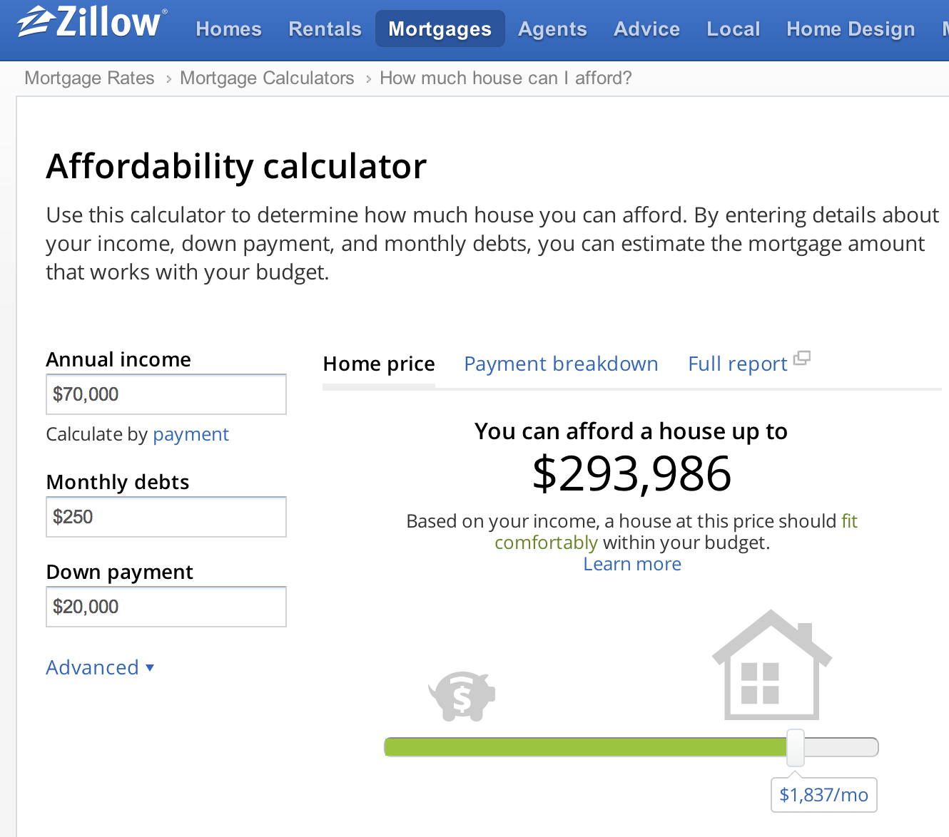
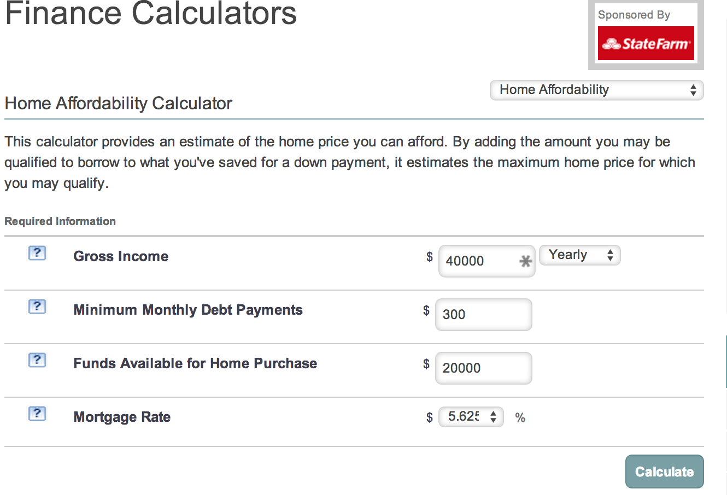
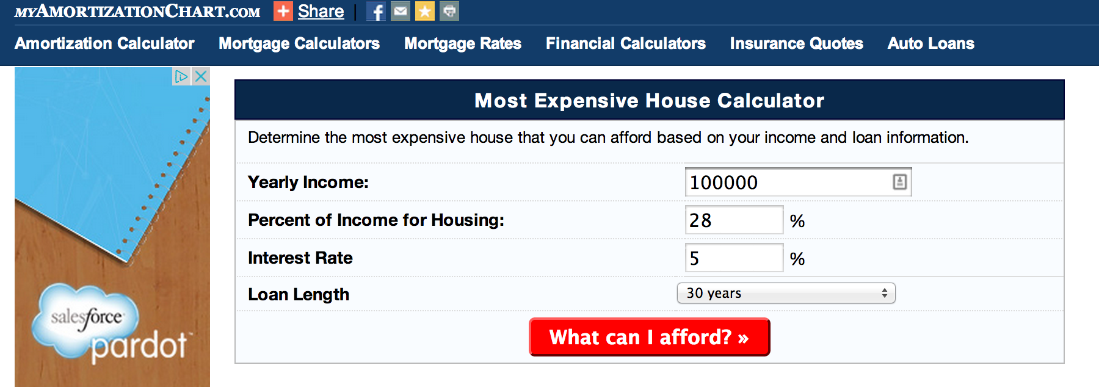
Existing Tools

Slide 6
Our Model
Uses data from:
Zillow
Bankrate
Census
Uses Optimization.
Demo!

Slide 7
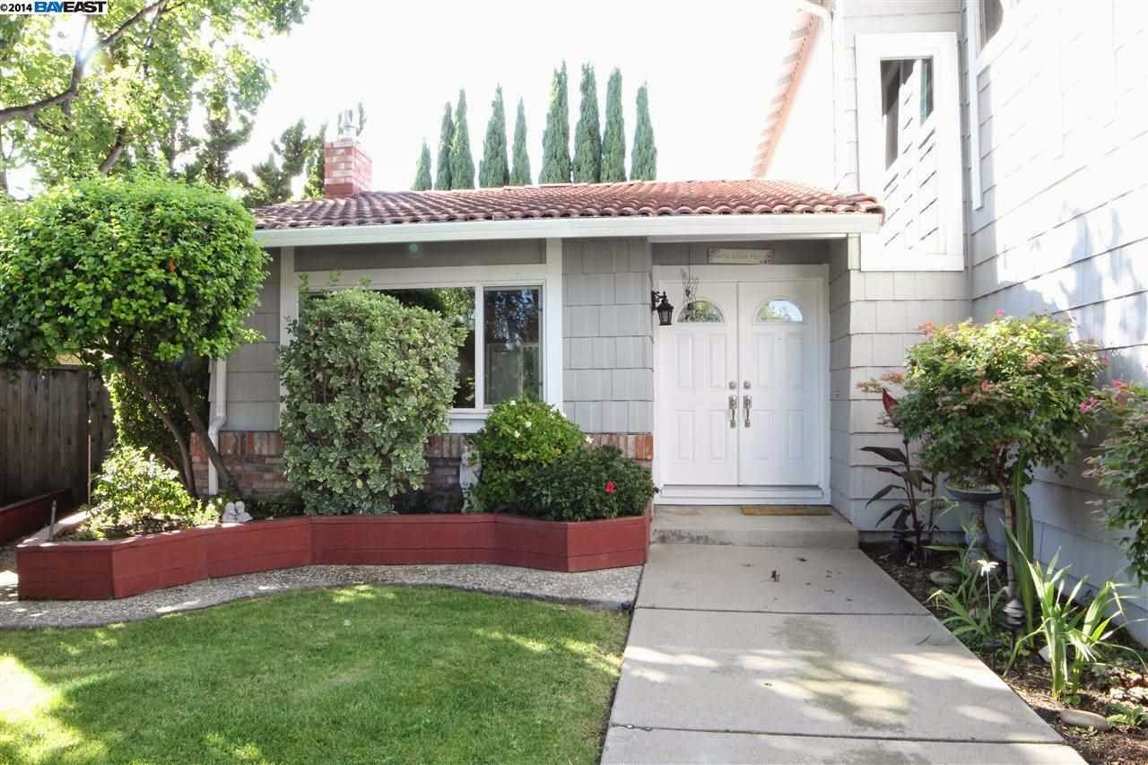
Our Model

Slide 8
Questions?

