Slide 1
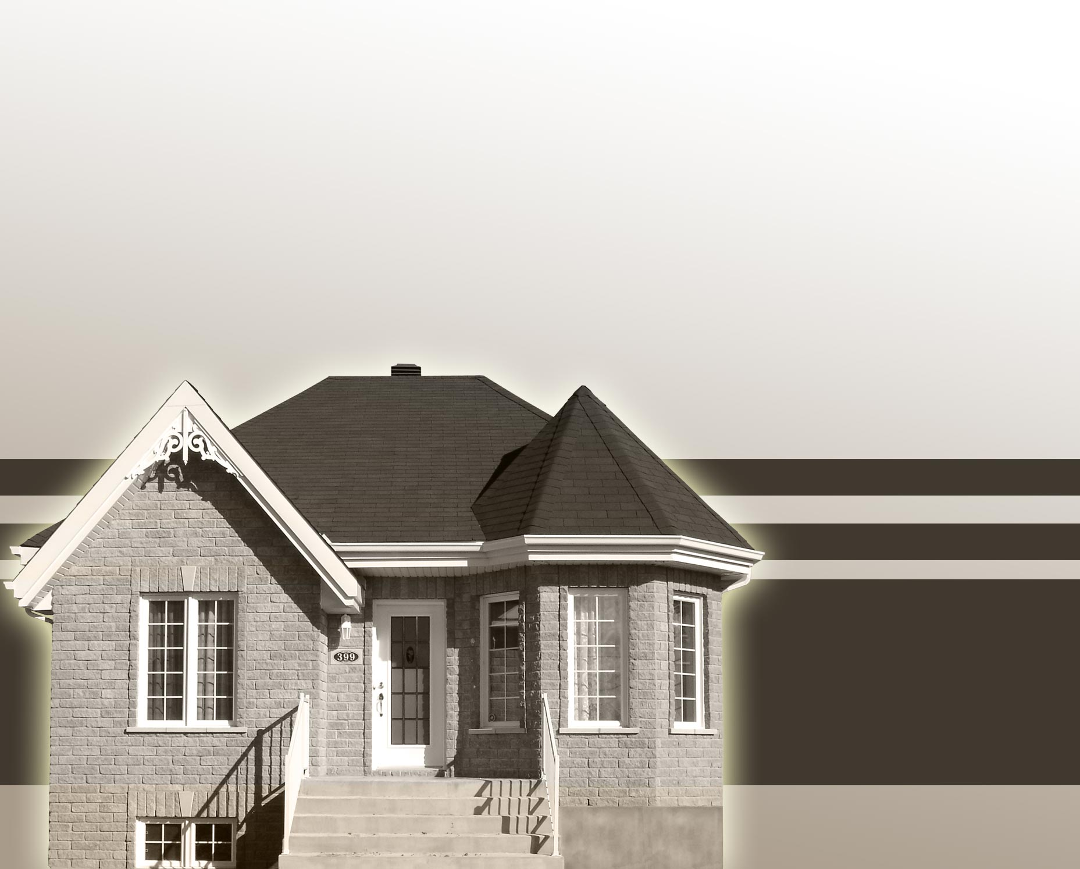
Home Affordability Calculator
Taposh Dutta Roy
Preeti Lal

Slide 2

Background
People want to buy the best house they can afford.
Without spreading themselves thin.
Everyone has different criteria.

Slide 3
Common criteria/concerns
Georgraphic location
Size of the house
Schools
Demographics of neighbors
Distance from work

Slide 4
Common Constraints
Income
Existing commitments
Monthly expenses
Daycare/School costs
Car loans
Student Loans

Slide 5
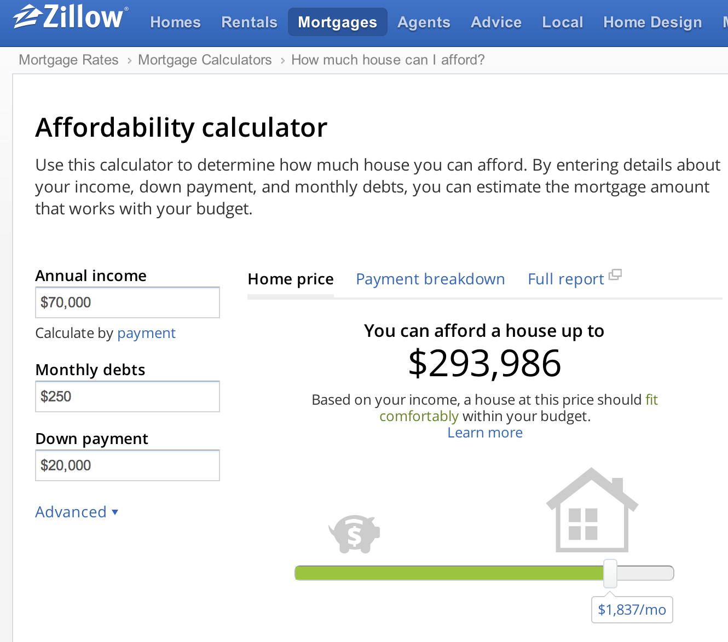
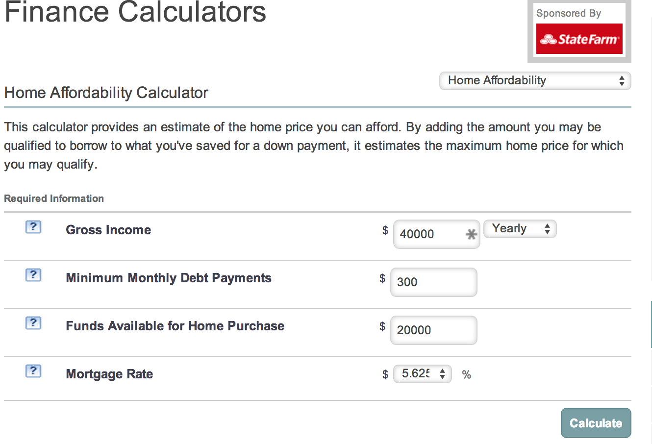
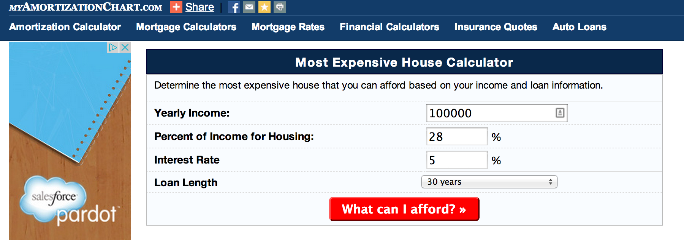
Existing Tools

Slide 6
Our Model
Uses data from:
Zillow
Bankrate
Census
Uses Optimization.

Slide 7
Our Model – Unique Value proposition
Existing tools stop at telling you the maximum you can afford to pay for a house.
Our model goes beyond that and tells you if that is enough for your target area or not.
It goes further and shows you alternate areas you should look at based on your budget and geographic location.

Slide 8
Our Model - Data
We got the data for median prices for 2 bedroom, 3 bedroom and 4 beroom houses from zillow.
We cleaned the data up and formatted it to fit our model.
We had to limit it to Northern California due to the volume of data.

Slide 9
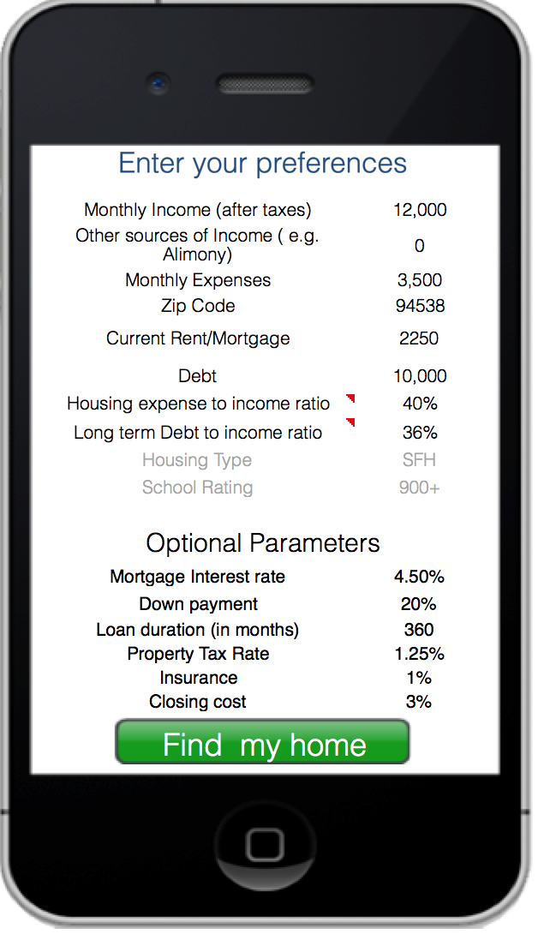
Demo!

Slide 10
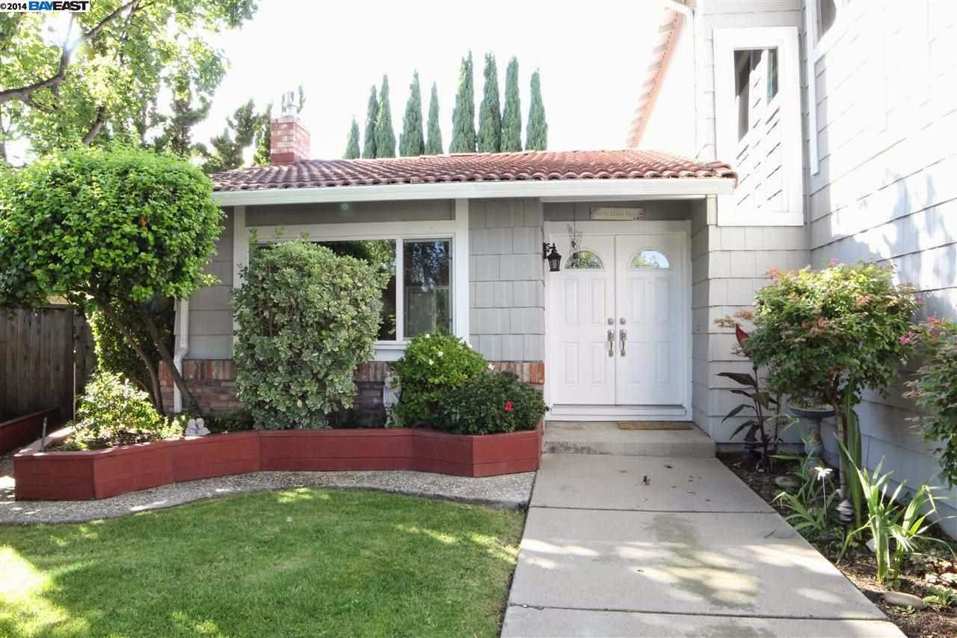
Our Model

Slide 11
Questions?

