Slide 1


NBA Salary & Performance Analysis (2025)
Are teams getting their money’s worth?
Thomas Preston | DSC680 | 7/19/2025

Slide 2
Project Goals
Understand if NBA salaries match player performance
Identify overpaid and undervalued players
Use machine learning to predict salary from stats
Create visualizations to show salary vs performance

Slide 3
What Data Did I Use?
NBA Player Stats & Salaries from 2025 only
Stats: PTS, AST, REB, FG%, 3P%, FT%, Age
Removed missing or incomplete records
Focused on current season only for clarity

Slide 4
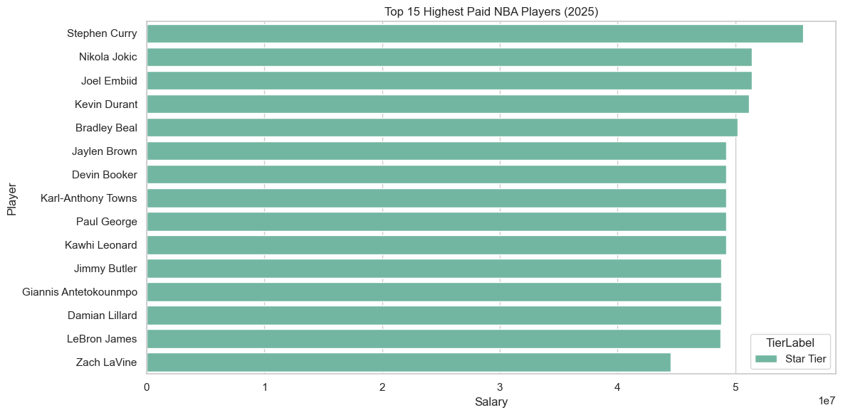
Top 15 Highest Paid Players
Some highest earners weren't top performers
Possible overpayment for reputation or past performance

Slide 5
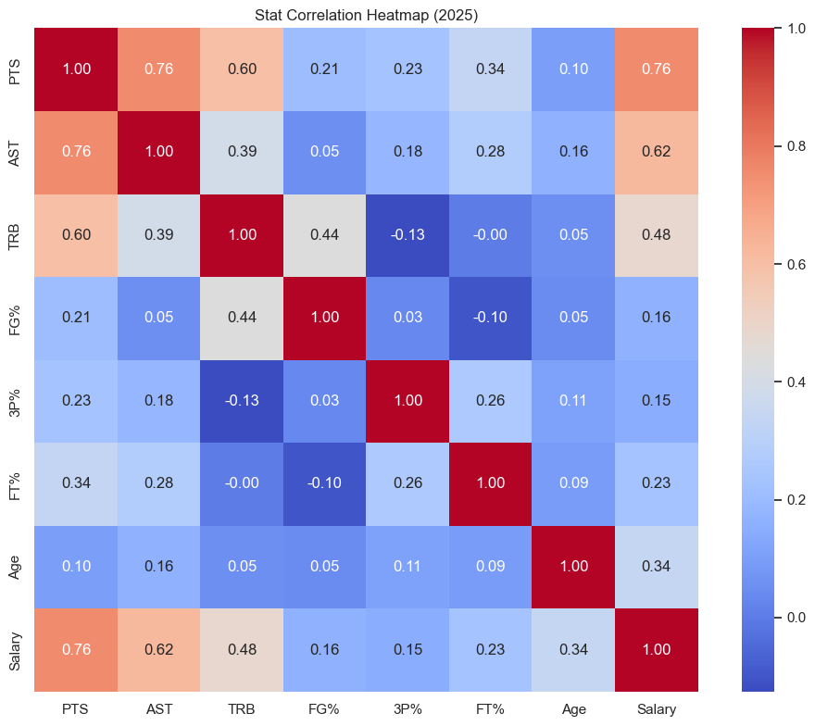
What Affects Salary Most?
Points, assists, and rebounds had strongest links
Age, FG%, and 3P% had weak or no strong correlation

Slide 6
How I Grouped Players (K-Means Clustering)
4 Tiers: Stars, Efficient Veterans, Solid Contributors, Role Players
Used player stats only, not salary
Grouped by similarity in performance

Slide 7
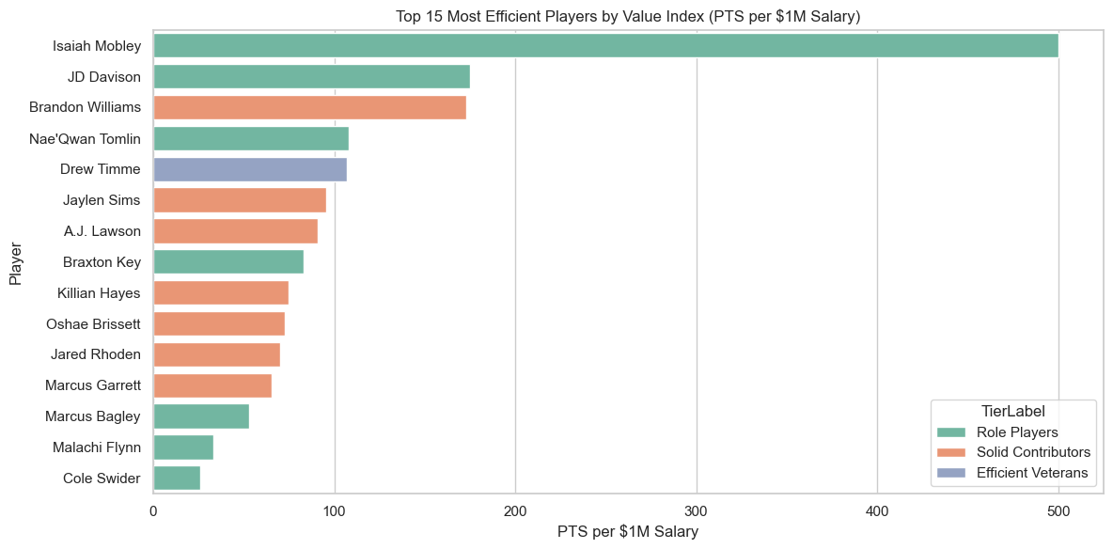
Who's Providing the Most Value?
Calculated points per $M salary
Top value players weren't always stars
Younger or lesser-known players often had high value

Slide 8
How Well Can We Predict Salary?
Random Forest: R² = 0.72, MAE ≈ $2.1M
Linear Regression: R² = 0.48, MAE ≈ $3.5M
Random Forest handled complexity better

Slide 9
Ethics & What’s Next?
Data may ignore context like injuries or team role
Rookies & veterans face different contract rules
Next steps: Add advanced stats (PER, Win Shares), look at multi-year trends

Slide 10
Key Takeaways
NBA salaries don’t always match current performance
Value comes from all tiers, not just stars
Teams may want to rethink how they evaluate contracts
Simple models + basic stats still reveal a lot

