Slide 1
This code is broken. Can you fix it?
(define rtrr (put-image triangle 25 “solid” “red”)
50 50
(rectangle 100 100
solid”
“red”)))
What should it do?

Slide 2
Finish this design recipe.
; double: Number → Number
(EXAMPLE ( )(* 20 2))
(EXAMPLE) (double 36)( ))
(define )

Slide 3
What is research?
Can we learn math from computer programming?
What is a phD?

Slide 4
Blue Circle
Write a function that takes a number and give s a blue circle.

Slide 5
Blue Circle
Write a function that takes a number and gives back a blue circle.

Slide 6
Contracts
How do we create our library of functions?

Slide 7
Double
Take a number and double it.

Slide 8
Warm Up
define
gtrc
put-image
Write the code for this circle of evaluation.
triangle
circle
25 "solid" "green"
50 "solid" "red"
50 50

Slide 9
computer screen coordinates
slightly different from math coordinates
(0,0)

Slide 10
Contracts Day 2
How do we create our library of functions?

Slide 11
What about this?
(put-image
(put-image (rectangle 500 100 "solid" "red")
250 250
(rectangle 500 100 "solid" "yellow"))
150 250
(rectangle 500 100 "solid" "black"))

Slide 12
Review of computer screen coordinates
How are they slightly different from math coordinates?
(0,0)
x increases to the right
y increases going down

Slide 13
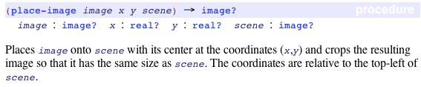
search the documentation for place-image
enter place-image into your contract library

Slide 14
what is a scene?
Enter the following code in wescheme:
(place-image
(circle 50 "solid" "red") 25 25
(rectangle 100 100 "solid" "blue"))

Slide 15
nested place-image functions
What is the domain of place image?

Slide 16
additional functions
you are required to learn these additional functions and enter them into your contract library
string-length
image-width
image-height
bitmap/url
rotate
scale
scale/xy
flip-vertical
flip-horizontal

Slide 17
Green Triangle
Write a function that takes a number and gives a green triangle.

Slide 18
Composition of Functions
How can one expression be the argument of another?
(+ 3 (* 5 7))
(rotate 45 (square 50 “solid” “red”))

Slide 19
error messages
enter the following code exactly how it is written
(circle 50 "solid" "red"
What does the message say?

Slide 20
how about this one?
(circle "solid" 50 "red")
What is the message telling us?

Slide 21
what is the difference between a type and a value?
Units in science, sets/intervals in math, datatypes in computer science.
We need to be able to talk about ideas in general terms
Types are general
Values are specific

Slide 22
enter the following code and be prepared to discuss
1
1
(define width 100)
(define radius
(* width 1/2))
(define rc
(circle radius "solid" "red"))
3
4
6
7

Slide 23
composition of functions: putting one function inside of another
Interpret the following line of code.
(* 5 (+ 3 2))
...and this one?
(rotate 45
(triangle 50 "solid" "green"))
How many parameters does rotate have? How do we answer this question?

Slide 24
locating images relative to each other
Go to the Designing Structure Worksheet

Slide 25
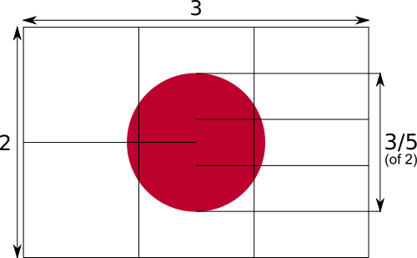
flag of japan
The width is 3 or a multiple of 3.
The height is 2 or a multiple of 2.
The diameter of the circle is three fifths of the height.

Slide 26
This makes an image...
(place-image
(circle 60 "solid" "red")
150 100
(rectangle 300 200 "outline" "black"))

Slide 27
but this is a program.
Go to Japan Flag Good to see an example of program.

Slide 28
Mr. Allatta's U.S. Flag Program
Go to http://www.wescheme.org/openEditor?publicId=tCt9uyrglj
Extension: Look for a better way to create the stars.

Slide 29
Style
"You know you are done when your code is as beautiful as the flag it creates," Emmanuel Schanzer, creator of WeScheme

Slide 30



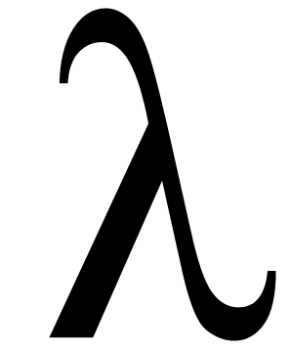
many names
Racket - the actual language we will be using
WeScheme - a cloud-based programming environment for Racket
Bootstrap - a curriculum for teaching mathematics with Racket
Scheme - the parent of Racket

Slide 31

we want to create the following image
What do we need to know about it?
height, width, size, components

Slide 32
first we need to think about the pieces
The width is 3 or a multiple of 3.
The height is 2 or a multiple of 2.
The diameter of the circle is three fifths of the height.
A black outline
A white rectangle
A red circle

Slide 33
expression
anything that can be evaluated

Slide 34
lets write some code for each piece
;The black outlined rectangle
(rectangle 300 200 "outline" "black")
;The white solid rectangle
(rectangle 300 200 "solid" "white")
;The red solid circle
(circle 60 "solid" "red")
1
2
4
5
6
7

Slide 35
now we need to put it together
how does it fit together?
we place the circle onto the outline and place them both onto the white background

Slide 36
now that we know what to do, lets write the code
This place-image function is actually happening first.
(place-image
(circle 60 "solid" "red")
150 100
(place-image
(rectangle 300 200 "outline" "black")
150 100
(rectangle 300 200 "solid" "white")))
What is the type of value of this place-image function? An image.
This whole place-image function is the 4th parameter of the first place-image function.
What does the inside place-image function do?
What does the outside place-image function do?

Slide 37
add comments to help others understand your code
; a comment in Racket begins with a semi-colon.
; this place image-function place a red circle on a black outline, on a white background.
(place-image
(circle 60 "solid" "red")
150 100
(place-image
(rectangle 300 200 "outline" "black")
150 100
(rectangle 300 200 "solid" "white")))

Slide 38
make your own flag
write a program that displays a flag using two place-image functions. Plan your flag on the worksheet before you begin coding.

Slide 39
extension
for an image that is not cropped by a scene use overlay/xy
other function to incorporate in your program:
flip-horizontal, flip-vertical, scale, scale/xy, above, below, rotate, bitmap/url

Slide 40
Using Variables
How do write programs using variables?

Slide 41
functions
all operations are functions, so + is a function.
5+4
+ takes 5, 4 and adds them

Slide 42
What does it do?
(require bootstrap2012/bootstrap-teachpack)
(put-image (rectangle 500 100 "solid" "red")
250 250
(put-image (rectangle 500 100 "solid" "black")
250 150
(put-image (rectangle 500 100 "solid" "yellow")
250 50
(rectangle 500 300 "outline" "black")
)
)
)

Slide 43
gt
function header
(define (gt side)
(triangle gt "solid" "green"))
function body

Slide 44
Formal Language
What do we need to know to write expressions in WeScheme?

Slide 45
composition of functions: putting one function inside of another
Interpret the following line of code.
(* 5 (+ 3 2))
...and this one?
(rotate 45
(triangle 50 "solid" "green"))
How many parameters does rotate have? How do we answer this question?

Slide 46
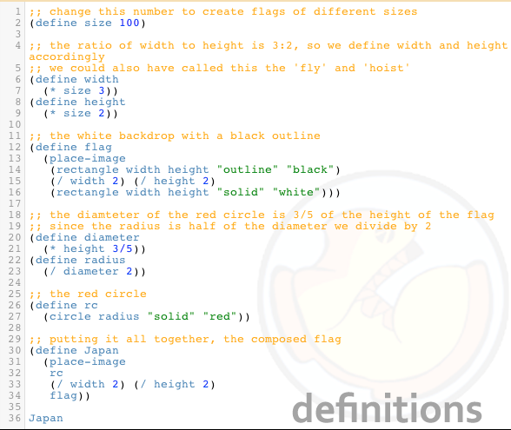
Flag of Japan Program

Slide 47
formal vs. informal language

Slide 48
How Did We Solve This Problem?
Write a function called gt that takes in a size and returns a solid green triangle with that size.
(define (gt size)
(triangle size "solid" "green"))

Slide 49
Three Parts of Function Definition
NAME - WHAT IT'S CALLED
PARAMETER(S) - WHAT GOES IN
BODY - WHAT IS RETURNED
(define (name param)
(body_expression param))

Slide 50
Work on #2!
Write a function called cc that takes in a color and returns a solid size 30 circle with that color.

Slide 51
Can We Solve This?
Write a function called mySquare that takes in a size and returns a solid blue rectangle whose height and width are that size.

Slide 52
Testing

Slide 53
Testing

Slide 54
Green Triangle
Write a function called greenTri that takes in a number and returns a solid green triangle with the size of the parameter.
Write a function that takes a number and gives a green triangle.

Slide 55
write a test for greenTri
(greenTri 50)
"should be a green triangle, side length 50"
(greenTri 75)
"should be a green triangle, side length 75"

Slide 56
gt: Write a function called greenTri that takes in a number and returns a solid green triangle with the size of the parameter.
function signature
(define (gt size)
(triangle size "solid" "green"))
function body

Slide 57
Blue Circle
Write a function that takes a number and returns a blue circle.

Slide 58
tests for bc
(bc 50)
"should be the same as"
(circle 50 "solid" "blue")
(bc 75)
"should be the same as"
(circle 75 "solid" "blue")

Slide 59
Double
Take a number and double it.

Slide 60
Write two tests for double
(double 6)
"should be the same as"
(* 6 2)
(double 100)
"should be the same as"
(* 100 2)

Slide 61
circle what changes: this is where we will put our parameter
(double 6)
"should be the same as"
(* 6 2)
(double 100)
"should be the same as"
(* 100 2)

Slide 62
Now write the function signature and body
(double 6)
"should be the same as"
(* 6 2)
(double 100)
"should be the same as"
(* 100 2)
(define (double number)
(* number 2))

Slide 63
Design Recipe for anything, version 0
Decide what you want to do.
Do it.
Check that you did it right.
Keep doing it.

Slide 64
Design Recipe for Functions, version 1
Write a function contract and purpose statement for the function you want to write.
Write several examples of how the function will be used, with their correct answers.
Look at what changed in your examples, that is where your parameters will go.
Write the head of the function definition.
Write the body of the function definition.

Slide 65
numbers
everything you already think of

Slide 66
iterate
the act of repeating a process with the aim of reaching a goal
the act of repeating a process with the aim of reaching a goal

Slide 67
circles of evaluation
Math
Circle of Evaluation
Racket Code

Slide 68
More Defining Functions
How do we define a function with multiple parameters?
Write the contract and purpose statement for red-circle.

Slide 69
parts of a function
arguments
name
(circle 50 "solid" "red")

Slide 70
let's remember the contracts for above and beside

Slide 71
5. & 6. define variables
book and calendar
(define book
(bitmap/url "http://goo.gl/JOhWk"))
(define calendar
(bitmap/url "http://goo.gl/A1hFA"))

Slide 72
8. book beside calendar
(beside book calendar)

Slide 73
10. book above calendar
(above book calendar)

Slide 74
11. book book
book book
(above
(beside book book)
(beside book book))

Slide 75
Design a function called two-by-two,
which takes in an image and produces four copies of that image in a two-by-two square.

Slide 76
Design a functions called counterchange,
which takes in two images and produces a two by two quilt of images where the two images are facing each other on the top and bottom alternatively.

Slide 77
Design Recipe with Student Choice
How do we build confidence and feel successful with the design recipe?

Slide 78

warm up
What will the Racket code
(circle 50 "solid" "red") return?
Is (circle 50 "solid" "red") a contract or an example?

Slide 79
make a connection
can you match each part of the contract with part of the example?
; circle : number string string -> image
(circle 50 "solid" "red")

Slide 80
How are programming languages similar to natural languages?
defining a variable is like defining a noun
defining a function is like defining a verb

Slide 81
let's finish this design recipe
the design recipe is a method to help us design our own functions
; double : number -> number
; takes in a number and multiplies it by 2
(check-expect (double ____)
(* 20 2))
(check-expect (double 36)
(* ____ ____))
(define (________ ________)
(* ________ ________))

Slide 82
Image Functions
What do we need to know to write image functions in Racket?

Slide 83
Writing Examples of Functions
Warm Up: Takes two minutes to answer the following question on your Warm Up slip:
What do we need to know to write an example of a function and a test from a contract and purpose statement?
What is the benefit of defining our own functions? Explain why you think this.

Slide 84
What is the big picture?
Design Recipe for defining functions.
Write a contract and purpose statement
Write an example and a test for that example
Look at what changed between the examples
Define the function using parameters

Slide 85
What do we need to write an example?
;rectangle: number string string -> image
If we had never seen rectangle would we be able to write an example for it? Why?

Slide 86
Writing examples
Look at both the contract and
purpose statement
Correct computer science type
Correct information
Complete the EXAMPLES side of the worksheet.

Slide 87
Defining Functions
Why do we want to write our own functions?

Slide 88
Functions are like shortcuts
There is a long way to do things, but computer scientists are lazy!
Defining functions give us a shortcut for writing lots of code.

Slide 89
Writing a test
Why do we need a test for our example?

Slide 90
Writing a test
Why do we need a test for our example?

Slide 91
Tests show us how to define our functions.
A test is a way to do the same thing as our function using other functions that are already defined.
Complete the TESTS side of the worksheet.

Slide 92
contracts (API)
(circle radius mode color)
; circle : number string string -> image
name domain range

Slide 93
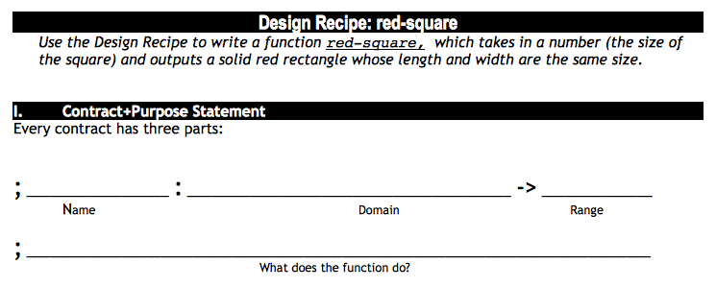

Slide 94
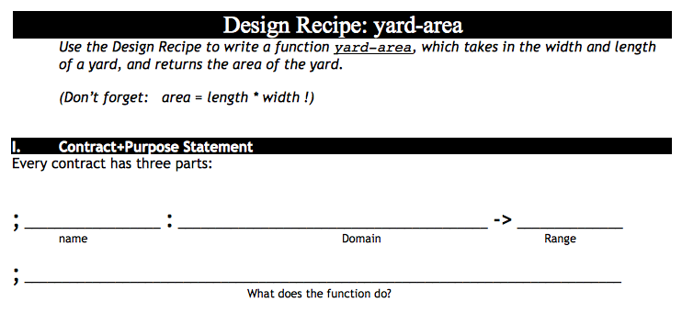
October 25th, 2012
B
Take out Lesson 4 Homework and your lesson 4 workbook
Write the contract for yard-area
Enter the contract into wescheme with your
A
Take out Lesson 4 Homework and your lesson 4 workbook
Write the contract for yard-area
Enter the contract into wescheme with your

Slide 95
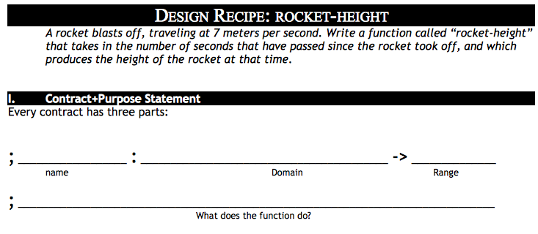

Slide 96
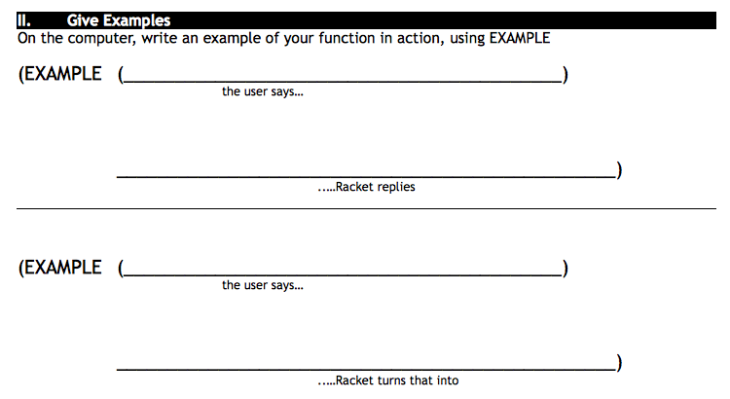
yard-area 50 60
(* 50 60)

Slide 97
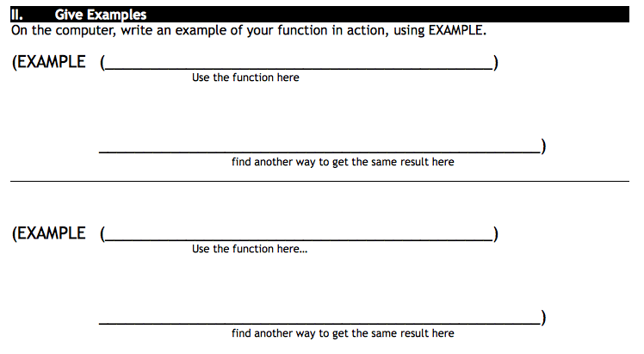

Slide 98
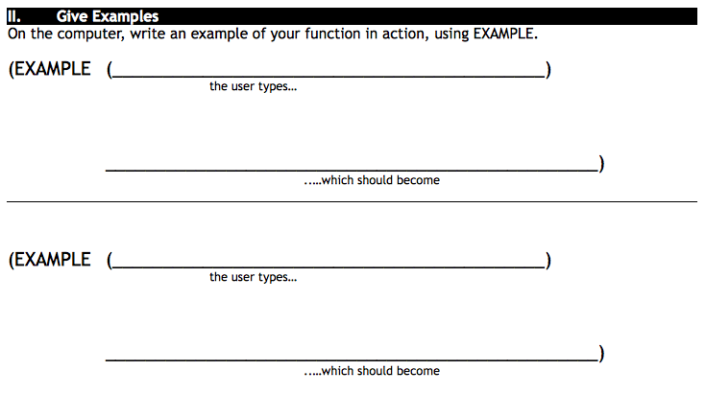
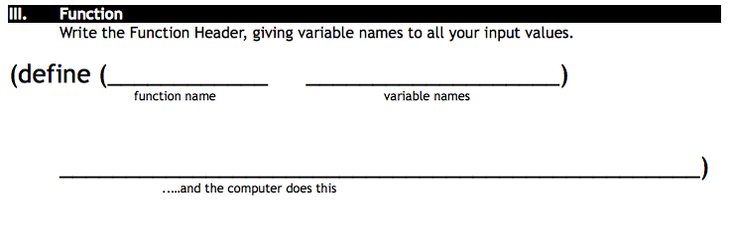

Slide 99
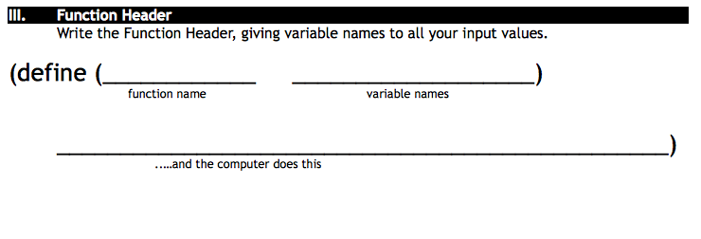

Slide 100
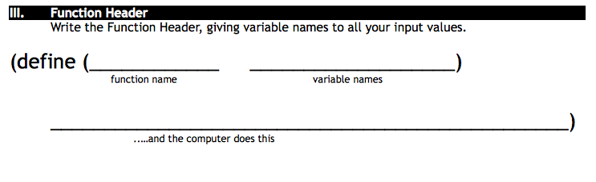

Slide 101
Algebra
just another language

Slide 102
in Racket we define values this way:
we can even define values in terms of what has come before
(define x 4)
(define y (+ x 10))

Slide 103
on your hand-out: convert the code into algebra
Racket Code | Algebra
(define x 10) | x = 10
(define y (* x 2)) | y = x*2 or y=2x
(define z (+ x y))
(define age 14)
(define months (* age 12))
(define days (* months 30))
(define hours (* days 24))
(define minutes (* hours 60))

Slide 104
can you define a function g, which takes in a variable q and multiplies it by 20?
can you define a function h, which takes in a variable r and divides it by 2 then adds 5?
can you define a function f, which takes in a variable s and multiplies it by 1/3?
can you define a function g, which takes in a variable t and subtracts 13 from it?

Slide 105


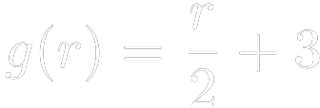

can you translate this algebra into code?
1)
2)
3)
4)

Slide 106

Review:
by replacing define with an equal sign
we can write
this is called functions notation.
it says the function "f of x" equals "x + 1"

Slide 107
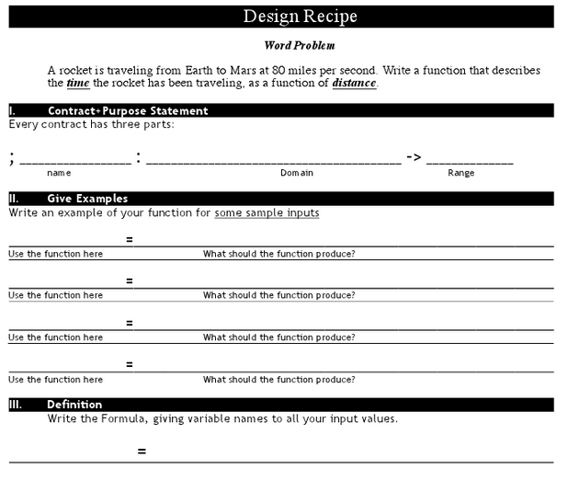

Slide 108
aim: what is the connection between functions in algebra and functions in Racket
warm up:
Take a laptop and a worksheet back to your seat
Notes:
Think back to the first blocks pattern.
What was the input of the function? (stage)
What was the output? (# of blocks)
y = x + 1
what is the input, what is the output

Slide 109
in algebra we define values using an equal sign
algebra
racket
and we can define values in terms of other values
x = 4
(define x 4)
y = x + 10
(define y (+ x 10))

Slide 110
you also know how to define functions like this one
what is the name of this function?
(define (f x) (+ x 1))
How many variables does it take?
What is the name of that variable?
What does the function do to the variable x?
Notes:
tell me the name of this function?
How many variables does it take? What is the name of that variable?
What does the function do to the variable x?
Can you define a function g, which takes in a variable q and multiplies it by 20.

Slide 111
now translate them into algebra

Slide 112
Today we are going to look at some word problems that you will see in algebra

Slide 113
Describe how the function + works.

Slide 114
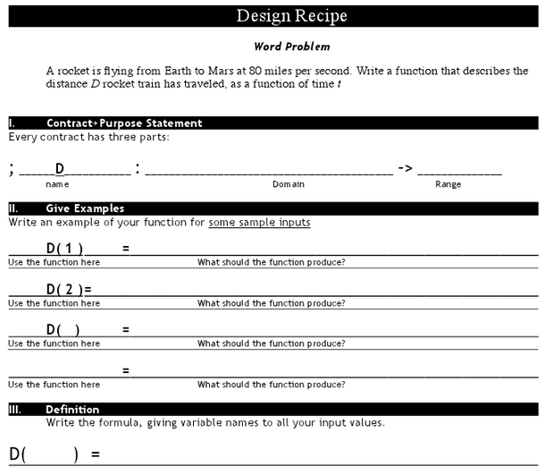
Distance

Slide 115
Suppose we had a word problem that wanted to know how far the rocket traveled in 6 seconds: which one would we use?
What if we wanted to know how long it takes for the rocket to go a thousand miles?
What if I knew the train left at 1pm, and I wanted to know what time it arrives in Chicago, 800 miles away?
Would I want my time function, or my distance function?

Slide 116
Lesson 5
Bug Finding

Slide 117
Lesson 5
Bug Finding

Slide 118
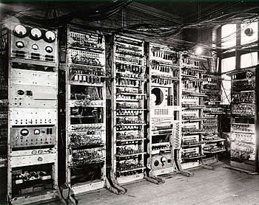
computers were once larger arrays of relay tubes--similar to light bulbs

Slide 119
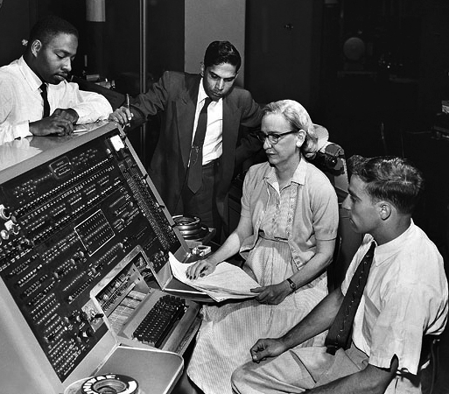
What is a bug?
Admiral Grace Hopper was one of the foremost computer scientists of her day

Slide 120
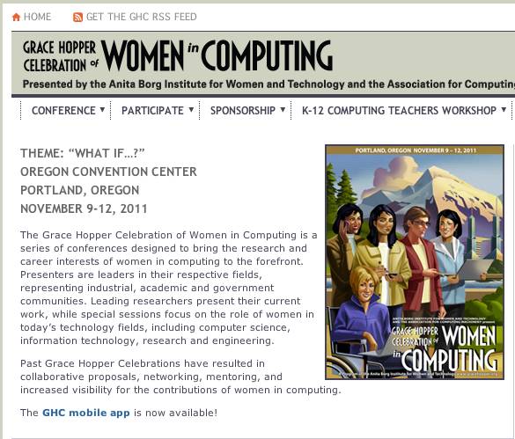
Grace Hopper Celebration of Women in Computing
Computer-scientists gather every year to honor Grace Hopper

Slide 121
(0,480)
(640,480)
D
(500,300)
480
P
T
(200,240)
(550,140)
(0,0)
640
(640,0)
Notes:
What are the coordinates of the corners?
Coordinates appear clockwise from origin on click
What is the Danger's x-coordinate? Its y-coordinate?
If it is moving to the left, what is changing: the x or y coordinate? Collect data: one finger for x, two for y.
Suppose it moved to the right by 50 pixels. What are the new coordinates? (550,300)
I want my danger to always move left by 50 pixels, each time the screen is redrawn, so that it goes from (550, 300) to (500,300) to (450, 300), etc.
What if it starts at (100, 100)? Where will go next? What if it’s at (400, 600)? What if it’s off the screen, at (650, 50)? (Answer: (50, 100), (350, 600), (600,50))

Slide 122
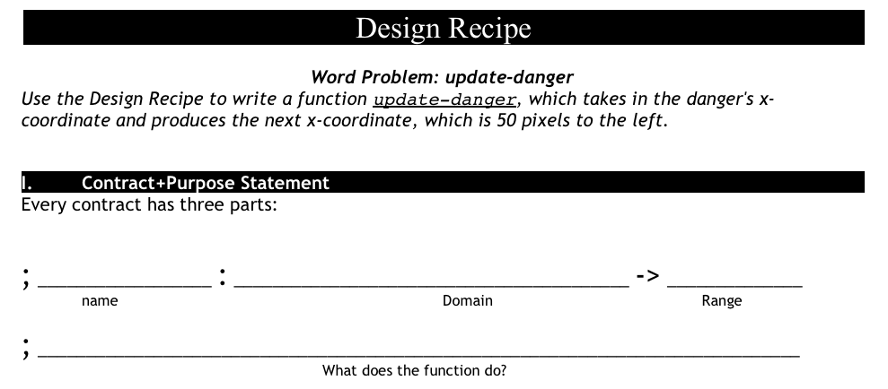
update-danger
what is the name of the function?
what are the inputs?
what are the outputs?

Slide 123
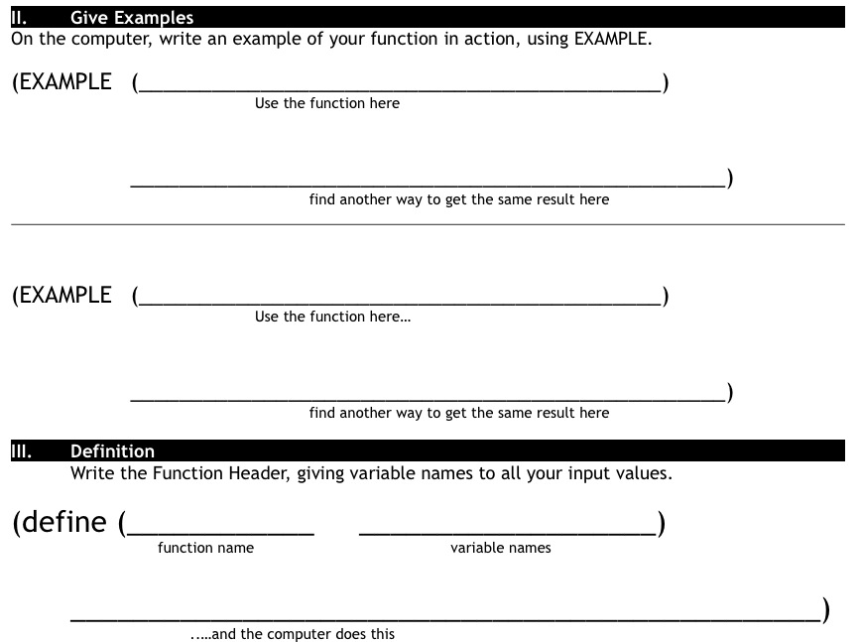
Finish the design recipe with two examples and a definition
Don't forget to circle your examples!

Slide 124
Now you have a 90, don't just satisfy the requirements. Impress me.
Here are some suggestions:
Can you make your danger move slower? faster?
Can you make your target the move other way?
(just try, you can do it)
The promotion goes to the person who goes above and beyond.

Slide 125
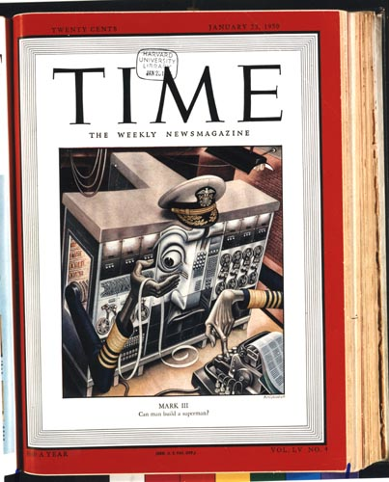
January, 1950
20¢
can man build a superman?

Slide 126
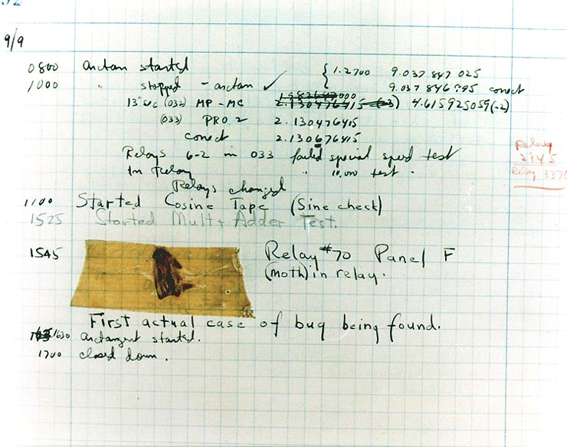
First actual case of bug being found.

Slide 127
Bug Finding
Directions
Open your bug program.
Click run.
Read the error message.
Fix the bug.
Click run again.
Repeat until you have found all of the bugs and the program runs without errors.
Write a sentence explaining each bug on the space provided.

Slide 128
What is the domain of update-danger?
Number
String Number
String
Image
Number Number
Notes:
Make wrong options fade out over time, then move on. At fade out add self-reflection questions not overtly addressed in the lecture.

Slide 129
how to write examples for update-danger
Current x-coordinate | Racket Code | Next x-coordinate
50
75
30
(- 50 50)
0
(- 75 50)
25
(- 30 50)
-20
Notes:
Animation : Racket Code -> Next x-coordinate

Slide 130
Complete the Design Recipe for update-target
paper first then type
circle examples
ask questions
use your time well

Slide 131
find your player
search images.google.com for animated gif images
find an image not blocked by the DOE
click the image, then click full-size image
copy and paste the URL of the image into your game file

Slide 132
scale your player
; scale: number image -> image
; scale/xy: number number image -> image
how can you use the scale function to scale your player

Slide 133
how to write examples for update-danger
Current x-coordinate | Racket Code | Next x-coordinate
50
75
30
(- 50 50)
0
(- 75 50)
25
(- 30 50)
-20
Notes:
Animation : Racket Code -> Next x-coordinate

Slide 134
update-danger
what is the name of the function?
what are the inputs?
what are the outputs?

Slide 135
Complete the Design Recipe for update-target
paper first then type
circle examples
ask questions
use your time well

Slide 136
What is the domain of update-danger?
Number
String Number
String
Image
Number Number
Notes:
Make wrong options fade out over time, then move on. At fade out add self-reflection questions not overtly addressed in the lecture.

Slide 137
Homework due Monday, November 25
Find game images for your game and put them into your game file.

Slide 138
Complete the Design Recipe for update-target
paper first then type
circle examples
ask questions
use your time well

Slide 139
how to write examples for update-danger
Current x-coordinate | Racket Code | Next x-coordinate
50
75
30
(- 50 50)
0
(- 75 50)
25
(- 30 50)
-20
Notes:
Animation : Racket Code -> Next x-coordinate

Slide 140
getting your game just right
what is the contract for bitmap/url?
how do we scale an image?
can you do anything else to your images?

Slide 141
find your player
search images.google.com for animated gif images
find an image not blocked by the DOE
click the image, then click full-size image
copy and paste the URL of the image into your game file

Slide 142
scale your player
; scale: number image -> image
; scale/xy: number number image -> image
how can you use the scale function to scale your player?

Slide 143
Lesson 6 Booleans
teaching functions to compare

Slide 144
warm up
What would Racket say to the following lines of code?
> (+ 1 4)
> (/ 4 2)
> (- 0 9)
> (* 3 4)

Slide 145
more booleans
how about these?
(> 0 5)
(= 1 9)
(<= 2 2)
(string=? "dog" "cat")

Slide 146
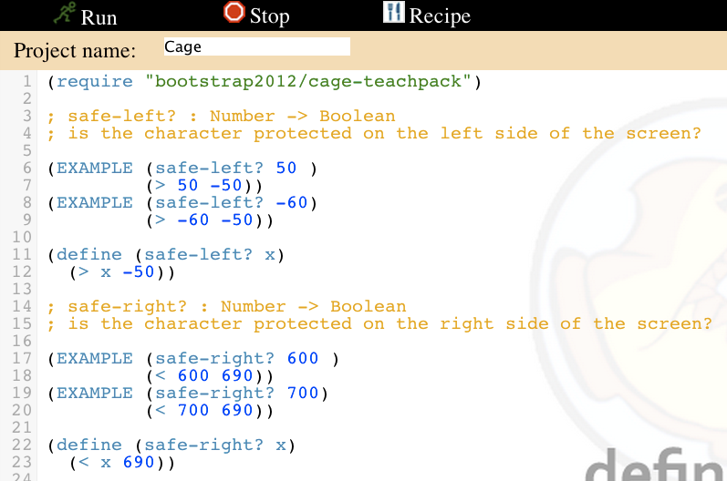
fix safe-left? and safe-right?
enter your examples
fix your definitions

Slide 147
3.
Sugar is sweet and Ice is cold.

Slide 148
AND OR EXAMPLES
1.
Sugar is sweet.

Slide 149
5.
Sugar is sweet and Ice is hot.

Slide 150
7.
Sugar is sweet or Ice is hot.

Slide 151
language table
Data Types | Functions
Notes:
What types of data have we worked with so far? What are some functions that work on those data types?

Slide 152
true or false
True or False
Mr. Allatta is wearing a tie.
Ice is hot.
Our classroom is on the 4th floor of the Washington Irving campus.
Notes:
So far, our language can only add, subtract, multiply and divide numbers. It can't compare them or decide whether something is true or false! We'll be adding the power of comparison to our language today.

Slide 153
boolean contracts
 | Function Name | Domain | Range
(> 0 5)
(= 1 9)
(<= 2 2)
(string=? "dog" "cat")

Slide 154
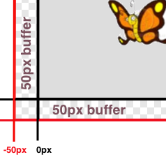
lesson 6
Sam is in a 640 x 480 yard. How far he can go to the left and right before he's out of sight?
Notes:
what data types do we know so far?
what are some functions that we know so far?
and we know how to define functions using functions in the computers language.
When Run is clicked, a window with a butterfly in it will pop up. You can use the arrow keys to move the butterfly around.
This butterfly is Sam - he’s a happy student like you! He likes to fly around outside and enjoy the fresh air.
His yard is 640 pixels wide and 480 pixels tall. If the bottom-left corner is (0, 0), what are the coordinates of the other corners?
Sam’s mom tells him that he should stay where she can see him - that means he can even step a little outside of the yard...as long as a piece of him is visible, his mom is okay.
Try moving him so he’s a little off the screen, but still safe. How far can he go?
Sometimes, however, Sam sneaks out of the box and just keeps going! He’s free! Free as a bird! (well, as a butterfly!) Look at his smile! He’s so happy to be free! Why shouldn’t he be?
Well...there’s some bad news.
Sam doesn’t realize that there’s a monster outside his yard, waiting to eat him! As long as ANY part of Sam is still in the yard, he is safe...but the moment he disappears completely his mom won’t be able to keep an eye on him!
It’s up to you to keep him safe!
Draw a 640x480 rectangle on the board to represent the screen, and have students help you identify the coordinates at the corners. Then turn students’ attention to the computers, and have them analyze the last function in the code, called onscreen?.
This file contains three function definitions. Can you find all three? What are the names of these functions?
(safe-left?, safe-right? and onscreen?)
Skit:
Have a volunteer stand up to be safe-left?. Ask them about their domain and range, and what they do according to the code (they always return true). Have students practice calling the function with sample values, then have another volunteer repeat the process as safe-right?. Finally, have a third volunteer do the same as onscreen?. Note that onscreen? must use safe-left? when evaluate an input!
The computer only talks to onscreen?, when deciding whether or not to let same keep moving. In turn, onscreen? will need to use both safe-left?and safe-right? to figure out if Sam is safe on both sides.
What are the Domain and Range of onscreen? What does the function do? What will happen when it’s given a sample input? (Answer: It calls the function ’safe-left?’ on the variable x)
We need to fix this code, to keep Sam safe. He can fly left or right and there is nothing to stop him from moving off the screen... yet!
How far can Sam go to the left before he disappears completely? (Answer: -50.) So he is onscreen as long as x is greater than -50!
Take some ideas from the class, then explain if necessary.
When the butterfly is drawn at some coordinate, it is centered at that coordinate. So if it’s drawn at 0, half of the butterfly is actually off the screen. We add the extra 50 pixels on all sides, because a piece of him is still visible as long as he is within 50 pixels of the screen’s edge.
Turn to Page 17. Take thirty seconds to fill out what we’ve discovered.
Turn to Page 18 and read the word problem for the safe-left function.
Who would like to act out safe-left? Take a volunteer.
Exercise:
According to the word problem, what’s your name? What’s your Domain? Your Range? Given Sam’s x-coordinate, and tell me if any part of him is still on the screen. Let’s try it out. "safe-left forty-five!" "safe-left three!" "safe-left negative sixty-one!" How did you know Sam was not protected at -61? because the number was not greater than -50!.
Complete the design recipe for safe-left.
Raise your hand after you complete each step.
When a team has completed the Design Recipe for safe-left, they must type in the examples and function body onto the computer.
So now we have a function that will tell us whether or not Sam is safe on the left side of the screen.
Click "Run", and try to move Sam off the left edge of the screen. Congrats! You’ve protected Sam on one side!
Unfortunately, Sam can still escape on the right hand side. We need a safe-right!
(act out with another volunteer, if necessary).
Turn to Page 19, and write another function called safe-right.
Call me over when you reach a stopping point!
Notice that even though we’ve fixed safe-right?, onscreen? won’t know about it until we change the body ofonscreen? so it calls safe-right? instead of safe-left?! Please make this change now, so that Same is safe on the right side instead of the left side.
Good job! Now we can keep Sam safe on the left side, or we can keep Sam safe on the right side. However, we don’t have a way to keep him safe on both sides! When we call onscreen? with an x-coordinate, what should it do?

Slide 155

estimate Sam's x coordinate
50
50
50
50
50
50
50
50
480
640

Slide 156
and
or
; and: Boolean Boolean -> Boolean
; Returns true if BOTH inputs are true
; or: Boolean Boolean -> Boolean
; Returns true if EITHER of the inputs are true.
Notes:
Sugar is sweet.
Ice is hot.
Sugar is sweet and Ice is cold.
Sugar is sweet and Ice is hot. Why is it false? Isn’t sugar still sweet?
Sugar is sweet or Ice is cold.
Sugar is sweet or Ice is hot. Why is it true? Ice isn’t hot!

Slide 157
2.
Ice is hot.

Slide 158
4.
Sugar is sweet and Ice is hot.

Slide 159
6.
Sugar is sweet or Ice is cold.

Slide 160
how to design programs?
There are two ways to go about solving this word problem:
(define (onscreen? x)
(and (> x -50) (< x 690)))
and...
(define (onscreen? x)
(and (safeleft? x) (saferight? x)))
Notes:
Does it matter? Both will work just fine when you type them in...so why care?
There’s more to being a writer than putting down grammatically-correct sentences. There’s more to being an architect or an artist than building a bridge or coloring in a canvas. All of these disciples involved an element of design.
Likewise, there is more to being a Programmer than just writing code. You've gotten decent at writing code, and now you’re able to write sophisticated programs that include multiple functions - congratulations! But that also means you’re ready to consider what it means to design the code that you write.
The first solution puts all of the logic into one function: the left boundary and the right boundary are both tested by onscreen?. In the second solution, onscreen? uses both helper functions, each of which only tests one boundary at a time. Can you think of a reason why one might be better than another? Is it better to have a single, complex function that does all the work, or to have multiple simple functions that only do one thing apiece?
Suppose you just built a car, but it’s not working right. What would you do? Ideally, you’d like to test each part of the car (the engine, the transmission, etc) one at a time, to see which one was broken. The same is true for code! If you have a bug, it’s much easier to find when every function is simple and easy to test, and the only complex functions are just built out of simpler ones.
Another reason to like the second example is the fact that it lets programmers be lazy. Suppose you have a few characters in a videogame, all of which need to be kept on the screen. Some of them might only need safe-left?, others might only need safe-right?, and only a few might need onscreen?. What happens if the game suddenly needs to run on computers with differently-sized monitors, where the boundary is 1000 instead of 690? If you have simple and complex functions spread throughout your code, you’ll need to change them all. If your complex functions just use the simpler ones, you’d only need to change them in one place!
Badly designed programs can work just fine, but they are hard to read, hard to test, and easy to screw up if things change. As you grow and develop as a programmer, you’ll need to think beyond just "making code work". It’s not good enough if it just works - as artists, we should care about whether or not code is well designed, too.
This is what functions allow us to do! Everyone from programmers to mathematicians uses functions to carve up complex problems into simpler pieces, which make it possible to design elegant solutions to difficult problems.
So the next time you sit down to solve a problem, think about algebraic abstraction, and how you might design a beautiful solution out of simple functions, rather than a huge, complex one.

Slide 161
7 - Conditional Branching
partial functions

Slide 162
Design Recipe: cost
Luigi’s Pizza has hired you as a programmer. They offer Pepperoni ($10.50), Cheese ($9.00), Chicken ($11.25) and Broccoli ($10.25). Write a function called cost which takes in the name of a topping and outputs the cost of a pizza with that topping.
Contract+Purpose Statement
Every contract has three parts:
; __________________ : _______________________________ -> ______________
name Domain Range
;____________________________________________________________________

Slide 163
Function Header
Write the Function Header, giving variable names to all your input values.
(define (____________ ___________________)
function name variable names
(cond
))
(string=? toppings “pepperoni”)

Slide 164
Design Recipe: update-player
Write a function called update-player, which takes in the player’s y-coordinate and the name of the key pressed, and returns the new y-coordinate.
Contract+Purpose Statement
Every contract has three parts:
; __________________ : _________________________ -> ____________________
name Domain Range
Give Examples
On the computer, write an example of your function for each key, using EXAMPLE.
(EXAMPLE (____________________________) ___________________________)
Use the function here What should the function produce?
(EXAMPLE (____________________________) ___________________________)
Use the function here What should the function produce?

Slide 165
Give Examples
On the computer, write an example of your function for each topping, using EXAMPLE.
(EXAMPLE (________________________) ___________________________)
Use the function here What should the function produce?
(EXAMPLE (_________________________) ___________________________)
Use the function here What should the function produce?
(EXAMPLE (__________________________) ___________________________)
Use the function here What should the function produce?
(EXAMPLE (_________________________) ___________________________)
Use the function here What should the function produce?

Slide 166
how to design programs?
There are two ways to go about solving this word problem:
(define (onscreen? x)
(and (> x -50) (< x 690)))
and...
(define (onscreen? x)
(and (safe-left? x) (safe-right? x)))
Notes:
Does it matter? Both will work just fine when you type them in...so why care?
There’s more to being a writer than putting down grammatically-correct sentences. There’s more to being an architect or an artist than building a bridge or coloring in a canvas. All of these disciples involved an element of design.
Likewise, there is more to being a Programmer than just writing code. You've gotten decent at writing code, and now you’re able to write sophisticated programs that include multiple functions - congratulations! But that also means you’re ready to consider what it means to design the code that you write.
The first solution puts all of the logic into one function: the left boundary and the right boundary are both tested by onscreen?. In the second solution, onscreen? uses both helper functions, each of which only tests one boundary at a time. Can you think of a reason why one might be better than another? Is it better to have a single, complex function that does all the work, or to have multiple simple functions that only do one thing apiece?
Suppose you just built a car, but it’s not working right. What would you do? Ideally, you’d like to test each part of the car (the engine, the transmission, etc) one at a time, to see which one was broken. The same is true for code! If you have a bug, it’s much easier to find when every function is simple and easy to test, and the only complex functions are just built out of simpler ones.
Another reason to like the second example is the fact that it lets programmers be lazy. Suppose you have a few characters in a videogame, all of which need to be kept on the screen. Some of them might only need safe-left?, others might only need safe-right?, and only a few might need onscreen?. What happens if the game suddenly needs to run on computers with differently-sized monitors, where the boundary is 1000 instead of 690? If you have simple and complex functions spread throughout your code, you’ll need to change them all. If your complex functions just use the simpler ones, you’d only need to change them in one place!
Badly designed programs can work just fine, but they are hard to read, hard to test, and easy to screw up if things change. As you grow and develop as a programmer, you’ll need to think beyond just "making code work". It’s not good enough if it just works - as artists, we should care about whether or not code is well designed, too.
This is what functions allow us to do! Everyone from programmers to mathematicians uses functions to carve up complex problems into simpler pieces, which make it possible to design elegant solutions to difficult problems.
So the next time you sit down to solve a problem, think about algebraic abstraction, and how you might design a beautiful solution out of simple functions, rather than a huge, complex one.

Slide 167
Collision Detection
line-length, distance, collide?

Slide 168

Convert the expression to circles of evaluation
The distance between the points (4, 2) and (1, 3) is given by:
sq
-
1 4

