Slide 1
Taptastic
Hung hong – quyen hoang
hack@wpi 2017

Slide 2

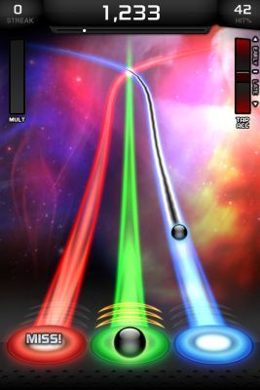
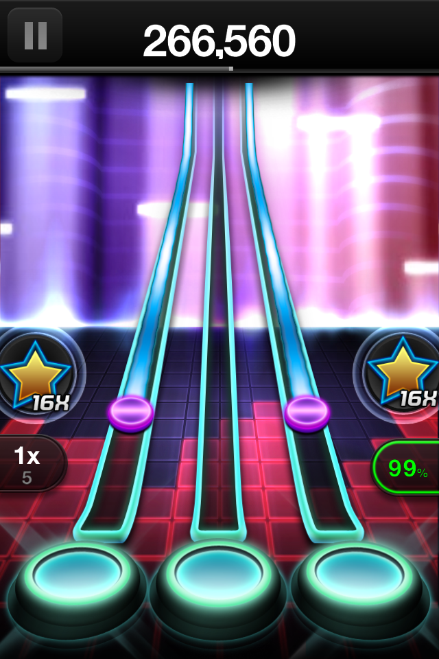

Slide 3

INTRODUCING…
TAPTASTIC

Slide 4
Demo Time!
Link to our game’s website: https://taptastic.github.io/
More information: https://taptastic.github.io/README.txt

Slide 5

THANK YOU FOR YOUR LISTENING!
ANY QUESTION?

