Slide 1

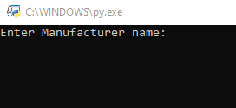

Final Coding Project
By. Taqi Syed
1863528
CIS 2348
Spring 2021
28115

Slide 2
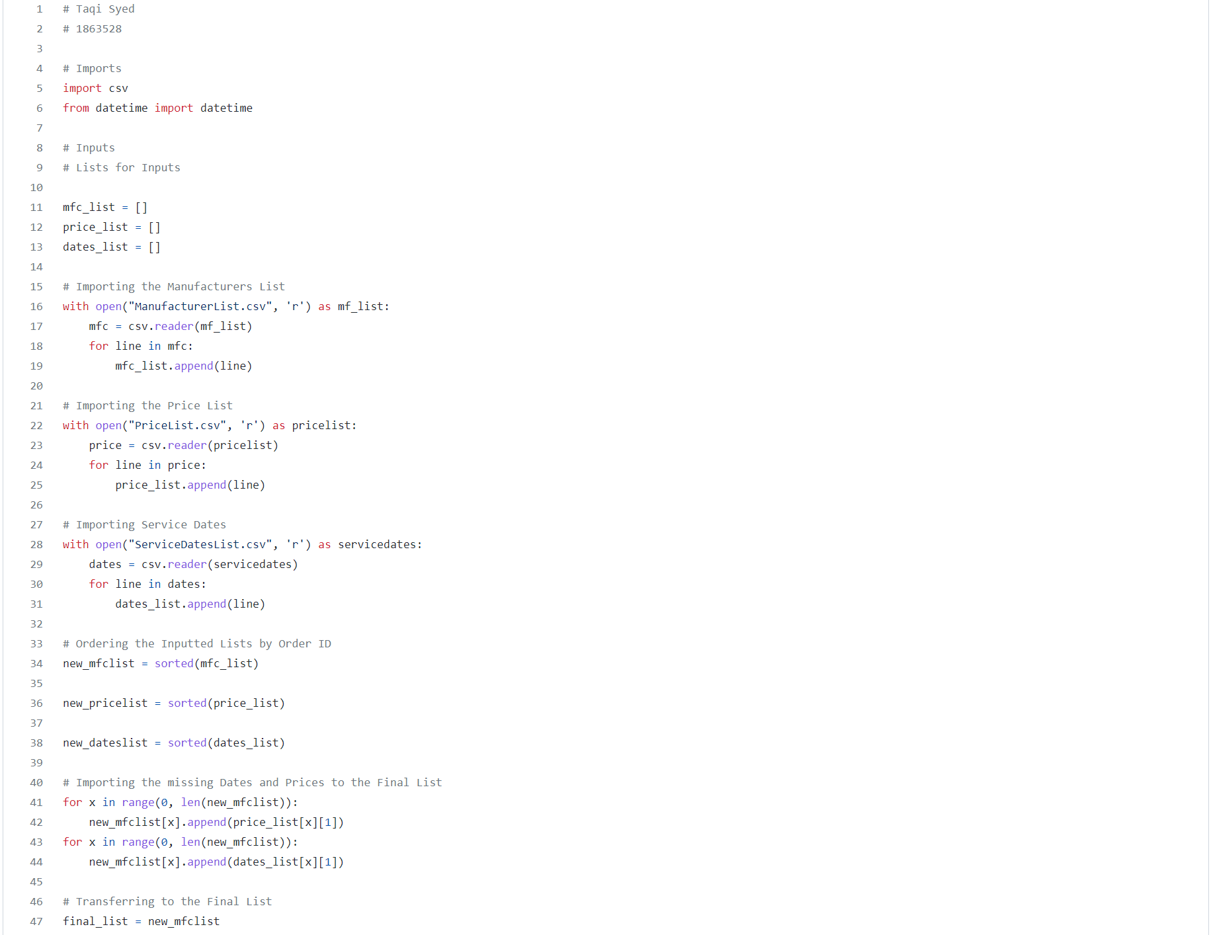
Part 1 of the Project
For Part 1 of the Project, I was incapable of completing the entire code, I was able to import the multiple lists into a class but couldn’t sort them.
In lines 16-19 I imported the Manufacturer List
In lines 22-25 I imported the Price List
In Lines 28-31 I imported the Service Dates list
In lines 34-38 I created the new sorted lists which led to creating the final list in lines 47.

Slide 3
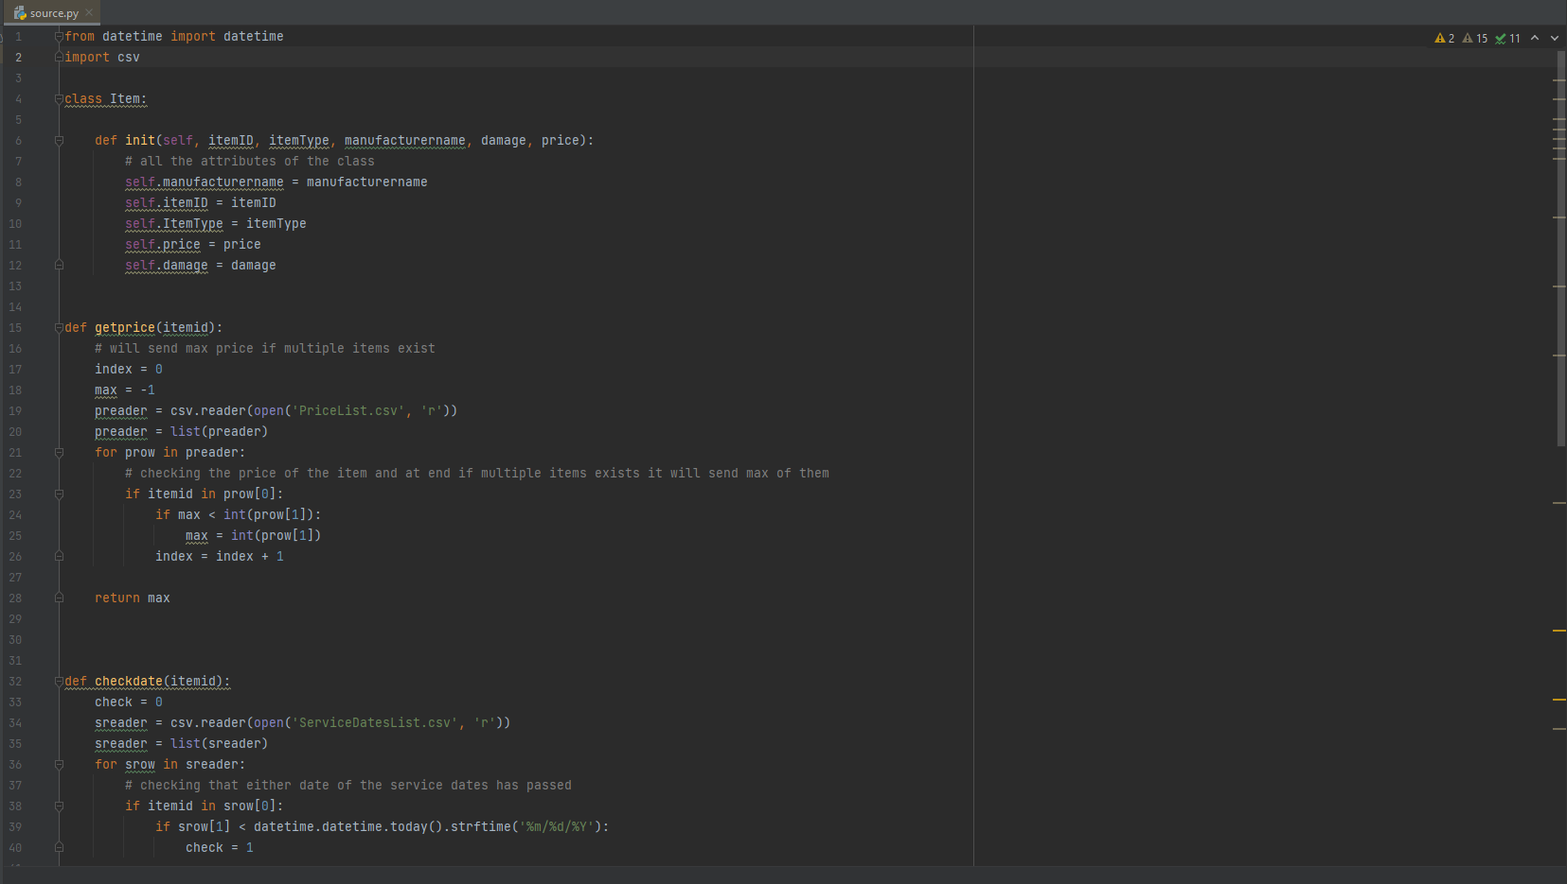
Part 2 of the Project (1/2)
I started fresh for Part 2 of the Project.
I understood that my sole objective in Part 2 was to create an Interactive Query for the user.
I initially created my Class for the items and defined all the attributes in lines 4-12
I started with getting the price of the items using the Price List, after importing the list I created a function to check if Multiple Items Existed and if they did, to return the most expensive item (Lines 15-28)
I then proceeded with a function to check the dates of the items. I imported the Service Dates list and used a datetime function to check if the items service date had passed or was upcoming

Slide 4
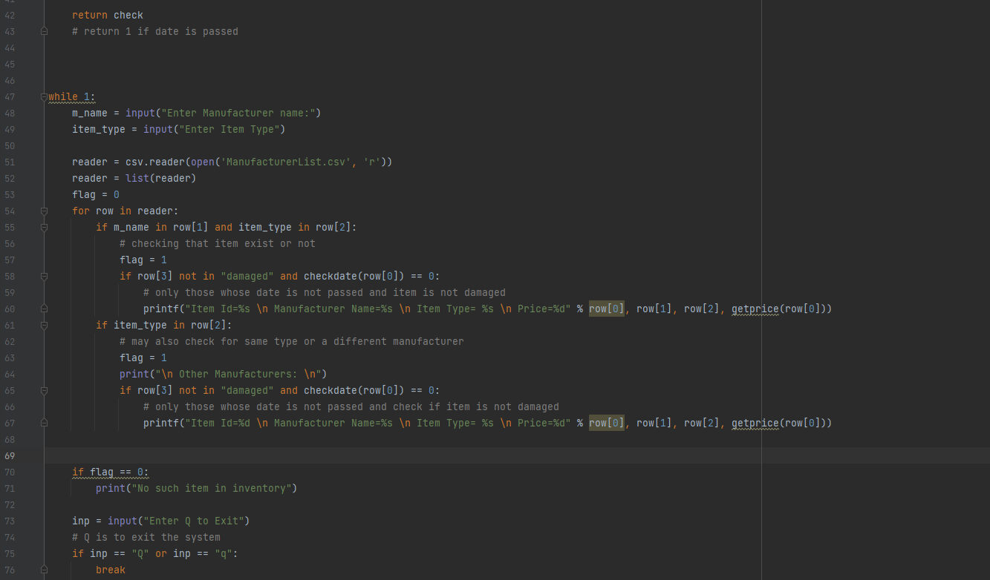
Part 2 of the Project (2/2)
I continued my code with a function to check if the Item the user is looking for existed or not. If it matched it in the list, it would mean it exists.
I then created a code that would check only for items that weren’t damaged AND the service date wasn’t passed, and then printed the information.
I also added a code that would check for the Manufacturer and check if it was different or the same; the code would then print either/or.
If all the information didn’t match, it will print “No such item in Inventory.”
I then prompted the user an option to click “q” to exit the system

