Slide 1
CSS INTRODUCTION
What is CSS?

Slide 2
1. What is CSS?
CSS stands for Cascading Style Sheets
CSS describes how HTML elements are to be displayed on screen, paper, or in other media
CSS saves a lot of work. It can control the layout of multiple web pages all at once
External stylesheets are stored in CSS files
Why Use CSS?
CSS is used to define styles for your web pages, including the design, layout and variations in display for different devices and screen sizes.

Slide 3
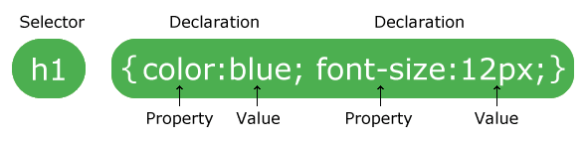
2. CSS Syntax and Selectors
A CSS rule-set consists of a selector and a declaration block:
CSS selectors are used to "find" (or select) HTML elements based on their element name, id, class, attribute, and more.

Slide 4
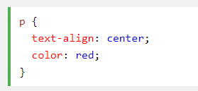
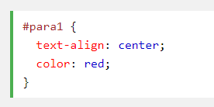
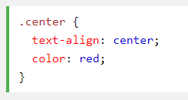
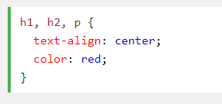
2. CSS Syntax and Selectors
The element selector:
The id selector:
The class selector:
Grouping selectors:

Slide 5
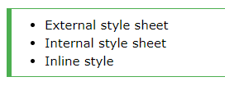
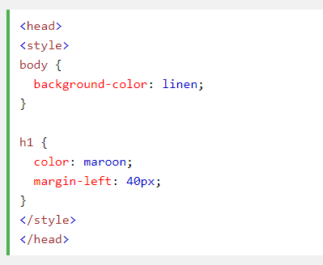
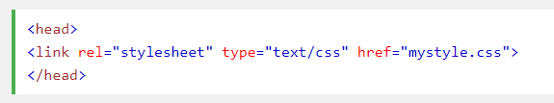
3. CSS How To…
There are three ways of inserting a style sheet:
External style sheet
Internal style sheet
Inline style

Slide 6
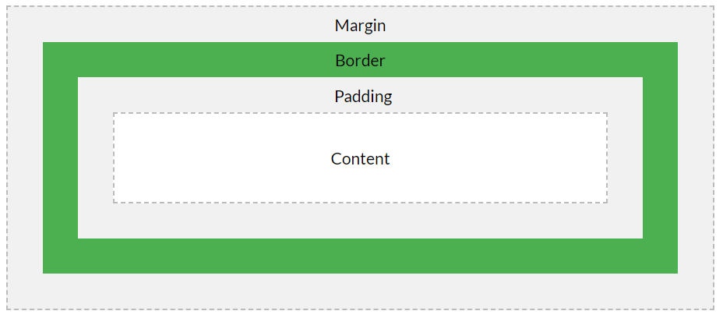
4. CSS Box Model
All HTML elements can be considered as boxes.

Slide 7
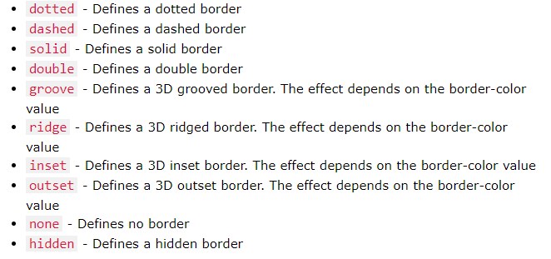
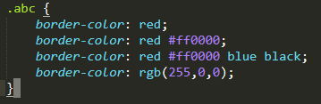
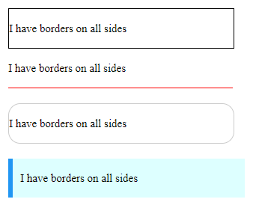
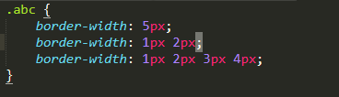
5. CSS Border
The CSS border properties allow you to specify the style, width, and color of an element’s border.
border-style
border-width
border-color

Slide 8
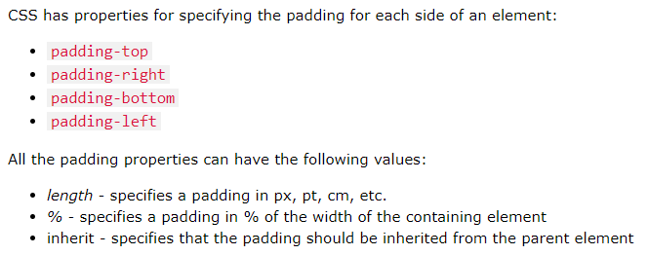
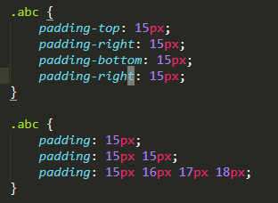
6. CSS Padding
The CSS padding properties are used to generate space around an element’s content, inside of any defined borders.

Slide 9
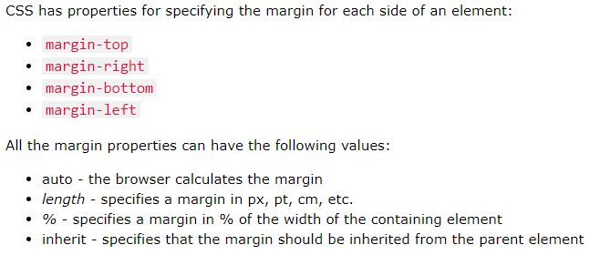
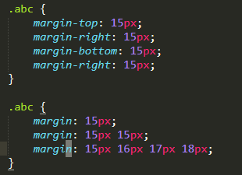
7. CSS Margins
The CSS margin properties are used to create space around elements, outside of any defined borders.

Slide 10
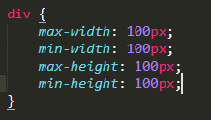

8. CSS Width and Height
The height and width properties are used to set the height and width of an element.
The height and width can be set to auto (this is default. Means that the browser calculates the height and width), or be specified in length values, like px, cm, etc., or in percent (%) of the containing block.

Slide 11

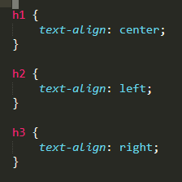
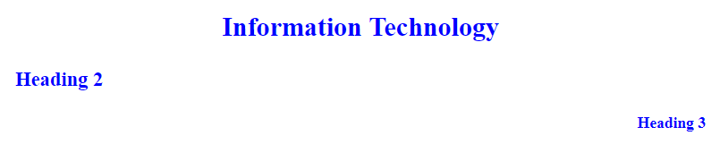
9. CSS Text
Text color: the color property is used to set the color of the text.
Text alignment: the text-align property is used to set the horizontal.

Slide 12
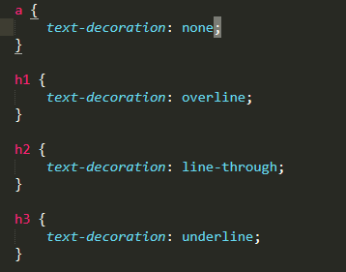
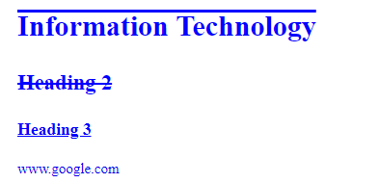
9. CSS Text
Text decoration: the text-decoration property is used to set or remove decorations from text.

Slide 13
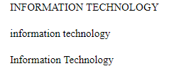

9. CSS Text
Text transformation: the text-transform property is used to specify uppercase and lowercase letters in a text.

Slide 14
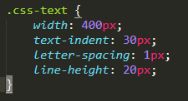
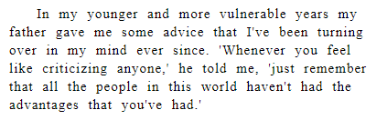
9. CSS Text
Text indentation: the text-indent property is used to specify the indentation of the first line of a text.
Letter spacing: the letter-spacing property is used to specify the space between the characters in a text.
Line height: the line-height property is used to specify the space between lines.

Slide 15


9. CSS Text
Text shadow: the shadow property adds shadow to text.

Slide 16
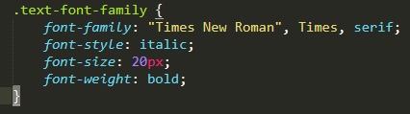

9. CSS Font
The CSS font properties define the font family, boldness, size, and the style of a text.

Slide 17
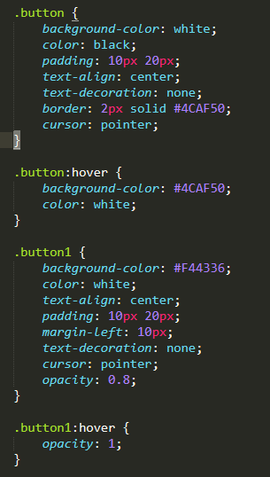

10. CSS Links

Slide 18
11. CSS Position
The position property specifies the type of positioning method used for an elements.
There are five different position values: static, relative, fixed, absolute, sticky.
Elements are then positioned using the top, bottom, left and right properties. However, these properties will not work unless the position properties is set first. They also work differently depending on the position value.

Slide 19
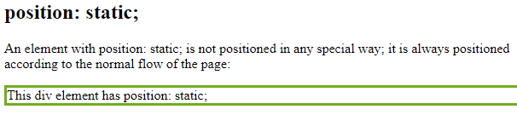

11. CSS Position
Position: static
HTML elements are positioned static by default.
Static positioned elements are not affected by the top, bottom, left, and right properties.

Slide 20
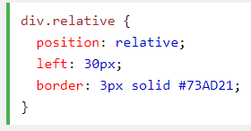
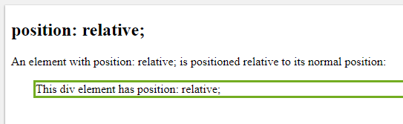
11. CSS Position
Position: relative
An elements with position: relative is positioned to its normal position.
Setting the top, right, bottom, and left properties of a relatively-positioned element will cause it to be adjusted away from its normal position.

Slide 21
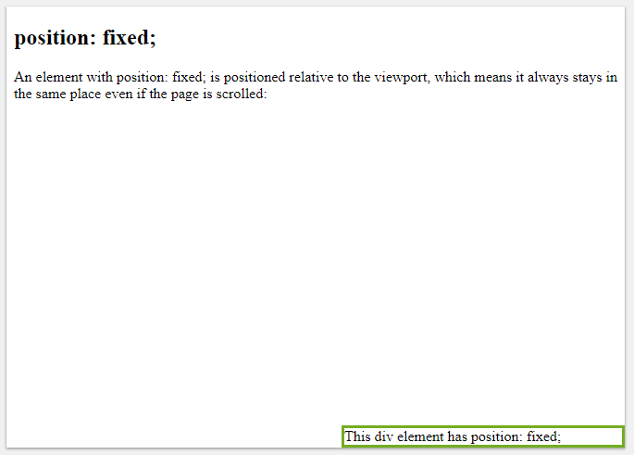
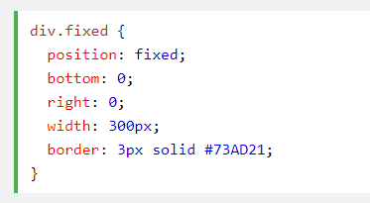
11. CSS Position
Position: fixed
An elements with position: fixed is positioned relative to viewport, which means it always stays in the same place even if the page is scrolled.

Slide 22
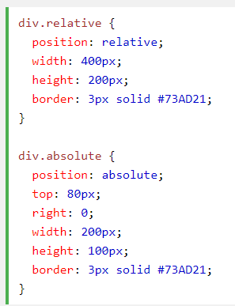
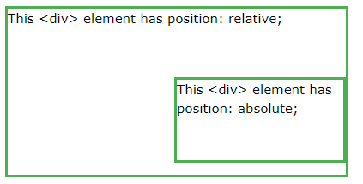
11. CSS Position
Position: absolute
An elements with position: absolute is positioned relative to nearest positioned ancestor viewport (instead of positioned relative to the viewport, like fixed).

Slide 23
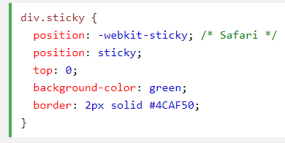
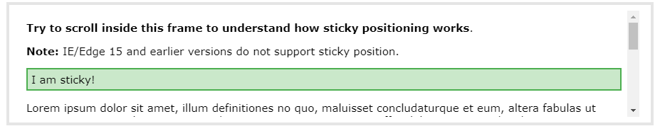
11. CSS Position
Position: sticky
An elements with position: sticky is positioned based on the user’s scroll position.

Slide 24
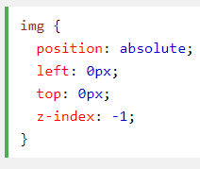
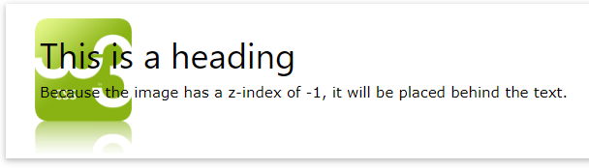
11. CSS Position
Overlapping Elements
When elements are positioned, they can overlap elements.
The z-index property specifies the stack order of an element (which element should be place in front of, or behind, the others).

Slide 25
12. CSS Backgrounds
The CSS background properties are used to define the background effects for elements.
CSS background properties:
+ background-color
+ background-image
+ background-repeat
+ background-attachment
+ background-position

Slide 26
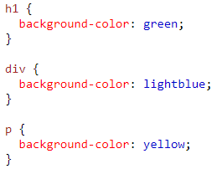
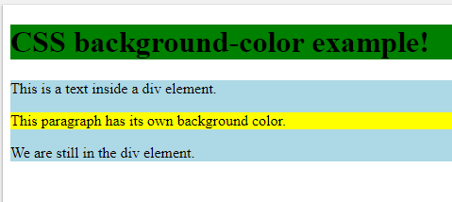
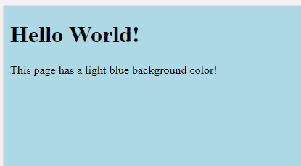
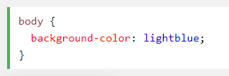
12. CSS Backgrounds
The background-color property specifies the background color of an element.

Slide 27
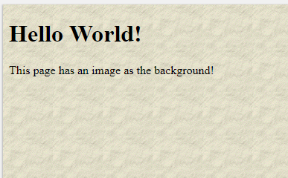
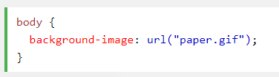
12. CSS Backgrounds
The background-image property specifies an image to use as the background of an element.
By default, the images is repeated so it covers the entire element.

Slide 28
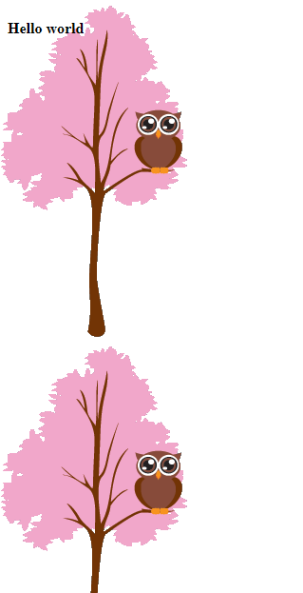
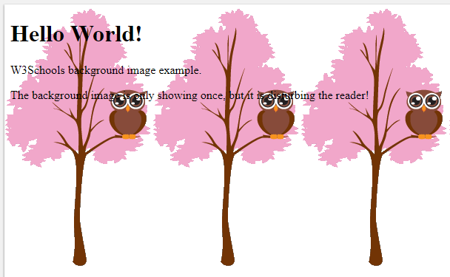


12. CSS Backgrounds
Background image repeat horizontally or vertically.
By default, the background-image property repeats an image both horizontally and vertically.
Some images should be repeated only horizontally or vertically.

Slide 29
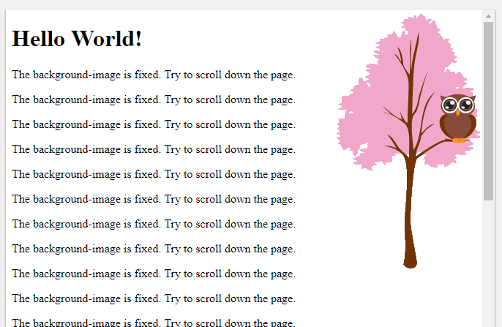
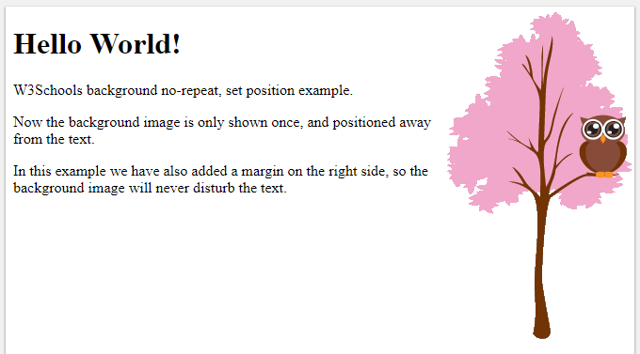
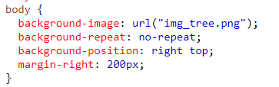
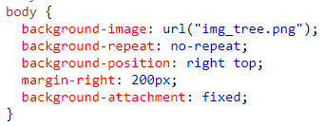
12. CSS Backgrounds
Background image – set position and no-repeat.
Background image – fixed position

Slide 30



14. CSS Flexbox
The flexbox layout module aims at proving a more efficient way to lay out, align and distribute space among items in a container, even when their size is unknown and/or dynamic.
To start using the flexbox model, you need to first define a flex container.

Slide 31


14. CSS Flexbox
The flex-direction property
The flex-direction property defines in which direction the container wants to stack the flex items.
flex-direction: row, column, row-reverse, column-reverse

Slide 32




14. CSS Flexbox
The flex-wrap property
The flex-wrap property specifies whether the flex items should wrap or not.
flex-wrap: wrap, nowrap

Slide 33


14. CSS Flexbox
The justify-content property
The justify-content property is used to align the flex items.
justify-content: center, flex-start, flex-end, space-around, space-between.

Slide 34


14. CSS Flexbox
The align-items property
The align-items property is used to align the flex items vertically.
align-items: center, flex-start, flex-end, stretch, baseline.

Slide 35


14. CSS Flexbox
The align-content property
The align-content property is used to align the flex lines.
align-content: space-between, space-around, flex-start, flex-end, stretch, center.

Slide 36
14. CSS Flexbox
Child Elements (items)
The direct child elements of a flex container automatically becomes flexible (flex) items.
The flex item properties are: order, flex-grow, flex-shrink, flex-basis, flex, align-self

Slide 37


14. CSS Flexbox
The order property
The order property specifies the order of the flex items.

Slide 38


14. CSS Flexbox
The flex-grow property
The flex-grow property specifies how much a flex item will grow relative to the rest of the flex items.

Slide 39


14. CSS Flexbox
The flex-shrink property
The flex-shrink property specifies how much a flex item will shrink relative to the rest of the flex items.

Slide 40


14. CSS Flexbox
The flex-basis property
The flex-basis property specifies the initial length of a flex item.

Slide 41


14. CSS Flexbox
The align-self property
The align-self property specifies the alignment for the selected item inside the flexible container.
The align-self property overrides the default alignment set by the container's align-items property.

Slide 42

Thank You and Questions!

