Slide 1
HTML INTRODUCTION
What is html?

Slide 2
1. What is HTML?
HTML stands for Hyper Text Markup Language
HTML describes the structure of Web pages using markup
HTML elements are the building blocks of HTML pages
HTML elements are represented by tags
HTML tags label pieces of content such as "heading", "paragraph", "table", and so on
Browsers do not display the HTML tags, but use them to render the content of the page

Slide 3
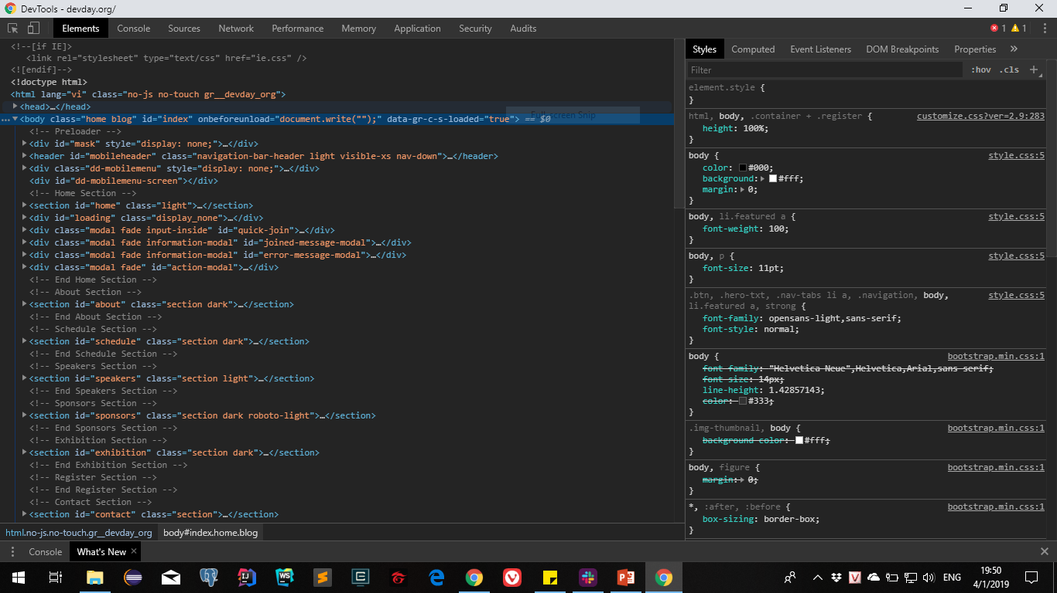

1. What is HTML?

Slide 4


2. HTML Elements & HTML Attributes
An HTML element usually consists of a start tag and end tag, with the content inserted in between:
All HTML elements can have attributes
Attributes provide additional information about an element
Attributes are always specified in the start tag
Attributes usually come in name/value pairs like: name="value"

Slide 5
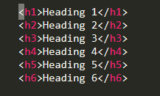
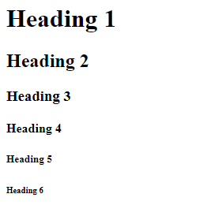
3. HTML Tags
HTML headings: headings are defined with the <h1> to <h6> tags.

Slide 6
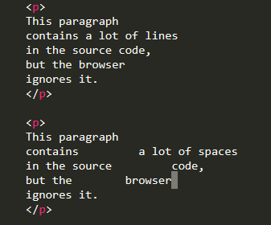

3. HTML Tags
HTML paragraphs: the HTML <p> element defines a paragraphs.

Slide 7

3. HTML Tags
HTML links:
- HTML links are hyperlinks.
- You can click on a link and jump to another document.
- When you move the mouse over a link, the mouse arrow will turn into a little hand.

Slide 8

3. HTML Tags
HTML images:
- In HTML, images are defined with the <img> tag.
- The <img> tag is empty, it contains attributes only, does not
have a closing tag.
- The src attribute specifies the URL (Web address) of the image.

Slide 9
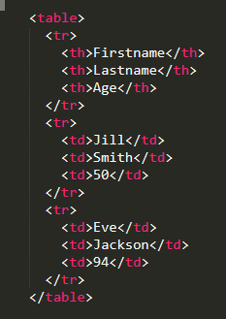

3. HTML Tags
HTML tables:
- An HTML table is defined with the <table> tag.
- Each table row is defined with the <tr> tag. A table header is
defined with the <th> tag. By default, table headings bold and centered. A table data/cell is defined with the <td> tag.

Slide 10
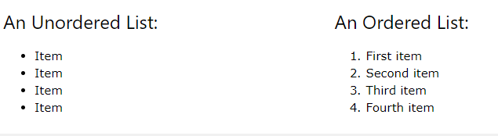




3. HTML Tags
HTML lists:
- Unordered HTML List
- Ordered HTML List

Slide 11

Demo

Slide 12



4. HTML Blocks
HTML Blocks:
- Block-level elements: A block-level element always starts on a new line and takes up the full width available (stretches out to the left and right as far as it can).
- Inline Elements: An inline element does not start on a new line and only takes up as much width as necessary.

Slide 13

3. HTML Form
HTML Form:
- The HTML <form> element defines a form that is used to collect user input.
- The most important form elements is the <input> tag. The <input> element can be displayed in several ways, depending on the type attribute.

Slide 14


3. HTML Form
HTML Form:

Slide 15

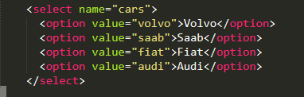

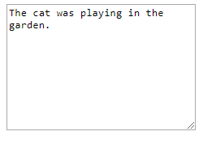
3. HTML Form
HTML Form:
- The <select> element defines a drop-down list. The <option> elements defines an option that can be selected.
- The <textarea> element defines a multi-line input field.

Slide 16

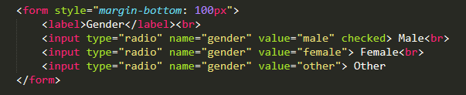


3. HTML Form
HTML Form:

Slide 17




3. HTML Form
HTML Form:

Slide 18
Demo

Slide 19
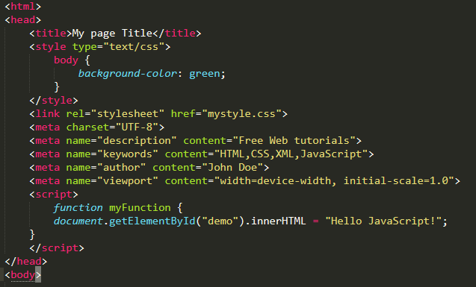
4. HTML Header
HTML head:
- The <head> element is a container for metadata and is placed between the <html> tag and the <body> tag.
- The following tags describe metadata: <title>, <style>, <meta>, <script>, <link>

Slide 20


5. Differences Between HTML and HTML5?
Differences Between HTML and HTML5
Notes:
https://www.w3schools.com/tags/ref_html_dtd.asp

Slide 21
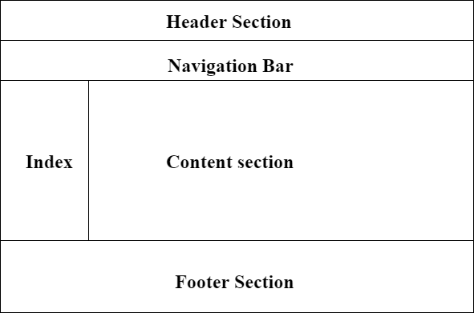
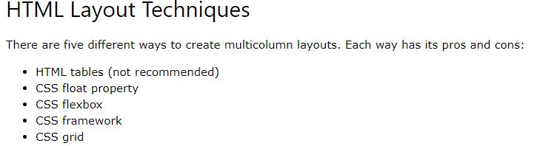
4. HTML Layouts
Layouts:

Slide 22

Thank You and Questions!

