Slide 1
Open Infra Project
Build Your Own Kubernetes Cluster
with Kubespray, Heketi, Gluster

Slide 2
Use cases
Prevent vendor lock
Might reduce cost (AWS EKS, GCP GKE, Azure AKS $0.1/h)
Freely customization, can be deployed on any machine
Good for small production (with limited operation overhead)
Good for learning purpose (alternative for minikube)

Slide 3
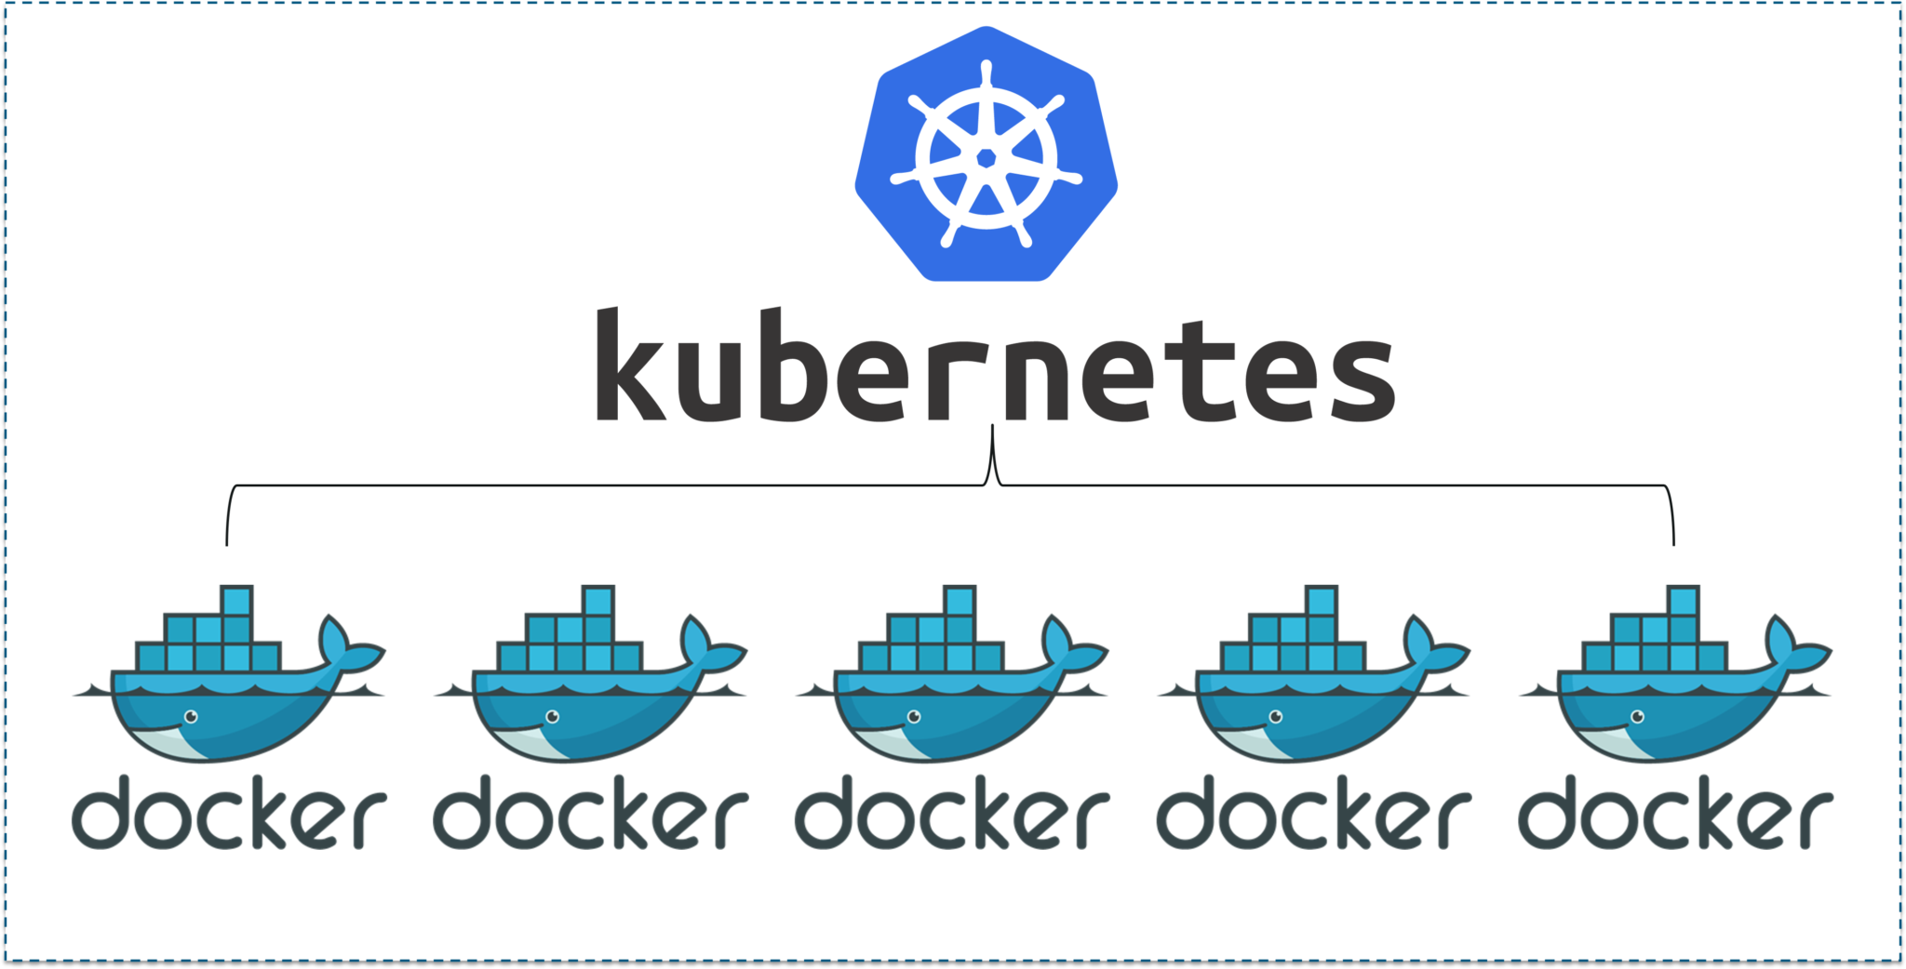
KubeSpray

Slide 4
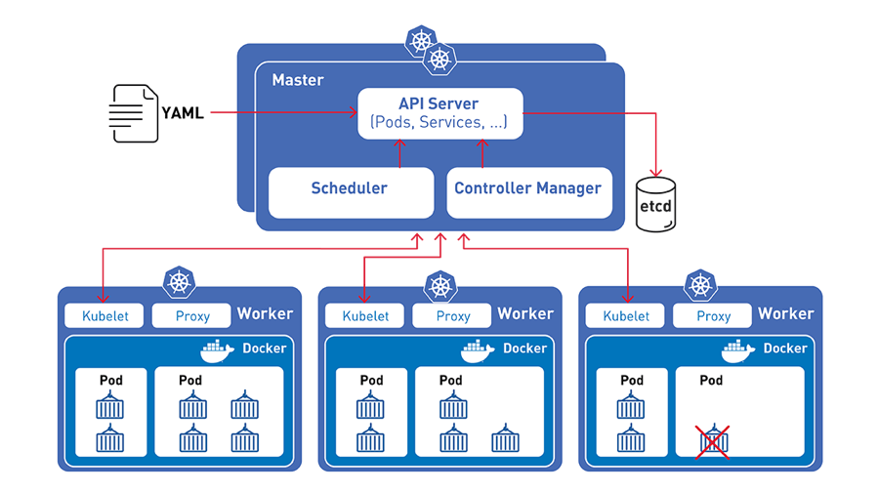
Introduction - KubeSpray
Actively developed open source, 11.2K stars, 5988 commits
Can be deployed on any cloud provider infrastructure
Highly available, reliable, customizable
Easy installation and configuration
Alternative for kops, kubeadm
Support almost all linux systems

Slide 5
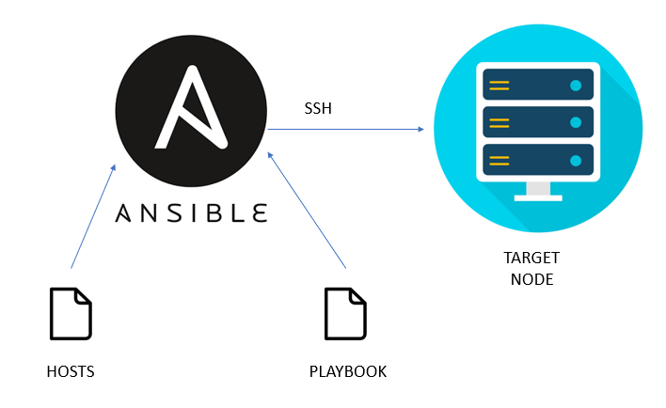
Installation step
Install ansible, python, pip
Prepare SSH key on all nodes
Config and upload parameters
Execute playbook
Create service account / role binding / cluster config
Check cluster info

Slide 6
Gluster & Heketi

Slide 7
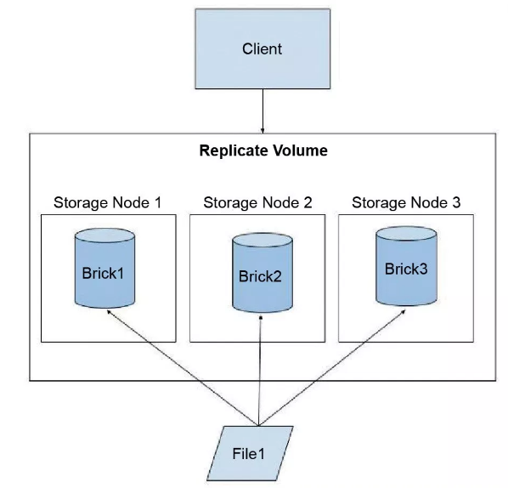
Introduction: Gluster
Open storage platform backed by Redhat, both having free and commercial version.
Relatively easy to install, config and operate (especially use with Heketi APIs)
Distributed file system
Support replication, high available

Slide 8
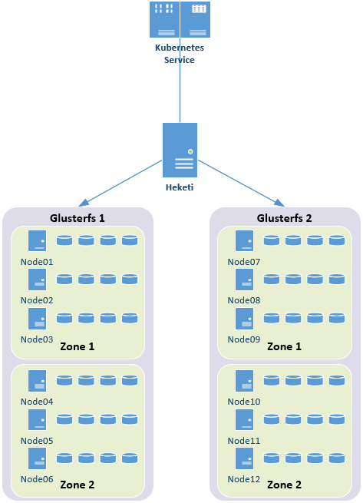
Introduction: Heketi
RESTful management interface for Gluster
Reduce volume operation overhead on Gluster

Slide 9
Architecture Design
Open-infra project

Slide 10
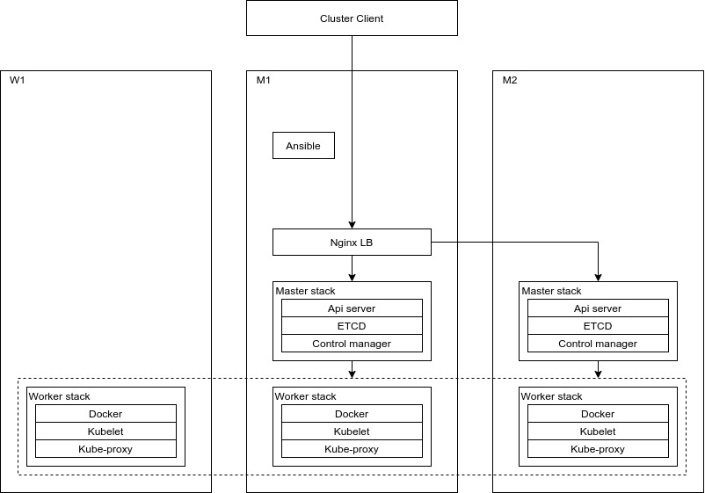

Slide 11
