Slide 1

An-Najah National University
2026
Artificial Intelligence-Based Intrusion Detection for Enhancing Wireless Network Security
Dr. Jehad Hammare.
By: Shahd Radwan, Taqwa Qadah.
Notes:
[Sources] Research content and project framing adapted from uploaded project draft: AI_IDS_Wireless_Security_Revised_Shahd(1).docx. University logo extracted from the uploaded document assets. [/Sources]

Slide 2




An AI-powered intrusion detection layer built for wireless networks - designed to catch what signature-based tools miss.
AI-based IDS
Wireless-first
Random Forest core

Slide 3
The Problem
Wireless traffic is growing fast, but security visibility is still weak.
Open-air exposure
Wireless traffic travels through the air, which makes interception, spoofing, and disruption easier than in closed wired links.
Why this matters to customers
Campuses and enterprises rely on dense Wi-Fi environments with many unmanaged endpoints.
IoT and healthcare-style wireless deployments increase attack surface and make manual monitoring harder.
Customers need faster detection without adding heavyweight infrastructure.
Blind spot in legacy IDS
Traditional IDS depends heavily on known attack signatures and struggles with unknown or zero-day threats.
Operational cost
False alarms waste analyst time, while missed attacks create service disruption and data risk.
Investor takeaway
There is a clear gap between static security tools and the dynamic behavior of modern wireless networks.
Notes:
[Sources] Claims on wireless-network exposure, common attack types, and limitations of signature-based IDS are based on the uploaded project draft and its cited references. [/Sources]

Slide 4
Why Now
Three trends make this the right moment for an AI-driven wireless IDS.
1
Wireless-first operations
2
AI is practical now
3
Detection needs to evolve
Organizations now treat Wi-Fi as primary infrastructure, not just a convenience layer.
Machine-learning classifiers can now be implemented with lightweight tools and integrated into monitoring workflows.
Static signatures alone are not enough for shifting attack behavior in wireless environments.
Result: more traffic, more endpoints, more monitoring complexity.
Result: feasible detection upgrades without enterprise-scale complexity.
Result: customers are ready for behavior-based security layers.
Notes:
[Sources] Timing and opportunity narrative are inferred from the uploaded project draft: growing wireless dependence, dynamic threat behavior, and applicability of AI/ML to IDS. [/Sources]

Slide 5
Our Solution
A behavior-based IDS layer that turns wireless traffic into actionable security alerts.
1
2
3
4
1. Collect
2. Prepare
3. Classify
4. Respond
Capture traffic features from the wireless environment.
Clean and encode data so the model can learn useful patterns.
Use Random Forest to decide whether traffic is normal or malicious.
Trigger alerts and support mitigation actions for suspicious flows.
This is not another signature list. It is an adaptive detection workflow designed to spot suspicious behavior earlier.
Notes:
[Sources] Solution workflow is based on the uploaded project draft sections: Proposed System, System Design, Methodology, and Implementation. [/Sources]

Slide 6
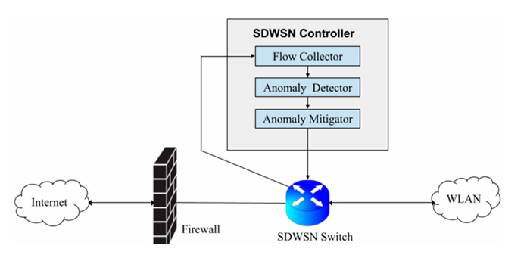
Product Architecture
The technical design is simple enough to deploy, but strong enough to improve detection quality.
Core modules
Flow Collector gathers network-traffic features and connection behavior.
Preprocessing layer prepares the raw data for reliable classification.
Random Forest acts as the intelligence engine for anomaly detection.
Alert/Response layer converts model output into operator action.
Investor message: the architecture is modular, understandable, and suitable for staged productization.
Notes:
[Sources] Architecture figure extracted from the uploaded project document assets. Module descriptions are based on the System Design section of the uploaded project draft. [/Sources]

Slide 7
Why This Approach Wins
Random Forest gives us a practical balance of accuracy, robustness, and deployability.
Compared with traditional signature-based IDS
Why Random Forest specifically
Detects suspicious behavior rather than waiting for exact signature matches.
Improves chances of spotting unknown or previously unseen attacks.
Reduces dependence on constant manual rule updates.
Supports smarter monitoring in fast-changing wireless environments.
Strong classification performance
Lower overfitting risk than a single tree
Handles noisy and high-dimensional data well
Easy to explain to technical buyers
Notes:
[Sources] Advantages and comparison points are grounded in the uploaded project draft: Literature Review, AI/ML background, Comparison with Traditional Methods, and Advantages sections. [/Sources]

Slide 8
Current Status
We already have a working prototype - now we need validation and scale.
Prototype complete
Validation path
Python + Scikit-learn implementation with end-to-end training, testing, and classification workflow.
Demo-ready
Academic benchmark
Pilot environment
Product hardening
The system can load data, preprocess features, classify traffic, and produce evaluation outputs.
Validate using NSL-KDD and stronger evaluation metrics.
Test in a controlled wireless deployment with real traffic patterns.
Add alert workflows, dashboards, and integration options.
Next milestone
Replace sample/demo data with benchmark and real wireless traffic for stronger proof and pilot readiness.
Investor message: technical feasibility is proven; the investment unlocks real-world validation and commercialization.
Notes:
[Sources] Prototype status is based on the uploaded project implementation section and the working classroom code discussed in the session. No large-scale real-world validation is claimed. [/Sources]

Slide 9
Who Buys This
We target environments where wireless uptime and trust are critical.
Universities and campuses
SMEs and branch offices
High-density Wi-Fi, many devices, constant access needs.
Need affordable detection without a large SOC team.
Healthcare and IoT settings
Managed network providers
Wireless devices require continuous monitoring and protection.
A value-added detection layer for multiple customer deployments.
Possible revenue paths: pilot projects • software licensing • integration into wireless monitoring stacks
Notes:
[Sources] Use cases are inferred from the wireless-network and IDS application contexts discussed in the uploaded project draft, including wireless and sensor-network environments. [/Sources]

Slide 10
What Investment Unlocks
We are looking for an investor or pilot partner who can help move this from prototype to product.
Phase 1
Phase 2
Phase 3
Benchmark validation
Pilot deployment
Commercial packaging
1
2
3
Run formal testing on NSL-KDD and expand evaluation.
Validate on real wireless traffic with operational feedback.
Build alerts, dashboarding, and integration-ready product features.
Ask: early-stage support for validation, pilot access, and productization
Notes:
[Sources] Roadmap and investment ask are strategic inferences built from the project status in the uploaded draft and working prototype context. [/Sources]

Slide 11
Why Back This Project?
Clear pain point in wireless security.
Practical AI solution with explainable architecture.
Working prototype already built.
Strong path from academic concept to pilotable product.
AI-IDS for Wireless Security
From research concept to investable security product.
Notes:
[Sources] Closing summary is based on the uploaded project draft and the investor-oriented reframing requested by the user. [/Sources]

Slide 12


