Slide 1
DATA ANALYTICS
Task Presentation
Beginner • Intermediate • Advanced
By:
Tara Bhramaramba
Data Analyst Internship
ShadowFox

Slide 2
CONTENTS
• 1. Acknowledgement
• 2. Beginner Level – Sales Data Visualization & Dashboard
• 3. Intermediate Level – Customer & Revenue Analytics
• 4. Advanced Level – IBM HR Attrition Analytics
• 5. Overall Business Insights & Skills Gained
• 6. Conclusion
1

Slide 3
ACKNOWLEDGEMENT
I would like to express my gratitude to ShadowFox for providing the opportunity to work on practical data analytics tasks.
This presentation summarizes my work across Beginner, Intermediate, and Advanced levels, including data preparation, visualization, KPI development, dashboards, business insights, and recommendations.
I also used reference materials and ChatGPT for generating ideas and support during the learning and documentation process.
2

Slide 4
BEGINNER LEVEL
• Project focus: Superstore Sales Data Analysis
• Learned the basic analytics workflow: raw data → cleaning → KPIs → charts → dashboard → insights
• Created basic business visualizations and KPI cards
• Prepared a Tableau-style dashboard and complete report
Key objective: understand how data can be transformed into clear business information.
3

Slide 5
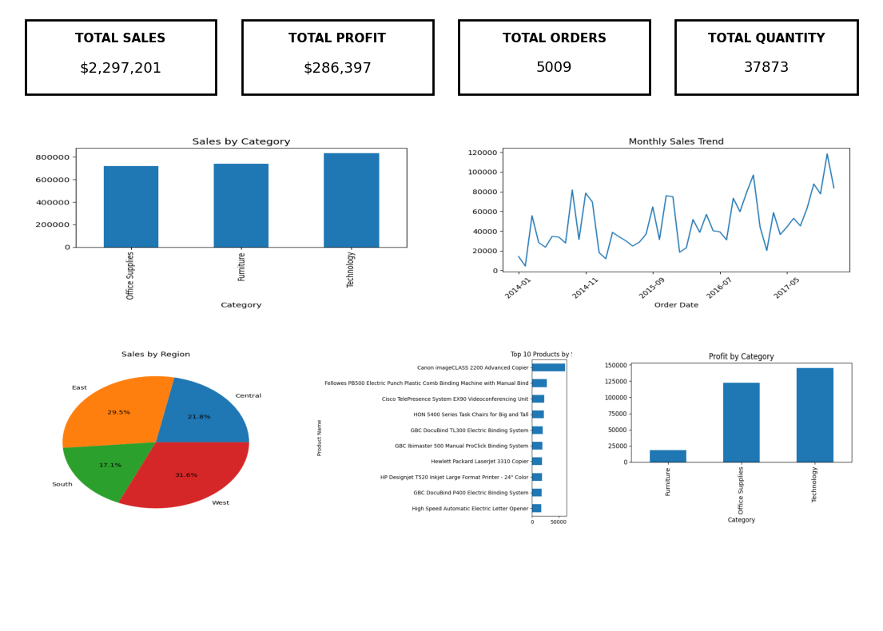
BEGINNER – DATASET & DATA CLEANING
• Dataset: Superstore sales data
• Checked column names and data types
• Checked missing values and duplicate records
• Standardized data for analysis
• Prepared a cleaned dataset for visualization
4

Slide 6
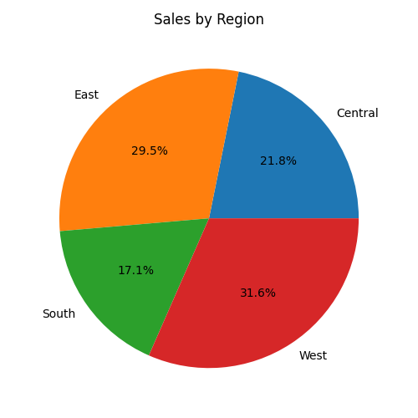
BEGINNER – SALES BY REGION
Compares regional sales performance and helps identify stronger and weaker markets.
Business use
Supports sales monitoring, comparison and decision-making.
5

Slide 7
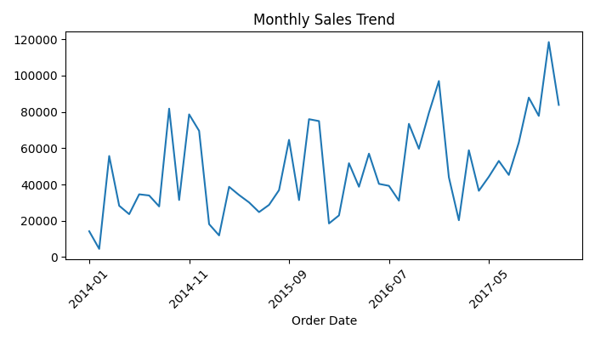
BEGINNER – MONTHLY SALES TREND
Shows how sales change over time and helps identify trends and periods of stronger or weaker performance.
Business use
Supports sales monitoring, comparison and decision-making.
6

Slide 8
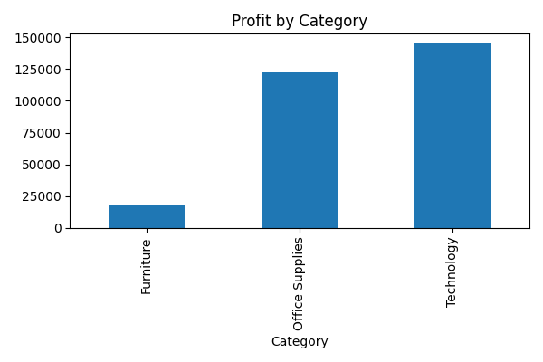
BEGINNER – PROFIT BY CATEGORY
Compares profit contribution across product categories.
Business use
Supports sales monitoring, comparison and decision-making.
7

Slide 9
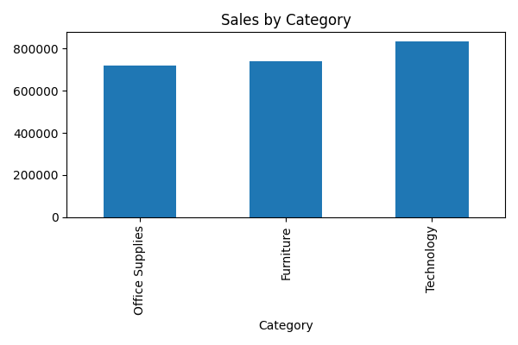
BEGINNER – SALES BY CATEGORY
Shows how each product category contributes to total sales.
Business use
Supports sales monitoring, comparison and decision-making.
8

Slide 10
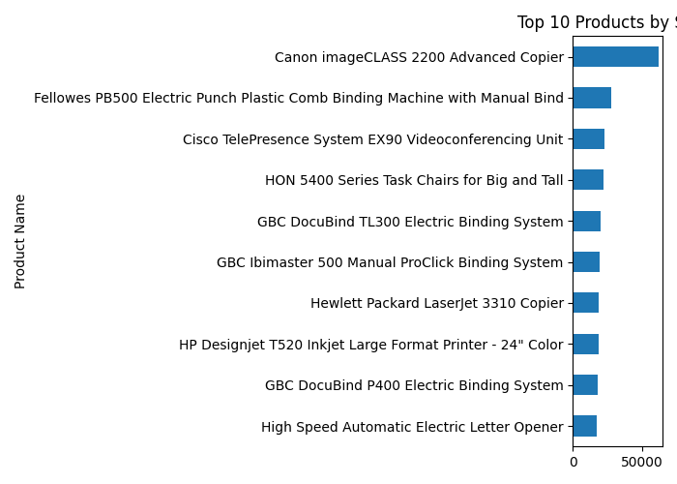
BEGINNER – TOP 10 PRODUCTS
Highlights products with strong sales performance for further business attention.
Business use
Supports sales monitoring, comparison and decision-making.
9

Slide 11
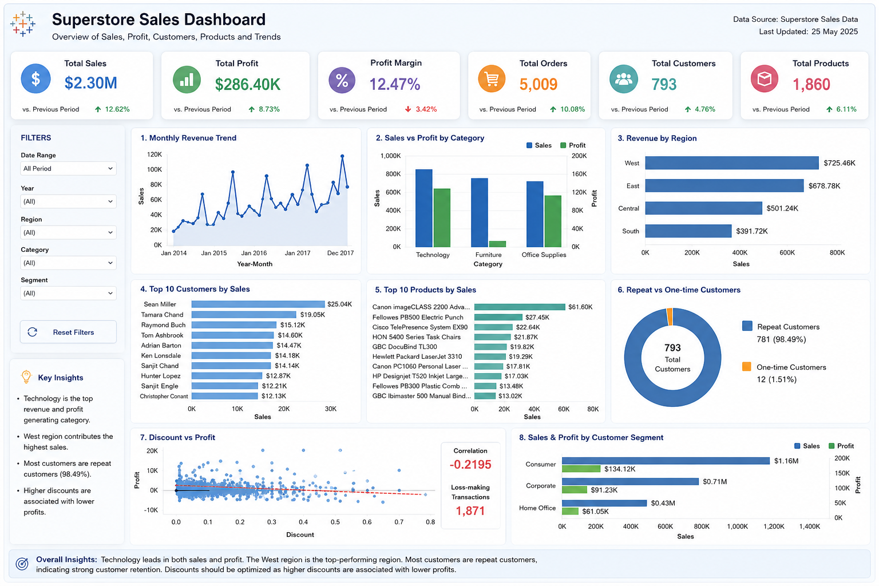
BEGINNER – KPI CARDS & DASHBOARD
• KPI cards: Total Sales, Total Profit and other key measures
• Combined multiple charts into a single Tableau-style dashboard
• Designed for quick monitoring and simple business storytelling
• Prepared business insights and recommendations
10

Slide 12
BEGINNER – OUTCOME
• Data cleaning fundamentals
• KPI calculation
• Basic chart selection
• Dashboard layout and visual hierarchy
• Business insight writing
• Complete Beginner report and video prepared
11

Slide 13
INTERMEDIATE LEVEL
• Project focus: Customer & Revenue Analytics using Superstore data
• Moved from basic visualization to exploratory and comparative analysis
• Analyzed customers, products, regions, segments, revenue, profit and discounts
• Created 8 visualizations, KPI cards, dashboard, business insights and recommendations
12

Slide 14
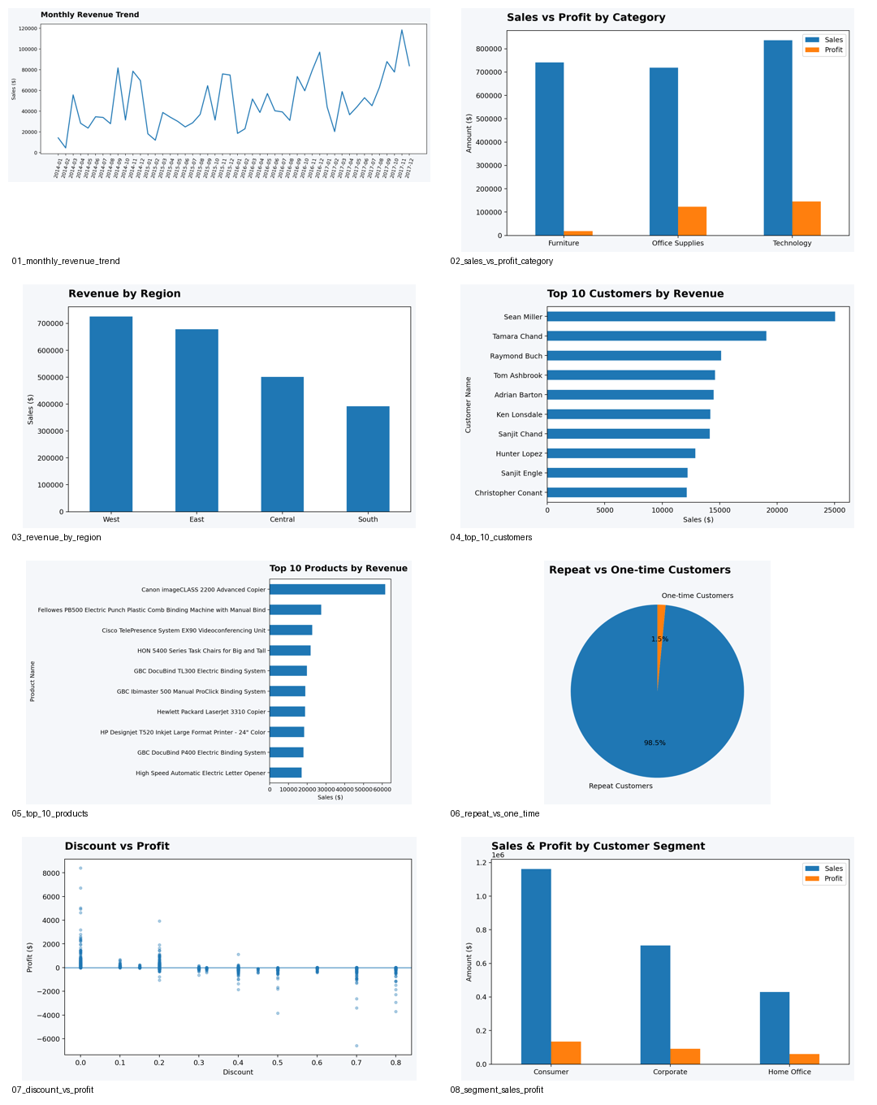
INTERMEDIATE – DATASET PREPARATION
• Used the cleaned Superstore dataset
• Validated analytical fields
• Prepared data for customer, product, regional and profitability analysis
• Structured measures consistently across the 8 visualizations
13

Slide 15
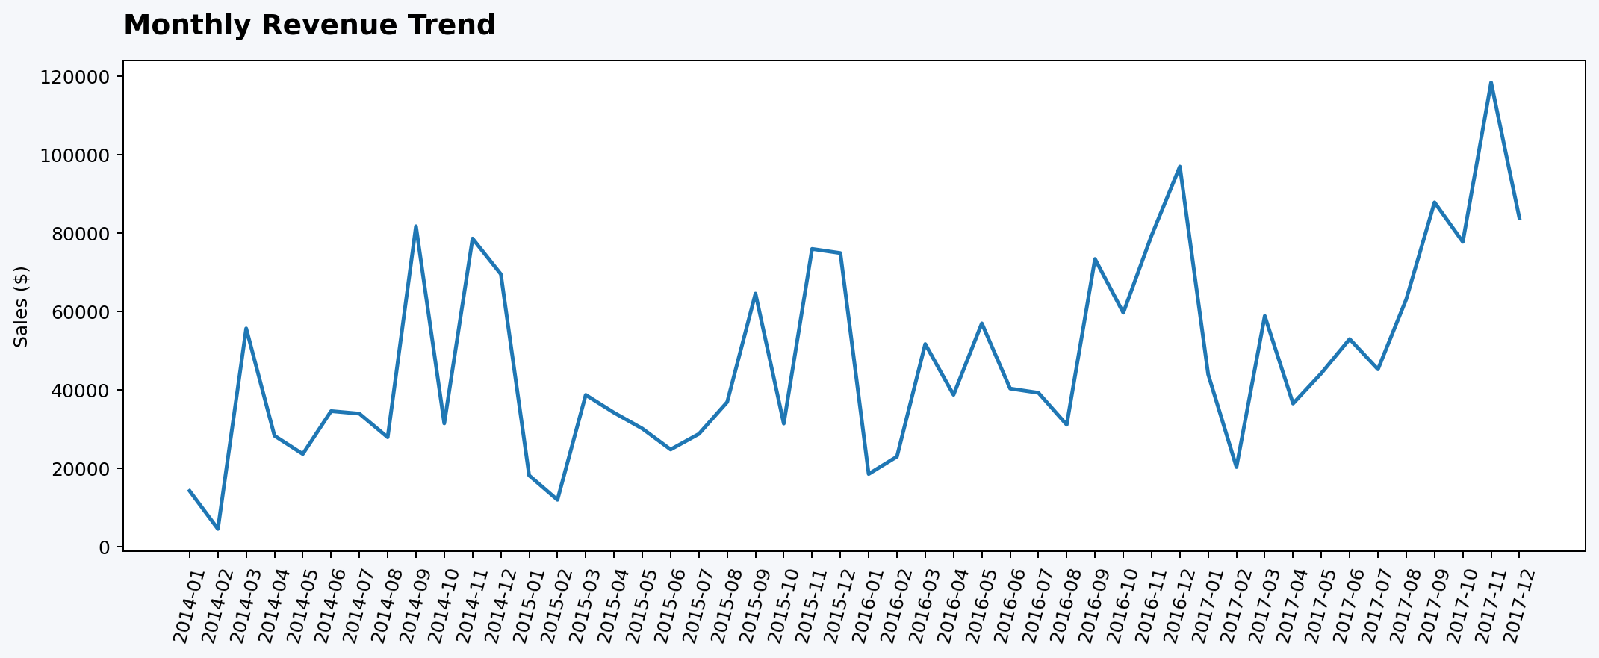
INTERMEDIATE – MONTHLY REVENUE TREND
Tracks revenue movement over time.
Decision use
Supports customer, product, regional and profitability decisions.
14

Slide 16
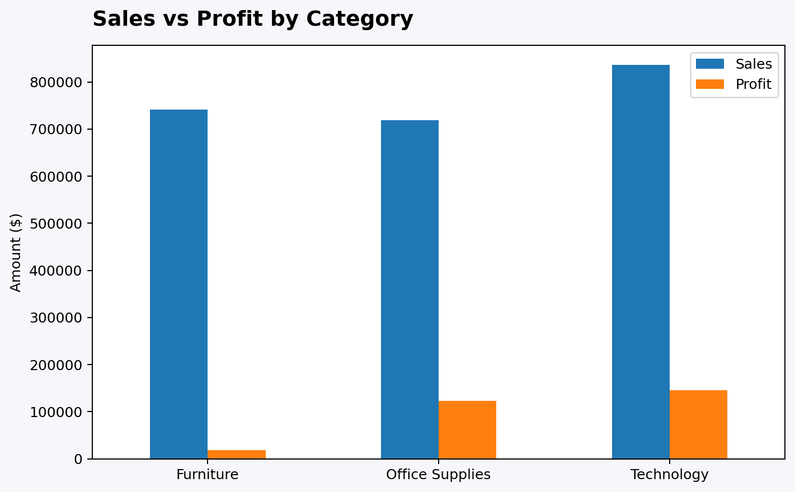
INTERMEDIATE – SALES VS PROFIT BY CATEGORY
Compares sales performance with profitability by category.
Decision use
Supports customer, product, regional and profitability decisions.
15

Slide 17
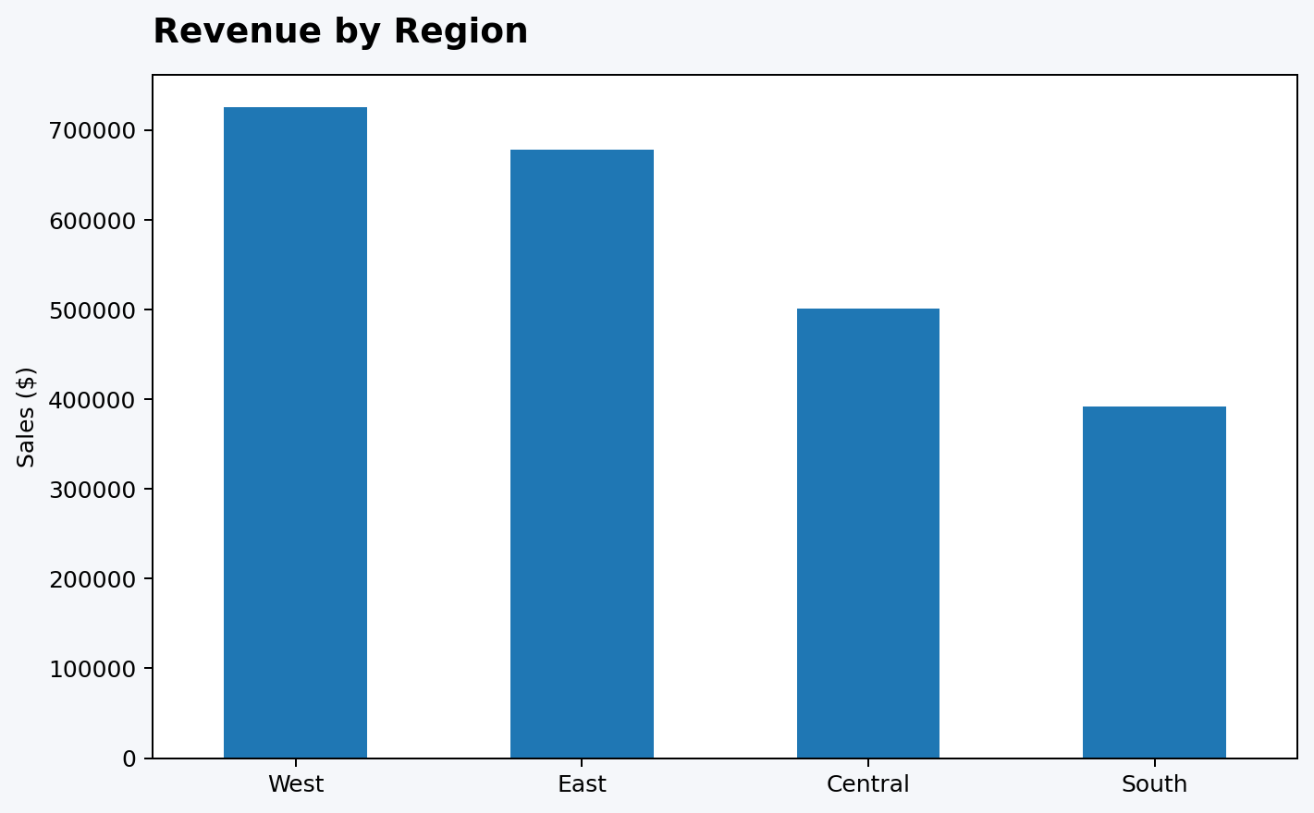
INTERMEDIATE – REVENUE BY REGION
Compares regional contribution to revenue.
Decision use
Supports customer, product, regional and profitability decisions.
16

Slide 18
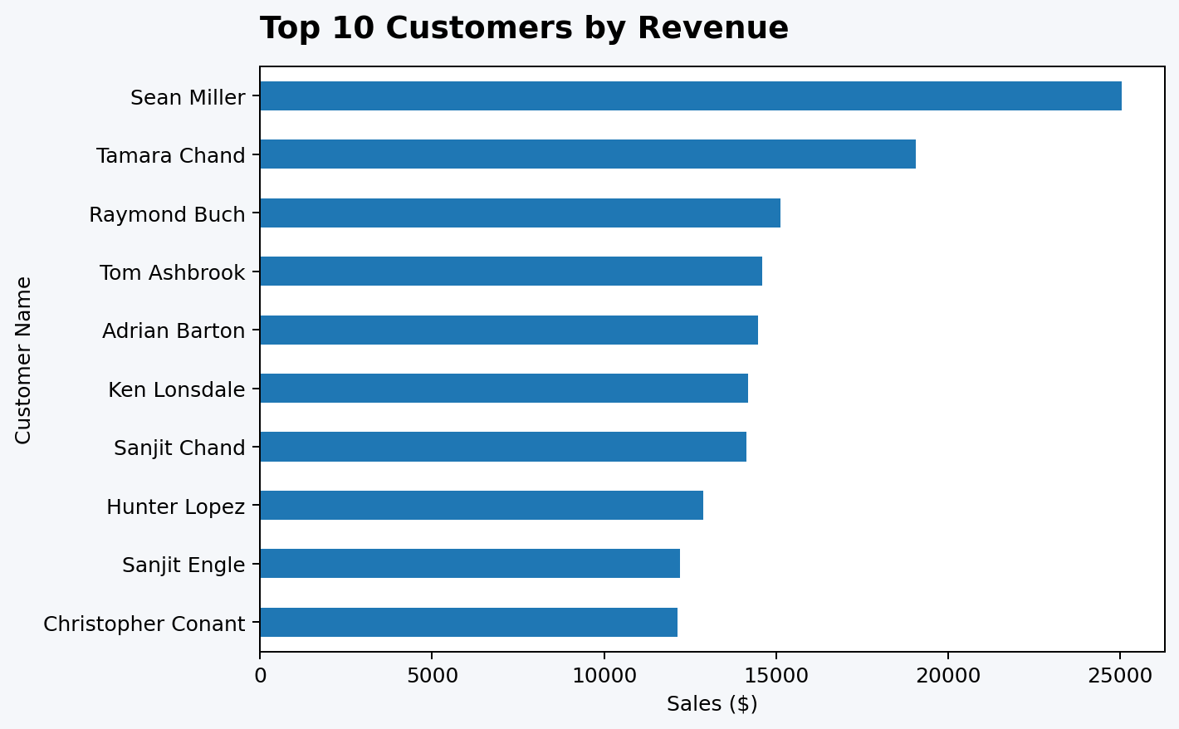
INTERMEDIATE – TOP 10 CUSTOMERS
Identifies high-value customers for retention and relationship management.
Decision use
Supports customer, product, regional and profitability decisions.
17

Slide 19
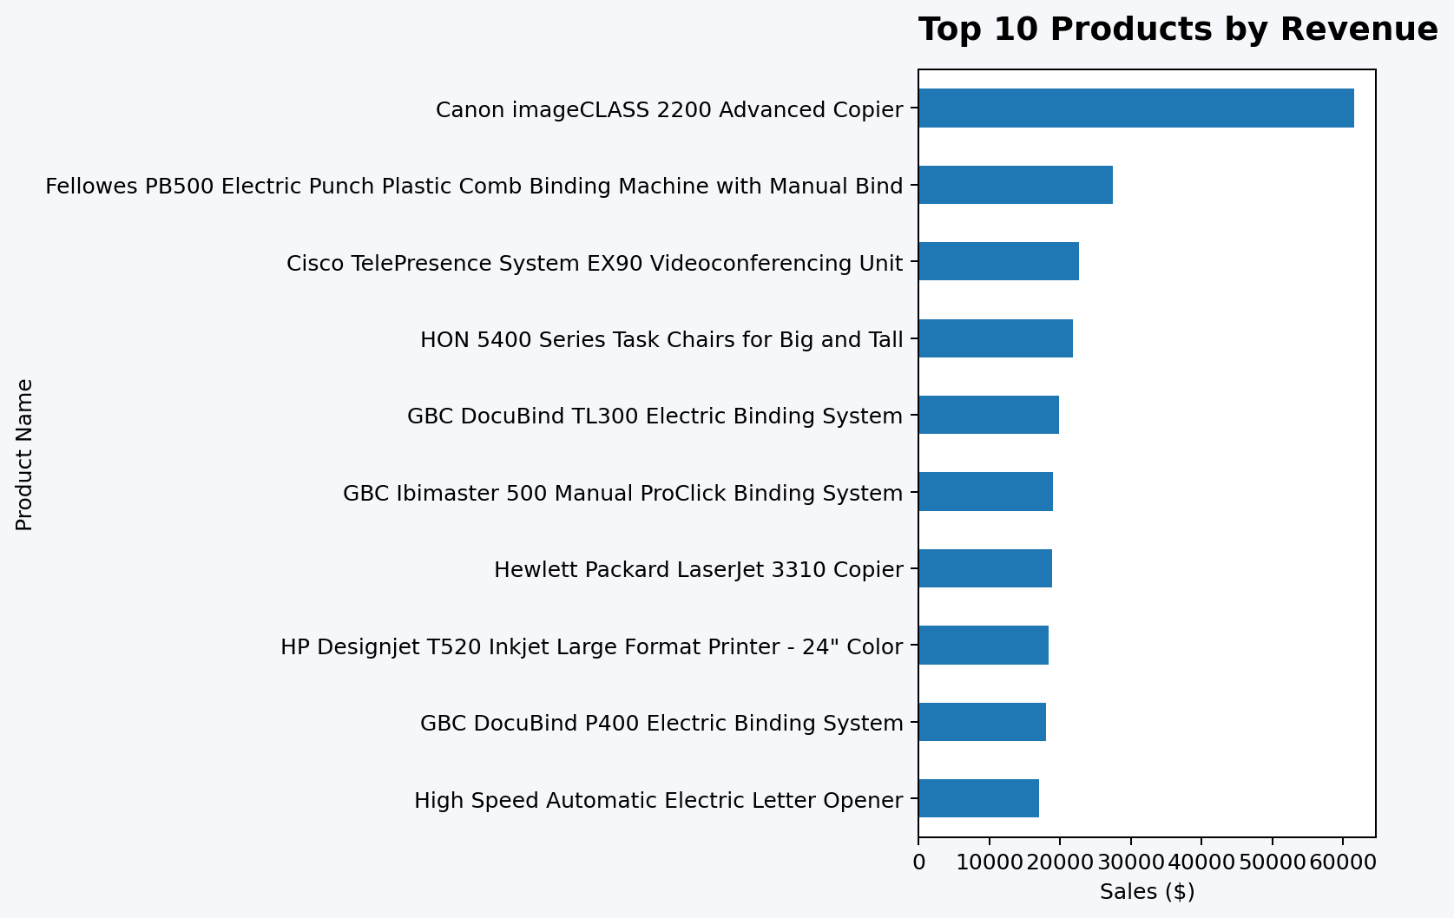
INTERMEDIATE – TOP 10 PRODUCTS
Identifies strong-performing products.
Decision use
Supports customer, product, regional and profitability decisions.
18

Slide 20
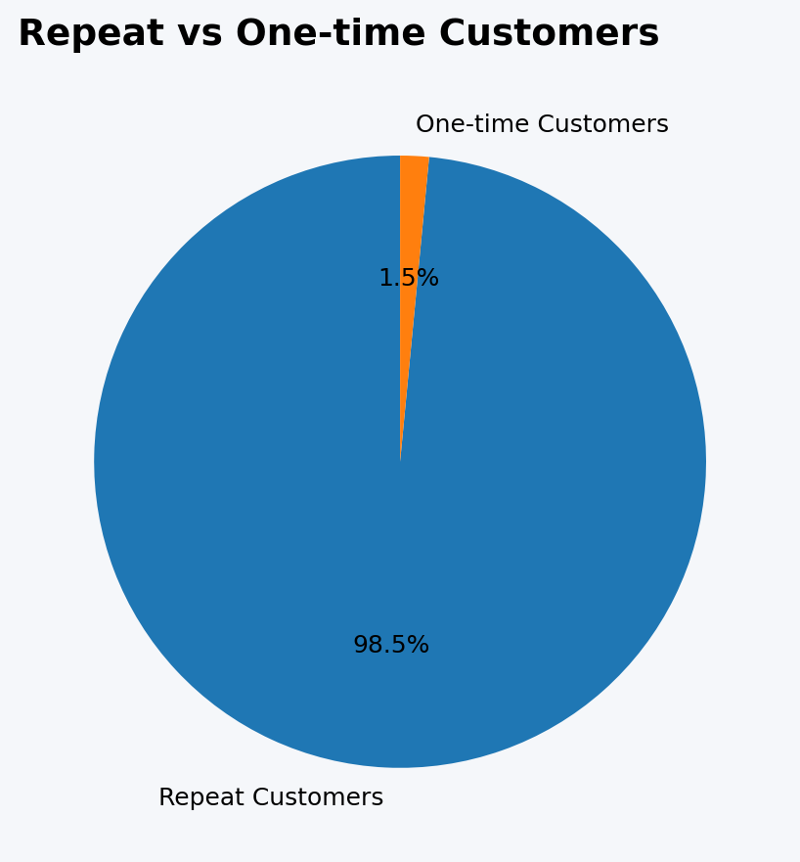
INTERMEDIATE – REPEAT VS ONE-TIME CUSTOMERS
Examines recurring versus one-time customer business.
Decision use
Supports customer, product, regional and profitability decisions.
19

Slide 21
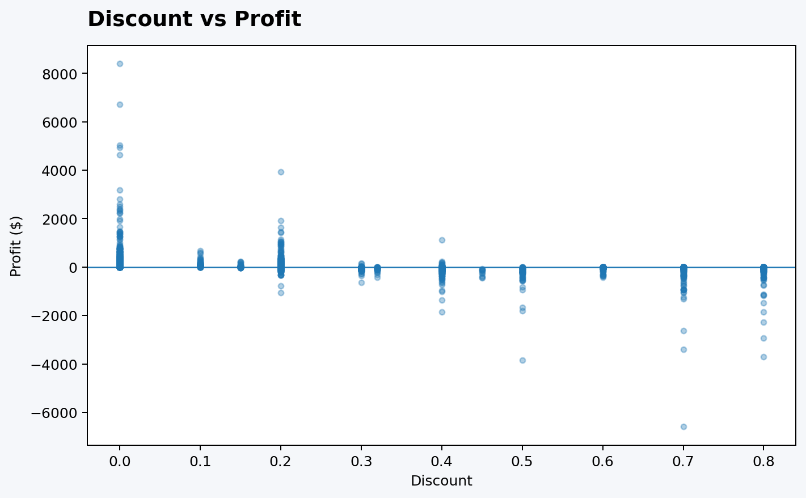
INTERMEDIATE – DISCOUNT VS PROFIT
Investigates the relationship between discounting and profit.
Decision use
Supports customer, product, regional and profitability decisions.
20

Slide 22
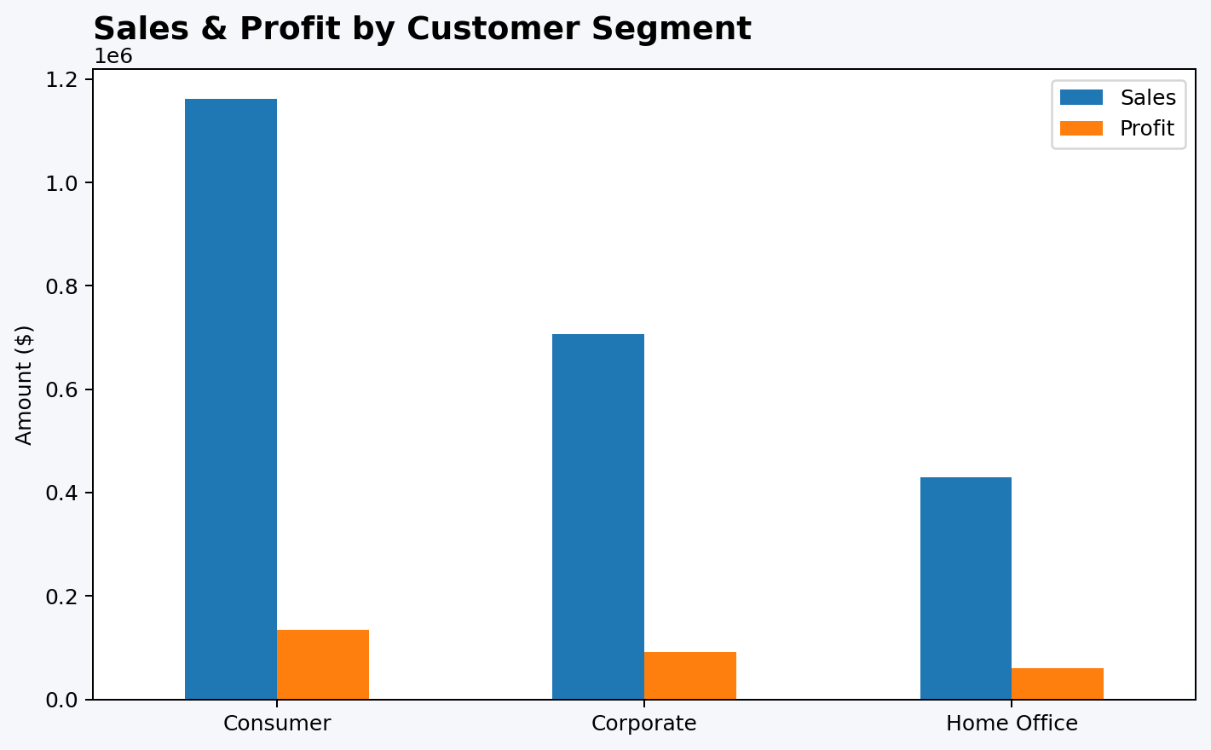
INTERMEDIATE – SEGMENT SALES & PROFIT
Compares sales and profit across customer segments.
Decision use
Supports customer, product, regional and profitability decisions.
21

Slide 23
INTERMEDIATE – KPI CARDS & DASHBOARD
• KPI cards summarize key revenue and profitability measures
• Dashboard combines all 8 visualizations
• Customer, product, regional and segment views are connected
• Business insights move from descriptive charts toward recommendations
22

Slide 24
INTERMEDIATE – BUSINESS INSIGHTS
• Identified high-value customers and products
• Compared regional revenue performance
• Evaluated category and segment profitability
• Examined repeat-customer behavior
• Studied discount versus profit patterns
• Converted findings into actionable recommendations
23

Slide 25
ADVANCED LEVEL
• Project focus: IBM HR Analytics – Employee Attrition
• Dataset: 1,470 employees and 35 original fields
• Created HR-specific KPIs and transformed analytical fields
• Built 8 attrition visualizations and an executive dashboard
• Added interactive filters, drill-down prototype and decision-oriented storytelling
24

Slide 26
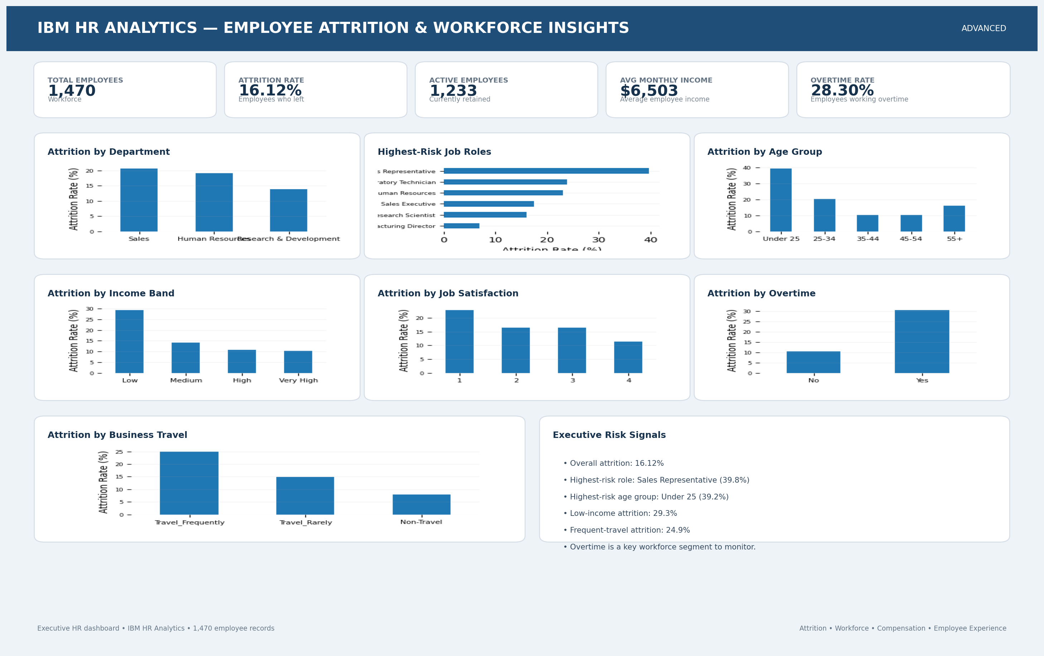
ADVANCED – DATA PREPARATION
• Checked and prepared HR fields
• Created Attrition Flag and OverTime Flag
• Created Age Group, Income Band and Tenure Group
• Checked duplicates and missing values
• Prepared cleaned Excel and CSV datasets
25

Slide 27
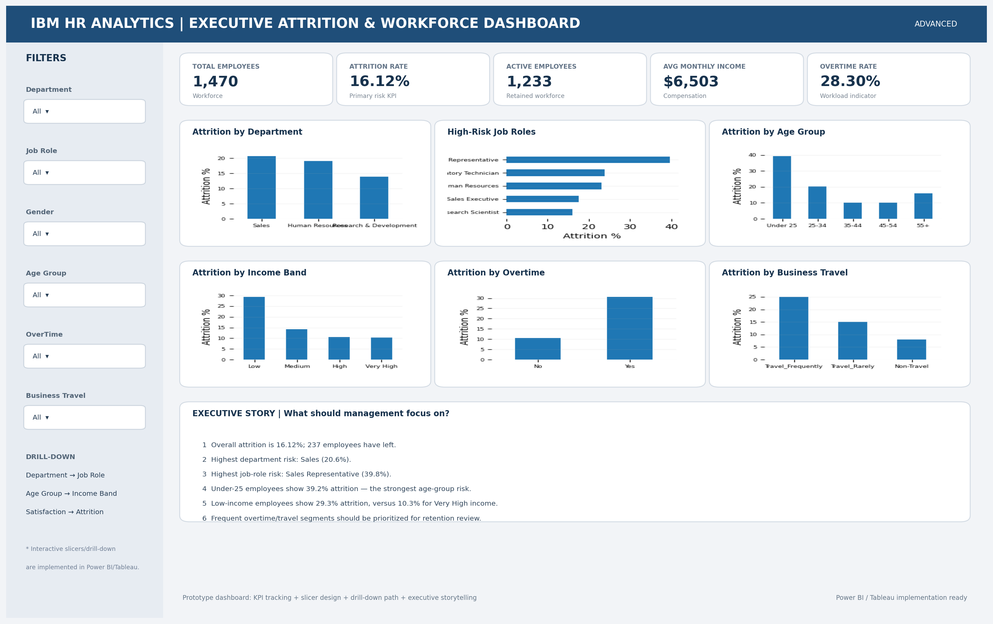
ADVANCED – EXECUTIVE KPI CARDS
• Total Employees: 1,470
• Employees Who Left: 237
• Active Employees: 1,233
• Attrition Rate: 16.12%
• Average Monthly Income: about $6,503
• Overtime Rate: 28.30%
26

Slide 28
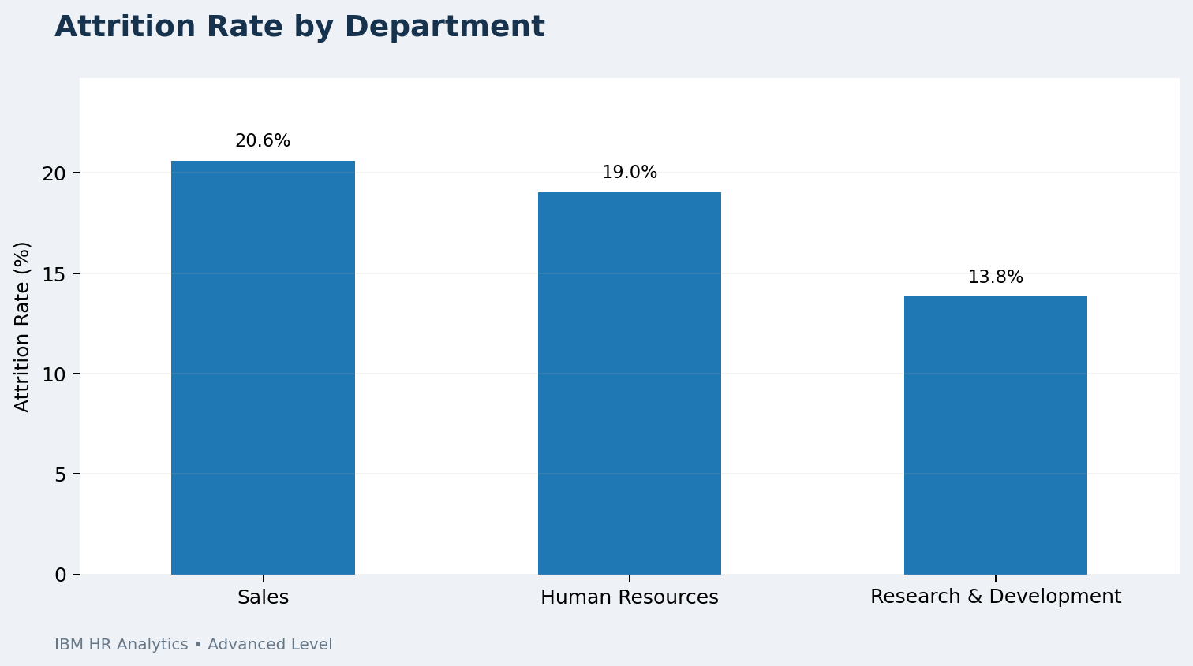
ADVANCED – ATTRITION BY DEPARTMENT
Sales has the highest department attrition in the analysis.
HR decision use
Helps identify workforce segments for retention analysis.
27

Slide 29
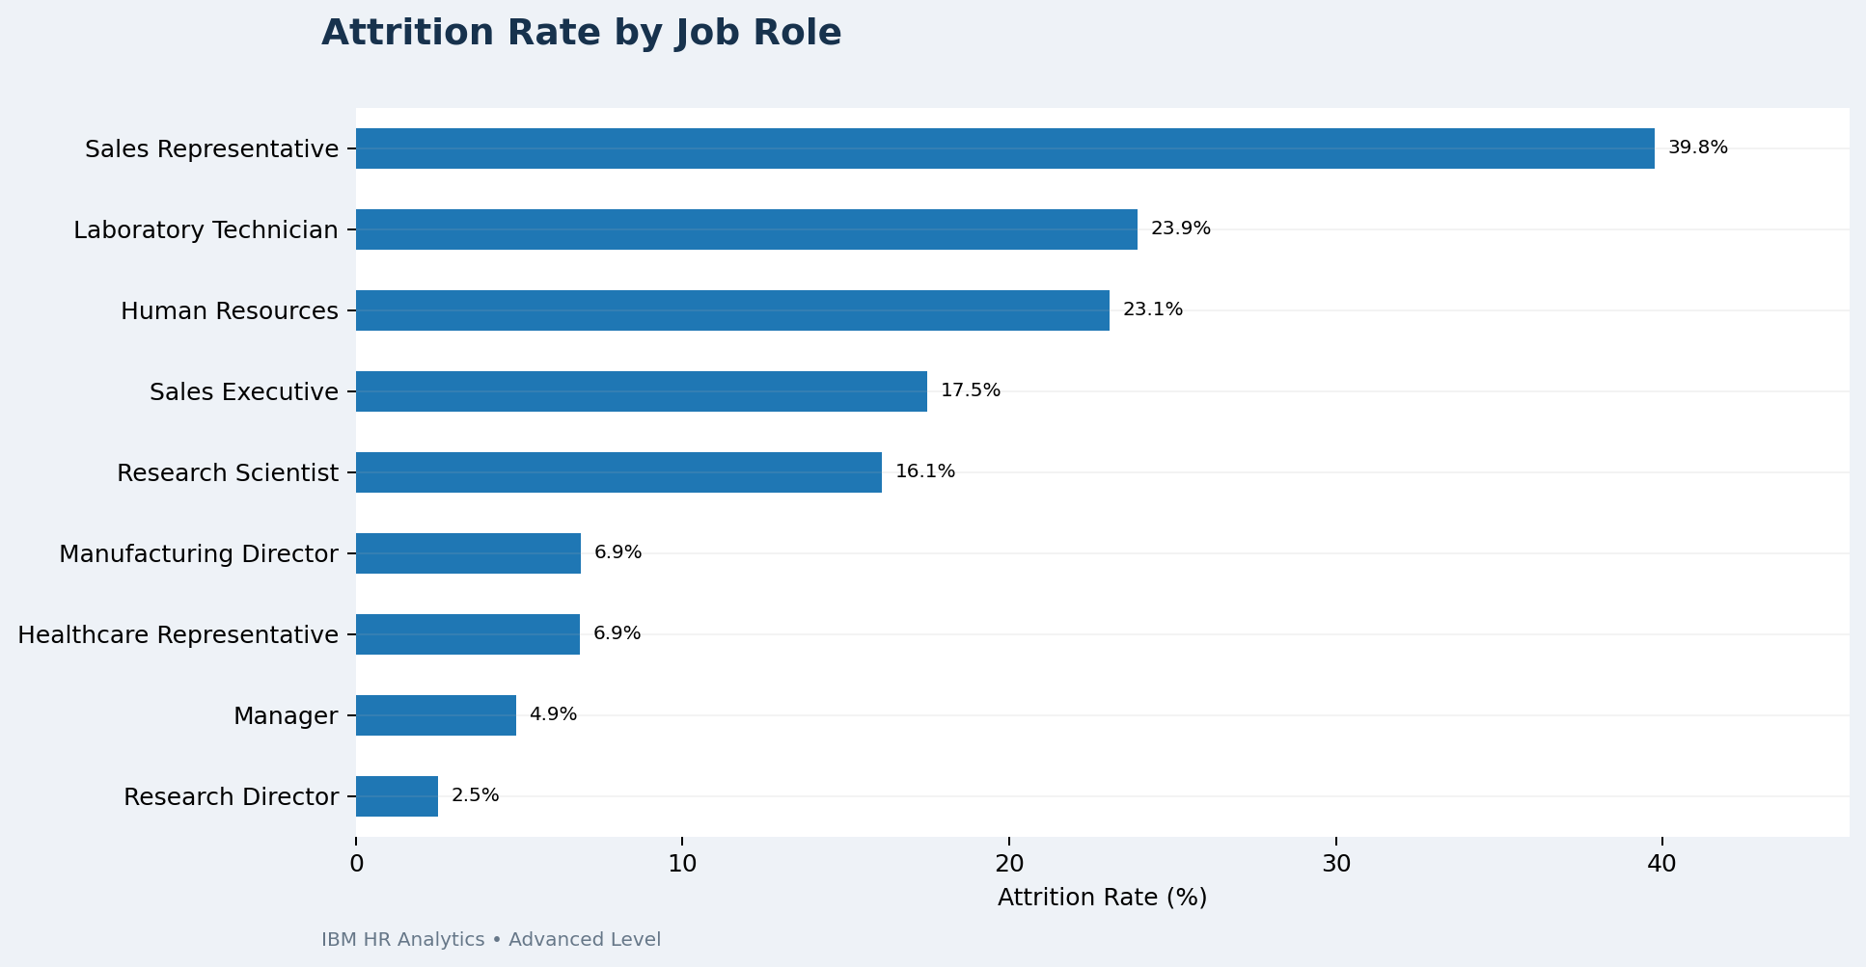
ADVANCED – ATTRITION BY JOB ROLE
Sales Representatives show the highest job-role attrition.
HR decision use
Helps identify workforce segments for retention analysis.
28

Slide 30
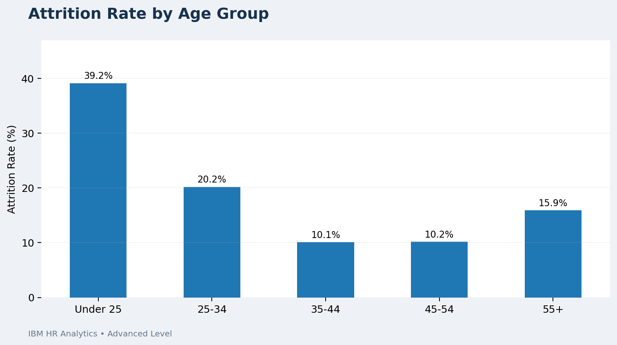
ADVANCED – ATTRITION BY AGE GROUP
Younger employees show higher attrition in the dataset.
HR decision use
Helps identify workforce segments for retention analysis.
29

Slide 31
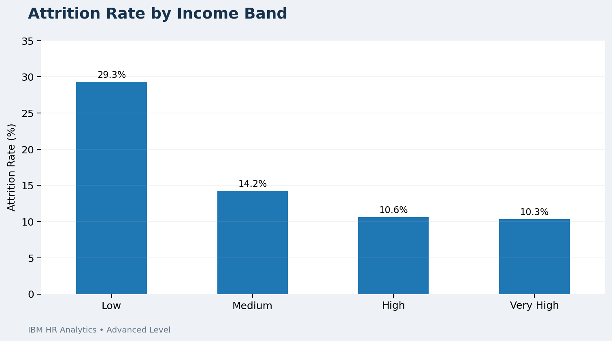
ADVANCED – ATTRITION BY INCOME BAND
Compares attrition across income groups.
HR decision use
Helps identify workforce segments for retention analysis.
30

Slide 32
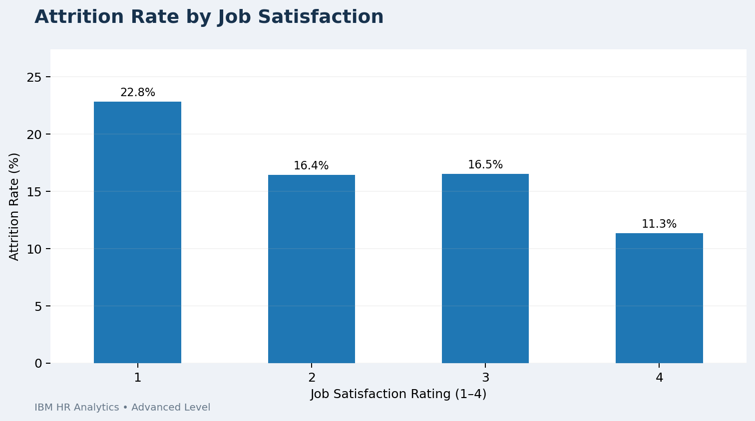
ADVANCED – ATTRITION BY JOB SATISFACTION
Shows how attrition varies by satisfaction rating.
HR decision use
Helps identify workforce segments for retention analysis.
31

Slide 33
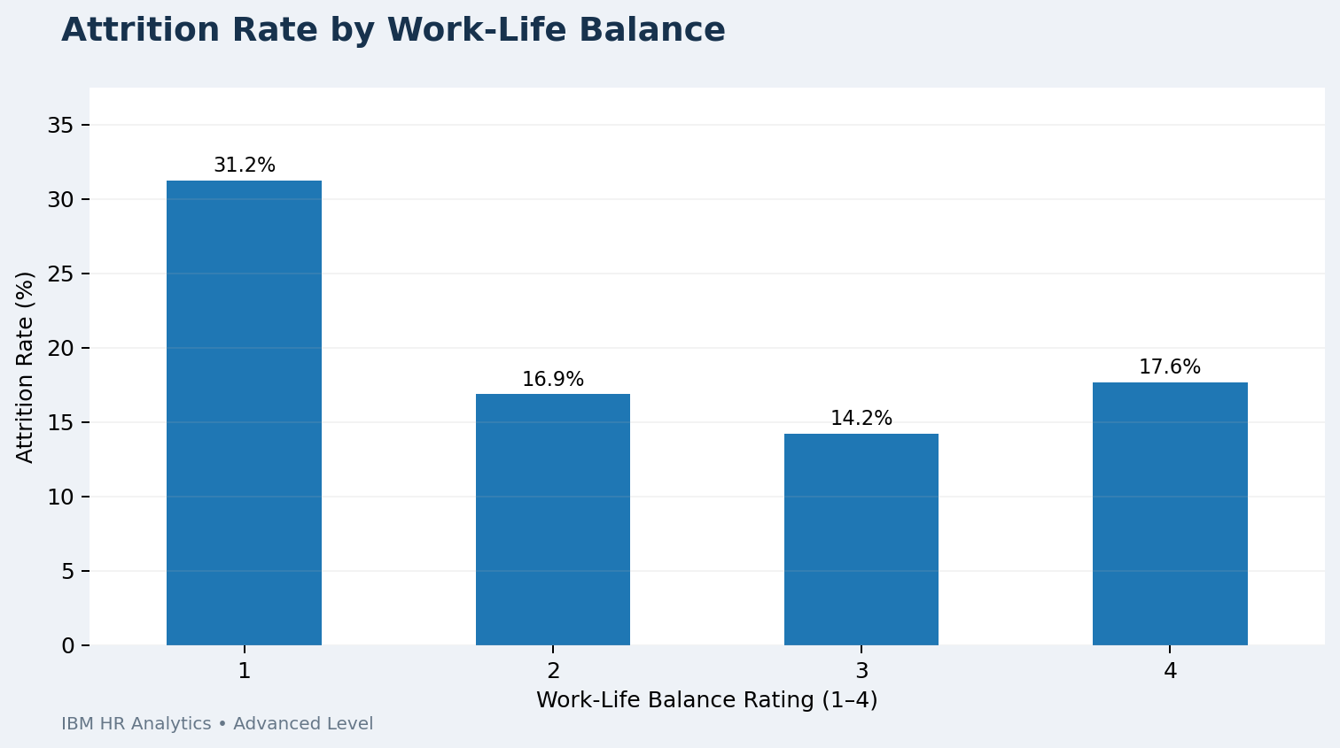
ADVANCED – ATTRITION BY WORK-LIFE BALANCE
Compares attrition across work-life balance ratings.
HR decision use
Helps identify workforce segments for retention analysis.
32

Slide 34
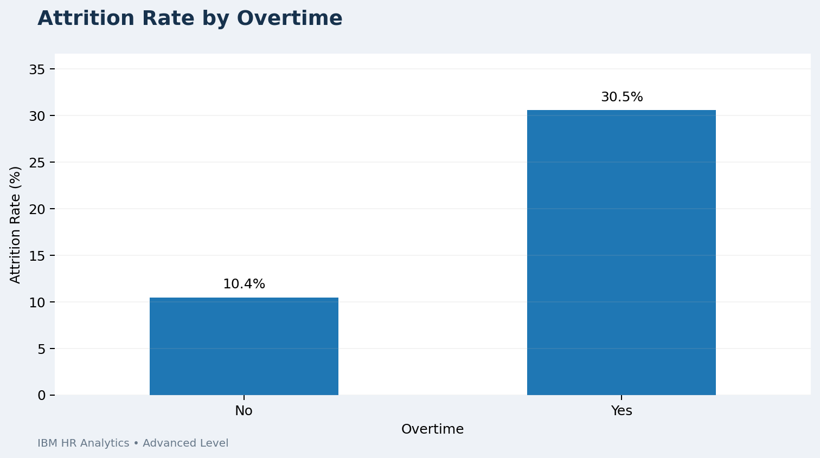
ADVANCED – ATTRITION BY OVERTIME
Shows higher attrition among employees working overtime.
HR decision use
Helps identify workforce segments for retention analysis.
33

Slide 35
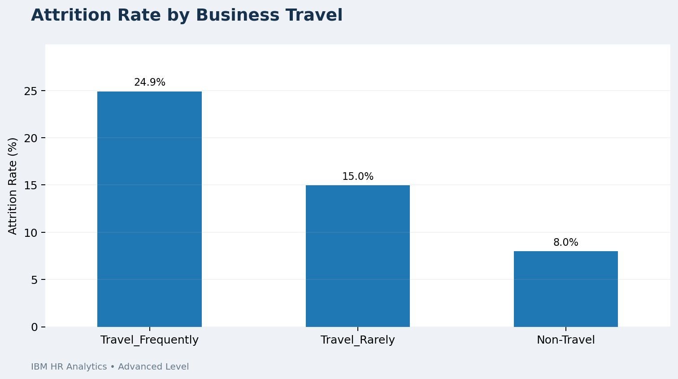
ADVANCED – ATTRITION BY BUSINESS TRAVEL
Compares attrition across travel categories.
HR decision use
Helps identify workforce segments for retention analysis.
34

Slide 36
ADVANCED – EXECUTIVE DASHBOARD
• KPI cards for workforce monitoring
• Filters: Department, Job Role, Gender, Age Group
• Filters: Overtime and Business Travel
• Department → Job Role drill-down prototype
• Executive risk signals and decision-oriented recommendations
35

Slide 37
ADVANCED – KEY HR INSIGHTS
• Sales attrition: 20.63%
• Sales Representatives: 39.76%
• Under 25: 39.18%
• Overtime: 30.53%
• Low income band: 29.27%
• Frequent travel: 24.91%
• Low satisfaction and poor work-life balance are additional warning signals
36

Slide 38
ADVANCED – RECOMMENDATIONS
• Prioritize retention programs for high-risk job roles
• Review overtime workload and staffing
• Strengthen mentoring and career development for younger employees
• Review compensation progression for lower-income groups
• Improve work-life balance and employee support
• Evaluate the burden of frequent business travel
• Use dashboard monitoring for ongoing HR decisions
37

Slide 39
OVERALL SKILLS GAINED
• Beginner: data cleaning, KPIs, basic charts and dashboard design
• Intermediate: exploratory analysis, customer/revenue analytics and profitability insights
• Advanced: HR analytics, executive KPIs, interactive filtering, drill-down and storytelling
• Across all levels: data preparation → visualization → interpretation → recommendation
• Prepared reports, dashboards and 3-minute presentation videos for each level
38

Slide 40
CONCLUSION
The three levels demonstrate a progressive Data Analytics workflow.
Beginner established the fundamentals of cleaning, KPI creation, visualization and dashboards. Intermediate expanded the analysis into customers, products, regions, segments, revenue and profitability. Advanced applied the same analytical process to HR attrition and transformed the results into an executive decision-support dashboard.
Overall, the projects developed practical skills in data preparation, visualization, dashboard design, business insight generation and decision-oriented storytelling.
39

Slide 41
THANK YOU
Thank you
Data Analytics Internship
Beginner • Intermediate • Advanced
40

