Slide 1


AI-Driven Voice Assistant For Student Study Guidance
G.Sneha-411721205046
Tara Mrithula.R -411721205051
Guided by,
Mrs.B.Latha, Associate Professor ,IT

Slide 2
ABSTRACT
This project introduces an AI-driven voice assistant designed to address the challenges students face, such as time management, lack of motivation, and focus. The system integrates study management, emotion recognition, and motivational techniques to create a personalized learning experience. By leveraging cognitive strategies like the Pomodoro technique and advanced AI models for sentiment analysis and task prioritization, this assistant ensures stress-free, efficient learning.
STAYING FOCUSED
LACK OF MOTIVATION
TIME MANAGEMENT &
PRODUCTIVITY

Slide 3
INTRODUCTION
Interact
Enable voice-based interaction using NLP and speech recognition
Organize
An AI voice assistant providing study management, academic support, and motivation, ensuring personalized, stress-free, and efficient learning for
Offer personalized study schedules, reminders, and time management strategies tailored to individual needs.
Assist
Provide instant solutions, explanations, and resource recommendations powered by AI for academic queries.
Motivate
Detect emotions and deliver motivational support, stress management techniques, and positive reinforcement.

Slide 4
LITERATURE REVIEW
Author(s) & Year | Title | Summary | Advantages | Disadvantages | How Our Solution Solves It
D. K. Yadlapally et al., 2023 | AI Voice Assistants for Learning | Explores AI-powered voice assistants in education. | Personalized learning, NLP-based AI | Lacks emotion detection, No security discussion | Uses emotion recognition & federated learning
J. Gowthamy et al., 2023 | Enhanced AI Voice Assistance | Improves AI voice interaction using ML & NLP. | Better speech recognition, Deep learning integration | Needs high computational resources, Large datasets | Uses lightweight AI & on-device processing
M. Murtaza et al., 2022 | AI-Based Personalized E-Learning | Explores AI for adaptive e-learning. | Adaptive models, Remote education support | Real-time adaptability issues, AI-driven grading concerns | Real-time learning updates, Task prioritization
T. Zobel et al., 2023 | Smart Learning Assistant for MOOCs | AI assistant providing real-time tutoring. | Enhances online learning interactivity | Needs large datasets, Struggles with complex queries | Optimized small dataset learning, NLP fine-tuning
D. K. Yadlapally, B. Vasireddy, M. Marimganti, T. Chowdary, C. Karthikeyan and T. Vignesh, "A Review on the Potential of AI Voice Assistants for Personalized and Adaptive Learning in Education," 2023 7th International Conference on Computing Methodologies and Communication (ICCMC), Erode, India, 2023
This paper explores the application of AI-powered voice assistants in education. It discusses how these assistants can personalize learning experiences by adapting to student needs. It reviews various AI technologies such as Natural Language Processing (NLP), machine learning, and sentiment analysis to improve engagement and understanding.
Advantages:
Comprehensive analysis of AI-driven voice assistants.
Emphasizes personalized learning methodologies.
Examines real-world case studies and applications.
Disadvantages:
Lacks Emotion detection and motivation factors.
Does not deeply discuss security risks in AI-based learning.
J. Gowthamy, A. Senthilselvi, A. Kumar, S. Aakash and G. Sreedhar, "Enhanced AI Voice Assistance using Machine Learning and NLP," 2023 Third International Conference on Smart Technologies, Communication and Robotics (STCR), Sathyamangalam, India, 2023
This paper presents an advanced AI voice assistant model that leverages NLP and machine learning techniques for better human-computer interaction. It focuses on improving speech recognition accuracy and response relevance through deep learning models.
Advantages:
Enhances speech recognition precision.
Integrates state-of-the-art NLP techniques.
Evaluates different machine learning models to optimize performance.
Disadvantages:
Requires high computational resources for real-time processing.
Depends on large, high-quality datasets for effective learning.

Slide 5
LITERATURE REVIEW
Author(s) & Year | Title | Summary | Advantages | Disadvantages | How Our Solution Solves It
QIU BIN et al., 2023 | AI-Powered Recommendation Systems | Reviews AI-based recommendation techniques. | Personalized learning, AI-enhanced engagement | Privacy concerns, High processing needs | Uses federated learning & efficient AI models
R. Raman et al., 2023 | Human Voice AI in Education | Explores AI-powered tutors & voice-based learning. | Better engagement, AI-driven voice models | Limited real-world examples, AI response inconsistencies | Improved speech-to-text, Adaptive AI models
G. K. Michelon et al., 2023 | AI-Powered Virtual Assistants | Focuses on hands-free AI assistants. | Accessible for visually impaired, Hands-free interaction | Struggles with accents, Needs internet access | Accent-adaptive AI, Offline processing
U. Mittal et al., 2024 | Generative AI for Education | Examines AI-generated educational content. | Personalized content, AI-based tutoring | Bias issues, Content regulation difficulties | Human-in-the-loop verification, AI bias correction
D. K. Yadlapally, B. Vasireddy, M. Marimganti, T. Chowdary, C. Karthikeyan and T. Vignesh, "A Review on the Potential of AI Voice Assistants for Personalized and Adaptive Learning in Education," 2023 7th International Conference on Computing Methodologies and Communication (ICCMC), Erode, India, 2023
This paper explores the application of AI-powered voice assistants in education. It discusses how these assistants can personalize learning experiences by adapting to student needs. It reviews various AI technologies such as Natural Language Processing (NLP), machine learning, and sentiment analysis to improve engagement and understanding.
Advantages:
Comprehensive analysis of AI-driven voice assistants.
Emphasizes personalized learning methodologies.
Examines real-world case studies and applications.
Disadvantages:
Lacks Emotion detection and motivation factors.
Does not deeply discuss security risks in AI-based learning.
J. Gowthamy, A. Senthilselvi, A. Kumar, S. Aakash and G. Sreedhar, "Enhanced AI Voice Assistance using Machine Learning and NLP," 2023 Third International Conference on Smart Technologies, Communication and Robotics (STCR), Sathyamangalam, India, 2023
This paper presents an advanced AI voice assistant model that leverages NLP and machine learning techniques for better human-computer interaction. It focuses on improving speech recognition accuracy and response relevance through deep learning models.
Advantages:
Enhances speech recognition precision.
Integrates state-of-the-art NLP techniques.
Evaluates different machine learning models to optimize performance.
Disadvantages:
Requires high computational resources for real-time processing.
Depends on large, high-quality datasets for effective learning.

Slide 6
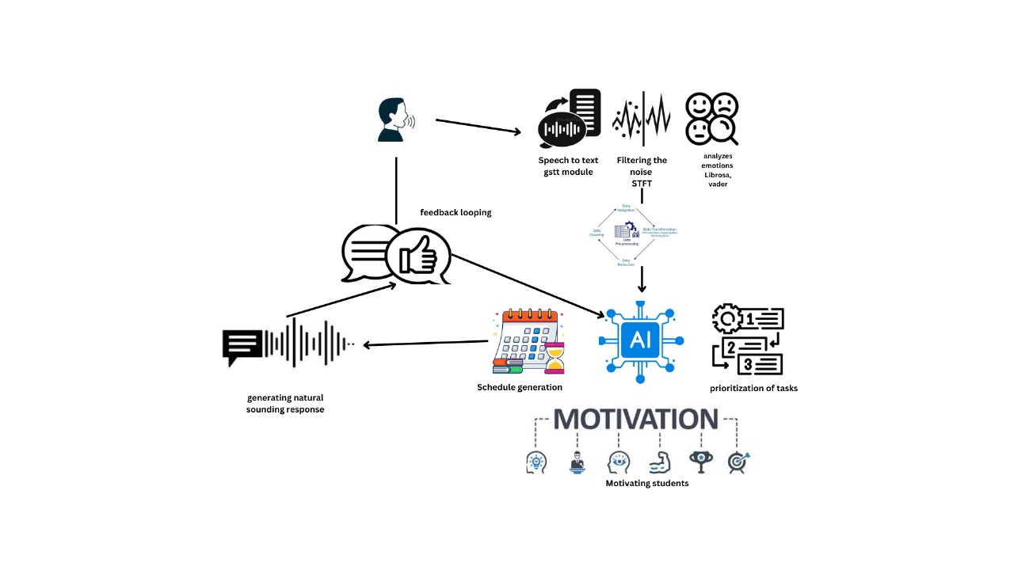
BLOCK DIAGRAM

Slide 7
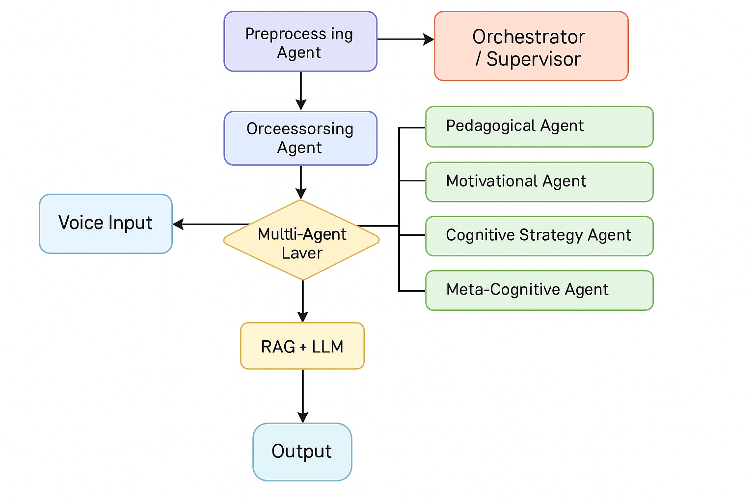
FLOWCHART
Fine tuning agent

Slide 8
EXISTING SYSTEM
Existing Works in AI-Based Learning Assistants
Integration of AI and NLP
A review of voice assistants like Alexa and Siri shows potential for educational use. However, these systems are not specifically designed for academic guidance.
Federated Learning Applications
Papers emphasize federated learning for personalized systems but lack real-time adaptability.
Collaborative and Content-Based Filtering for Recommendations
These systems are used in e-learning but often fail to incorporate emotional or motivational aspects critical for students.
Generative AI for Personalized Learning
Generative AI has improved resource generation but struggles with tailoring ongoing support to real-time student needs.
Smart Learning Assistants
MOOC platforms have introduced basic assistants, but they are limited to predefined queries without emotional intelligence or motivational support.
Disadvantages of the Existing System
Lack of Emotional Intelligence
Current systems fail to detect or respond to student emotions, such as stress or lack of motivation.
Limited Real-Time Interaction
Existing tools are static and cannot dynamically
adapt to the student’s evolving progress or challenges.
No Personalized Motivation
Current solutions do not offer encouragement or reinforcement based on individual student performance.
One-Size-Fits-All Approach
Many systems adopt generic strategies, ignoring unique learning styles and needs.
Inefficient Task Management
Existing systems lack advanced techniques like the Pomodoro method or task prioritization matrices to improve productivity.

Slide 9
PROPOSED SYSTEM
New Works Included in the Project
AI-Driven Voice Assistance
Implementing an advanced voice assistant for personalized learning.
Emotion Recognition System
Using AI models to detect student emotions and provide suitable responses.
Task Prioritization and Scheduling
Integrating AI-based scheduling systems such as the Pomodoro Technique.
Speech-to-Text and Text-to-Speech Integration
Enhancing accessibility through natural language processing.
Real-Time Adaptive Learning
AI-driven adaptation of study materials based on user progress.
Advantages of the Proposed System
Personalized Learning Experience
The system adapts content and recommendations based on individual learning patterns.
Improved Time Management
AI-driven scheduling techniques help students plan their study sessions efficiently.
Enhanced User Engagement
Emotion recognition and interactive responses keep students motivated.
Accessibility Features
Voice assistance, speech-to-text, and text-to-speech make learning more inclusive.
Real-Time Progress Tracking
Students receive instant feedback and performance analysis for continuous improvement.

Slide 10
METHODOLOGY
System Workflow and High-Level Architecture
1. Voice Input
- Student provides voice input (query, emotion, command)
- Captured using mic and sent to STT (Whisper AI)
2. Preprocessing Agent
- Converts speech to text
- Extracts emotional cues (Librosa, MFCC)
- Analyzes tone + keywords using NLP (spaCy, RoBERTa)
3. Orchestrator (Supervisor Agent)
- Receives structured input
- Assesses learner state
- Routes to appropriate agent(s)

Slide 11
METHODOLOGY
4. Multi-Agent System
- Pedagogical Agent: RAG-based explanations
- Motivational Agent: Encouragement based on emotion
- Cognitive Strategy Agent: Pomodoro, prioritization
- Meta-Cognitive Agent: Self-monitoring tactics
- Engagement Agent: Re-engagement logic
5. RAG + Teacher Model
- Retrieves textbook data + diagrams
- LLM creates teacher-style response
6. Output Response Layer
- Converts to speech (GTTS / Tacotron)
- Visual + audio sent to student interface
7. Feedback Loop
- Tracks feedback, updates learner profile

Slide 12
METHODOLOGY
AI Engine – Core Functionalities
Adaptive Study Schedule Generator (CBA‑Driven)
Dynamic Scheduling: Creates personalized study plans based on each student’s Cognitive Load Index, Error Frequency, and time availability.
Iterative Refinement: Instead of a generic reinforcement learning loop, the system continuously re-checks CBA metrics (e.g., engagement, fatigue) to adjust task order, break intervals, and difficulty levels.
Fatigue & Confidence Adjustments: If a student’s Fatigue Index is high, the system slots in lighter or motivational tasks. If the Confidence Score is low, it schedules reviews of foundational material.

Slide 13
METHODOLOGY
AI Engine – Core Functionalities
CBA‑Based Task Prioritization
Behavioral Insights: Replaces the simple “urgent vs. important” matrix with CBA metrics. For example, if Conceptual Gap Probability is high on certain tasks, the system flags them as high priority—even if they aren’t “urgent” in a classical sense.
Personalized Path: Tasks that align with a student’s Growth Mindset Index (GMI) or show potential for big learning gains are given top priority, ensuring each session tackles the most impactful areas first.
Proactive Intervention: Detects patterns like repeated errors or slipping confidence to re-prioritize tasks immediately and prevent burnout.

Slide 14
METHODOLOGY
Output and Feedback Mechanism
Key Features:
Natural-Sounding Responses:
Converts AI-generated text into speech using WaveNet, Tacotron, or GTTS.
Ensures responses are clear and engaging.
Motivational Prompts:
Provides task-based encouragement and emotional support.
Dynamically adjusts suggestions based on progress.
Feedback Loop:
Collects user feedback to refine the study schedules, recommendations, and motivational prompts.
Uses reinforcement learning to improve system performance over time.
Privacy Preservation:
Implements Federated Learning to keep student data secure while enabling personalized learning.

Slide 15
System Modules – Multi-Agent Architecture (Part 1)
🎙️ Voice Capture Module
Captures real-time voice, filters noise
🔍 Preprocessing Agent
Speech-to-text, emotion + keyword extraction
🧭 Orchestrator (Supervisor)
Routes query to agents based on learner state
📘 Pedagogical Agent
RAG-based content delivery
💡 Motivational Agent
Provides real-time encouragement

Slide 16
System Modules – Multi-Agent Architecture (Part 1)
🧠 Cognitive Agent
Applies Pomodoro, adjusts based on fatigue
📈 Meta-Cognitive Agent
Offers self-learning strategies
🧩 Engagement Agent
Detects distraction, keeps learner focused
📚 RAG Module
Retrieves textbook chunks + diagrams
👩‍🏫 Teacher LLM
Generates engaging explanations

Slide 17
System Modules – Multi-Agent Architecture (Part 3)
🔊 TTS Output Module
Converts response to speech
📦 Student Progress Tracker
Logs interaction, emotion, performance
☁️ GCP Deployment Stack
Compute Engine / Cloud Run / Cloud SQL / Firebase

Slide 18
ALGORITHM/ TECHNIQUES/ TOOLS USED
Algorithms and Techniques Used
Natural Language Processing (NLP)
Used for understanding and processing user voice commands.
Implements models like BERT and SpaCy for text analysis.
Sentiment and Emotion Analysis
Uses VADER (Valence Aware Dictionary and sEntiment Reasoner) for text-based sentiment detection.
LIBROSA is used for audio-based emotion recognition.
Task Prioritization – Eisenhower Matrix
Categorizes study tasks into urgent vs. important.
Helps in managing workload efficiently.
Speech-to-Text and Text-to-Speech Conversion
GTTS (Google Text-to-Speech) for voice output.
Whisper AI for converting spoken language into text.
Pomodoro Technique for Study Management
Implements 25-minute focused study sessions with short breaks.
Increases concentration and reduces burnout.
Tools Used
Programming Language: Python (FastAPI, TensorFlow, NLTK)
Speech Processing Libraries: GTTS, PyDub, Whisper AI
Machine Learning Models: TensorFlow, PyTorch for AI-based predictions
Backend Development: FastAPI for server-side logic and API integration
Frontend Frameworks: HTML, CSS, JavaScript for interactive UI

Slide 19
HARDWARE / SOFTWARE REQUIREMENTS
Hardware Requirements
Processor: Intel Core i5 or higher / AMD Ryzen 5 or higher
RAM: Minimum 8GB (Recommended 16GB for AI processing)
Storage: Minimum 256GB SSD (Recommended 512GB for faster data access)
Microphone & Speaker: High-quality input/output devices for voice interaction
GPU (Optional): NVIDIA RTX 3060 or higher for AI model training
Software Requirements
Programming Languages: Python, JavaScript (Node.js)
AI/ML Frameworks: TensorFlow, PyTorch, Scikit-Learn, Hugging Face Transformers
Speech Processing: Google Speech-to-Text, Whisper, GTTS, WaveNet, LIBROSA
NLP Libraries: spaCy, NLTK, VADER Sentiment Analysis
Backend & Database: FastAPI, Flask, MongoDB, PostgreSQL, Redis
Cloud & Deployment: Google Cloud, AWS, Firebase, Docker
Frontend: React, Vue.js, Flutter, Electron.js

Slide 20
CONCLUSION
The AI-driven voice assistant enhances personalized learning by integrating NLP, emotion recognition, and AI-based task management. It offers real-time feedback, motivation, and adaptive recommendations through speech-to-text, text-to-speech, and sentiment analysis. This system bridges traditional education and AI-driven learning, boosting student engagement and productivity. Future improvements could include multilingual support, deeper personalization, and smart device integration, making it an even more effective tool for modern learning.

Slide 21
REFERENCES
Z. Chen, J. Du, C. Jiang, Y. Lu and Z. Han, "Communication-Efficient Personalized Federated Learning for Green Communications in IoMT," ICC 2024 - IEEE International Conference on Communications, Denver, CO, USA, 2024
A. Tlili, S. Salha, H. Wang, R. Huang, J. Rudolph and R. Weidong, "Does personalization really help in improving learning achievement? A meta-analysis," 2024 IEEE International Conference on Advanced Learning Technologies (ICALT), Nicosia, North Cyprus, Cyprus, 2024
A. A. Krivetskaya et al., "Intraoperative assessment of blood flow during esophageal resection using fluorescence diagnostics and diffuse scattering spectroscopy," 2024 International Conference Laser Optics (ICLO), Saint Petersburg, Russian Federation, 2024

Slide 22
THANK YOU

Slide 23
System Modules – Multi-Agent Architecture (Part 3)
🔊 TTS Output Module
Converts response to speech
📦 Student Progress Tracker
Logs interaction, emotion, performance
☁️ GCP Deployment Stack
Compute Engine / Cloud Run / Cloud SQL / Firebase

Slide 24
System Modules – Multi-Agent Architecture (Part 1)
🎙️ Voice Capture Module
Captures real-time voice, filters noise
🔍 Preprocessing Agent
Speech-to-text, emotion + keyword extraction
🧭 Orchestrator (Supervisor)
Routes query to agents based on learner state
📘 Pedagogical Agent
RAG-based content delivery
💡 Motivational Agent
Provides real-time encouragement

Slide 25
System Modules – Multi-Agent Architecture (Part 2)
🧠 Cognitive Agent
Applies Pomodoro, adjusts based on fatigue
📈 Meta-Cognitive Agent
Offers self-learning strategies
🧩 Engagement Agent
Detects distraction, keeps learner focused
📚 RAG Module
Retrieves textbook chunks + diagrams
👩‍🏫 Teacher LLM
Generates engaging explanations

