Slide 1
MoodSight: Automated Mental Well-being Classifier

Slide 2

Introduction
Understanding and addressing mental health concerns is crucial for individual well-being and societal health. The PRIMATE dataset plays a pivotal role by offering a curated collection of posts, titles, and annotations, allowing for the development of classification models to automatically identify and categorize mental health indicators. This dataset serves as a vital resource in advancing mental health awareness, facilitating early intervention, and providing support to those in need.

Slide 3
Mental Health and Its Impact On Society
Individual Well-being
Emotional,psychological,and social well being,affecting how individuals think,feel,and act.
Workplace productivity
Affects productivity and performance,and may struggle with concentration,motivation.
Social Relationships
Social isolation,loneliness and relationship difficulties .
Physical health
Both physical and mental health are interconnected,leads to increase in chronic diseases.
Economic Impact
Substantial healthcare costs,lost productivity,and reduced earning potential

Slide 4


OVERVIEW OF DATASET
Individual expressions of mental health, often with details about symptoms, experiences, or concerns.
Brief overviews or headings for each post, offering a glimpse into the main content.
POSTS
POST TITLE
Labels indicating the presence or absence of specific mental health indicators like depression or anxiety symptoms, crucial for training classification models
ANNOTATIONS
POST TEXT
Individual narratives describing emotions, experiences, challenges, or requests for support related to mental health.

Slide 5
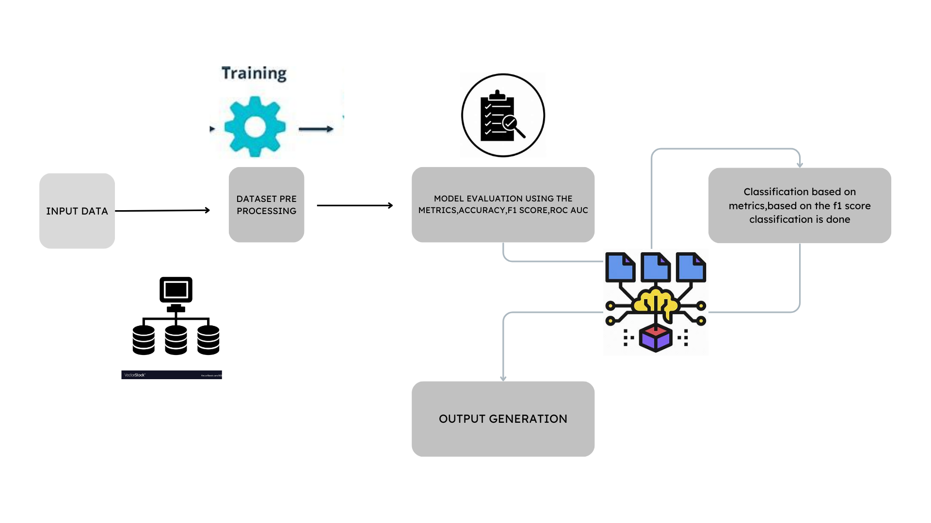
ARCHITECTURE

Slide 6
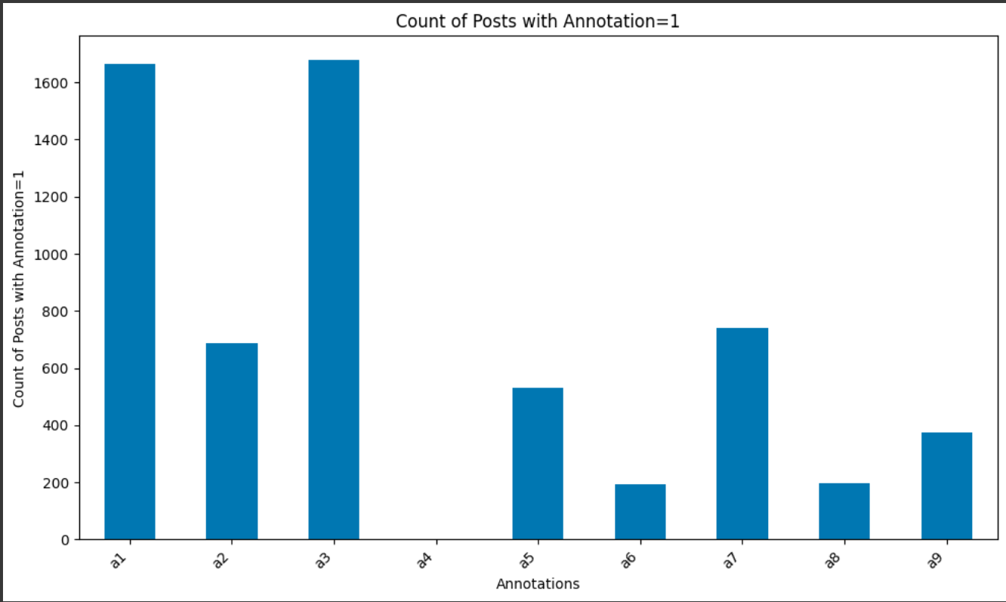

ANALYSIS OF MENTAL HEALTH INDICATOR
Stage 1

Slide 7
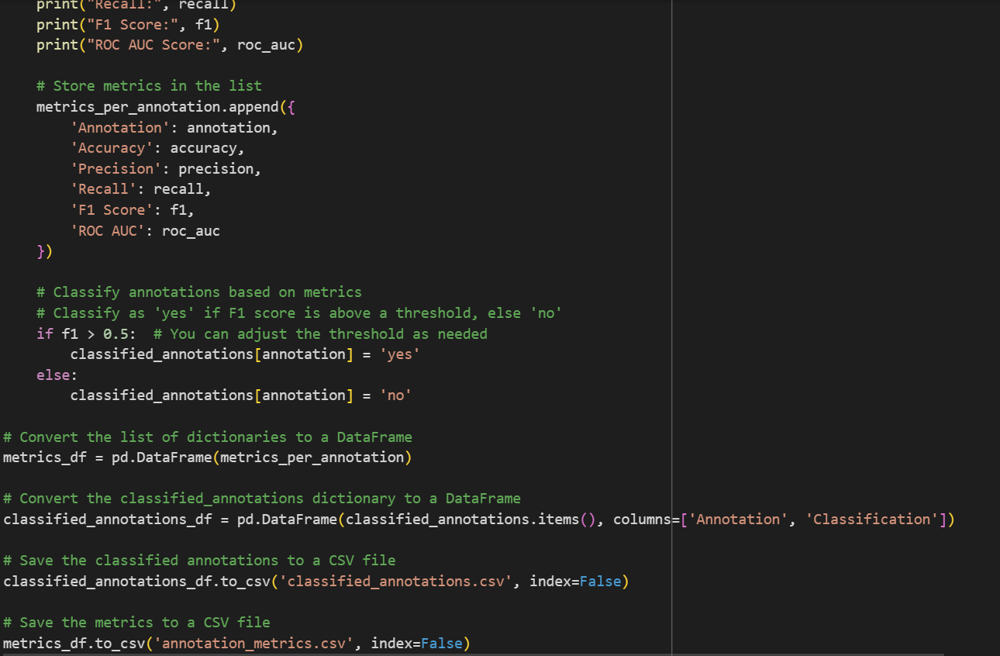
ANALYSIS OF MENTAL HEALTH INDICATOR
Stage 1

Slide 8
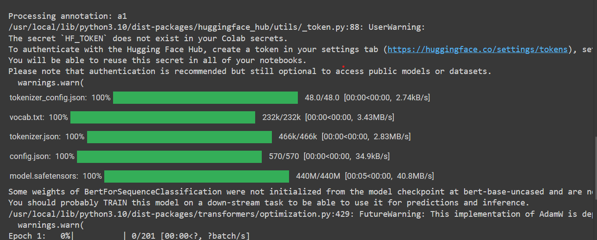

Slide 9
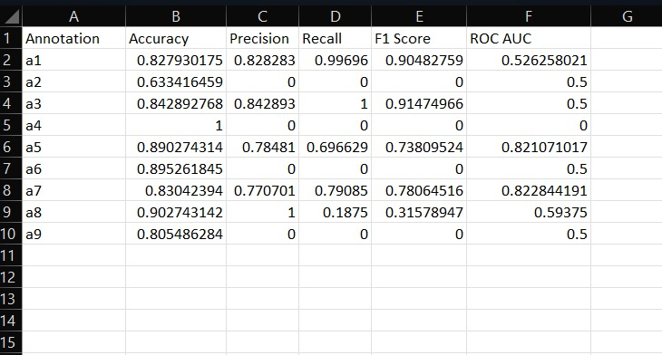
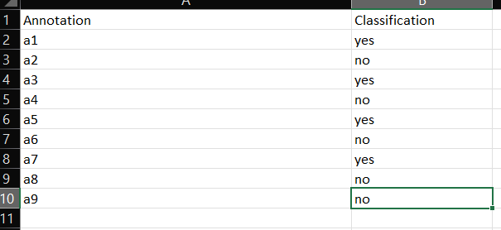
Performance metrics

Slide 10
FUTURE APPLICATIONS
Work with public health agencies and government organizations to deploy the model for monitoring population-level mental health indicators, informing policy decisions, and allocating resources effectively.
Social Media Monitoring Tools: Develop tools for analyzing social media data to identify individuals at risk of mental health issues and provide targeted interventions or resources.
Integrate the model into existing mental health apps or develop new apps focused on early detection, personalized support, and remote monitoring of mental health issues.
Collaborate with employers to integrate the model into corporate wellness programs, providing employees with access to mental health support and resources.
Partner with telehealth platforms to incorporate the model into their services, enabling remote mental health consultations, support, and intervention.

Slide 11
Conclusion
Developing an AI model for mental health prediction requires a balanced and diverse dataset,advanced feature extraction techniques, and careful model selection.Continous monitoring of the model metrics helped In improving the model precision

