Slide 1

SAT Analysis
By Tara Celesta

Slide 2

Problem Statement
Our SAT test is criticized as being a tool that creates racial disparity. This critique stems from the idea that our exam gives an unfair advantage to students who attend white-majority schools.
This project aims to identify, at the Colorado state level, the differences in participation rates and test scores of students by their race.
From this information, CollegeBoard can improve funding decisions to ensure that our test is BIPOC inclusive. Achieving this inclusivity will allow us to achieve our mission of providing a fair measurement of success for all students.

Slide 3
Procedure & Methods
What
SAT scores
SAT participation results
Highschool Students of Colorado
Where
Colorado department of Education website
When
2019 test results
How
Python to analyze data
Python and Google Sheets for graphs

Slide 4
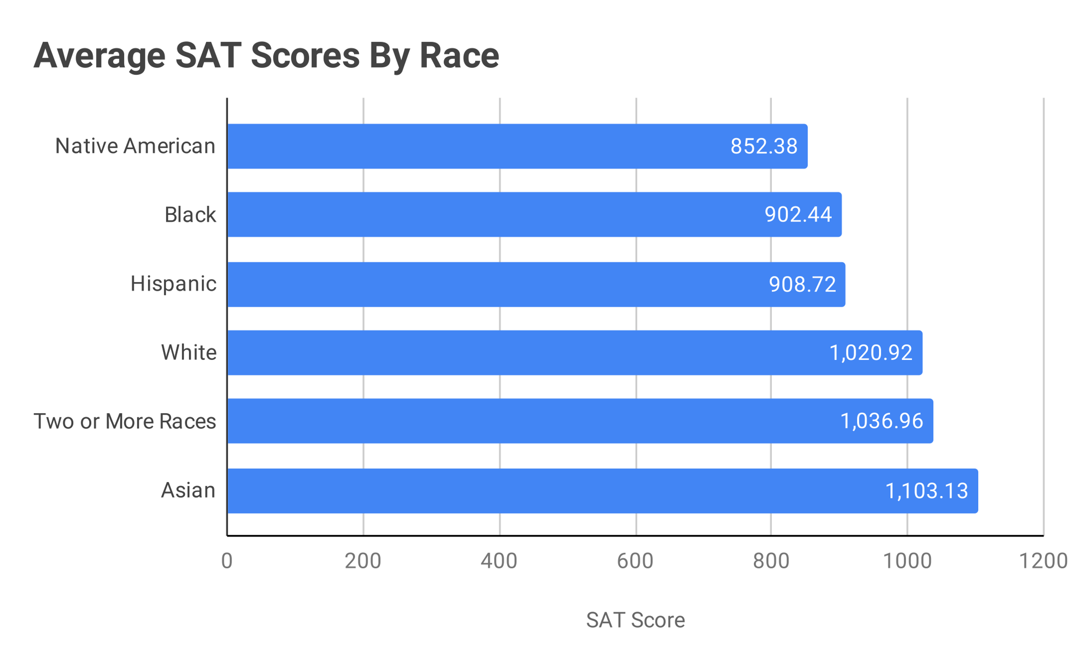
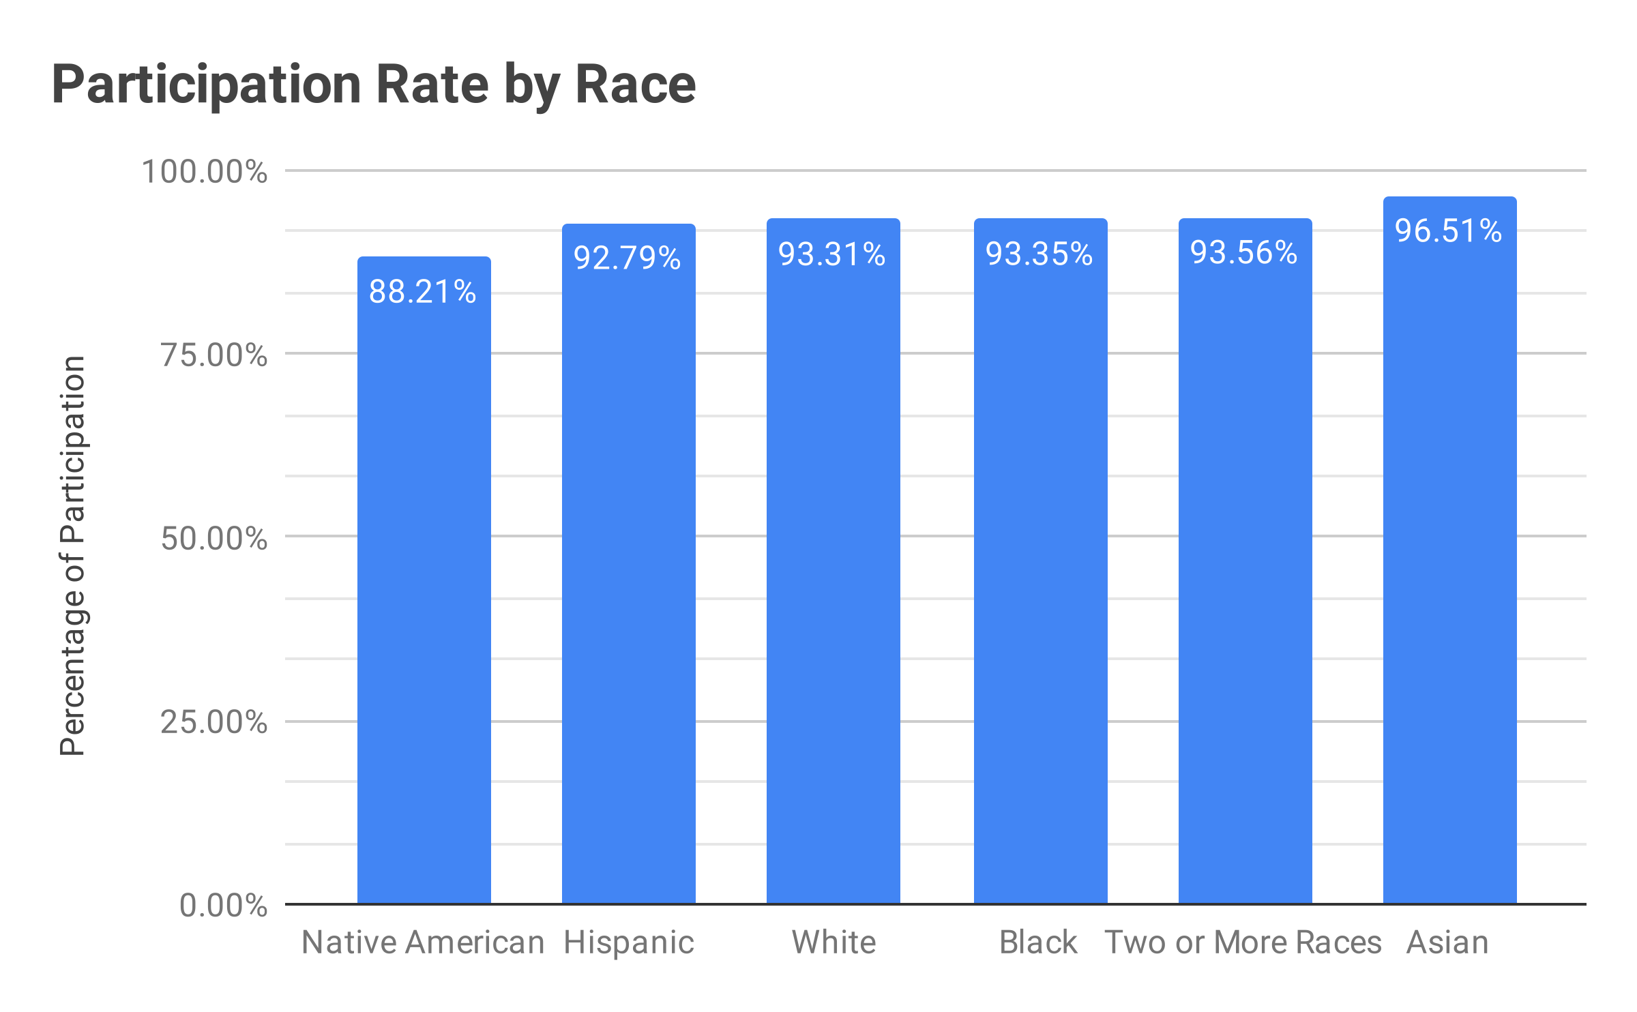
Lowest scoring students
Native American (852)
Black (902)
Hispanic (909)
Highest scoring students
White (1021)
Asian (1103)
2 or more races (1037)
Primary
Findings
SAT attendance rates were very similar by race

Slide 5

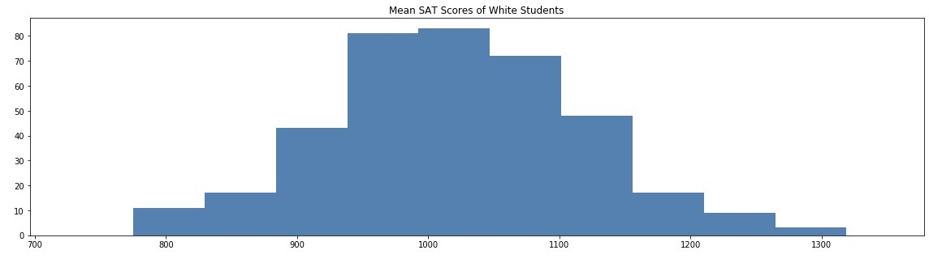
Hispanic students score 112 points less than their white peers.

Slide 6

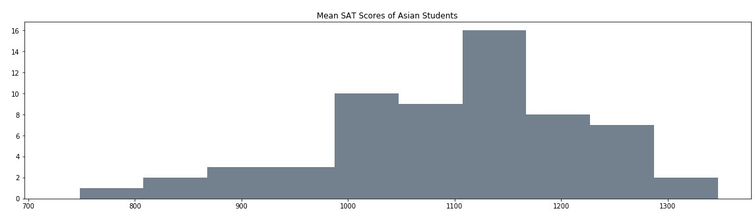
Black Student score 200 points less than their Asian Peers

Slide 7
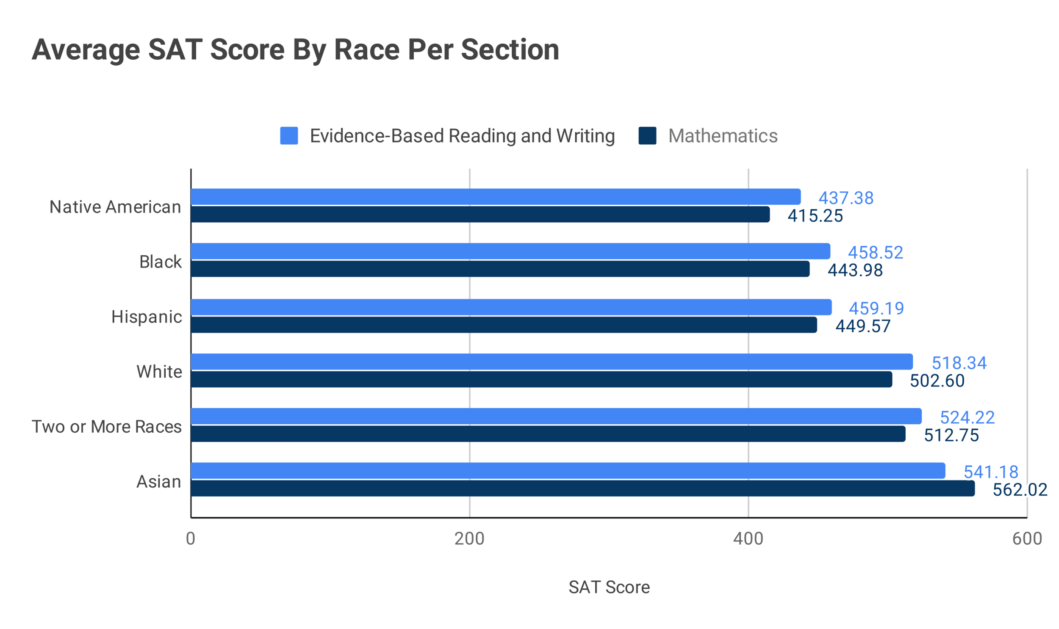
Primary Findings
Primary Findings

Slide 8
Conclusion
Next Step: More Investigation
The SAT's racial achievement gap is a reflection of the racial inequities in our society as a whole. Reconciling this gap will lead to equalizing educational opportunities and is one way to dissiminate inequality.
Now that we know SAT scores hold a racial bias, we must hypothesize the reasons behind this.
Once we discover the “why’s” behind this disparity, we can create appropriate programs and allocate funding properly to help solve this problem
Possible Items to Investigate:
What makes a student test better?
Take the SAT test more than once get better scores?
What test Prep are these students using?
How are these items available to students across races?
Do wealthier students get higher SAT scores?
Is this because of tutoring costs?
Is this because of testing costs?
Do wealthier school districts get better Scores?
Gifted and Talented programs available?
A/P courses available?
Test prep classes available?
Drop out, suspension, unaddressed emotional/behavioral disorders?
Who writes the SAT tests? Are the questions biases towards more affluent students?

