Slide 1

Amstelhaege
Applying algorithms for urban planning
By Jos Feenstra, Tara Elsen and Christiaan Wewer

Slide 2
Content Layout
Case problem
Approach algorithm
Current code and datastructure

Slide 3
Case problem
Fill a residential area with 20/40/60 houses
3 types of houses --> 60%, 25%, 15%
20% water, 4 water bodies
Each house has ‘personal space’
More ‘personal space’ = x% more cash

Slide 4
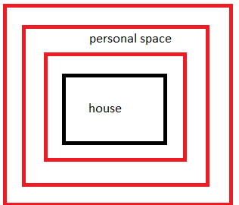
Algorithm
Depth first instead breadth first
Ring approach (personal space)
Hillclimbing: Add most worthy rings
Other?
Amount branches: a lot
~ 160*180*80*3 = 7*10^6
Pruning hoe ook alweer?
Backtracking: als most valuable ring niet kan 1 stapje terug en de 1 na most valuable ring
Kakuro (wil jos dit vertellen?)

Slide 5
Visualisation
Mathplotlib
Rhino
Grasshopper

Slide 6
Current code
I

