Slide 1
Enabling Flexible Network FPGA Clusters in a Heterogeneous Cloud Data Center
Naif Tarafdar, Thomas Lin, Eric Fukuda,
Hadi Bannazadeh, Alberto Leon-Garcia, Paul Chow
University of Toronto

Slide 2
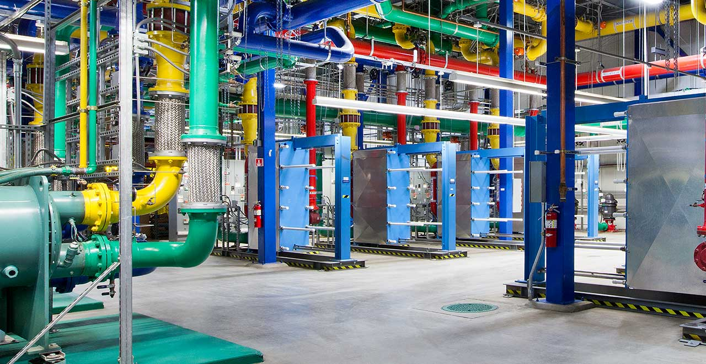
Cloudy with a chance of FPGAs?
Big data needs more compute power: How about FPGAs in datacenters?
Datacenters are approximately 200 billion dollar industry
Datacenter applications are large
No large scale datacenter multi-FPGA fabric deployed until 2014

Slide 3

Cloudy with a Chance of FPGAs?
Microsoft Catapult
1632 Servers
Bing search engine
10 % more power, 95 % more throughput
Intel acquisition of Altera in December 2015
More than just a chance

Slide 4
Large Clusters Difficult To Manage
Large resources of clusters difficult to manage
Expensive
Solution:
Allow users framework to create their own clusters from a pool of available resources

Slide 5
Related Work
Byma et al:
FPGA broke into partial FPGAs
Multiple users share portion of FPGA

Slide 6
Related Work
Byma et al:
FPGA broke into partial FPGAs
Multiple users share portion of FPGA
IBM Supervessel:
FPGA tightly coupled with virtual machine CPU
Connected to CPU via shared memory
Network connection through CPU

Slide 7
Related Work
Byma et al:
FPGA broke into partial FPGAs
Multiple users share portion of FPGA
IBM Supervessel:
FPGA tightly coupled with Virtual Machine CPU
Connected to CPU via shared memory
Network connection through CPU
Amazon:
FPGA(s) tightly coupled with virtual machine CPU
Up to 8 FPGAs connected via high performance network link

Slide 8
Related Work
Byma et al:
FPGA broke into partial FPGAs
Multiple users share portion of FPGA
IBM Supervessel:
FPGA tightly coupled with Virtual Machine CPU
Connected to CPU via shared memory
Network connection through CPU
Amazon:
FPGA(s) tightly coupled with virtual machine CPU
Up to 8 FPGAs connected via high performance network link
IBM Hyperscale
Network connected FPGAs
Modified Openstack to accept bitstream and then returns IP address and programmed FPGA to user

Slide 9
Problems We Target
Large multi-FPGA systems
Create abstraction between FPGAs in multi-FPGA systems
Easy scalability of system

Slide 10
Problems We Target
Large multi-FPGA systems
Create abstraction between FPGAs in multi-FPGA systems
Easy scalability of system
Network capabilities
FPGA cluster directly accessible by any other network device in the datacenter

Slide 11

Overall System View
User
Input From User
FPGA Mapping File
Logical Cluster Description
FPGA Cluster Generator

Slide 12
Overall System View
User
FPGA Cluster Generator
Individual FPGA Projects
Output to VM with FPGA Tools

Slide 13
Overall System View
User
FPGA Cluster Generator
Command For Resource Allocation
Output to Cloud Manager
Commands For Connecting FPGAs to Network

Slide 14
Overall System View
Output To User
User
MAC addresses of FPGAs in Multi-FPGA Cluster
FPGA Cluster Generator

Slide 15
Baseline Infrastructure
SAVI (Smart Applications on Virtualized Infrastructure)
OpenStack (Cloud Managing Software)
Xilinx SDAccel (FPGA Hypervisor)

Slide 16
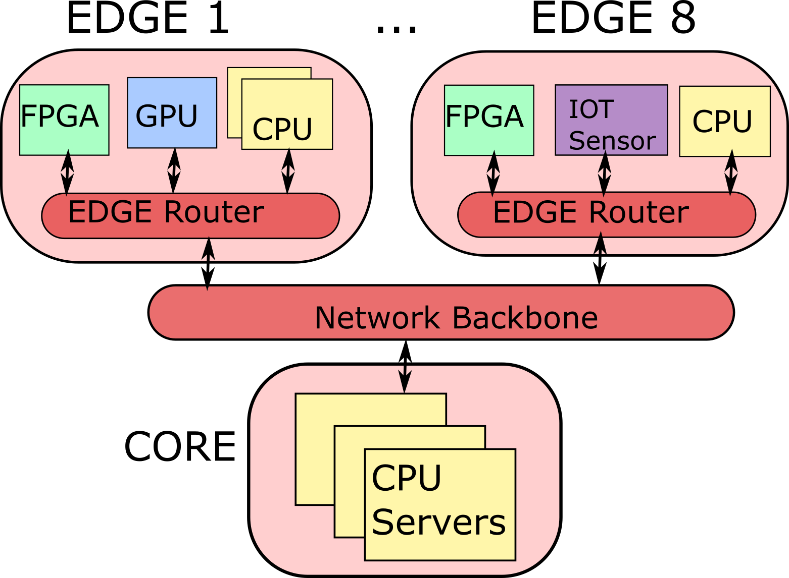
SAVI (Smart Applications on Virtualized Infrastructure)

Slide 17
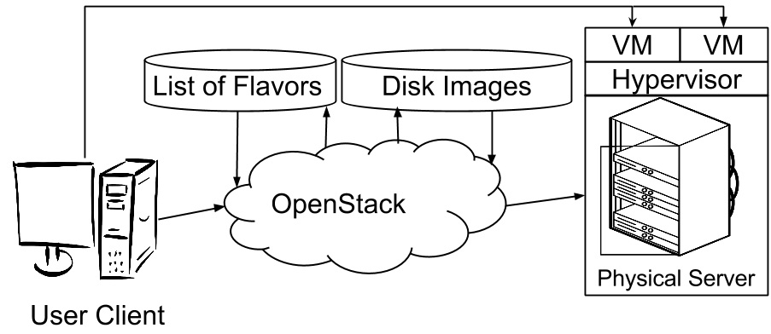
Cloud Managing Software: OpenStack

Slide 18
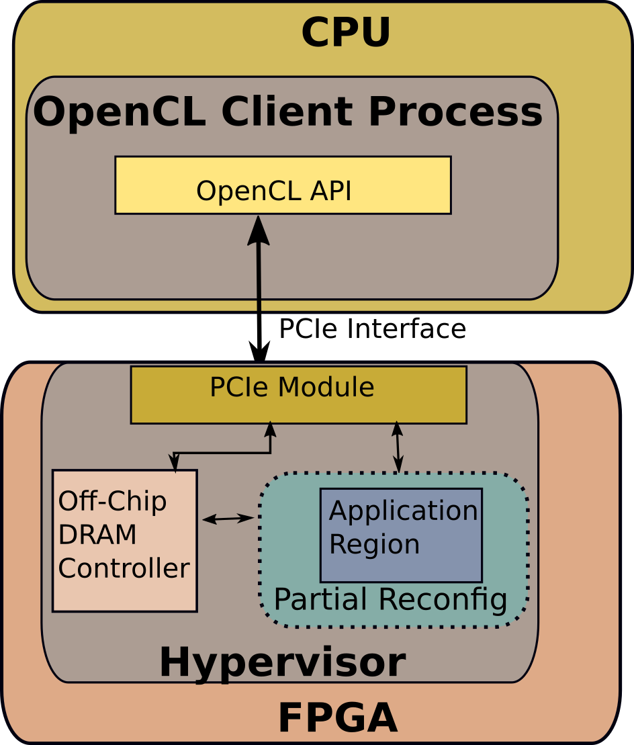
FPGA Hypervisor: Xilinx SDAccel
Abstracts physical hardware on FPGA and provides software interface for these modules
Publicly available through Xilinx
No network interface

Slide 19
Contributions
Non-network FPGA from cloud

Slide 20
Contributions
Non-network FPGA from cloud
Networking infrastructure for FPGAs to communicate in heterogeneous network
Modified FPGA hypervisor for networking support
FPGAs MAC addresses, accessible by any network device in datacenter

Slide 21
Contributions
Non-network FPGA from cloud
Networking infrastructure for FPGAs to communicate in heterogeneous network
Modified FPGA hypervisor for networking support
FPGAs MAC addresses, accessible by any network device in datacenter
FPGA cluster generator

Slide 22
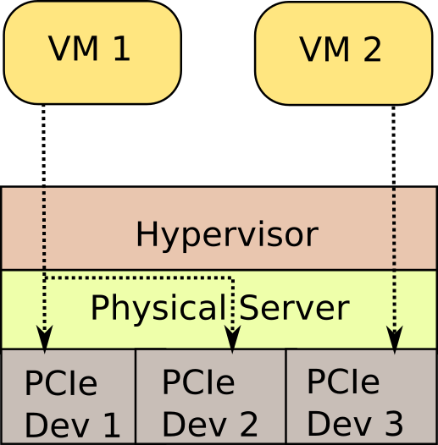
Non-network FPGA from Cloud
Deployment Flow
User develops their application on a VM without an FPGA.
Save VM snapshot
Upload VM snapshot to OpenStack
Create new VM with snapshot and FPGA

Slide 23
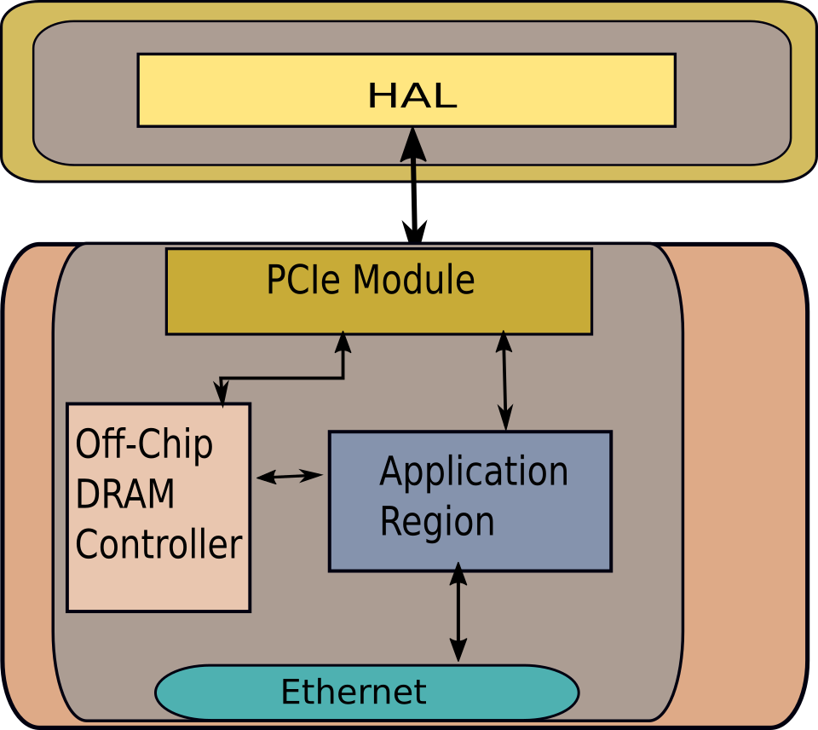
FPGA Hypervisor: Networking Hypervisor
Customized shell with:
PCIe module
Off Chip Memory controller
1 GB Ethernet
Note: No partial reconfiguration

Slide 24
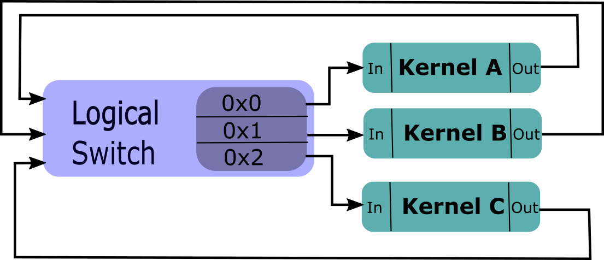
Logical Cluster Description
FPGA Mapping File
Kernel A | FPGA 1
Kernel B | FPGA 1
Kernel C | FPGA 2

Slide 25
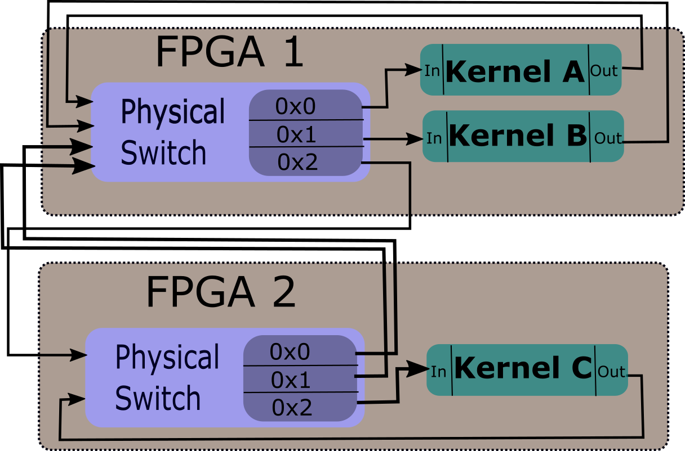
Physical Mapping

Slide 26
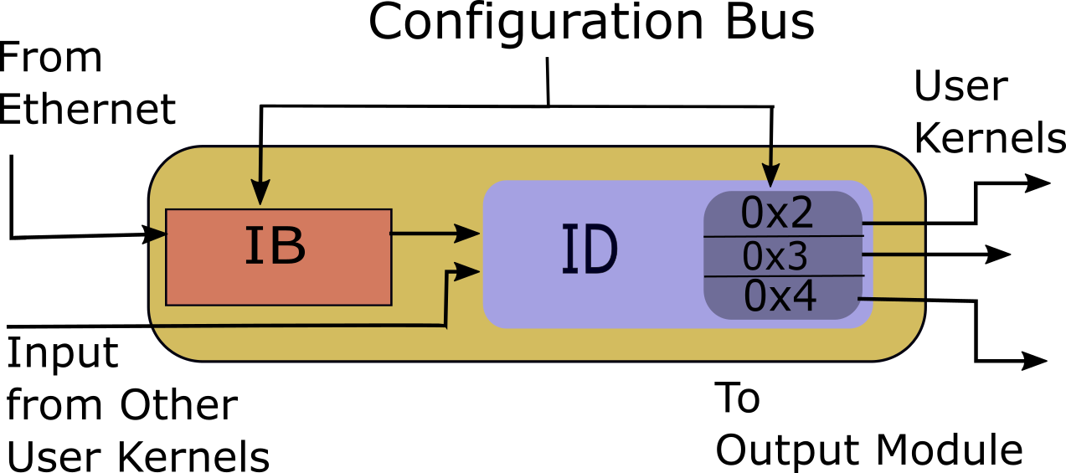
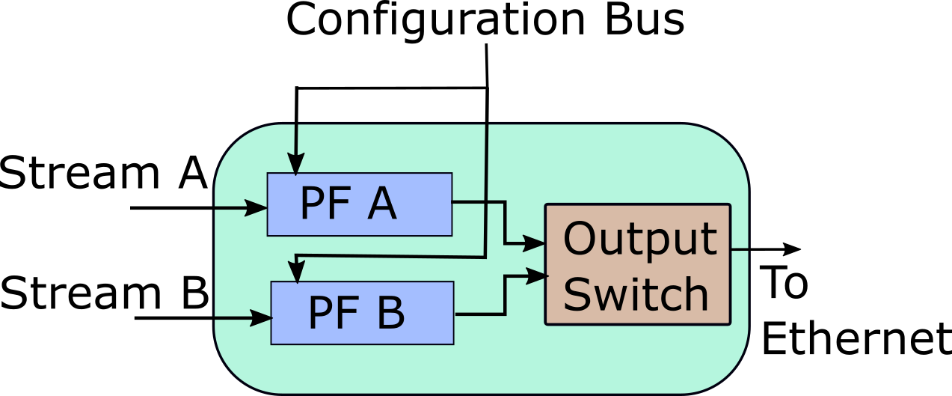
I/O to FPGAs in Cluster
Input
Output

Slide 27
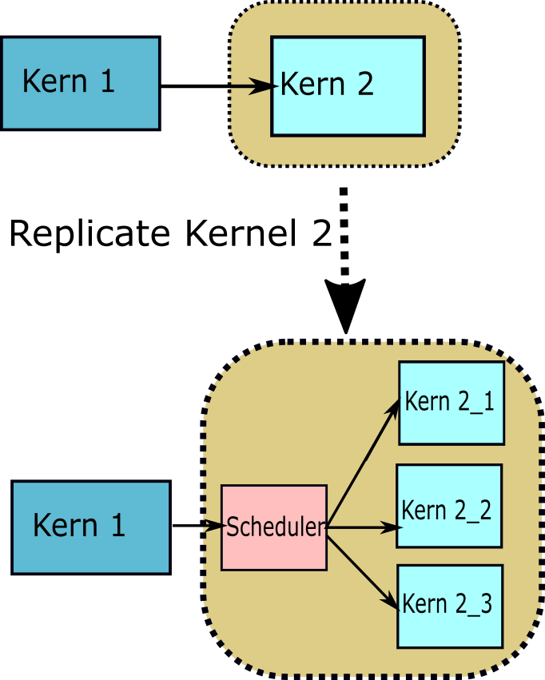
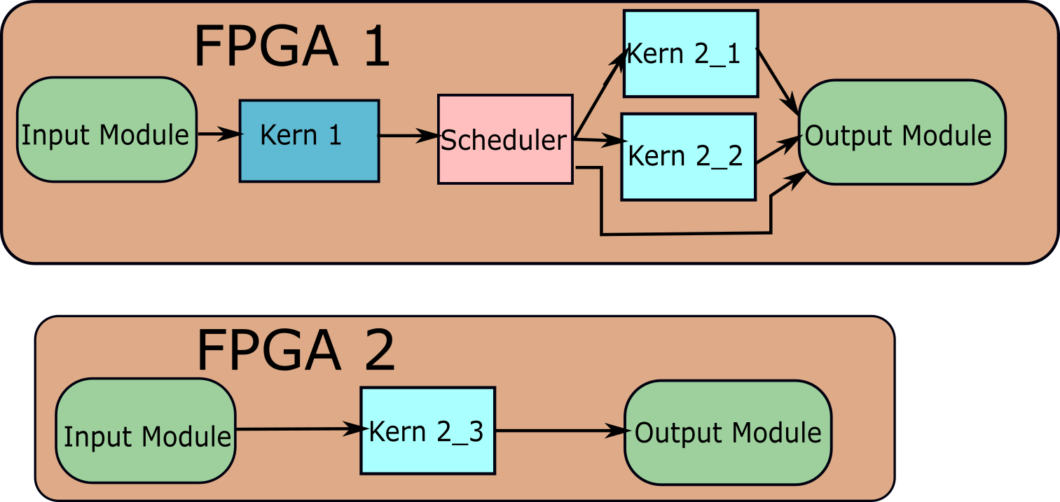
Scaling Up the Clusters

Slide 28
Networking Backend
FPGA Cluster Generator
Network Port Request
OpenStack
SAVI Network Manager

Slide 29
Networking Backend
FPGA Cluster Generator
Network MAC address
OpenStack
SAVI Network Manager

Slide 30
Networking Backend
FPGA Cluster Generator
Network MAC address
FPGA Port on Physical Switch
OpenStack
SAVI Network Manager

Slide 31
Resource Utilization
Hardware Setup | LUTS | Flip-Flops | BRAM
SDAccel Base | 53346 (12.3 %) | 64550 (7.45 %) | 228 (15.5 %)
Ethernet Support | 8998 (2.1 %) | 11574 (1.34 %) | 0 (0 %)
Input Module | 169 (0.039 %) | 294 (0.033 %) | 2 (1.36 %)
Output Module | 773(0.178 %) | 402 (0.059%) | 4 (2.72 %)
Total Available | 233200 | 866400 | 1470

Slide 32
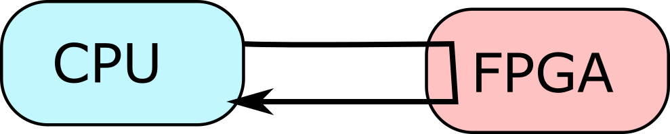
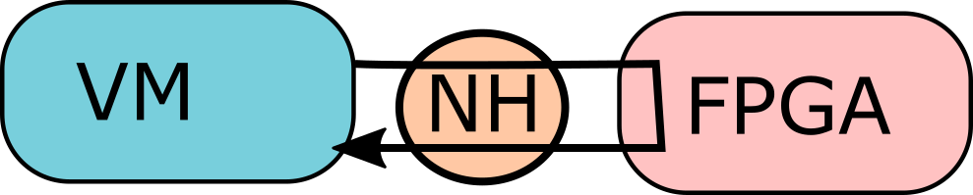
Testing Latency and Throughput
Directly Connected CPU to FPGA
VM to one FPGA in SAVI

Slide 33
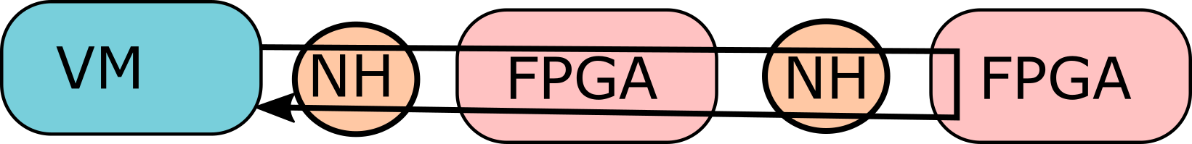
Testing Latency and Throughput
VM to two FPGA chain in SAVI
VM to three FPGA chain in SAVI

Slide 34
Round-trip Latency
Test | Latency (ms)
CPU + FPGA | 0.0650
VM + 1 FPGA | 0.500
VM + 2 FPGA | 0.645
VM + 3 FPGA | 0.790

Slide 35
Round-trip Latency
Test | Latency (ms)
CPU + FPGA | 0.0650
VM + 1 FPGA | 0.500
VM + 2 FPGA | 0.645
VM + 3 FPGA | 0.790
CPU > VM
Extra network Hop

Slide 36
Round-trip Latency
Test | Latency (ms)
CPU + FPGA | 0.0650
VM + 1 FPGA | 0.500
VM + 2 FPGA | 0.645
VM + 3 FPGA | 0.790
Linear

Slide 37
Microbenchmark Throughput
Physical Limit of Network Link

Slide 38
Microbenchmark Throughput
Physical Limit of Network Link

Slide 39
Microbenchmark Throughput
Physical Limit of Network Link

Slide 40
Microbenchmark Throughput
Physical Limit of Network Link

Slide 41
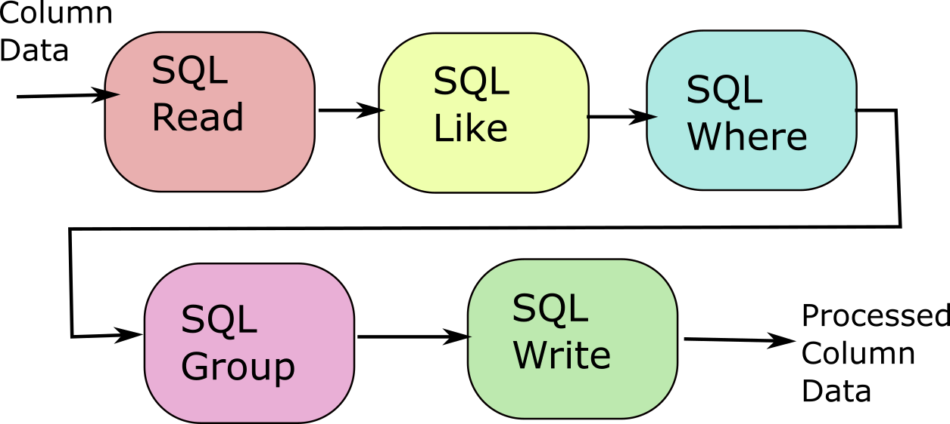
Case Study: Scalability of Query Processing Engine
Representative Case study: Database Streaming Query Processing Engine
Size
Streaming
Scalable

Slide 42
Case Study: Scalability of Query Processing Engine
Query Processing Engine

Slide 43
Case Study: Scalability of Query Processing Engine
Query Processing Engine
Scheduler
Query Processing Engine

Slide 44
Case Study: Scalability of Query Processing Engine
Query Processing Engine
Scheduler
-Replicated 6 times
3 FPGAs
2 units /FPGA
Query Processing Engine

Slide 45
Case Study: Scalability of Query Processing Engine

Slide 46
Conclusion and Summary
Users can create elastic FPGA clusters from cloud easily
Inter-FPGA fabric automatically generated
FPGAs provided network interface
Little overhead
Easy to scale

Slide 47
Future Work
Infrastructure Upgrade
10G
Partial Reconfiguration

Slide 48
Future Work
Infrastructure Upgrade
10G
Partial Reconfiguration
Automatic Partitioning/Scheduling
HLS Model (Scheduler): Behavioral
Circuit Partitioning

Slide 49
Future Work
Infrastructure Upgrade
10G
Partial Reconfiguration
Automatic Partitioning/Scheduling
HLS Model (Scheduler): Behavioral
Circuit Partitioning
Debugging of Large clusters
Combine individual debug environments
Monitor health

Slide 50
Future Work
Infrastructure Upgrade
10G
Partial Reconfiguration
Automatic Partitioning/Scheduling
HLS Model (Scheduler): Behavioral
Circuit Partitioning
Debugging of Large clusters
Combine individual debug environments
Monitor health
Large Scale Applications
Networking Applications (NFV)
Distributed Applications (Web-search)
Heterogeneous IOT Applications

Slide 51
Thank You

Slide 52

Questions?
Email: naif.tarafdar@mail.utoronto.ca

