Slide 1
A Modular Heterogeneous Stack for Deploying FPGAs and CPUs in the Data Center
Nariman Eskandari, Naif Tarafdar, Daniel Ly-Ma, Paul Chow
Notes:
Hi, welcome to my talk on a modular heterogeneous stack for deploying fpgas and cpus in the data center.
I am naif Tarafdar and I will be presenting on behalf of Nariman eskandari who could not make it due to visa issues.

Slide 2

FPGAs in Clouds and Data Centers?
Microsoft
Catapult v1(2014)
10% more power, 95% throughput
Catapult v2 (2017)
Brainwave (2017)
Notes:
This is a question that has been quite definitively answered but do FPGAs belong in clouds and data centers.
Well in 2014 Microsoft has launched catapult v1 where at scale they deployed fpgas in their bing search engine and observed 95 % more throughput with only 10 % more power
They further continued targeting scalability in v2 by connecting fpgas directly on the network as abump on the wire
In 2014, Microsoft introduced the new servers that FPGAs are deployed in them.
By only 10% more power consumption, the servers almost double the performance of bing search engine.
3 years later it introduced catapult v2 that is a cloud infrastructure
And in the year they released the machine learning platform that is built on top of catapult v2 called brainwave

Slide 3

FPGAs in Clouds and Data Centers?
Microsoft
Catapult v1(2014)
10% more power, 95% throughput
Catapult v2 (2017)
Brainwave (2017)
Amazon
AWS F1(2017)
Notes:
The popularity of FPGAs for scale applications can be seen as they are now also deployed in cloud compute services such as amazon f1.

Slide 4
Background: Heterogeneous Communication
Architecture models for FPGA and CPU clusters:
CPU
Network
CPU
CPU
Network
CPU
FPGA
FPGA
FPGA
FPGA
Slave Model
Peer Model
Notes:
Now that we have quickly gone over some motivation to show that heterogeneous devices belong in the data center, I’d like to cover some background.
Firstly I will cover communication models.
On the left hand side we have
As background I want to define some term
There are to models for architecture of CPUs and FPGAs
Slave model: that CPUs are connected to FPGAs through PCIe or other links but CPUs are connected to the network
So if a FPGA wants to send data to another FPGA it should go through cpus and network
In standalone model, FPGAs and CPUs are accessible though the network as standalone node

Slide 5
Background: Heterogeneous Communication
Architecture models for FPGA and CPU clusters:
CPU
Network
CPU
CPU
Network
CPU
FPGA
FPGA
FPGA
FPGA
Slave Model
Peer Model
Notes:
As background I want to define some term
There are to models for architecture of CPUs and FPGAs
Slave model: that CPUs are connected to FPGAs through PCIe or other links but CPUs are connected to the network
So if a FPGA wants to send data to another FPGA it should go through cpus and network
In standalone model, FPGAs and CPUs are accessible though the network as standalone node

Slide 6
Background: Heterogeneous Communication
Architecture models for FPGA and CPU clusters:
CPU
Network
CPU
CPU
Network
CPU
FPGA
FPGA
FPGA
FPGA
Slave Model
Peer Model
Notes:
As background I want to define some term
There are to models for architecture of CPUs and FPGAs
Slave model: that CPUs are connected to FPGAs through PCIe or other links but CPUs are connected to the network
So if a FPGA wants to send data to another FPGA it should go through cpus and network
In standalone model, FPGAs and CPUs are accessible though the network as standalone node

Slide 7
Background: Heterogeneous Communication
Architecture models for FPGA and CPU clusters:
CPU
Network
CPU
CPU
Network
CPU
FPGA
FPGA
FPGA
FPGA
Slave Model
Peer Model
Notes:
As background I want to define some term
There are to models for architecture of CPUs and FPGAs
Slave model: that CPUs are connected to FPGAs through PCIe or other links but CPUs are connected to the network
So if a FPGA wants to send data to another FPGA it should go through cpus and network
In standalone model, FPGAs and CPUs are accessible though the network as standalone node

Slide 8
Background: Heterogeneous Communication
Architecture models for FPGA and CPU clusters:
CPU
Network
CPU
CPU
Network
CPU
FPGA
FPGA
FPGA
FPGA
Slave Model
Peer Model
Communication
Peer model: No different way to communicate between Accelerators and CPUs
Easier
Direct connection between accelerators
Notes:
As background I want to define some term
There are to models for architecture of CPUs and FPGAs
Slave model: that CPUs are connected to FPGAs through PCIe or other links but CPUs are connected to the network
So if a FPGA wants to send data to another FPGA it should go through cpus and network
In standalone model, FPGAs and CPUs are accessible though the network as standalone node

Slide 9

Background: System Orchestration
User
Request
User issues request
Resources connected on network
Give user network handle of cluster
Network Handle of Cluster
Heterogeneous Cloud Provider
CPU
FPGA
CPU
FPGA
Network

Slide 10
Contributions
Galapagos: Rearchitected work in [FPGA 2017] to focus on modularity
Previously large monolithic layer
Modularity allows users to experiment with design space for heterogeneous clusters
Also addressed scalability issues in [FPGA 2017]
¹ Naif Tarafdar et al. Enabling Flexible Network FPGA Clusters in a Heterogeneous Cloud Data Center, FPGA 2017.
Notes:
Remove reliability to not explain, new architecture with a focus on modularity

Slide 11
Contributions
Galapagos: Rearchitected work in [FPGA 2017] to focus on modularity
Previously large monolithic layer
Modularity allows users to experiment with design space for heterogeneous clusters
Also addressed scalability issues in [FPGA 2017]
HUMboldt (Heterogeneous Uniform Messaging) : A Communication Layer
Heterogeneous (multi-FPGA and CPU)
Same high-level code for software and hardware (portable)
Easy to use in order to make scalable applications for CPU/FPGA Cluster.
¹ Naif Tarafdar et al. Enabling Flexible Network FPGA Clusters in a Heterogeneous Cloud Data Center, FPGA 2017.
Notes:
Remove reliability to not explain, new architecture with a focus on modularity

Slide 12
Outline
Galapagos
HUMboldt
Results
Conclusion
Future Work

Slide 13
Outline
Galapagos
HUMboldt
Results
Conclusion
Future Work

Slide 14
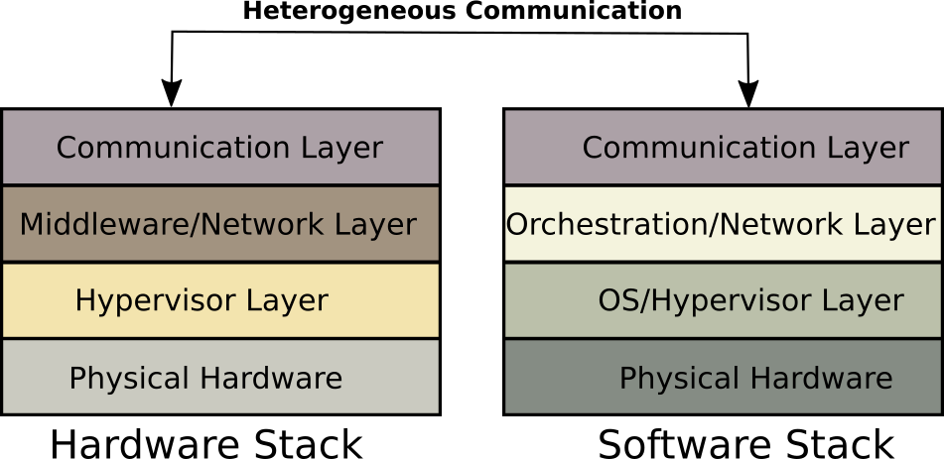
Heterogeneous Abstraction Stack
Monolithic Orchestration Layer
[FPGA 2017]
Notes:
Animate, show modular contributions (animate show hum and Galapagos, and old monolithic)

Slide 15
Heterogeneous Abstraction Stack
HUMboldt
Galapagos
Notes:
Animate, show modular contributions (animate show hum and Galapagos, and old monolithic)

Slide 16
Galapagos: Middleware Layer
User can define a FPGA cluster using cluster description files and AXI-Stream kernels
VM
FPGA 1
File
Tool Flow
Network
Kernel
VM
VM
Kernel
Kernel
AXI-Stream
AXI-Stream
FPGA 2
FPGA 3
Notes:
Put numbers for FPGAs, talk about kernels when orchestrating!!

Slide 17
Galapagos: Middleware Layer
User can define a FPGA cluster using cluster description files and AXI-Stream kernels
VM
FPGA 1
File
Tool Flow
Network
Kernel
VM
VM
Kernel
Kernel
AXI-Stream
AXI-Stream
FPGA 2
FPGA 3
Notes:
Put numbers for FPGAs, talk about kernels when orchestrating!!

Slide 18
Galapagos: Middleware Layer
User can define a FPGA cluster using cluster description files and AXI-Stream kernels
VM
FPGA 1
File
Tool Flow
Network
Kernel
VM
VM
Kernel
Kernel
AXI-Stream
AXI-Stream
FPGA 2
FPGA 3
Notes:
Put numbers for FPGAs, talk about kernels when orchestrating!!

Slide 19
Galapagos: Middleware Layer
User can define a FPGA cluster using cluster description files and AXI-Stream kernels
VM
FPGA 1
File
Tool Flow
Network
Kernel
VM
VM
Kernel
Kernel
AXI-Stream
AXI-Stream
FPGA 2
FPGA 3
Notes:
Put numbers for FPGAs, talk about kernels when orchestrating!!

Slide 20
Galapagos Hypervisor
CPU
The Hypervisor abstracts all the I/O interfaces
Limitations of the base infrastructure:
Closed source (proprietary IPs)
Not easily portable for other boards support (Heterogeneity)
Driver
PCIE
2
x DDR
Application
Region
Network
Notes:
less Details!!!!!!!!!!
One slide for these three

Slide 21
Galapagos Hypervisor
CPU
The Hypervisor abstracts all the I/O interfaces
Limitations of the base infrastructure:
Closed source (proprietary IPs)
Not easily portable for other boards support (Heterogeneity)
Redesigned using publicly available Xilinx IPs
Supports higher level of the network stack.
IP layer
Transport Layer (e.g. TCP)
Driver
PCIE
2
x DDR
Application
Region
Network
Notes:
less Details!!!!!!!!!!
One slide for these three

Slide 22
Galapagos Hypervisor
CPU
The Hypervisor abstracts all the I/O interfaces
Limitations of the base infrastructure:
Closed source (proprietary IPs)
Not easily portable for other boards support (Heterogeneity)
Redesigned using publicly available Xilinx IPs
Supports higher level of the network stack.
IP layer
Transport Layer (e.g. TCP)
Driver
PCIE
2
x DDR
Application
Region
FPGA
FPG
Network
Notes:
less Details!!!!!!!!!!
One slide for these three

Slide 23
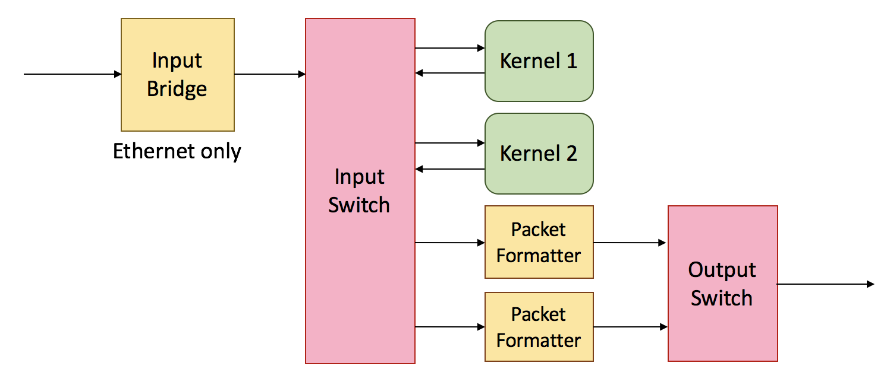
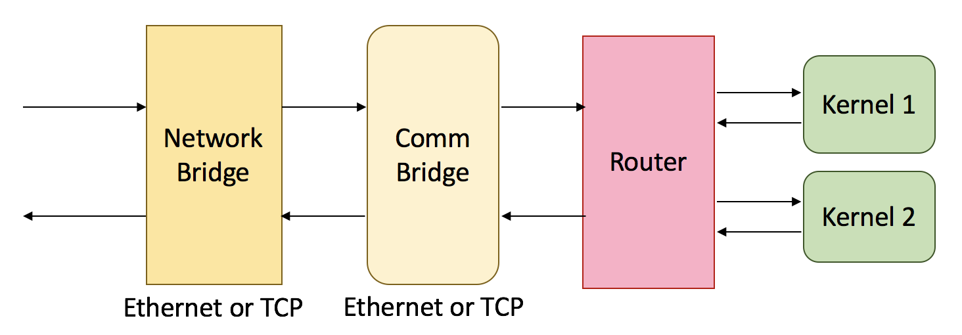
Galapagos: Hypervisor Application Region
[FPGA 2017]
Galapagos
Notes:
Slide number? Highlight, Scalability and Modularity Improvements for Galapagos, Show box of app region in shell, remove all base infrastructe, vsn 1,

Slide 24
Galapagos: Hypervisor Application Region
[FPGA 2017]
Galapagos
Notes:
Slide number? Highlight, Scalability and Modularity Improvements for Galapagos, Show box of app region in shell, remove all base infrastructe, vsn 1,

Slide 25
Galapagos: Application Region – Router
[FPGA 2017]
Galapagos
Notes:
First animate around app region, remove and continue

Slide 26
Galapagos: Application Region – Network Bridge
[FPGA 2017]
Galapagos
Notes:
Moving laser pointer a lot over figures. Point to one, then talk and move on, just talk with animation rather than depending on laser

Slide 27
Galapagos: Application Region – Comm Bridge
[FPGA 2017]
Galapagos
Notes:
Delete that
Have a summery of Galapagos
Why we transit to HUMbolt

Slide 28
Outline
Base infrastructure
Galapagos
HUMboldt
Results
Conclusion
Future Work

Slide 29
HUMboldt (Heterogeneous Uniform Messaging) Communication Layer
A message passing communication layer
A minimal subset of MPI
Only blocking send and receives
Software and Hardware library
Exact same source code for both hardware and software
Functional portability
Notes:
Mention HUMboldt name earlier and define it, same source code works for both hw/sw

Slide 30
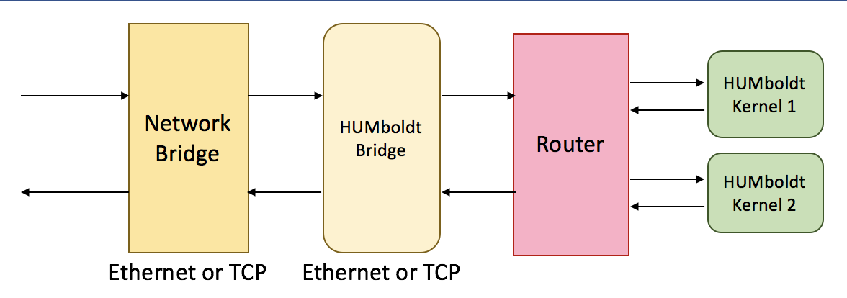
HUMboldt Hardware
All the functions are implemented as High-Level Synthesis (HLS) functions
Library for user to integrate in HLS code
Functional portability
Easy to use
The underlying protocol is handled by Galapagos
Notes:
Mention HLS library,
Show animation of on chip and off chip. Box highlighting the fact that they are all on one fpga

Slide 31
HUMboldt Software
Uses standard socket programming libraries
TCP and Ethernet
Software kernels communicating through a mature software MPI library (MPICH)
It parses the cluster description files at runtime to choose the right protocol
Hardware node: HUMboldt
Software nodes: MPICH
Notes:
A figure for sw to sw

Slide 32
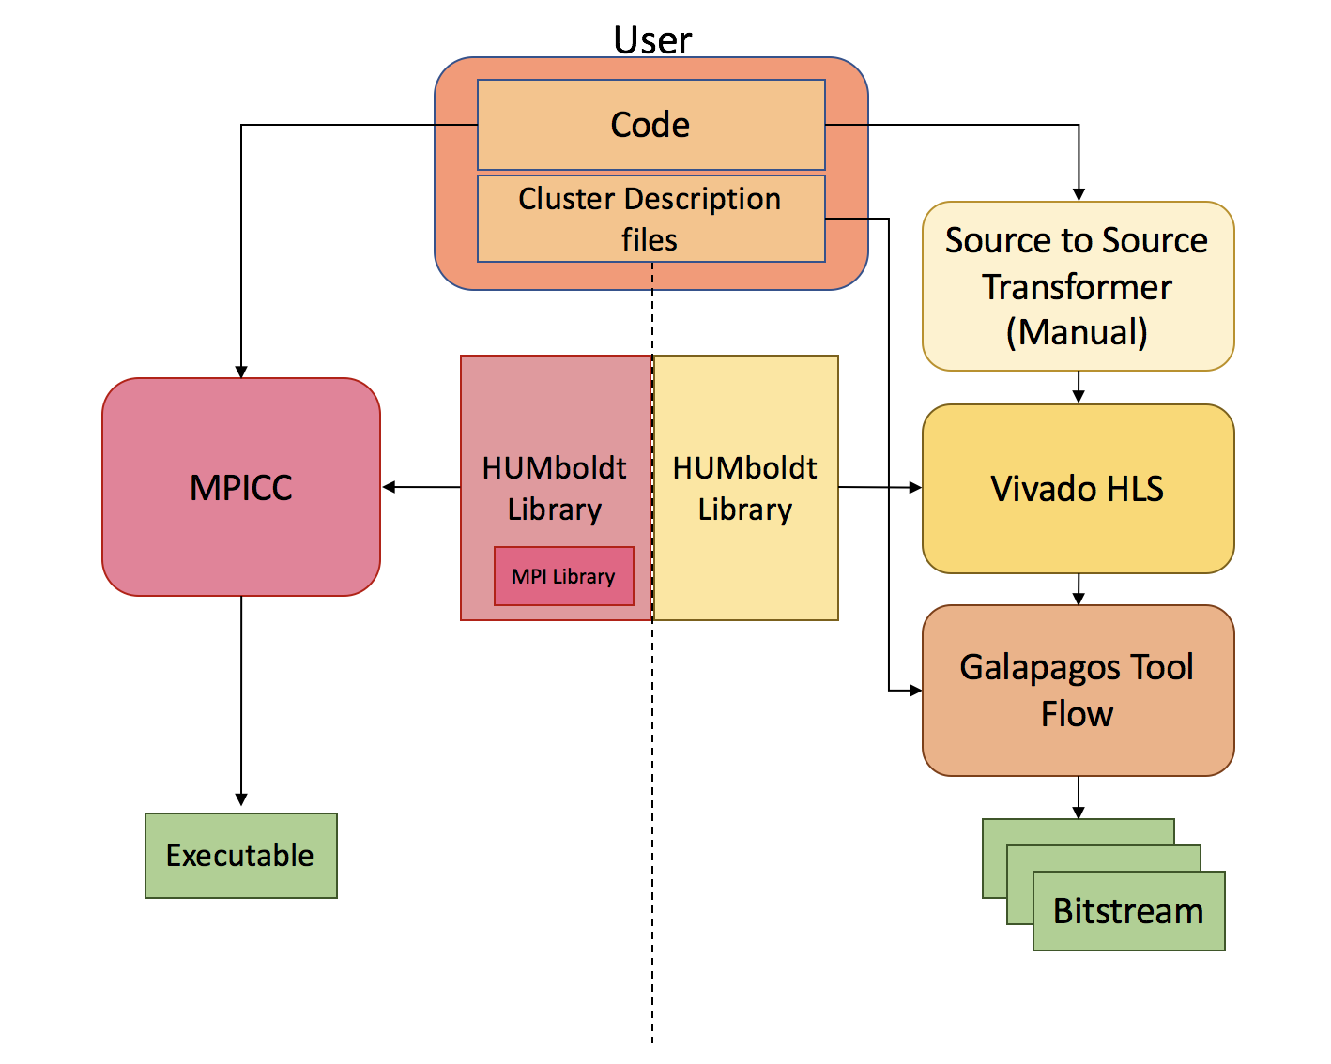
System Tool Flow
HUMboldt has two branches for creating the entire cluster
Software kernels
Hardware kernels
Same code can be used for both software and hardware kernels
Notes:
Box here is necessary
Hard to follow
Change hardware library to HUMboldt!
MPICH

Slide 33
System Tool Flow
HUMboldt has two branches for creating the entire cluster
Software kernels
Hardware kernels
Same code can be used for both software and hardware kernels
Notes:
Box here is necessary
Hard to follow
Change hardware library to HUMboldt!
MPICH

Slide 34
System Tool Flow
HUMboldt has two branches for creating the entire cluster
Software kernels
Hardware kernels
Same code can be used for both software and hardware kernels
Notes:
Box here is necessary
Hard to follow
Change hardware library to HUMboldt!
MPICH

Slide 35
System Tool Flow
<cluster>
<node>
<type> sw </type>
<kernel> 0 </kernel>
<mac_addr> ac:c4:7a:88:c0:47 </mac_addr>
<ip_addr> 10.1.2.152 </ip_addr>
</node>
<node>
<appBridge>
<name> Humboldt_bridge</name>
</appBridge>
<board> adm-8k5-debug </board>
<type> hw </type>
<comm> eth </comm>
<kernel> 1 </kernel>
.
.
.
<kernel> 16 </kernel>
<mac_addr> fa:16:3e:55:ca:02 </mac_addr>
<ip_addr> 10.1.2.101 </ip_addr>
</node>
</cluster>
Ease of use
Changing the underlying protocol
Notes:
Spend less time
HUMboldt bridge
Cluster Description File )title)
Change red on black, include text and make it easier to read

Slide 36
System Tool Flow
<cluster>
<node>
<type> sw </type>
<kernel> 0 </kernel>
<mac_addr> ac:c4:7a:88:c0:47 </mac_addr>
<ip_addr> 10.1.2.152 </ip_addr>
</node>
<node>
<appBridge>
<name> Humboldt_bridge</name>
</appBridge>
<board> adm-8k5-debug </board>
<type> hw </type>
<comm> eth </comm>
<kernel> 1 </kernel>
.
.
.
<kernel> 16 </kernel>
<mac_addr> fa:16:3e:55:ca:02 </mac_addr>
<ip_addr> 10.1.2.101 </ip_addr>
</node>
</cluster>
Ease of use
Changing the underlying protocol
Changing from software to hardware
Notes:
Spend less time
HUMboldt bridge
Cluster Description File )title)
Change red on black, include text and make it easier to read

Slide 37
Outline
Goals
Contributions
Previous Works
Galapagos
HUMboldt
Results
Conclusion
Future Work

Slide 38
Results: Testbed
The testbed that is used is a cluster of:
Intel Xeon E5-2650 (2.20 GHz)
12 physical core, 24 threads
Alpha Data ADM-PCIE-8k5
Xilinx KU115 UltraScale devices
Notes:
Bullet point
Instead of part number just mention family
Be specific when mentioninc CPU cores

Slide 39
Galapagos/HUMboldt Resource Utilization
Abstraction Layer IP | LUTs | Flip-Flops | BRAMs
I) Hypervisor | 14.4 % | 9.1 % | 11.8 %
II) Network Bridge TCP | 4.4 % | 2.4 % | 0.1 %
III) Network Bridge Ethernet | 0.1 % | 0.1 % | 0.1 %
IV) HUMboldt Bridge | 0.1 % | 0.1% | 0.05 %
V) Router | 0.8 % | 0.5 % | 0.05 %
Total TCP (1 + II + IV + V) | 19.7 % | 12.1 % | 15.9 %
Total Ethernet (1 + III + IV + V) | 15.3 % | 9.7 % | 12.0 %
Notes:
Fix second point (table?) mention what resource. LUTS

Slide 40
Galapagos/HUMboldt Resource Utilization
Abstraction Layer IP | LUTs | Flip-Flops | BRAMs
I) Hypervisor | 14.4 % | 9.1 % | 11.8 %
II) Network Bridge TCP | 4.4 % | 2.4 % | 0.1 %
III) Network Bridge Ethernet | 0.1 % | 0.1 % | 0.1 %
IV) HUMboldt Bridge | 0.1 % | 0.1% | 0.05 %
V) Router | 0.8 % | 0.5 % | 0.05 %
Total TCP (1 + II + IV + V) | 19.7 % | 12.1 % | 15.9 %
Total Ethernet (1 + III + IV + V) | 15.3 % | 9.7 % | 12.0 %
Notes:
Fix second point (table?) mention what resource. LUTS

Slide 41
Galapagos/HUMboldt Resource Utilization
Abstraction Layer IP | LUTs | Flip-Flops | BRAMs
I) Hypervisor | 14.4 % | 9.1 % | 11.8 %
II) Network Bridge TCP | 4.4 % | 2.4 % | 0.1 %
III) Network Bridge Ethernet | 0.1 % | 0.1 % | 0.1 %
IV) HUMboldt Bridge | 0.1 % | 0.1% | 0.05 %
V) Router | 0.8 % | 0.5 % | 0.05 %
Total TCP (1 + II + IV + V) | 19.7 % | 12.1 % | 12.9 %
Total Ethernet (1 + III + IV + V) | 15.3 % | 9.7 % | 12.0 %
Notes:
Fix second point (table?) mention what resource. LUTS

Slide 42
Galapagos/HUMboldt Resource Utilization
Abstraction Layer IP | LUTs | Flip-Flops | BRAMs
I) Hypervisor | 14.4 % | 9.1 % | 11.8 %
II) Network Bridge TCP | 4.4 % | 2.4 % | 0.1 %
III) Network Bridge Ethernet | 0.1 % | 0.1 % | 0.1 %
IV) HUMboldt Bridge | 0.1 % | 0.1% | 0.05 %
V) Router | 0.8 % | 0.5 % | 0.05 %
Total TCP (1 + II + IV + V) | 19.7 % | 12.1 % | 15.9 %
Total Ethernet (1 + III + IV + V) | 15.3 % | 9.7 % | 12.0 %
Notes:
Fix second point (table?) mention what resource. LUTS

Slide 43
Galapagos/HUMboldt Resource Utilization
Abstraction Layer IP | LUTs | Flip-Flops | BRAMs
I) Hypervisor | 14.4 % | 9.1 % | 11.8 %
II) Network Bridge TCP | 4.4 % | 2.4 % | 0.1 %
III) Network Bridge Ethernet | 0.1 % | 0.1 % | 0.1 %
IV) HUMboldt Bridge | 0.1 % | 0.1% | 0.05 %
V) Router | 0.8 % | 0.5 % | 0.05 %
Total TCP (1 + II + IV + V) | 19.7 % | 12.1 % | 15.9 %
Total Ethernet (1 + III + IV + V) | 15.3 % | 9.7 % | 12.0 %
Notes:
Fix second point (table?) mention what resource. LUTS

Slide 44
Results: Microbenchmarks
FPGA
HUMboldt
Hardware Kernel
Hardware Kernel
FPGA
FPGA
Hardware Kernel
HUMboldt
Hardware Kernel
CPU
FPGA
Software Kernel
HUMboldt
Hardware Kernel
FPGA
HUMboldt
CPU
Hardware Kernel
Software Kernel
CPU
MPICH
CPU
Software Kernel
Software Kernel
Notes:
MPICH last row, investigate colour schemes

Slide 45
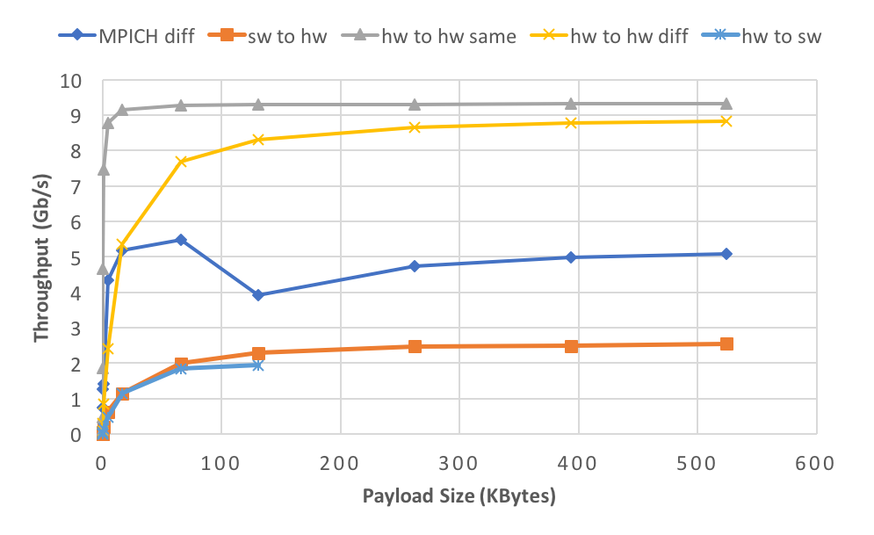
Results: Throughput
Ethernet
Notes:
Gap draw an arrow
Where the limit is for TCP

Slide 46
Results: Throughput
Ethernet
Notes:
Gap draw an arrow
Where the limit is for TCP
Highlight we are not the bottleneck (animate point?)

Slide 47
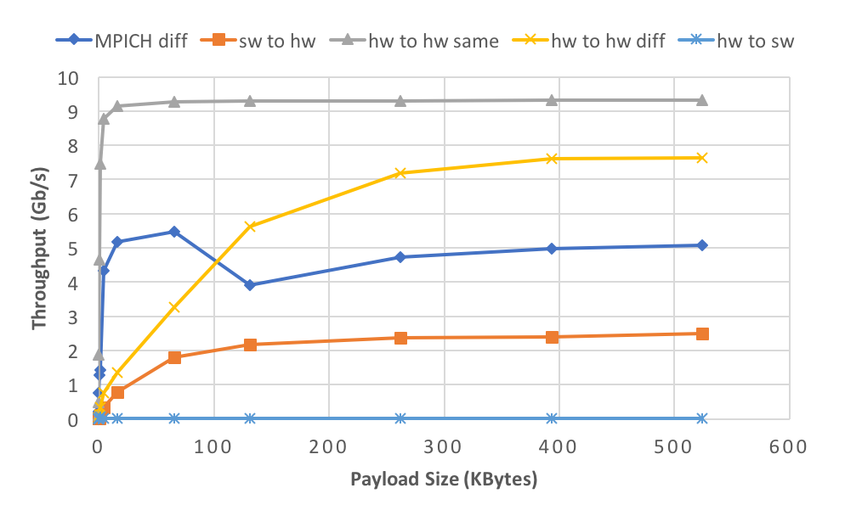
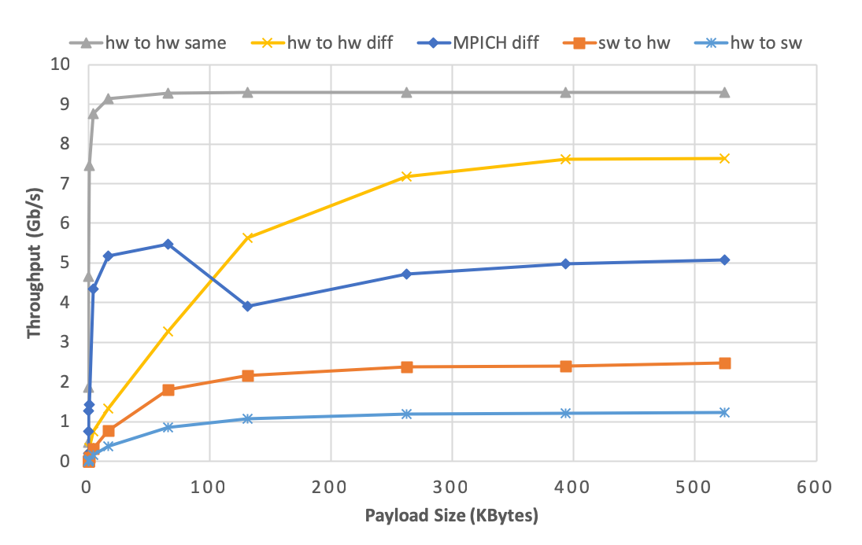
Results: Throughput
TCP
Notes:
Gap draw an arrow
Where the limit is for TCP

Slide 48
Results: Throughput
TCP
Notes:
Gap draw an arrow
Where the limit is for TCP

Slide 49
Results: Latency
Zero-payload packets
Relevant Comparison: Microsoft Catapult V2
40 G Ethernet
Lightweight transport layer
2.88 µs round trip
Microbenchmarks | Ethernet (µs) | TCP (µs)
Hardware to Hardware (same node) | 0.2 | 0.2
Hardware to hardware (different node) | 5.7 | 15.2
Software to Hardware | 27.5 | 48.8
Hardware to Software | 34.7 | 113.6
Notes:
Same node, no network

Slide 50
Results: Latency
Zero-payload packets
Relevant Comparison: Microsoft Catapult V2
40 G Ethernet
Lightweight transport layer
2.88 µs round trip
Microbenchmarks | Ethernet (µs) | TCP (µs)
Hardware to Hardware (same node) | 0.2 | 0.2
Hardware to hardware (different node) | 5.7 | 15.2
Software to Hardware | 27.5 | 48.8
Hardware to Software | 34.7 | 113.6
Notes:
Comparable round trip latency as Humboldt sends 4 packets instead of 2

Slide 51
Results: Latency
Zero-payload packets
Relevant Comparison: Microsoft Catapult V2
40 G Ethernet
Lightweight transport layer
2.88 µs round trip
Microbenchmarks | Ethernet (µs) | TCP (µs)
Hardware to Hardware (same node) | 0.2 | 0.2
Hardware to hardware (different node) | 5.7 | 15.2
Software to Hardware | 27.5 | 48.8
Hardware to Software | 34.7 | 113.6
Notes:
Software a lot slower

Slide 52
Outline
Goals
Contributions
Previous Works
Galapagos
HUMboldt
Results
Conclusion
Future Work

Slide 53
Conclusion
Galapagos: the improved version of the base infrastructure which is more modular, scalable, and reliable.
HUMboldt: a communication layer that is:
Heterogeneous: different nodes can talk in a same language
Functional portable: same code can be used for both software and hardware
Abstraction layers can with very minimal overhead improve scalability, modularity and productivity.
Notes:
Conclusion and summary not just conclusion
Layering! – abstraction overhead minimal but easier to use

Slide 54
Outline
Goals
Contributions
Previous Works
Hypervisor
Application Region
HUMboldt
Tool Flow
Results
Conclusion
Future Work

Slide 55
Future Work
Application that shows the true power of HUMboldt and Galapagos.
Investigate other layers of abstraction.
Implementing another type of communication layer.
Streaming model
Notes:
Different abstractions, remove mpi stuff,

Slide 56



Acknowledgements

Slide 57
Thank you
Questions?
Email: naif.tarafdar@mail.utoronto.ca
Notes:
Put email, and repos, move repos to uofthprc, add acknowledgements, Xilinx , Huawei, nserc, cmc

Slide 58
Back Up Slides

Slide 59
Base Infrastructure: System Interface
The base infrastructure takes three files to create a cluster.
Logical file
Mapping file
MAC address file

Slide 60
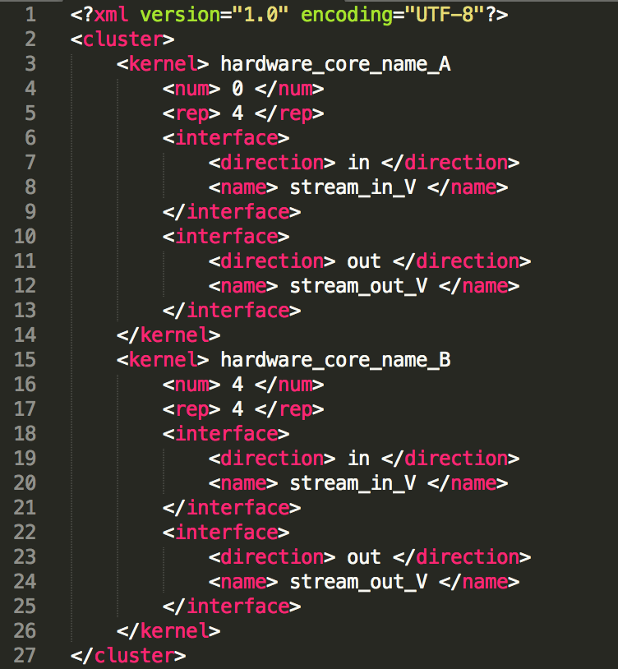
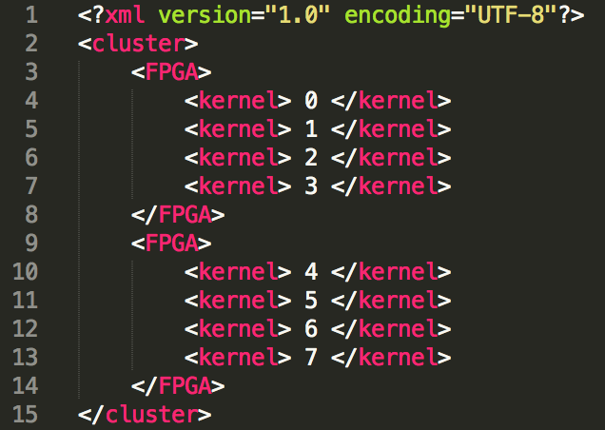

Base Infrastructure: System Interface
Mapping file
MAC address file
Logical file

Slide 61
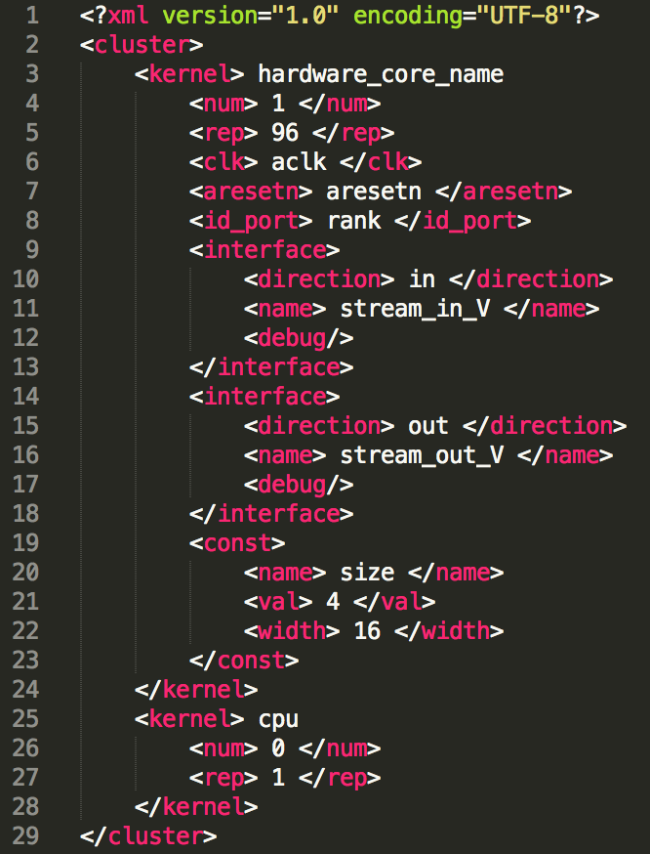
Galapagos: Logical file
Base infrastructure Logical file
Galapagos Logical file

Slide 62
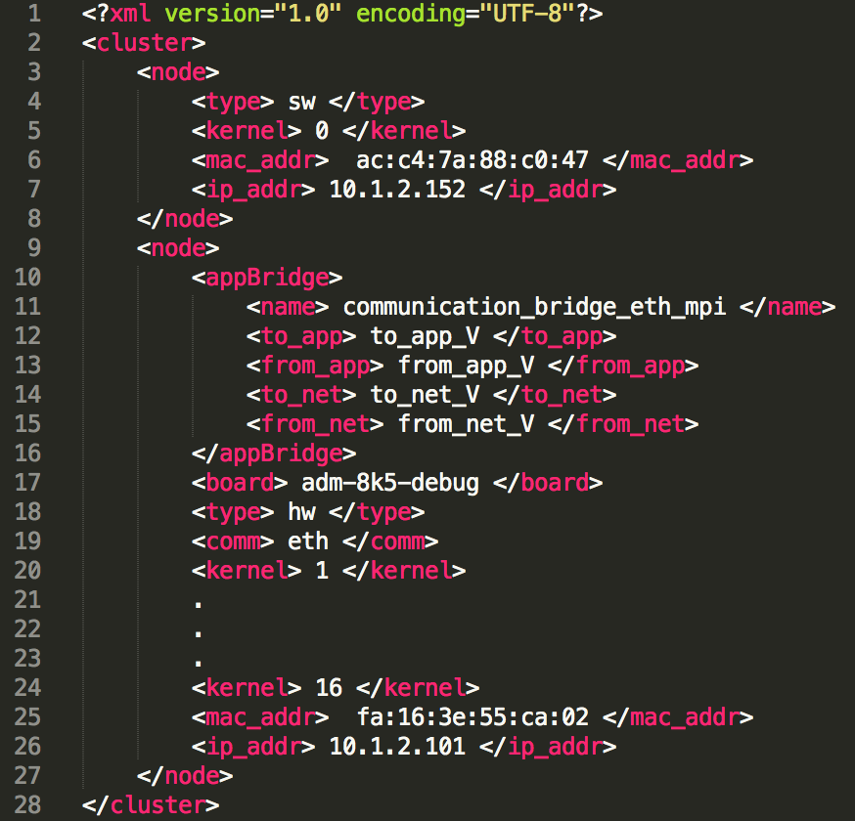
Galapagos: Mapping File
Base infrastructure Mapping file
Galapagos Mapping file

Slide 63
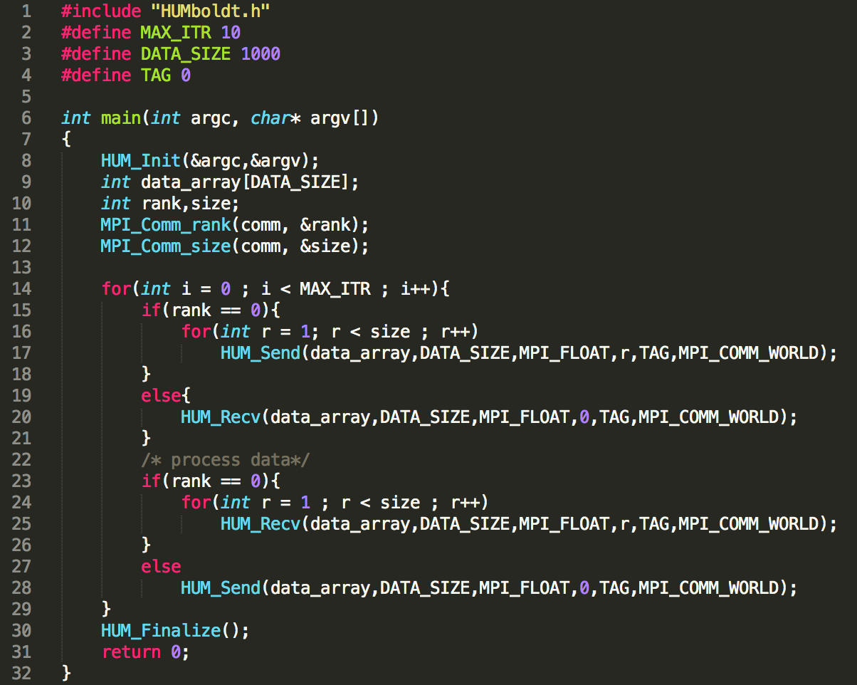
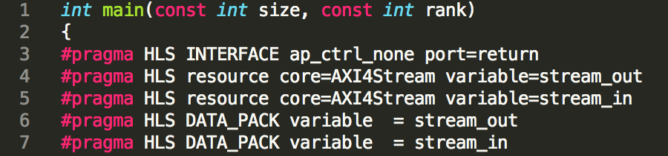
HUMboldt Sample code
To make HUMboldt code Synthesizable
Change ”main” to hardware core name
Rank connects to id port that is defined in logical file
Size is a constant that is defined in logical file
And the HLS pragmas should be added

Slide 64
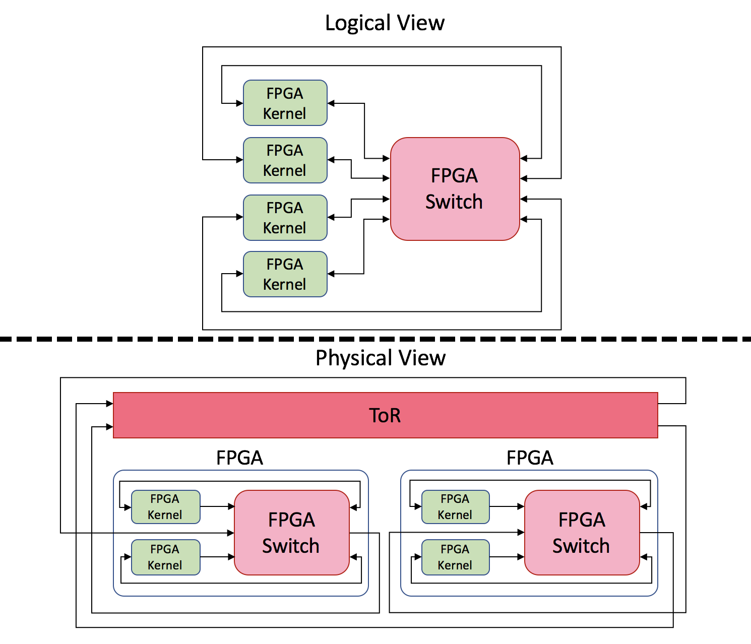
Base Infrastructure: Application Region
Base Infrastructure connects all the Streaming IPs automatically using the Cluster description files.
Logical file
Mapping file
MAC address file

Slide 65
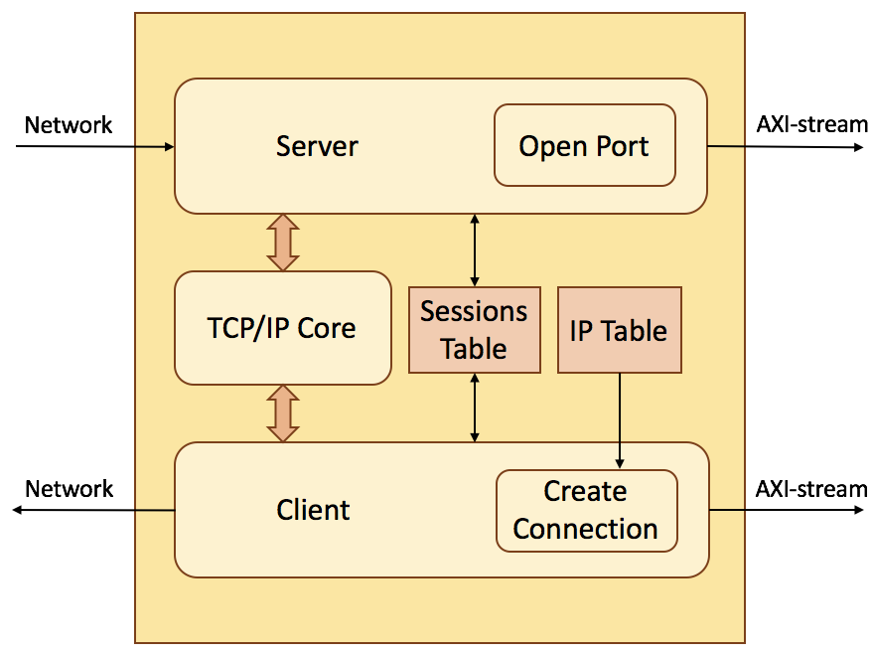
Galapagos: TCP Network Bridge
Reliable connections
Server as the receiver
Opens and listens to a specific port
Accepts the connections and stores the session ID into the session table
Receives data from session and forward them as AXI-Stream packets.
Client as sender
Creates the connection to server if it is not made
Stores the session ID into the session table
Send data out to the other network nodes

Slide 66
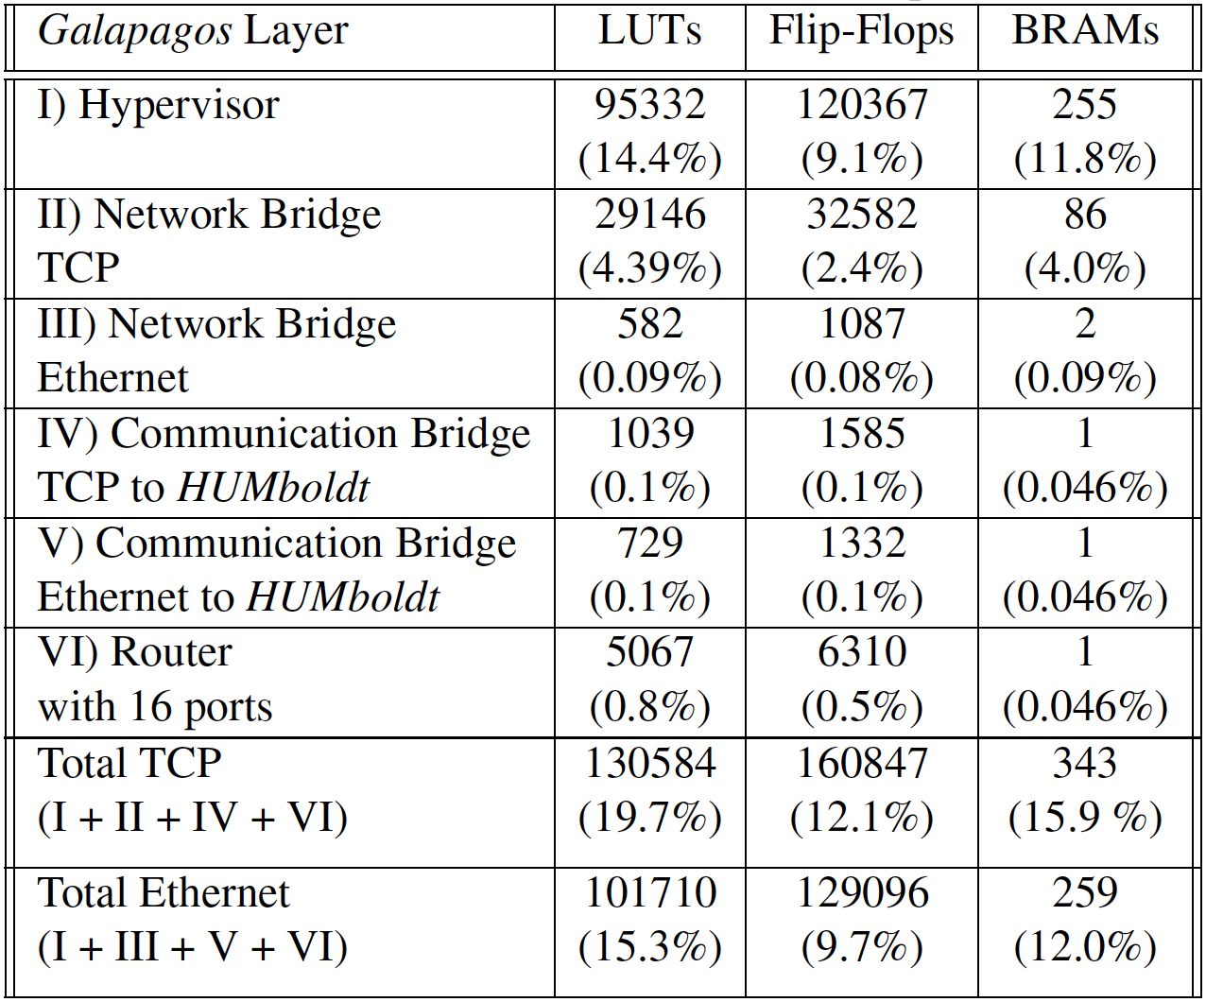
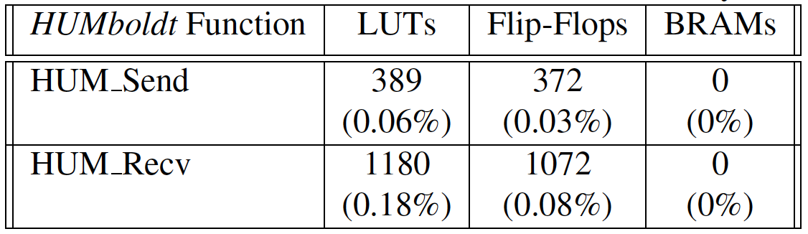
Resource Utilization
The resource utilization is 20% when the user chooses TCP
It is 15% when the user chooses Ethernet
Results are based on the 8K5 board

Slide 67

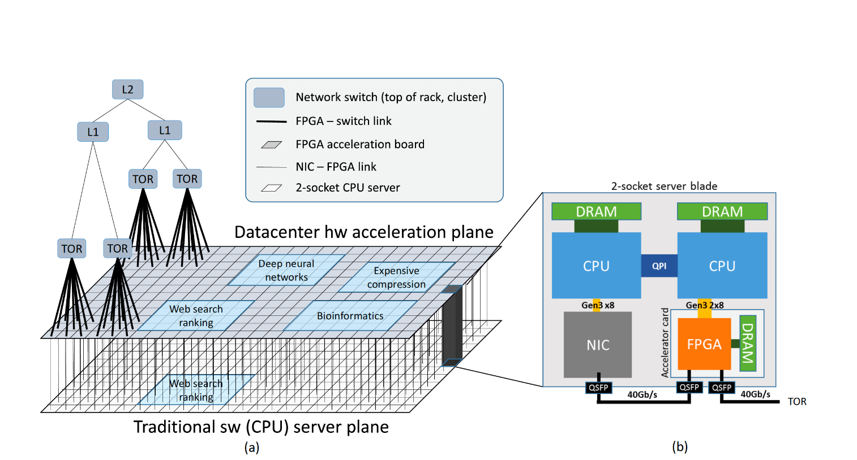
FPGAs in Clouds and Data Centers?
Catapult v1(2014)
Acceleration of Bing search engine
10% more power, 95% more throughput
Catapult v2 (2017)
Cloud based infrastructure
Notes:
Remove the detail
List of many people

Slide 68
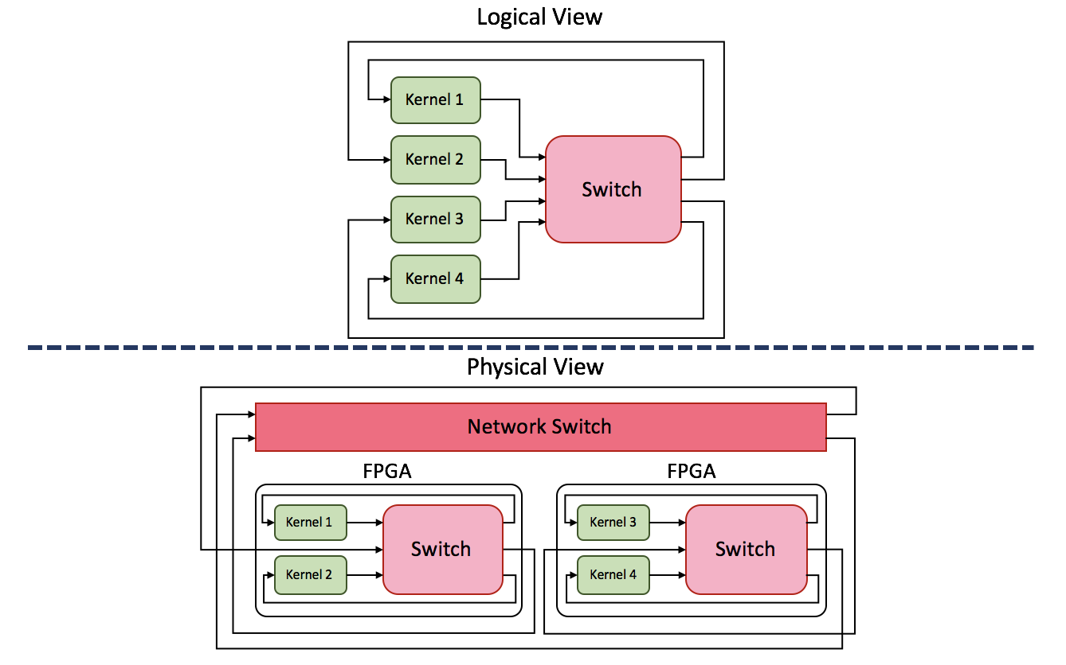
Base Infrastructure Application Region
Notes:
Showing packet is good
Make it more clear for a packet

Slide 69
Base Infrastructure Application Region
Notes:
Showing packet is good
Make it more clear for a packet

Slide 70


Base Infrastructure Application Region
Application Region
Application Region
3
4
FPGA 1
FPGA 2
Notes:
The switch os conectefd in the cluster whather in same or differetn
Same fpga dicrect connection
Diffent fpga go through packet formatter
Pf: Adds a network header

Slide 71
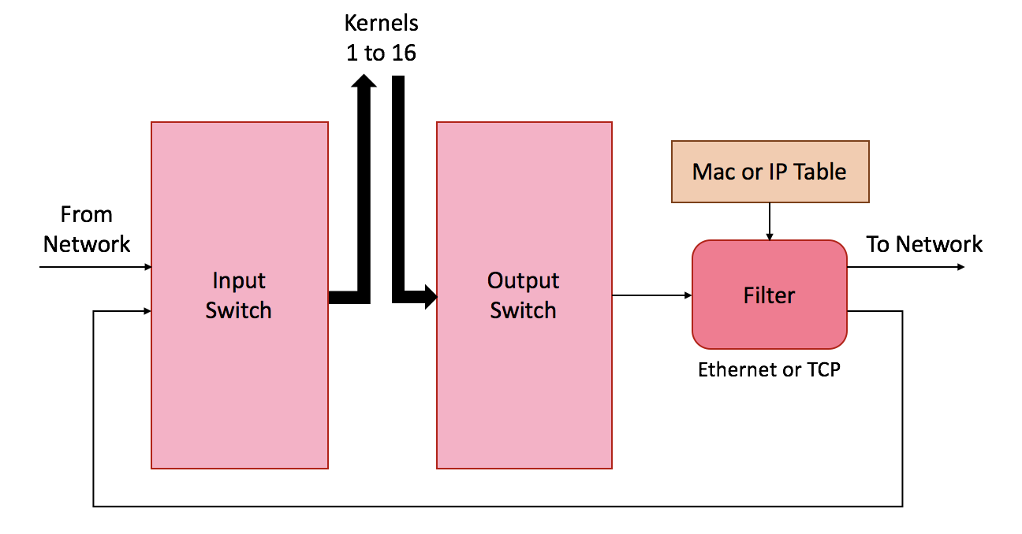
Galapagos: Application Region
Adding Router to address scalability limitation

Slide 72
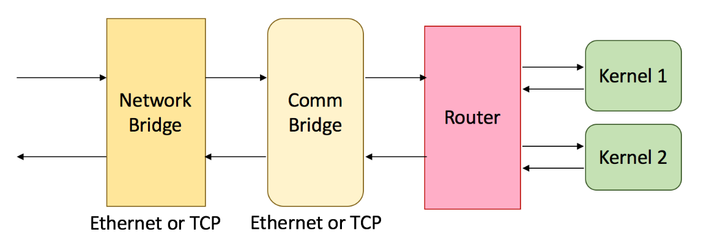
Galapagos Application Region
Application Region
Application Region
3
4
FPGA 1
FPGA 2
Notes:
The implementation of application layer or communication layer is independent from network protocol
For example
MPI as communication not related to what is the type of network brge

Slide 73
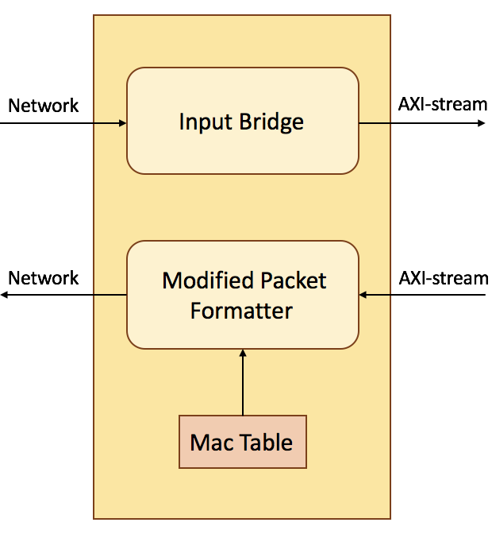
Galapagos: Network Bridge
Receives the packets from network and check if they are for this FPGA
Sends the outgoing packets out with a destination MAC or IP address
Interfaces are consistent with Galapagos
Notes:
Too small

Slide 74
Base Infrastructure Application Region
Application Region
Application Region
3
4
FPGA 1
FPGA 2
Notes:
The switch os conectefd in the cluster whather in same or differetn
Same fpga dicrect connection
Diffent fpga go through packet formatter
Pf: Adds a network header

Slide 75
Base Infrastructure Application Region
Limitations:
16 kernels in entire cluster
Unreliable communications
Not modular
Application Region
FPGA

