Slide 1

Heterogeneous Virtualized Network Function Framework for the Data Center
Naif Tarafdar, Thomas Lin, Nariman Eskandari,
David Lion, Alberto Leon-Garcia, Paul Chow University of Toronto

Slide 2



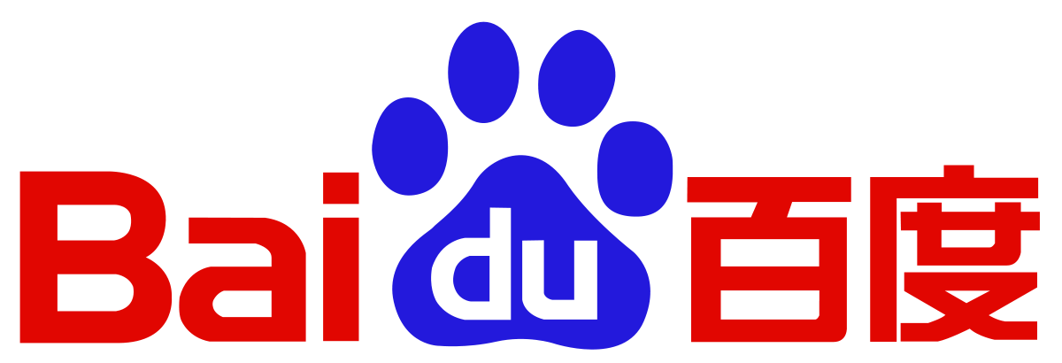
FPGAs Have Made it To the Cloud!
Notes:
-Starting with the Microsoft Catapult project in 2014, that has shown the benefits of putting FPGAs in the cloud by adding extra computation with a minuscule increase in power
->on a scale of a 1500 servers they accelerated their Bing search engine by 95 % with only ten percent increase in power
-Now to allow users who do not have access to large FPGA clusters there has been a lot of work in integrating FPGAs within cloud services for users to provision resources from a shared cloud
->one example being Microsoft's Azure service
- Amazon, Baidu, IBM have all worked on user FPGA cloud services.
-These are still all early works and have yet to investigate how to provison large multi FPGA clusters

Slide 3
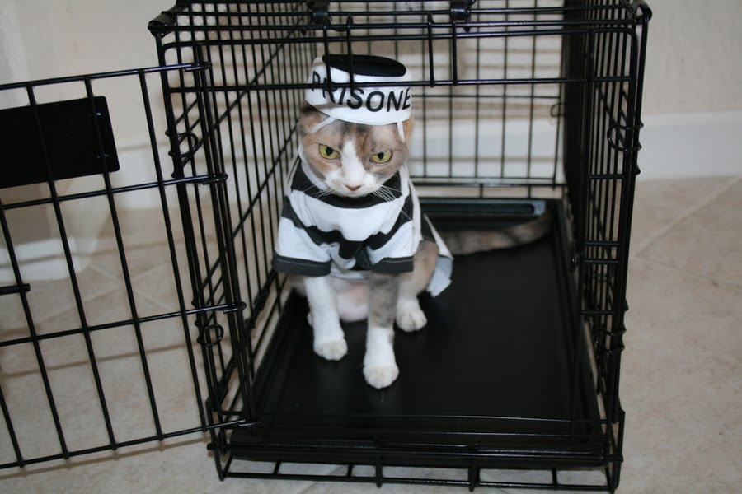
Programmability On a Large Scale
Programmability still a problem
FPGAs are a second-class citizen!
Notes:
-Programmability of these large clusters still remain to be a problem
-Many of the solutions in the cloud services have looked at providing FPGAs as accelerators along with CPU resources, and have yet to look at how these FPGAs will communicate in a heterogeneous environment as peers
-These FPGA resources have become larger and more versatile and can be useful as standalone devices in a heterogeneous environment
-FPGAs are currently a second-class citizen in these data centers, and our work looks at how to change our view

Slide 4

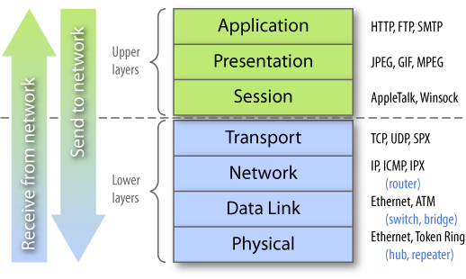
Stacked Approach
No need to reinvent the wheel every time!
Source: http://blog.asset-intertech.com/test_data_out/2011/02/the-test-stack.html
Notes:
-We look at this problem through the use of a stack.
-This is analagous to your network stack, where each layer provides a service to the layer above.
-The reason being is that when infrastructure changes or protocols change at some layer of the stack it ensures user applications and upper layers to stay consistent.
-For example in the network stack if the physical medium changes from electrical to optical networks, we can still use MAC addresses in the ethernet layer, IP in the internet layer and TCP in the transport layer for both of these physical mediums

Slide 5
Stacked Approach
No need to reinvent the wheel every time!
Source: http://blog.asset-intertech.com/test_data_out/2011/02/the-test-stack.html
Notes:
-We look at this problem through the use of a stack.
-This is analagous to your network stack, where each layer provides a service to the layer above.
-The reason being is that when infrastructure changes or protocols change at same layer of the stack it ensures user applications and upper layers to stay consistent.
-For example in the network stack if the physical medium changes from electrical to optical networks, we can still use MAC addresses in the ethernet layer, IP in the internet layer and TCP in the transport layer for both of these physical mediums

Slide 6
Stacked Approach
No need to reinvent the wheel every time!
Source: http://blog.asset-intertech.com/test_data_out/2011/02/the-test-stack.html
Notes:
-We look at this problem through the use of a stack.
-This is analagous to your network stack, where each layer provides a service to the layer above.
-The reason being is that when infrastructure changes or protocols change at same layer of the stack it ensures user applications and upper layers to stay consistent.
-For example in the network stack if the physical medium changes from electrical to optical networks, we can still use MAC addresses in the ethernet layer, IP in the internet layer and TCP in the transport layer for both of these physical mediums

Slide 7
Stacked Approach
No need to reinvent the wheel every time!
Source: http://blog.asset-intertech.com/test_data_out/2011/02/the-test-stack.html
Notes:
-We look at this problem through the use of a stack.
-This is analagous to your network stack, where each layer provides a service to the layer above.
-The reason being is that when infrastructure changes or protocols change at same layer of the stack it ensures user applications and upper layers to stay consistent.
-For example in the network stack if the physical medium changes from electrical to optical networks, we can still use MAC addresses in the ethernet layer, IP in the internet layer and TCP in the transport layer for both of these physical mediums

Slide 8
Hardware Stack
Programming Layer
Hardware Middleware Layer
Hardware Cloud Provisioning Layer
Hardware Hypervisor/Shell
Physical Hardware and Network Setup
Notes:
We take the same stack approach for representing our work in the cloud as well as other works in of integrating FPGAs in the cloud. The Physical hardware and network setup represents the physical FPGA boards, and how the network configurations, such as if they are directly connected to the network switch.
Next above that is the hypervisor layer. This layer usually represents physical hardware circuitry that has been abstracted away from the user.
On top of that we have a provisioning layer. This layer isn't necessarily provided by all the works. This looks into how can we proviison resources from the cloud, what is the interface, what handle does the cloud management software return to the user.
On top of that we have our middleware layer. This layer describes the representation of clusters of FPGAs. This is different than the physical network setup as this is the user's view of the cluster versus what is actually physically implemented.
On top of that we have a programming layer which represents heterogeneous programming models that can fit onto our FPGA clusters.

Slide 9
Related Work on the Hardware Stack
Catapult V1
Programming Layer
Hardware Middleware Layer
Hardware Cloud Provisioning Layer
Hardware Hypervisor/Shell
Physical Hardware and Network Setup
-Shell abstracting Serial and PCIe
-FPGAs connected in 2D torus via
High speed serial link
Notes:
Here is a stack representation with Microsoft's first version of catapult. They provided a hypervisor which they refer to as their shell.
This shell provides high speed serial links to communicate to other FPGAs in the torus, and a PCIe connection to the CPU.
Note that the network connection to the FPGA is through the CPU in this model.

Slide 10
Related Work on the Hardware Stack
Catapult V2
Programming Layer
Hardware Middleware Layer
Hardware Cloud Provisioning Layer
Hardware Hypervisor/Shell
Physical Hardware and Network Setup
Light-weight Transport Layer
-Shell abstracting PCIe and network
-FPGAs connected to network
Switch. CPUs network connection
Comes through FPGA port
Notes:
-This is the second version of the Catapult project. In this model microsoft has introduced a light-weight transport layer for FPGAs to communicate within a cluster, in a protocol similar to UDP.
-This shell abstracts awa

Slide 11
Related Work on the Hardware Stack
Programming Layer
Hardware Middleware Layer
Hardware Cloud Provisioning Layer
Hardware Hypervisor/Shell
Physical Hardware and Network Setup
-AWS/ Openstack
-Amazon-Servers connected FPGA
Ring through PCIe.
-FPGA Network DPDK
Notes:
-Here's some related work from Amazon, Baidu and IBM that offer FPGAs provisioned as cloud services.
-IBM leverages Openstack, an opensource cloud provisioning software to provision an FPGA. Here it's a single FPGA resource not connected on the network
-Amazon uses their own cloud provisioning service to provision the FPGA. FPGAs are connected via PCIe to the CPU. A ring of FPGAs are provisioned to the server

Slide 12

Previous Work on the Hardware Stack
Programming Layer
Hardware Middleware Layer
Hardware Cloud Provisioning Layer
Hardware Hypervisor/Shell
Physical Hardware and Network Setup
-Streaming Kernels connected to
One switch
-Kernels are physically distributed
-Individual FPGAs provisioned with
Openstack, along with network
-Shell abstracting network (1G) and PCIe
-Programmed flattened bitstream
Notes:
-This is an overview of our previous work. This was published in FPGA 17.
-This work similar to this one presented several layers of this hardware stack.
-In this model the user would provide a description of their multi kernel fpga platform
-each kernel is a streaming kernel that feeds into one large logical switch
-This follows a packet switching model which allows all our kernels to communicate with one another using kernel addresses.
-our middleware would then partiion that large switch with the use of a mapping file into multiple fpgas
-then ask Openstack for PCIe connected devices and virtual network ports which we would register to a specific fpga.
-our hypervisor in this includes a 1G interface, and the entire bitstream is programmed onto the region

Slide 13
Overview of this Work on the Hardware Stack
Programming Layer
Hardware Middleware Layer
Hardware Cloud Provisioning Layer
Hardware Hypervisor/Shell
Physical Hardware and Network Setup
-Circuit switched network
-Circuit includes CPU and FPGA
-Kernels are physically distributed
-Individual FPGAs provisioned with
Openstack, along with network
-Shell abstracting network (10G) and PCIe
-Partial Reconfiguration flow
Notes:
-This work looks at two things.
-First it provides an alternative middleware layer in the form of a circuit switching network, where our FPGA kernels are now network functions and we can layout paths
Between CPU and FPGA network functions.
- Next similar to the previous work we used the same cloud provisioning layer to provision the resources. With one caveat as we can present both CPU and FPGA network functions, furthermore these can be hotswapped, opening the door for an incremental heterogenous design flow.
-We also upgraded our hypervisor to 10G links and introduced a PR flow.

Slide 14
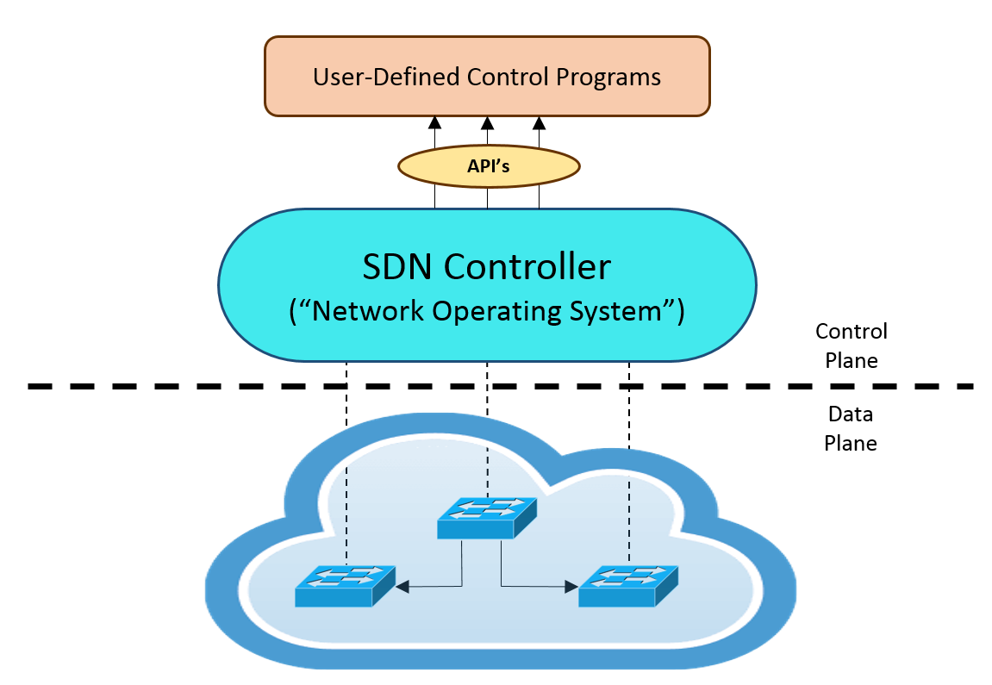
Software-Defined Networking
Notes:
-In this work we implement the connection of these network functions through the use of software defined networking.
-software defined networking (or SDN) is the concept of dividing the control plane and the data plane of the networking, allowing for full configurability of a large network
-Our data plane consists of the switches with simple forwarding rules. These are managed by a control plane.
-The control plane is a logicially centralized layer that manages these data switches by mapping a user request onto these switches
-The details of the data plane are abstracted away from the user through the use of an SDN controller, these details include the physical location and number of these swtiches.
-We use SDN to manage our switches and assign different switch ports a virtual port that we get assigned with through openstack
-Through the use of SDN it is possible to now stitch together network functions, our implementation looks at the formation of these chains, with both FPGAs and CPUs

Slide 15
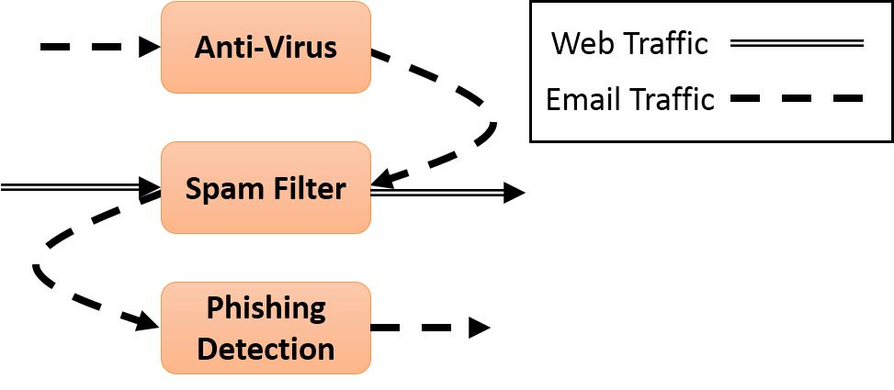
Service Chain Example
Notes:
-So you might ask why network functions. Here's one example of what a network function service chain might look like.
-A user in the cloud could ask the service manager for a chain of network functions such as the ones in this picture.
-The implementation of these services could be on a combination of heterogenous devices including CPUs and FPGAs.
-Our infrastructure allows the easy formation of these chains. We looked at the network function model because many of these are streaming applications which particularly do well on FPGAs, these services traditionally implemented in software tend to work even better on FPGAs.
-Each of these functions are known as virtualized network functions, as the physical implementation of these functions are abstracted away from the user

Slide 16
Incremental Design Flow
Legend
CPU
FPGA
VNF A
VNF B
VNF C
VNF D
Notes:
-Our framework allows for an incremental design flow of large multi fpga network clusters
-Here's an example of the initial implementation of a network cluster through the use of software vnfs, we'll go through the flow of how these are created later in the presentation
-Each VNF is presented as a software image representing our VNF, our middleware layer instantiates these software VNFs through the appropriate Openstack calls and with the use of our SDN framework connects them together
-Once the user is satisfied with the functionality of this VNF in software we can start to look at implementing parts of this chain in hardware

Slide 17
Incremental Design Flow
Legend
CPU
FPGA
VNF A
VNF B
VNF C
VNF D
VNF A
VNF B
VNF C
VNF D
VNF B
Notes:
-Now at this point we have implemented a hardware version of one of these VNFs, this could be in RTL, HLS or we can even lazily try to take the software implementation of the VNF and pump it through an HLS compiler
->as long as there is an input and output streaming port it should fit within our framework.
-We can look to integrate this as part of the chain, since we have verified the rest of the chain works, as long as this VNF functionally performs the same way as the other VNF and there are not timing assumptions in the rest of the VNFs then the functionality should be unchanged.

Slide 18
Incremental Design Flow
Legend
CPU
FPGA
VNF A
VNF B
VNF C
VNF D
VNF A
VNF B
X
VNF C
VNF D
X
VNF B
Notes:
-At this point our middleware will create a new virtual network port by provisioning a unique port through openstack, and registering that on the switch

Slide 19
Incremental Design Flow
Legend
CPU
FPGA
VNF A
VNF B
VNF C
VNF D
VNF A
VNF B
X
VNF C
VNF D
X
VNF B
Notes:
-Then we redirect the traffic from VNFA into the new VNFB. The details in how this is done will be explained later in this presentation

Slide 20
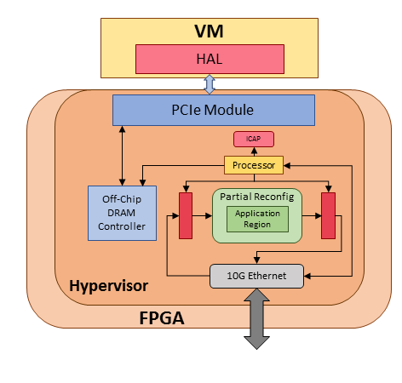
FPGA Hypervisor

Slide 21
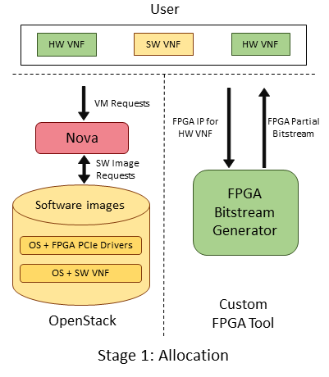
Service Chain Scheduler
Resource allocation
OS image
Parameters: cores, pcie devices, NIC ports
Bitstream generator
Notes:
-Our middleware layer from a high level works in two stages.
-as you see on the left hand side the first stage is the allocation of the resources
-we use the nova tool within the openstack framework that is responsible for the allocation of the compute resources
-each user specified chain such as the one presented by the user of three VNFs in this example is translated into a series of resource allocation by our service chain scheduler
-> the commands are for three calls to acquire each VNF. Each of these calls include an OS image, machine parameters which include the cores, pcie devices of the machine and number of NIC ports
-> before running the middleware layer we have to configure in our openstack configuration to passthrough our FPGA pcie device as a configuration
-Once the virtual machine CPUs are made, then another VM is made that we use as an FPGA bitstream generator. This bitstream generator is made with parameters that specified a large machine built to create FPGA bitstreams
-For each HW VNF in the chain which can be specified as RTL or as a pre-made bitsteram. If it is RTL it is then sent to an FPGA Bitstream Generator which generates the bitstreams for each RTL specified VNF
-These bitstreams are returned to the middle layer, then these bitstreams are transferred onto the virtual machines connected to each of the FPGAs, and the bitstreams are programmed onto the FPGAs via pcie

Slide 22
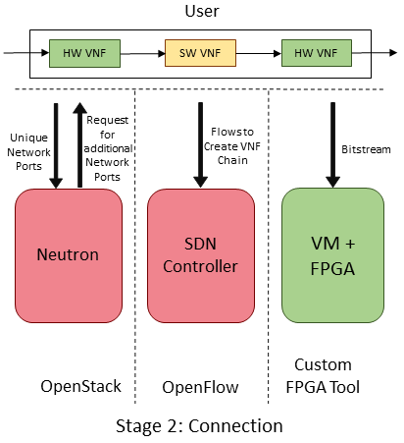
Service Chain Scheduler
For each FPGA, assign and register virtual port
Create chain between source and sink of network and intermediate VNFs
Notes:
-Once the resrouces are allocated in the cloud now we can work on connecting them in the network
-Our middleware layer then issues commands to neutron which is Openstack's network application for each additional network port that we need for the FPGA,
We do not need to do this for software VNFs as CPUs are already connected on the network
-Neutron keeps a database of all the network ports that have been allocated in the data center and assign a unique one
-we then register that port with a physical port the FPGA is connected to on the switch and now we can issue packets to the HW VNF by addressing the specific port
-But we still haven't formed the chain, at this point it is still part of the packet switched network and after we convert it to the circuit switched network
at this point we calculate the path from the first node of the chain to the end of the chain, and interject intermediate hops in the middle, I'll go into details of how this is done

Slide 23
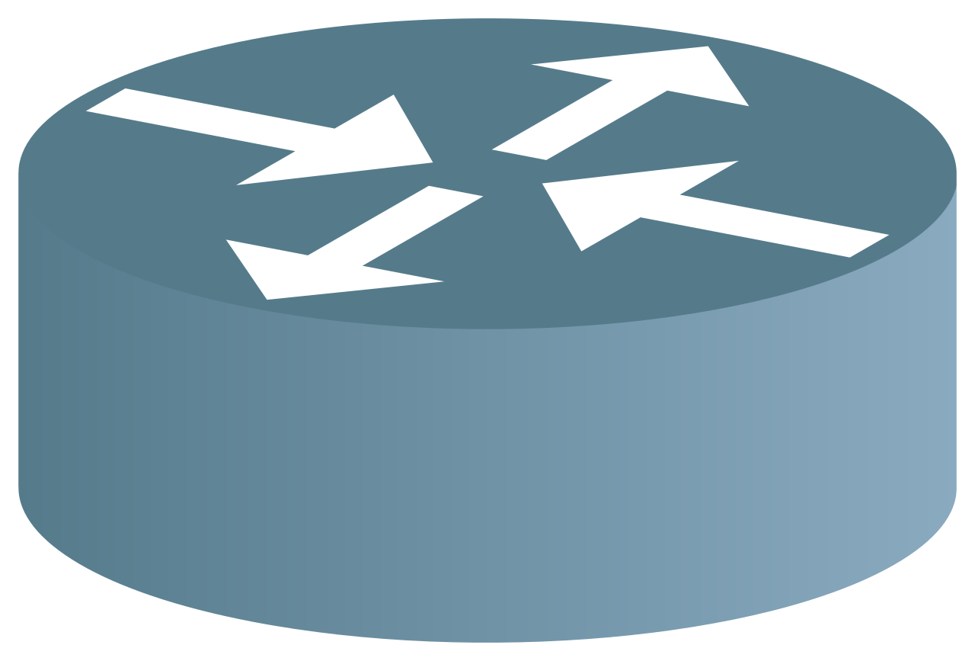
Network Chaining Steps
Source
Dest
VNF A
Notes:
-This is best demonstrated with an example. The purpose of chaining is to direct traffic through these functions without changing the addresses of the network packets, as many networking applications require analyzing packet headers
-We do this by first calculating the initial path between the source and sink of our network. This is used by looking at the source and sink ip addresses and we can query our SDN controller for the path between those two nodes. -Now for each VNF we would like to add to the network we calculate the path between the source and the VNF, and the VNF and the sink.
-we then update the respective switches of in

Slide 24
Network Chaining Steps
Source
Dest
VNF A
Notes:
-This is best demonstrated with an example. The purpose of chaining is to direct traffic through these functions without changing the addresses of the network packets, as many networking applications require analyzing packet headers
-We do this by first calculating the initial path between the source and sink of our network. This is used by looking at the source and sink ip addresses and we can query our SDN controller for the path between those two nodes. -Now for each VNF we would like to add to the network we calculate the path between the source and the VNF, and the VNF and the sink.
-we then update the respective switches of in

Slide 25
Network Chaining Steps
Source
Dest
VNF A
Notes:
-This is best demonstrated with an example. The purpose of chaining is to direct traffic through these functions without changing the addresses of the network packets, as many networking applications require analyzing packet headers
-We do this by first calculating the initial path between the source and sink of our network. This is used by looking at the source and sink ip addresses and we can query our SDN controller for the path between those two nodes. -Now for each VNF we would like to add to the network we calculate the path between the source and the VNF, and the VNF and the sink.
-we then update the respective switches of in

Slide 26
Overhead of Design
Hardware overhead: Hypervisor (on V690TFFG)
 | LUTs | Flip-Flops | BRAM
FPGA Hypervisor | 62344 (14.4 %) | 76124 (8.79 %) | 228 (15.5 %)
Total Available | 433200 | 866400 | 1479
Notes:
-The majority of the overhead in our design is due to the Hypervisor.
-These numbers are reported on the Alphadata 7v3 board which uses the V69TFFG Virtex 7 FPGA
The overhead of the hypervisor is minimal with about 15 % of the resources used on the FPGA.

Slide 27
Time to Create Application
 | Time to Program | Time to create Bitstream
PR | 20 to 40 s | 40 to 60 min
Hypervisor | 60 to 90 s | 90 to 120 min
Notes:
-Our hypervisor also reduces the time to create applications as reprogramming time is cut down to 20s and time to create a bitstream is 60 minutes.
-We also allow users to specify pre-made bitstreams as Images, to reduce on the time to create these bitstreams.

Slide 28
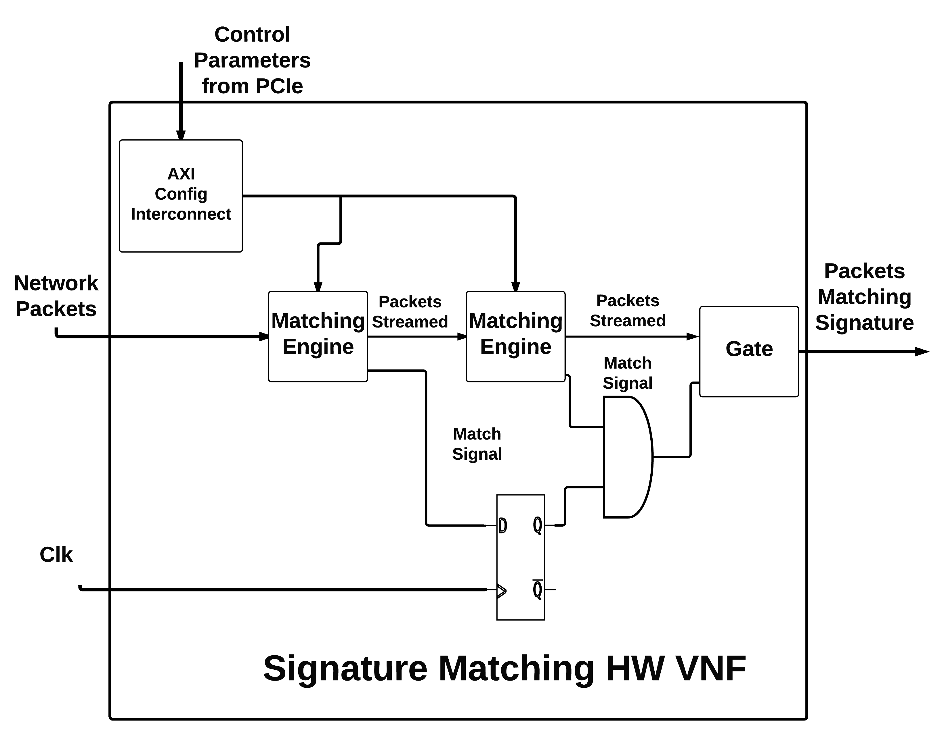
Case Study
We built a signature matching engine
Scan entire packet for pattern
Simple shift register in hardware
Software uses DPDK
Notes:
We built a signature matching engine as a case study. In the paper we look at different implementations of this engine. -A signature is defined to be a text pattern we search for in a given packet.
-The two implementations were for fixed offsets where we know exactly where in the packet to look for, and one without fixed offets.
-I am presenting the one without the fixed offset but please refer to the paper for both implementations of our case study.
-Each of these blocks checks for 8 signatures but we can easily just add multiple blocks as these are fully pipelined blocks working at line-rate.
-The software implementation uses DPDK which is a high performing low-overhead layer that allows our application to bypass the traditional network stack to acquire packets with little overhead and can acquire packets at line-rate. Thus the performance overhead in software that we acquire is due to the compuatation and not getting packets from the network.

Slide 29
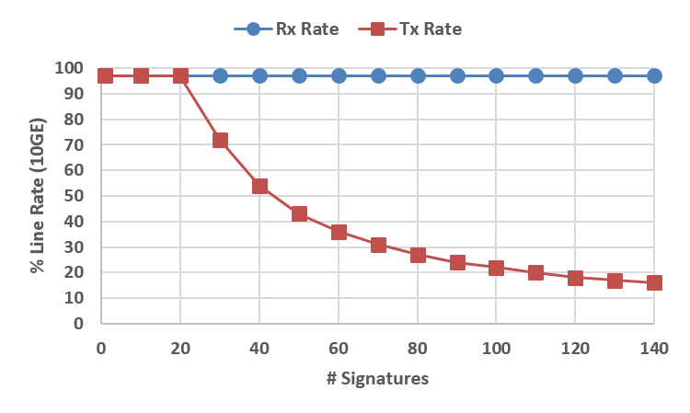
Throughput
Notes:
-The Hardware implementation of this block can keep up at line-rate, for as many signatures fit on the board. On this board we can fit about close 1500 signatures. Furthermore we can use multiple FPGAs as multiple VNFs in our framework to support even more signatures and it should continue to work without a throughput drop as the entire path can work at line-rate.
-The software implementation of this block requires an entire scan of the packet. Which is why after about 30 signatures the computation becomes too much to complete at line-rate. This can be mitigated by increasing the buffers for a latency cost, but since the software cannot keep up at line-rate this will eventually not be able to keep up with enough signatures.

Slide 30
Conclusion
Heterogeneous VNFs are useful: streaming nature
Framework to tie VNFs promote incremental development
Multiple implementations of the same block

Slide 31

Questions
Email: naif.tarafdar@mail.utoronto.ca
This Photo by Unknown Author is licensed under CC BY-SA

