Slide 1
Galapagos: A Stacked Approach for Hardware Integration in the Data Center
Naif Tarafdar, Nariman Eskandari, Daniel Rozkho, Daniel Ly-Ma, Varun Sharma, Camilo Vega, Sean Nijjar, Paul Chow
Nov 29, 2018

Slide 2
The Holy Grail
Heterogeneous Data Center
Distributed Flow Diagram
B
A
D
A
D
C
B
C

Slide 3
Data Centers are Heterogeneous
Take advantage of unique resources in data center
Need back doors or abstractions to communicate between different devices
Scaling this up is difficult as different devices have different programming models, abstractions etc.

Slide 4
Stacked Approach
We use several layers of abstraction.
Flexibility provided to user for them to control level of abstraction.
Where have we seen this before?

Slide 5

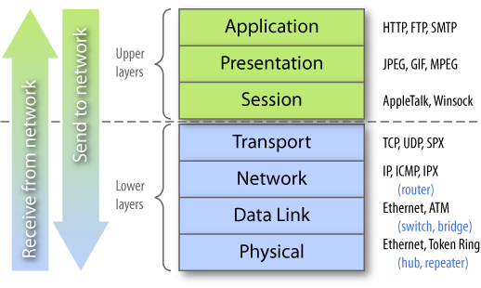
Stacked Approach
No need to reinvent the wheel every time!
Source: http://blog.asset-intertech.com/test_data_out/2011/02/the-test-stack.html
Notes:
-We look at this problem through the use of a stack.
-This is analagous to your network stack, where each layer provides a service to the layer above.
-The reason being is that when infrastructure changes or protocols change at some layer of the stack it ensures user applications and upper layers to stay consistent.
-For example in the network stack if the physical medium changes from electrical to optical networks, we can still use MAC addresses in the ethernet layer, IP in the internet layer and TCP in the transport layer for both of these physical mediums

Slide 6
Stacked Approach
No need to reinvent the wheel every time!
Source: http://blog.asset-intertech.com/test_data_out/2011/02/the-test-stack.html
Notes:
-We look at this problem through the use of a stack.
-This is analagous to your network stack, where each layer provides a service to the layer above.
-The reason being is that when infrastructure changes or protocols change at same layer of the stack it ensures user applications and upper layers to stay consistent.
-For example in the network stack if the physical medium changes from electrical to optical networks, we can still use MAC addresses in the ethernet layer, IP in the internet layer and TCP in the transport layer for both of these physical mediums

Slide 7
Stacked Approach
No need to reinvent the wheel every time!
Source: http://blog.asset-intertech.com/test_data_out/2011/02/the-test-stack.html
Notes:
-We look at this problem through the use of a stack.
-This is analagous to your network stack, where each layer provides a service to the layer above.
-The reason being is that when infrastructure changes or protocols change at same layer of the stack it ensures user applications and upper layers to stay consistent.
-For example in the network stack if the physical medium changes from electrical to optical networks, we can still use MAC addresses in the ethernet layer, IP in the internet layer and TCP in the transport layer for both of these physical mediums

Slide 8
Stacked Approach
No need to reinvent the wheel every time!
Source: http://blog.asset-intertech.com/test_data_out/2011/02/the-test-stack.html
Notes:
-We look at this problem through the use of a stack.
-This is analagous to your network stack, where each layer provides a service to the layer above.
-The reason being is that when infrastructure changes or protocols change at same layer of the stack it ensures user applications and upper layers to stay consistent.
-For example in the network stack if the physical medium changes from electrical to optical networks, we can still use MAC addresses in the ethernet layer, IP in the internet layer and TCP in the transport layer for both of these physical mediums

Slide 9
Galapagos Hardware Stack
Programming Layer
Hardware Middleware Layer
Hardware Cloud Provisioning Layer
Hardware Hypervisor/Shell
Physical Hardware and Network Setup
Notes:
We take the same stack approach for representing our work in the cloud as well as other works in of integrating FPGAs in the cloud. The Physical hardware and network setup represents the physical FPGA boards, and how the network configurations, such as if they are directly connected to the network switch.
Next above that is the hypervisor layer. This layer usually represents physical hardware circuitry that has been abstracted away from the user.
On top of that we have a provisioning layer. This layer isn't necessarily provided by all the works. This looks into how can we proviison resources from the cloud, what is the interface, what handle does the cloud management software return to the user.
On top of that we have our middleware layer. This layer describes the representation of clusters of FPGAs. This is different than the physical network setup as this is the user's view of the cluster versus what is actually physically implemented.
On top of that we have a programming layer which represents heterogeneous programming models that can fit onto our FPGA clusters.

Slide 10

Related Work on the Hardware Stack
Catapult
Light-weight Transport Layer
Programming Layer
Hardware Middleware Layer
Hardware Cloud Provisioning Layer
Hardware Hypervisor/Shell
Physical Hardware and Network Setup
-Shell abstracting PCIe and network
-FPGAs connected to network
Switch. CPUs network connection
Comes through FPGA port
Notes:
-This is the second version of the Catapult project. In this model microsoft has introduced a light-weight transport layer for FPGAs to communicate within a cluster, in a protocol similar to UDP.
-This shell abstracts awa

Slide 11



Related Work on the Hardware Stack
Programming Layer
Hardware Middleware Layer
Hardware Cloud Provisioning Layer
Hardware Hypervisor/Shell
Physical Hardware and Network Setup
-AWS/ Openstack
-Amazon-Servers connected FPGA
Ring through PCIe.
-FPGA Network DPDK
Notes:
-Here's some related work from Amazon, Baidu and IBM that offer FPGAs provisioned as cloud services.
-IBM leverages Openstack, an opensource cloud provisioning software to provision an FPGA. Here it's a single FPGA resource not connected on the network
-Amazon uses their own cloud provisioning service to provision the FPGA. FPGAs are connected via PCIe to the CPU. A ring of FPGAs are provisioned to the server

Slide 12
High-Level Overview
User supplies description of problem
Automatically partitioned and programmed onto cluster
Each layer of stack provides API for layer below.

Slide 13
L1: Physical Hardware and Network Setup

Slide 14
L1: Intro
This layer refers to the physical setup of our cluster
Two main families
PCIe Connected FPGAs (PCIe connection for power and control)
SoC FPGAs (PCIe backplane for power)
All FPGAs and CPUs connected to ToR for data
Notes:
-FB denotes FPGA board

Slide 15
L1: Diagram
VM
VM
VM
VM
VM
VM
Hypervisor
Hypervisor
Hypervisor
CPU Server
CPU Server
CPU Server
PCIe for Power
And Control
Signals from VM
PCIe for Power
FB
FB
MPSoC FB
FB
FB
VM
VM
1/10G Network Switch
Hypervisor
ARM CPU
100G Network Switch
FPGA
Notes:
-FB denotes FPGA board

Slide 16
L1: Inventory
Alphadata 7v3 * 4 – Virtex 7 -690T
~690K Logic cells, 3600 DSP Slices , 52.9 MB BRAM
2 * 10G SFP Networking ports
16 GB off-chip memory
Alphadata 8v3 * 8 – Virtex Ultrascale – XCV095
~1176K Logic cells, 768 DSP Slices, 60.8 MB BRAM
2 * 100G QSFP Networking Ports
16 GB off-chip memory
Alphadata 8k5 *8 –Virtex Ultrascale – KU115
~1450K Logic cells, 5520 DSP Slices,
2 * 10G SFP Networking ports
16 GB off-chip memory
Fidus Sidewinder * 2 – Zynq Ultrascale + MPSoC
ARM A53 (4 core) + ARM R5 (2 core)
~1140 Logic Cells, 1910 DSP Slices, 128 MB BRAM
2 * 100G QSFP Networking Ports
16 GB off-chip DRAM for ARM, 16 GB off-chip DRAM for FPGA

Slide 17
L1: Extensions
Currently compute is heterogeneous but network connections homogeneous
All devices are connected to same top of rack switch
Advantage: Easier to manage
Disadvantage: Cannot take advantage of locality
Proposal: introduce heterogeneous network connectivity through a network L1 switch
Abstract difficulty of heterogeneous network through another layer in the Galapagos Stack (middleware)

Slide 18
L2: Hypervisors

Slide 19
L2: Intro
This layer refers to the abstracted interfaces for a single FPGA
Main goals:
Introduce functional portability by standardizing interface
Increase productivity as user doesn’t need to worry about I/O
Allows users to share FPGA (Multi-tenant)
Notes:
-FB denotes FPGA board

Slide 20
L2: Simple Hypervisors
Non-MPSoC
MPSoC (In Progress)
MPSoC FB
VM
VM
VM
VM
Hypervisor
Hypervisor
CPU Server
ARM CPU
PCIe Passthrough
SMMU Passthrough
PCIe IP
PCIe IP
FPGA
VFPGA
VFPGA
VFPGA
VFPGA
Net IP
Net IP
Net IP
Notes:
-note all VFPGAs have control from CPU and data into network

Slide 21
L2: Advanced Hypervisors
Secured isolation of applications running on FPGA
Isolate application activity from the network, preventing harm from errant or malfunctioning applications
Enables multi-tenant (i.e. multi-tasking) deployments, each app isolated from the others
Virtualized access to external I/O
Higher-level protocols to abstract access to memory and networking

Slide 22
L2: Soft vs Hard Shell Distinction
Security and isolation must be provisioned in the static region of the hypervisor
parsing bitstreams to verify secure application behavior is an untenable solution, security must be included in static logic
termed “static hypervisor” or “hard shell”
Other higher-level 'OS' like features can be instantiated as needed in the PR region itself
Termed “dynamic hypervisor” or “soft shell”

Slide 23
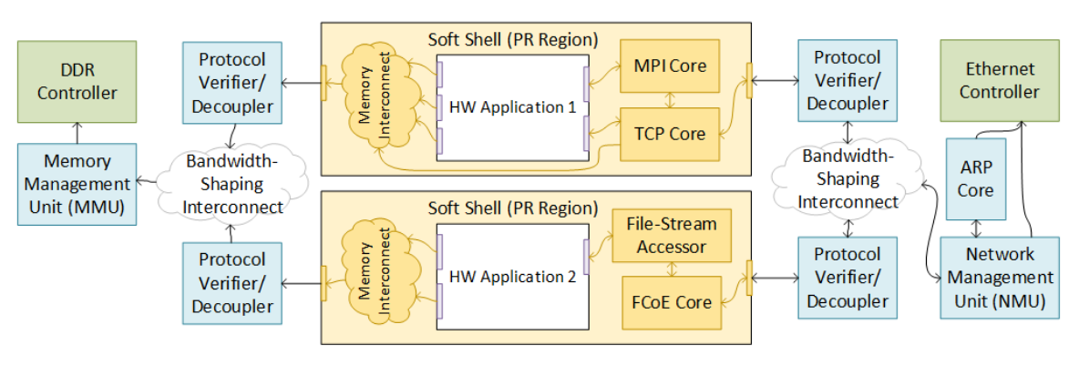
L2: High-Level (Long-term Plan)

Slide 24
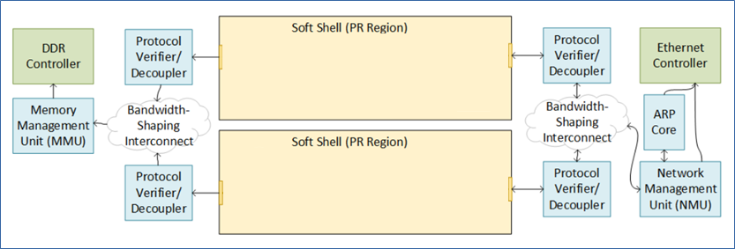
L2: Masters Focus (Hard Shell)

Slide 25
L2: Network Management (NMU)
Network Management Unit – parse network packet and restrict to allowable network domain (whether L1, L2, or L3, flexible)
AXI Stream interface
Each AXI ID (which can include multiple logical interfaces per soft shell) has own dedicated network policy

Slide 26
L2: Network Management (NMU)
Potential Modes of Network Isolation
Source-semantics enforcement
Source- and destination-semantics enforcement
Virtualized networking
Header encapsulation
Push to next level switch

Slide 27
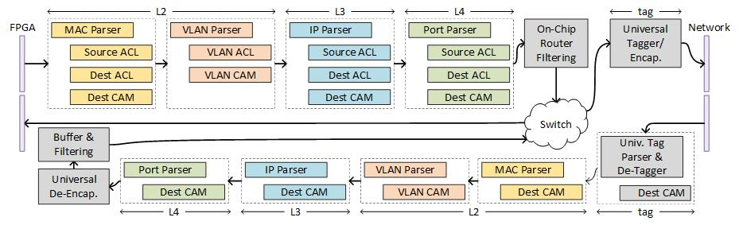
L2: Universal NMU
Universal NMU Implementation (FPGA 19)

Slide 28
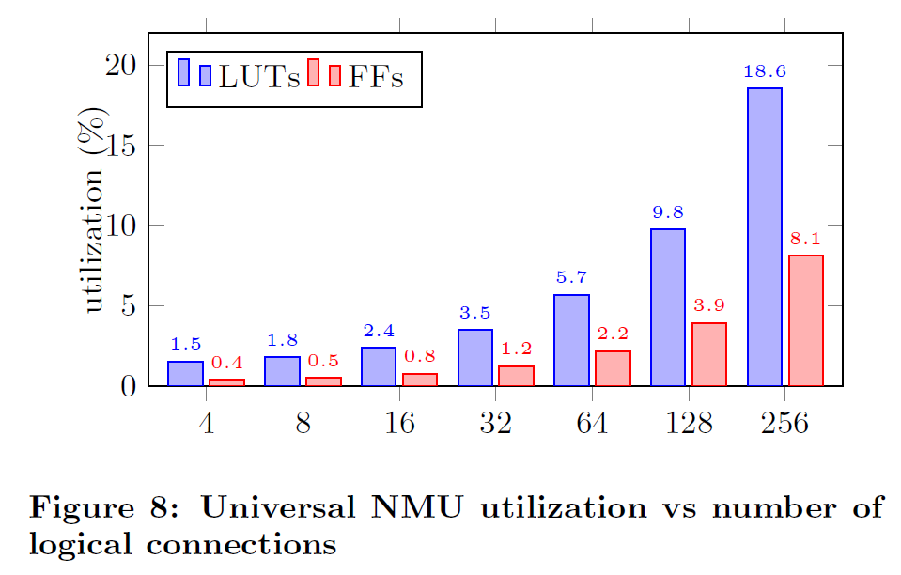
L2: Universal NMU
Universal NMU Implementation (FPGA 19)

Slide 29
L2: Performance Isolation
Use of bandwidth shaping to effectively allocate memory/network bandwidth to PR regions
Using existing Credit-Based Throttling Systems
Modified for AXI protocol
Added penalty for intentionally idle senders
Doesn’t yet account for memory access efficiency

Slide 30
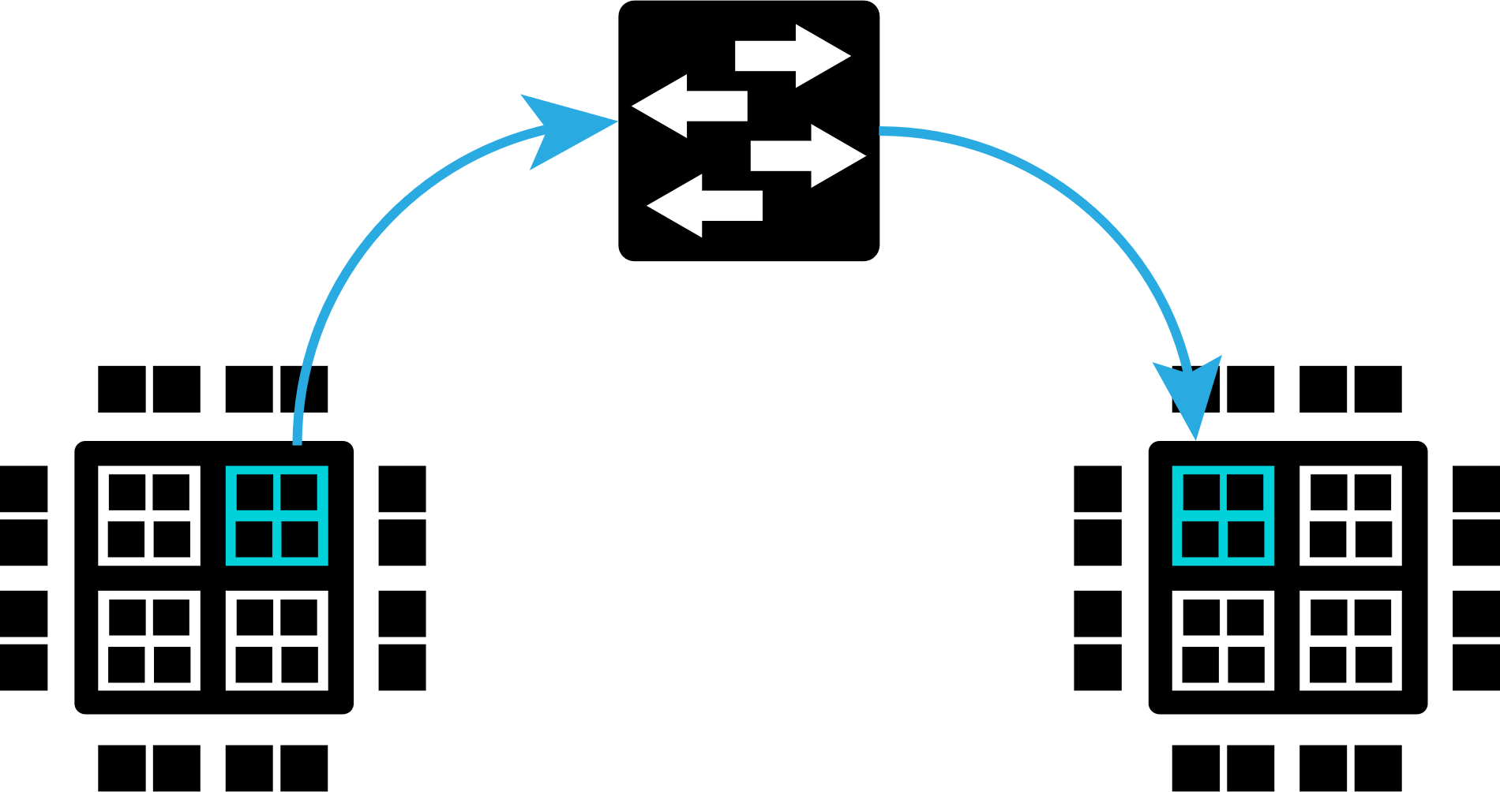
L2: Application Live Migration
Goal: Seamlessly move a running HW application between different physical FPGA devices
Analogous to moving running VMs between servers
Our approach:
Non intrusive and transparent FPGA state saving using bitstream readback and restore
Can migrate open TCP/IP network connections
Can migrate offchip memory contents
Minimizes downtime and bandwidth usage through memory precopying
Management of FPGA applications done using a REST API

Slide 31
L3: Cloud Provisioning Layer

Slide 32
L3: Intro
This layer refers to how we provision individual resources to a user from a shared pool
FPGAs and CPUs for data are peers, require additional network port provisioned
CPU attached via PCIe to FPGA, small VM/container for control
Notes:
-FB denotes FPGA board

Slide 33
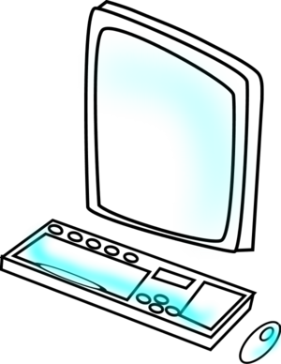
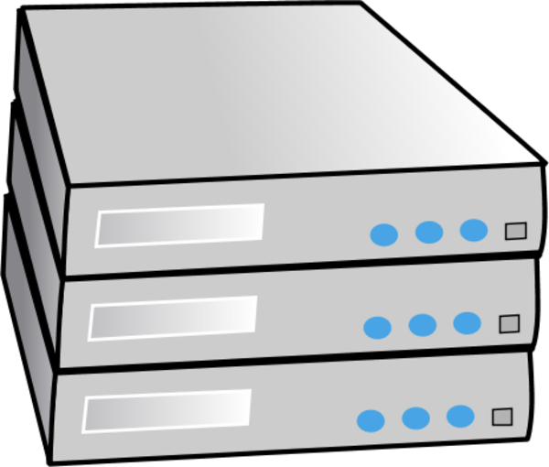

L3: Diagram
Virtual Machine
Virtual Machine
Virtual Machine
OpenStack
KVM Hypervisor (With Passthrough)
User
Network Switch
Physical Rack With PCIe FPGAs

Slide 34
L3: Current Status
Initially used VMs
Now moved to containers
Currently not integrated in rest of stack (in progress)

Slide 35
L4: Hardware MiddleWare Layer

Slide 36
L4: Intro
This layer refers to how we orchestrate clusters of resources
Includes FPGAs and CPUs
Orchestration includes automating the connections between resources and providing handle to entire cluster
Network communication via TCP or L2 ethernet (parameterizable)
Notes:
-FB denotes FPGA board

Slide 37

L4: Overview
User can define a FPGA cluster using cluster description files and AXI-Stream kernels
VM
FPGA
File
Tool Flow
Network
Kernel
VM
VM
Kernel
Kernel
AXI-Stream
AXI-Stream
FPGA
FPGA
Notes:
Put numbers for FPGAs

Slide 38
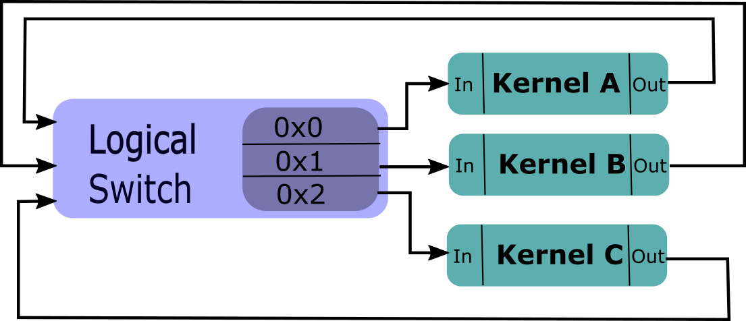
L4: Packet Switched Logical Cluster Description
FPGA Mapping File
Kernel A | FPGA 1
Kernel B | FPGA 1
Kernel C | FPGA 2

Slide 39
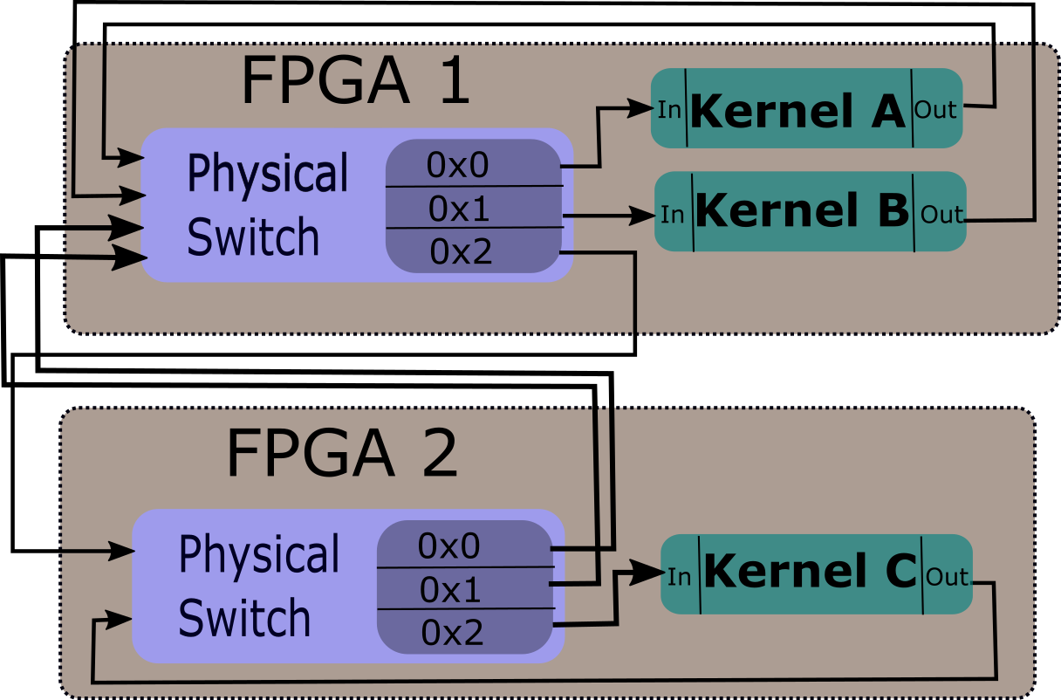
L4: Packet Switched Physical Mapping

Slide 40
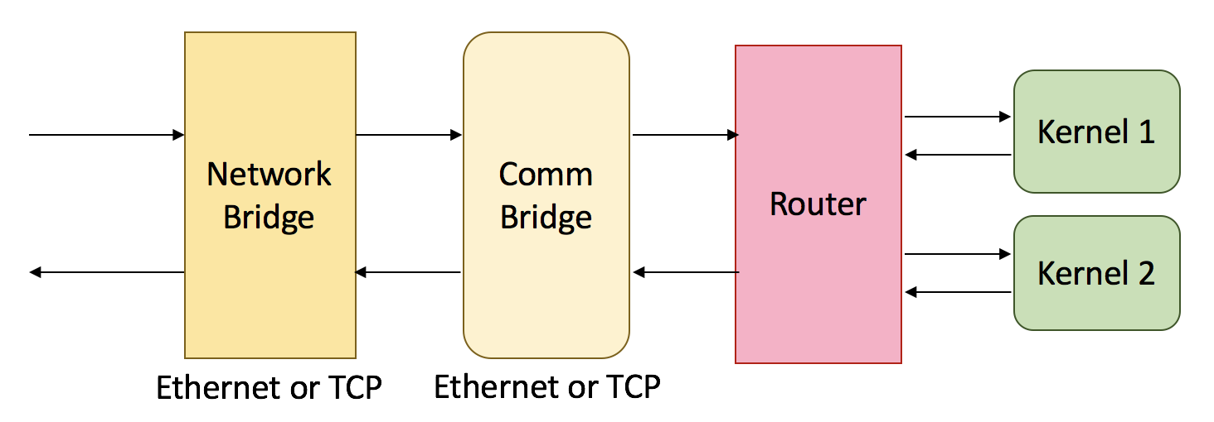
L4: Application Region

Slide 41
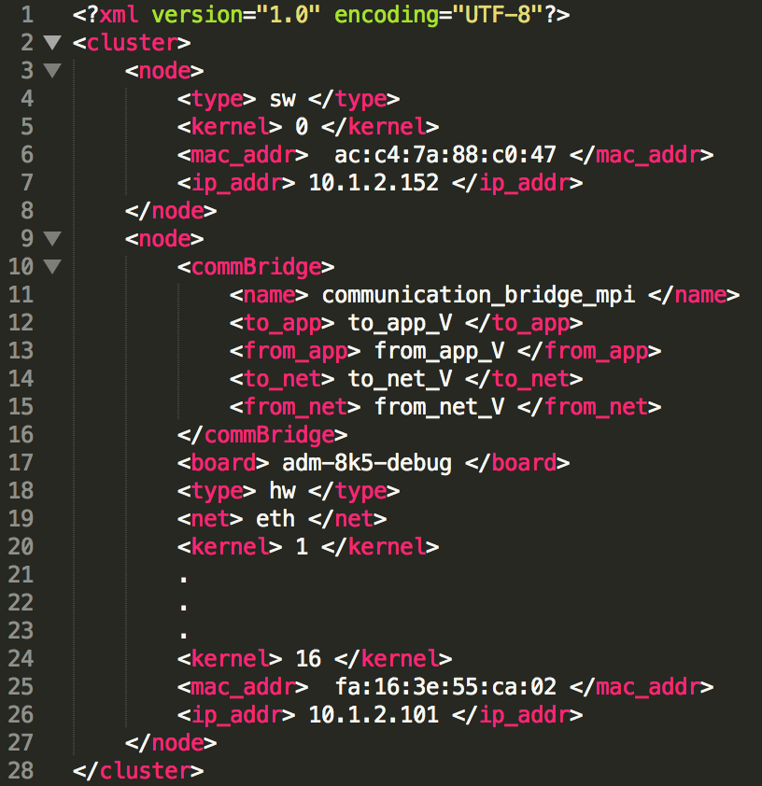
L4: System Tool Flow
Ease of use
Changing the underlying protocol
Notes:
Spend less time
HUMboldt bridge

Slide 42
L4: System Tool Flow
Ease of use
Changing the underlying protocol
Changing from software to hardware

Slide 43
L5: HUMBOLDT MPI Programming Layer

Slide 44
L5: HUMboldt (Heterogeneous Uniform Messaging) Communication Layer
A message passing communication layer
A minimal subset of MPI
Only blocking send and receives
Software and Hardware library
Functional portability

Slide 45
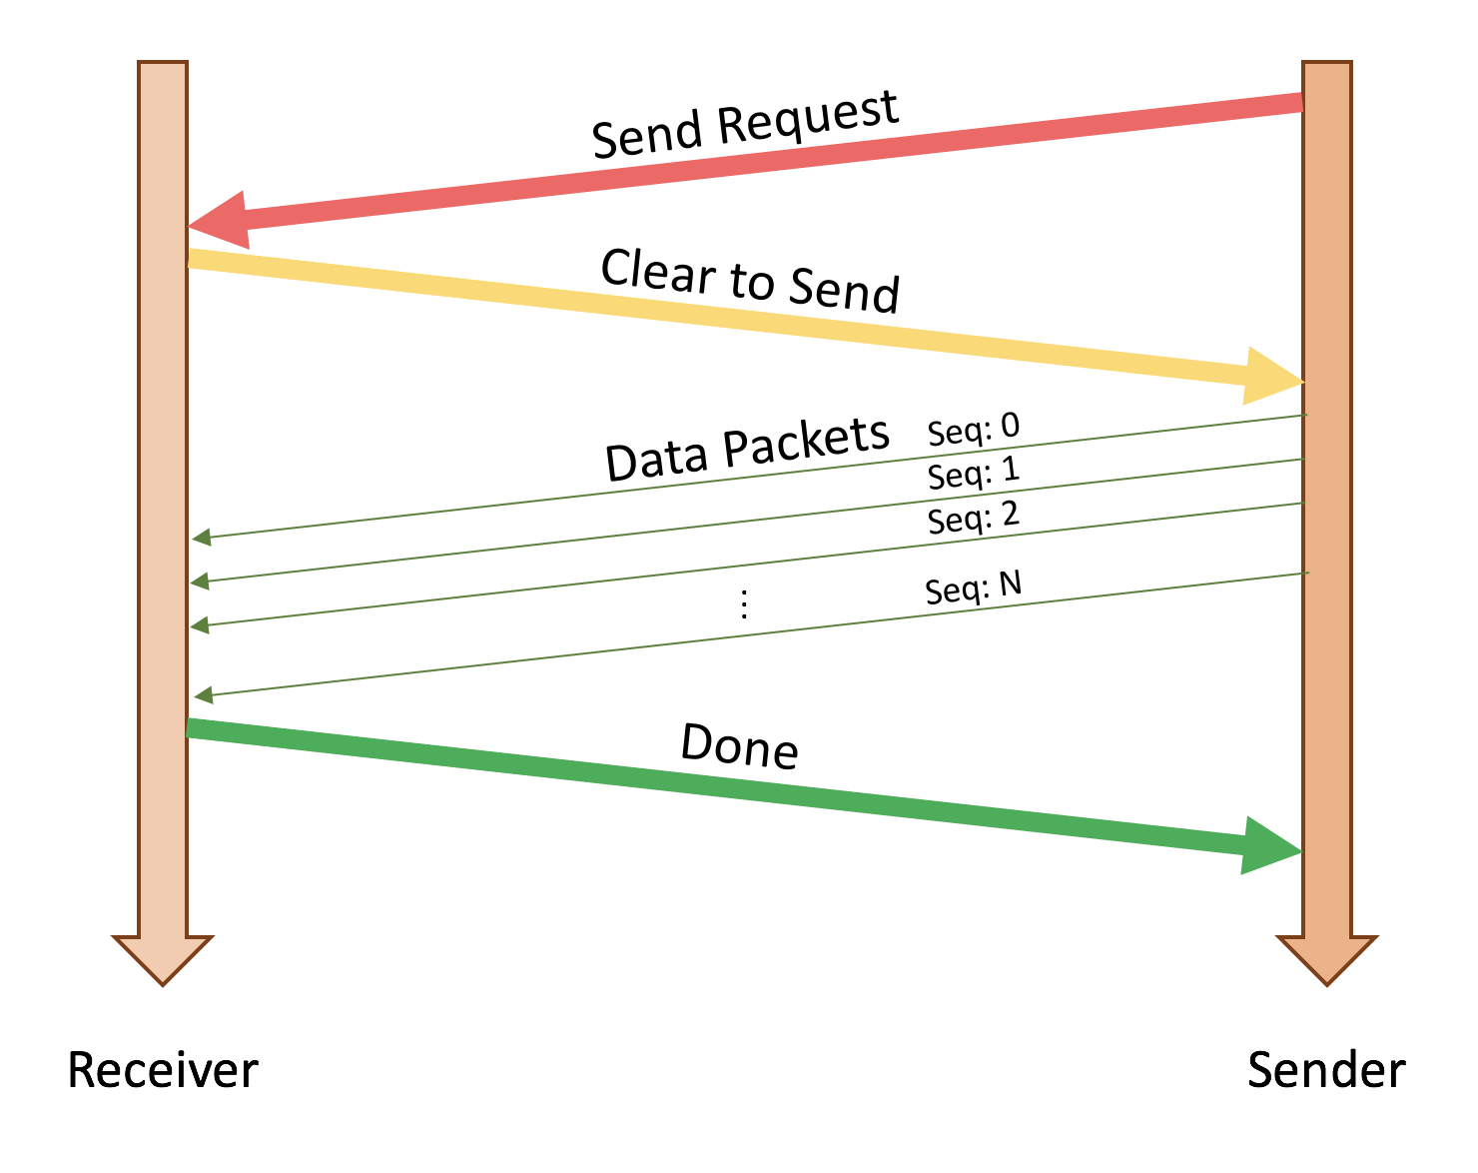
L5: HUMboldt Protocol
Rendezvous Protocol

Slide 46
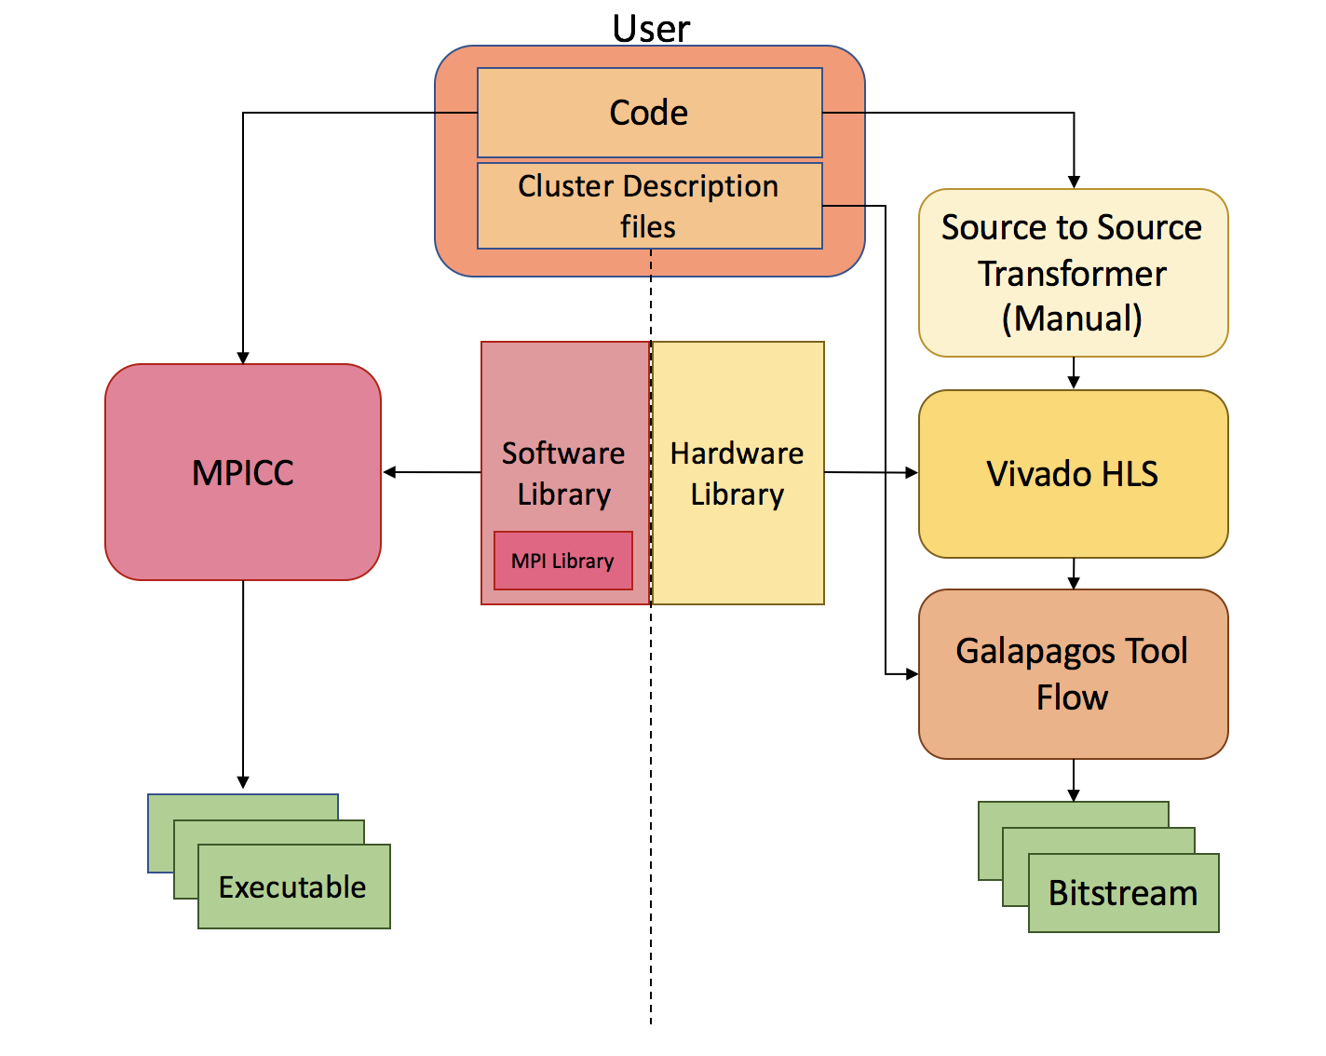
L5: System Tool Flow
HUMboldt has two branches for creating the entire cluster
Software ranks
Hardware ranks
Same code can be used for both software and hardware ranks
Notes:
Box here is necessary
Hard to follow
Change hardware library to HUMboldt!

Slide 47
L5: Results: Microbenchmarks
Hardware Kernel
FPGA
Hardware Kernel
FPGA
FPGA
Hardware Kernel
Hardware Kernel
CPU
FPGA
Software Kernel
Hardware Kernel
FPGA
CPU
Hardware Kernel
Software Kernel
CPU
CPU
Hardware Kernel
Software Kernel
MPICH
Notes:
Redo this

Slide 48
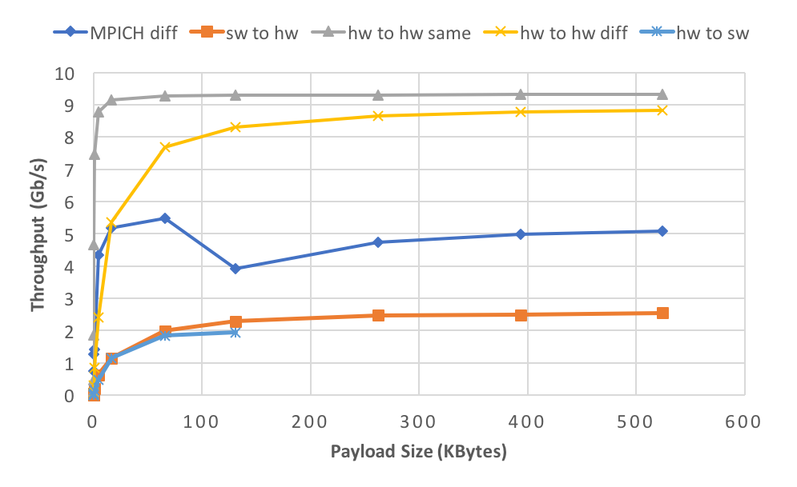
L5: Throughput Results
Ethernet
Notes:
Gap draw an arrow
Where the limit is for TCP

Slide 49
L5: Throughput Results
Ethernet
Notes:
Gap draw an arrow
Where the limit is for TCP

Slide 50
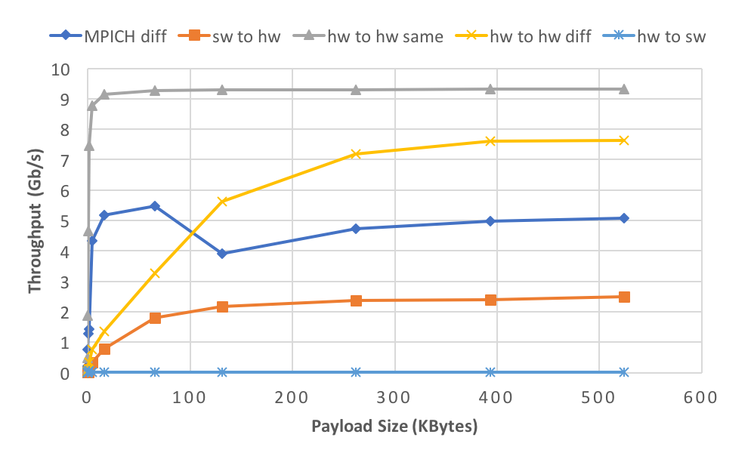
L5: Throughput Results
TCP
Notes:
Gap draw an arrow
Where the limit is for TCP

Slide 51
L5: Throughput Results
TCP
Notes:
Gap draw an arrow
Where the limit is for TCP

Slide 52
L5: Latency Results
Zero-payload packets
Microbenchmarks | Ethernet (µs) | TCP (µs)
Hardware to Hardware (same node) | 0.2 | 0.2
Hardware to hardware (different node) | 5.7 | 15.2
Software to Hardware | 27.5 | 48.8
Hardware to Software | 34.7 | 113.6

Slide 53
L5: Shared Memory Programming Layer

Slide 54
L5: PGAS
Partitioned Global Address Space
Describes a shared memory model
54
Nov. 29, 2018
Microsoft Research

Slide 55
L5: PGAS and the Cloud
Prior work
Written in VHDL for a static cluster
Current Progress
Hardware core built with HLS and RTL to send and respond to requests – undergoing testing
Future Work
Get/Put, HW/SW libraries → higher into the SW stack (compilers, UPC) + verification
55
Nov. 29, 2018
Microsoft Research

Slide 56
Aside: Sonar
Python-based front-end to hardware simulation
Generates SystemVerilog (and C) testbenches
Example application: get biases/weights from TF, convert to a large AXI-S transaction, and send to your core
Integration with Pynq?
56
Nov. 29, 2018
Microsoft Research

Slide 57
Machine Learning Application Layer

Slide 58
ML Application Layer Intro
This layer abstracts all notions of hardware through an application specific layer
User supplies graph representing computation
User supplies constraints
Latency and throughput
These are used by layer to determine best partitioning schemes

Slide 59
ML Application Layer Details
Inference kernels supplied by Xillinx
Kernels currently share data through shared memory
We wrote wrappers for these kernels
To stream
To use MPI
Created network DMA kernels to transfer memory between FPGAs
These kernels are instantiated upon FPGA boundaries

Slide 60
ML Application Layer Details
ML Layer has global view
Partitions neural network based off user constraints and device limitations (memory, logic)
Manages memory
Keeps track where each core is writing and manages network DMA

Slide 61
ML Application Layer Details
ML Layer has global view
Partitions neural network based off user constraints and device limitations (memory, logic)
Manages memory
Keeps track where each core is writing and manages network DMA

Slide 62
ML Application Layer Assign Ranks
ML Layer (CPU)
(rank 0)
Rank Assigner Server
Rank Assigner Client (CPU)
Rank Assigner Client (CPU)
Darius IP Wrapper
Darius IP Wrapper

Slide 63
ML Application Layer Setup Control
ML Layer (CPU)
(rank 0)
Control information(DMA memory addresses, Darius IP Core command info)
Darius IP Wrapper (rank 1)
Darius IP Wrapper
(rank 2)

Slide 64
ML Application Layer Data
ML Layer (CPU)
(rank 0)
-First image
Darius IP Wrapper (rank 1)
Darius IP Wrapper
(rank 2)
-Intermediate processed data

Slide 65
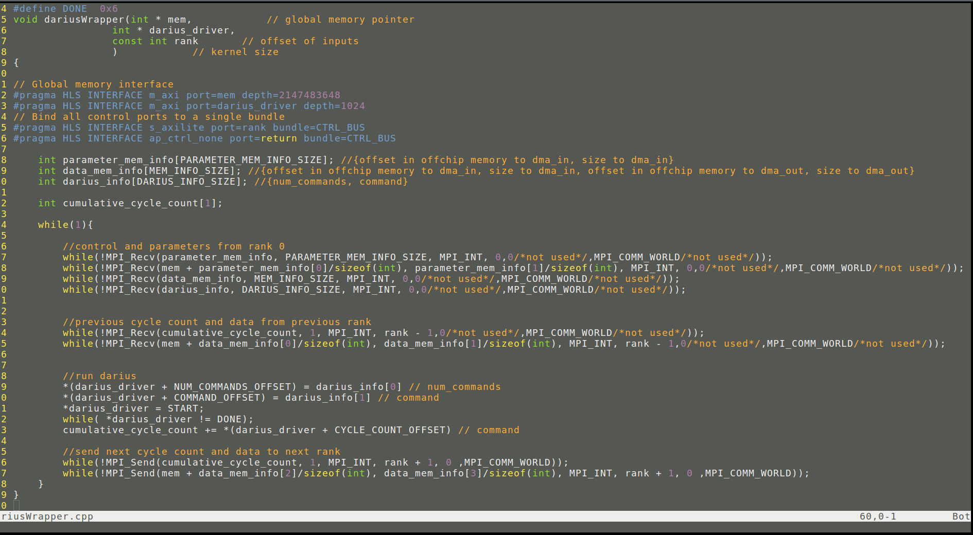
ML Application Darius Wrapper Snippet

Slide 66
ML Application Layer Checklist
Add off chip memory in hypervisor (done)
Add off chip memory in middleware (done)
Add control path for rank assignment in middleware
Create Darius Wrapper
Create Neural Net Partitioner
Simple partitioning scheme first, similar to brainwave
Create global MMU

Slide 67
AN RDMA-BASED STORAGE SYSTEM FOR A CLUSTER OF FPGAS AND CPUS

Slide 68
Goals
To Implement a scalable network-based storage system that can be utilized by any processor type (FPGA, CPU, GPU)
Storage is not local to the processing unit
Make storage transparent to the user
To minimize processor involvement
Minimizing the number of interrupts (Save overhead of dozens to hundreds of clock cycles due to context switch/OOO flushing)
Minimizing data copies
Notes:
What are my goals with such a system? I want to implement a scalable network based system. I want it to work with as many processor types as necessary (FPGA CPU and GPU) and I hope to achieve this by abstracting away the storage part from the user (server).
I also want a system which minimizes processor involvement. Every millisecond that a processor is doing storage is a millisecond it is not doing useful work. Not only does this help with simplifying the system, which helps with the transparency aspect, but it also plays a large role into the performance of the system. Modern systems in particular have huge interrupt overhead which I hope to address with this system.
71

Slide 69
High Level Overview
RDMA Front End
NVMe/PCIe Back End
Notes:
This project consists of two logical parts. The RDMA Front end which is the part the user/external servers see and interact with, and then there is the NVMe PCIe Back End which is the portion the SSD device interacts with. I will begin by explaining the Front End
72

Slide 70
High Level Overview
RDMA Front End
RDMA allows for hardware-based secure memory to memory transfers over an Ethernet network
NVMe/PCIe Back End
Notes:
Time does not allow me to fully give you an appreciation for the RDMA protocol but allow me to give you a taste test. RDMA is a protocol that satisfies my previously stated goals but for memory to memory transfers. It allows for hardware based, secure memory to memory copies where the processor just initializes the transactions, and is informed when it is finished, it has zero processor involvement during the data transfer portion.
73

Slide 71
High Level Overview
RDMA Front End
RDMA allows for hardware-based secure memory to memory transfers over an Ethernet network
User Processes set up hardware Queues that manage a portion of their local memory in user space
Data Transfers are between Queues (data never enters the processor)
Queues handle the data path, security, and virtual memory mapping
NVMe/PCIe Back End
Notes:
How this works is that the individual processes allocate using system calls these hardware queues which live inside of the network card. Each of theses queues manage a portion of their local memory in user space. I.e. Process A creates a queue B which manages addresses 1000 to 2000 of its local memory. Each queue also has a password and it is instructed to provide memory access within that memory region to anyone with that password. Data transfers then occur between queues on different devices.
74

Slide 72
High Level Overview
RDMA Front End
RDMA allows for hardware-based secure memory to memory transfers over an Ethernet network
User Processes set up hardware Queues that manage a portion of their local memory in user space
Idea: to create RDMA storage Queues
Queue setup and config uses regular UDP/IP messages
A processor tells the storage system to open a file, providing a file path and security information, and is returned a queue ID and password
Future memory to storage or storage to memory transfers look identical to memory to memory transfers and can use existing RDMA device drivers
NVMe/PCIe Back End
Notes:
Given this, my idea is to create a server with RDMA storage Queues. For queue creation, a process would send a normal UDP message to this central storage server with a file path and security information. The server would use this message to create a new RDMA queue on the storage server which the user can now read and write from. After setup, from the OS perspective on the remote server, there is no way for the OS to distinguish between a storage queue and a memory queue which means we can use the existing RDMA drivers for future data transfers. RDMA drivers exist for CPUs, GPUs and Xilinx has in the past month released support for a source only RDMA IP.
75

Slide 73
Storage Ops => RDMA Ops
Store to a file => RDMA Write to file’s queue
Load from a file => RDMA Read from file’s queue
Open/Close/Create/Delete/Seek a file or file folder => UDP Packet
No New Drivers Necessary
Notes:
To summarize, I am turning storage operations into RDMA operations. To store to a file, I perform an RDMA Write to the files queue. To load data, I perform an RDMA Read. For all other file operations, a simple UDP packet is sent for this purpose. As a result, we can use existing RDMA drivers and no new drivers are needed on the external server side.
76

Slide 74
High Level Overview
RDMA Front End
NVMe/PCIe Back End
FPGA
ARM Processor
Notes:
Now let us examine the back end portion, how it connects with the SSD
77

Slide 75
High Level Overview
RDMA Front End
NVMe/PCIe Back End
FPGA
RDMA Front End writes the incoming data to memory pages and reads outgoing data from those same pages within the FPGA
ARM Processor
Notes:
The front end processes incoming packets and write the incoming data to memory pages, and reads outgoing data from those same pages
78

Slide 76
High Level Overview
RDMA Front End
NVMe/PCIe Back End
FPGA
RDMA Front End writes the incoming data to memory pages and reads outgoing data from those same pages within the FPGA
A root complex (PCIe DMA) exists within the FPGA which places those memory pages within the PCIe address space
ARM Processor
Notes:
A root complex built inside of the FPGA then links that memory with the PCIe Subsystem. As a result, theses memory pages are now accessible to the SSD, all we need is something to initiate the transfers.
79

Slide 77
High Level Overview
RDMA Front End
NVMe/PCIe Back End
FPGA
ARM Processor
It is the software’s role in the ARM processor to ensure the data gets from those pages to and from the NVMe SSD
FPGA informs the software when one of the queues requires a data transfer
Software sends a data transfer message through a PCIe end point device to move the data between the FPGA and the storage
Software performs file system navigation
Notes:
This is the software role of the ARM processor. When a data transfer is needed (a write request finished copying data, a page is full, a read request needs data…) the FPGA tells the ARM processor. The processor in turn is a PCIe endpoint device which sends a data transfer message which performs the data move (i.e. move X bytes from storage address Y to memory address Z). The file navigation part is also performed by the software.
80

Slide 78
High Level Overview
RDMA Front End
NVMe/PCIe Back End
FPGA
ARM PROCESSOR
It is the software’s role in the ARM processor to ensure the data gets from those pages to and from the NVMe SSD
It is also the software’s role to process the queue setup and config messages and configure the FPGA as necessary
Notes:
Finally, the FPGA is setup to forward all non-rdma messages to the software. This include all of the setup and config messages and the software is responsible for navigating the file system and managing the FPGA (i.e. creating a new queue).
81

Slide 79
Integrating and Enabling FPGAs as Native Targets in Big-Data Streaming Frameworks

Slide 80
Distributed Data Streaming (DDS)
Heron, Storm, Spark, etc.
Frameworks describe problem as a DAG (called topology in Storm) of (streaming) computations (called bolts in Storm)
Collectively used by projects and companies number well in the hundreds (likely thousands)
Not all bolts are “scale-out” friendly
Some workloads/computations are more latency sensitive or are better suited for FPGAs
Example: A (contrived) social media text post content analysis pipeline
Live Social Media Post Stream
Message Extractor
Word Splitter
Sentiment Analysis
Marketing Services
Live Tweet Stream
Ad Recommendation ML Model
Ad Services

Slide 81
Start by Taking Advantage of Existing Solutions
Existing DDS frameworks (e.g. Storm) work well and provide many features:
Dynamic, on-demand resource allocation/scheduling and scaling
Network packet routing
Easy to use programming model
Can users (almost) seamlessly insert FPGA nodes into these streaming workloads?
Can these frameworks be exploited to simplify the design process of distributed FPGA services/applications?

Slide 82
Some Complications Exist...
Many popular DDS frameworks are implemented on top of the JVM (Java Virtual Machine) through languages like Java or Scala
As is, high performance JVM byte code running on FPGAs is a poor fit
Luckily, the JVM and these DDS frameworks utilize common technologies, collectively
Targeting these common technologies allows for a relatively framework agnostic FPGA data-streaming platform
Some shared technologies across DDS frameworks:
JVM application packaging and the (Java ARchive) JAR file format
Object (de)serialization through Kryo (an open source, high performance Java deserializer)
Availability of the JNI (Java Native Interface) for communication with native code
TCP or Layer 2 based node-to-node communication

Slide 83
Some Complications Exist In the Present Situation
Many popular DDS frameworks are implemented on top of the JVM (Java Virtual Machine) through languages like Java or Scala
As is, high performance JVM byte code running on FPGAs is a poor fit
Luckily, the JVM and these DDS frameworks utilize common technologies, collectively
Targeting these common technologies allows for a relatively framework agnostic FPGA data-streaming platform
Some shared technologies across DDS frameworks:
JVM application packaging and the (Java ARchive) JAR file format
Object (de)serialization through Kryo (an open source, high performance Java deserializer)
Availability of the JNI (Java Native Interface) for communication with native code
TCP or Layer 2 based node-to-node communication

Slide 84
Handling Common Scenarios
Performance sensitive sections of workload can be run on the FPGA “behind the scenes”
Networking
Object serialization/deserialization
Accelerates well (in a different schema) [**]
Bolt/Node computation
A CPU can be used for non-performance-intensive parts of the topology lifetime
Bolt/Node construction and deconstruction
Including FPGA programming
Exceptional packet handling
E.g. heart-beat or special request packets can be handed off to the CPU
Application building and packaging
Worker management
[**] Mueller R., Eguro K. “FPGA Accelerated Deserialization of Object Structures”. Microsoft Research, Sept. 2009. Available:
http://citeseerx.ist.psu.edu/viewdoc/download?doi=10.1.1.474.2486&rep=rep1&type=pdf

Slide 85
Conclusion
Used stack approach for flexibility of abstraction
Modular design of stack allows for multiple implementations of layers
It’s an art to balance ease of programming and performance tunability

