Slide 1
DAA Macro Project
Design and Analysis of Algorithms
Five units • Five algorithms • Five visualizations
B.Tech CSE | Algorithm Analysis · Greedy · Dynamic Programming · Backtracking · Branch and Bound

Slide 2
Project Overview
One project per unit
Unit | Project | Topic | Language
Unit I | Project 1 | Sorting Complexity Visualizer | Python
Unit II | Project 4 | Greedy Job Sequencing | C++
Unit III | Project 7 | Traveling Salesperson DP | Python
Unit IV | Project 10 | N-Queens Backtracking | Java
Unit V | Project 13 | Knapsack Branch and Bound | Python
Each project includes: working code • pseudocode • AI visualization prompt • generated visualization • README with output and complexity analysis
DAA Macro Project | Design and Analysis of Algorithms
2

Slide 3
UNIT I – Sorting Complexity Visualizer
Project 1
Problem
Pseudocode
Compare the time complexity of Merge Sort and Quick Sort for n = 10, 100, 1000.
MERGE-SORT(A):
split A in halves
sort each half
MERGE the halves
QUICK-SORT(A, lo, hi):
p = PARTITION(A, lo, hi)
QUICK-SORT(A, lo, p-1)
QUICK-SORT(A, p+1, hi)
Key idea
Merge Sort: T(n) = 2T(n/2) + n → O(n log n) always
Quick Sort average: O(n log n)
Quick Sort worst (bad pivot): T(n) = T(n−1) + n → O(n²)
Chart uses theoretical n·log₂n and n² – not benchmarks
Result: n = 1000: n log n ≈ 9,966 vs n² = 1,000,000
DAA Macro Project | Design and Analysis of Algorithms
3

Slide 4
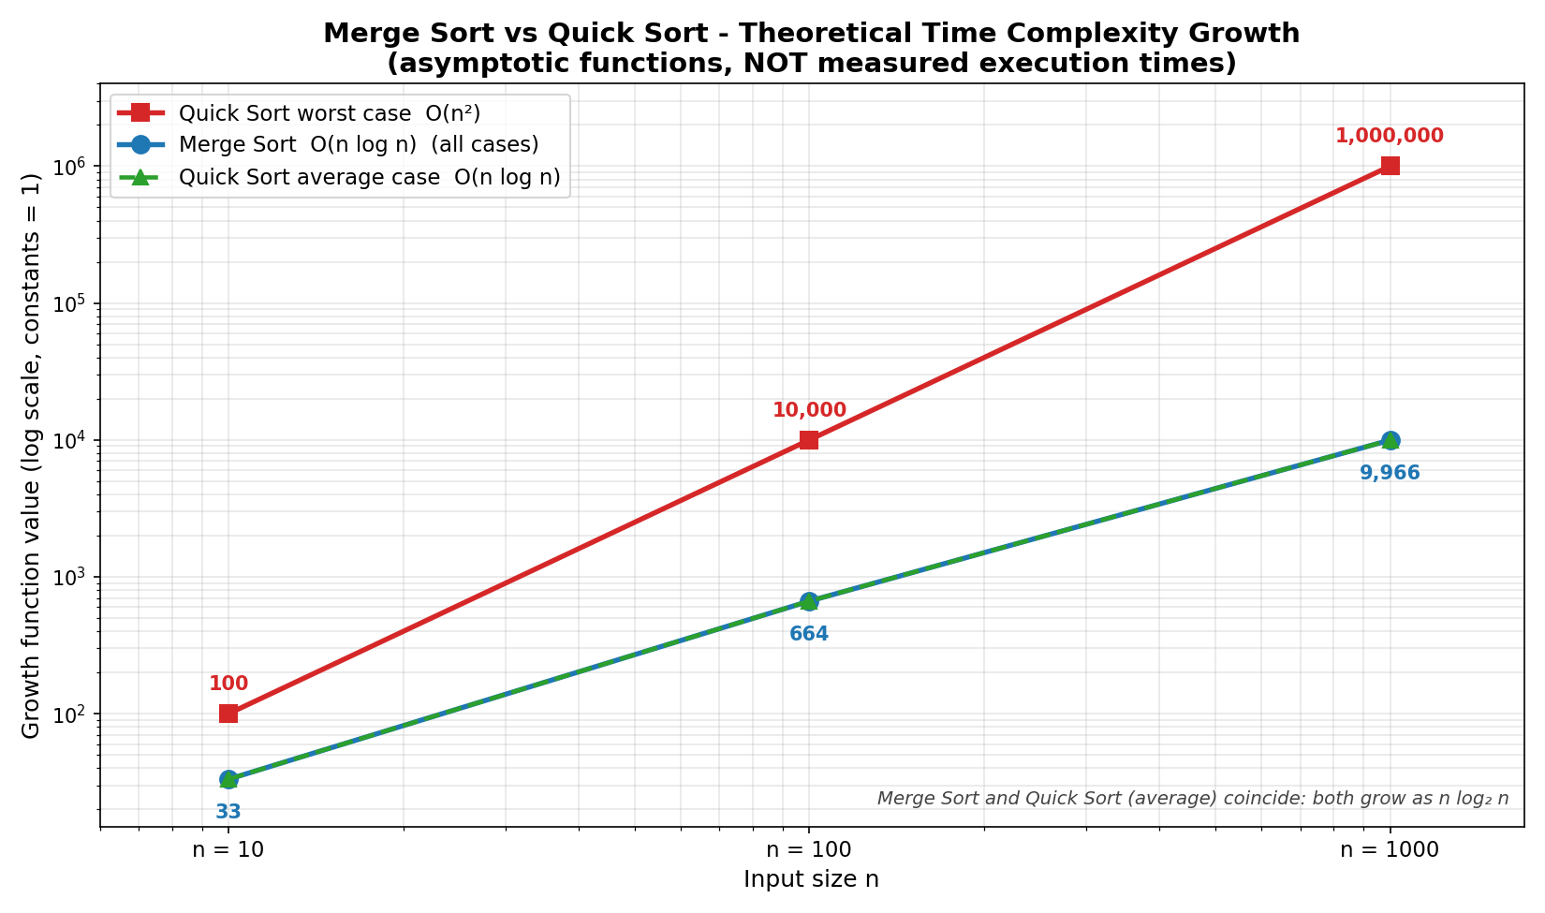
UNIT I – Visualization
Sorting Complexity Visualizer
What to notice
Red: Quick Sort worst case O(n²) → 1,000,000 at n = 1000
Blue/green: Merge Sort and Quick Sort average coincide (n log n)
Log-scale axes; labelled theoretical, not measured
DAA Macro Project | Design and Analysis of Algorithms
4

Slide 5
UNIT II – Greedy Job Sequencing
Project 4
Problem
Pseudocode
Job sequencing with deadlines: pick and order unit-time jobs to maximise profit.
sort jobs by profit (desc)
for each job j:
t = min(D, j.deadline)
while t>=1 and slot[t] used:
t = t - 1
if t >= 1:
slot[t] = j ; profit += j.p
else: skip j
Key idea
Sort jobs by decreasing profit
Place each job in the latest free slot ≤ its deadline
No free slot → skip the job
Sample: J1(2,100) J2(1,19) J3(2,27) J4(1,25) J5(3,15)
Result: Schedule: J3, J1, J5 | Total profit = 142
DAA Macro Project | Design and Analysis of Algorithms
5

Slide 6
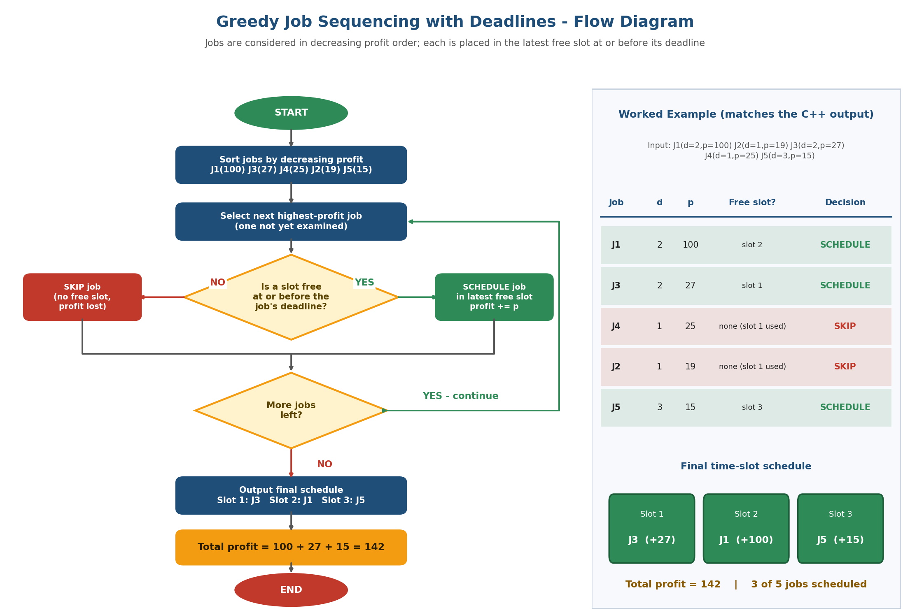
UNIT II – Visualization
Greedy Job Sequencing
What to notice
Left: algorithm flowchart with YES/NO decisions
Right: trace of the sample input
J4 and J2 skipped (slot 1 taken), J5 fills slot 3
DAA Macro Project | Design and Analysis of Algorithms
6

Slide 7
UNIT III – Traveling Salesperson DP
Project 7
Problem
Pseudocode
Held-Karp DP for TSP with 4 cities: shortest tour from A visiting all cities once.
for size = 2 .. n-1:
for each subset S, |S| = size:
for each j in S:
dp[S][j] = min_k ( dp[S-j][k]
+ d[k][j] )
best = min_j dp[ALL][j] + d[j][A]
Key idea
State dp[S][j]: start at A, visit subset S, end at j
Base: dp[{j}][j] = d(A, j)
Transition: dp[S][j] = min over k of dp[S−{j}][k] + d(k, j)
Subsets stored as bit masks; parent pointers rebuild the tour
Result: Minimum cost = 80 Tour: A → B → D → C → A
DAA Macro Project | Design and Analysis of Algorithms
7

Slide 8
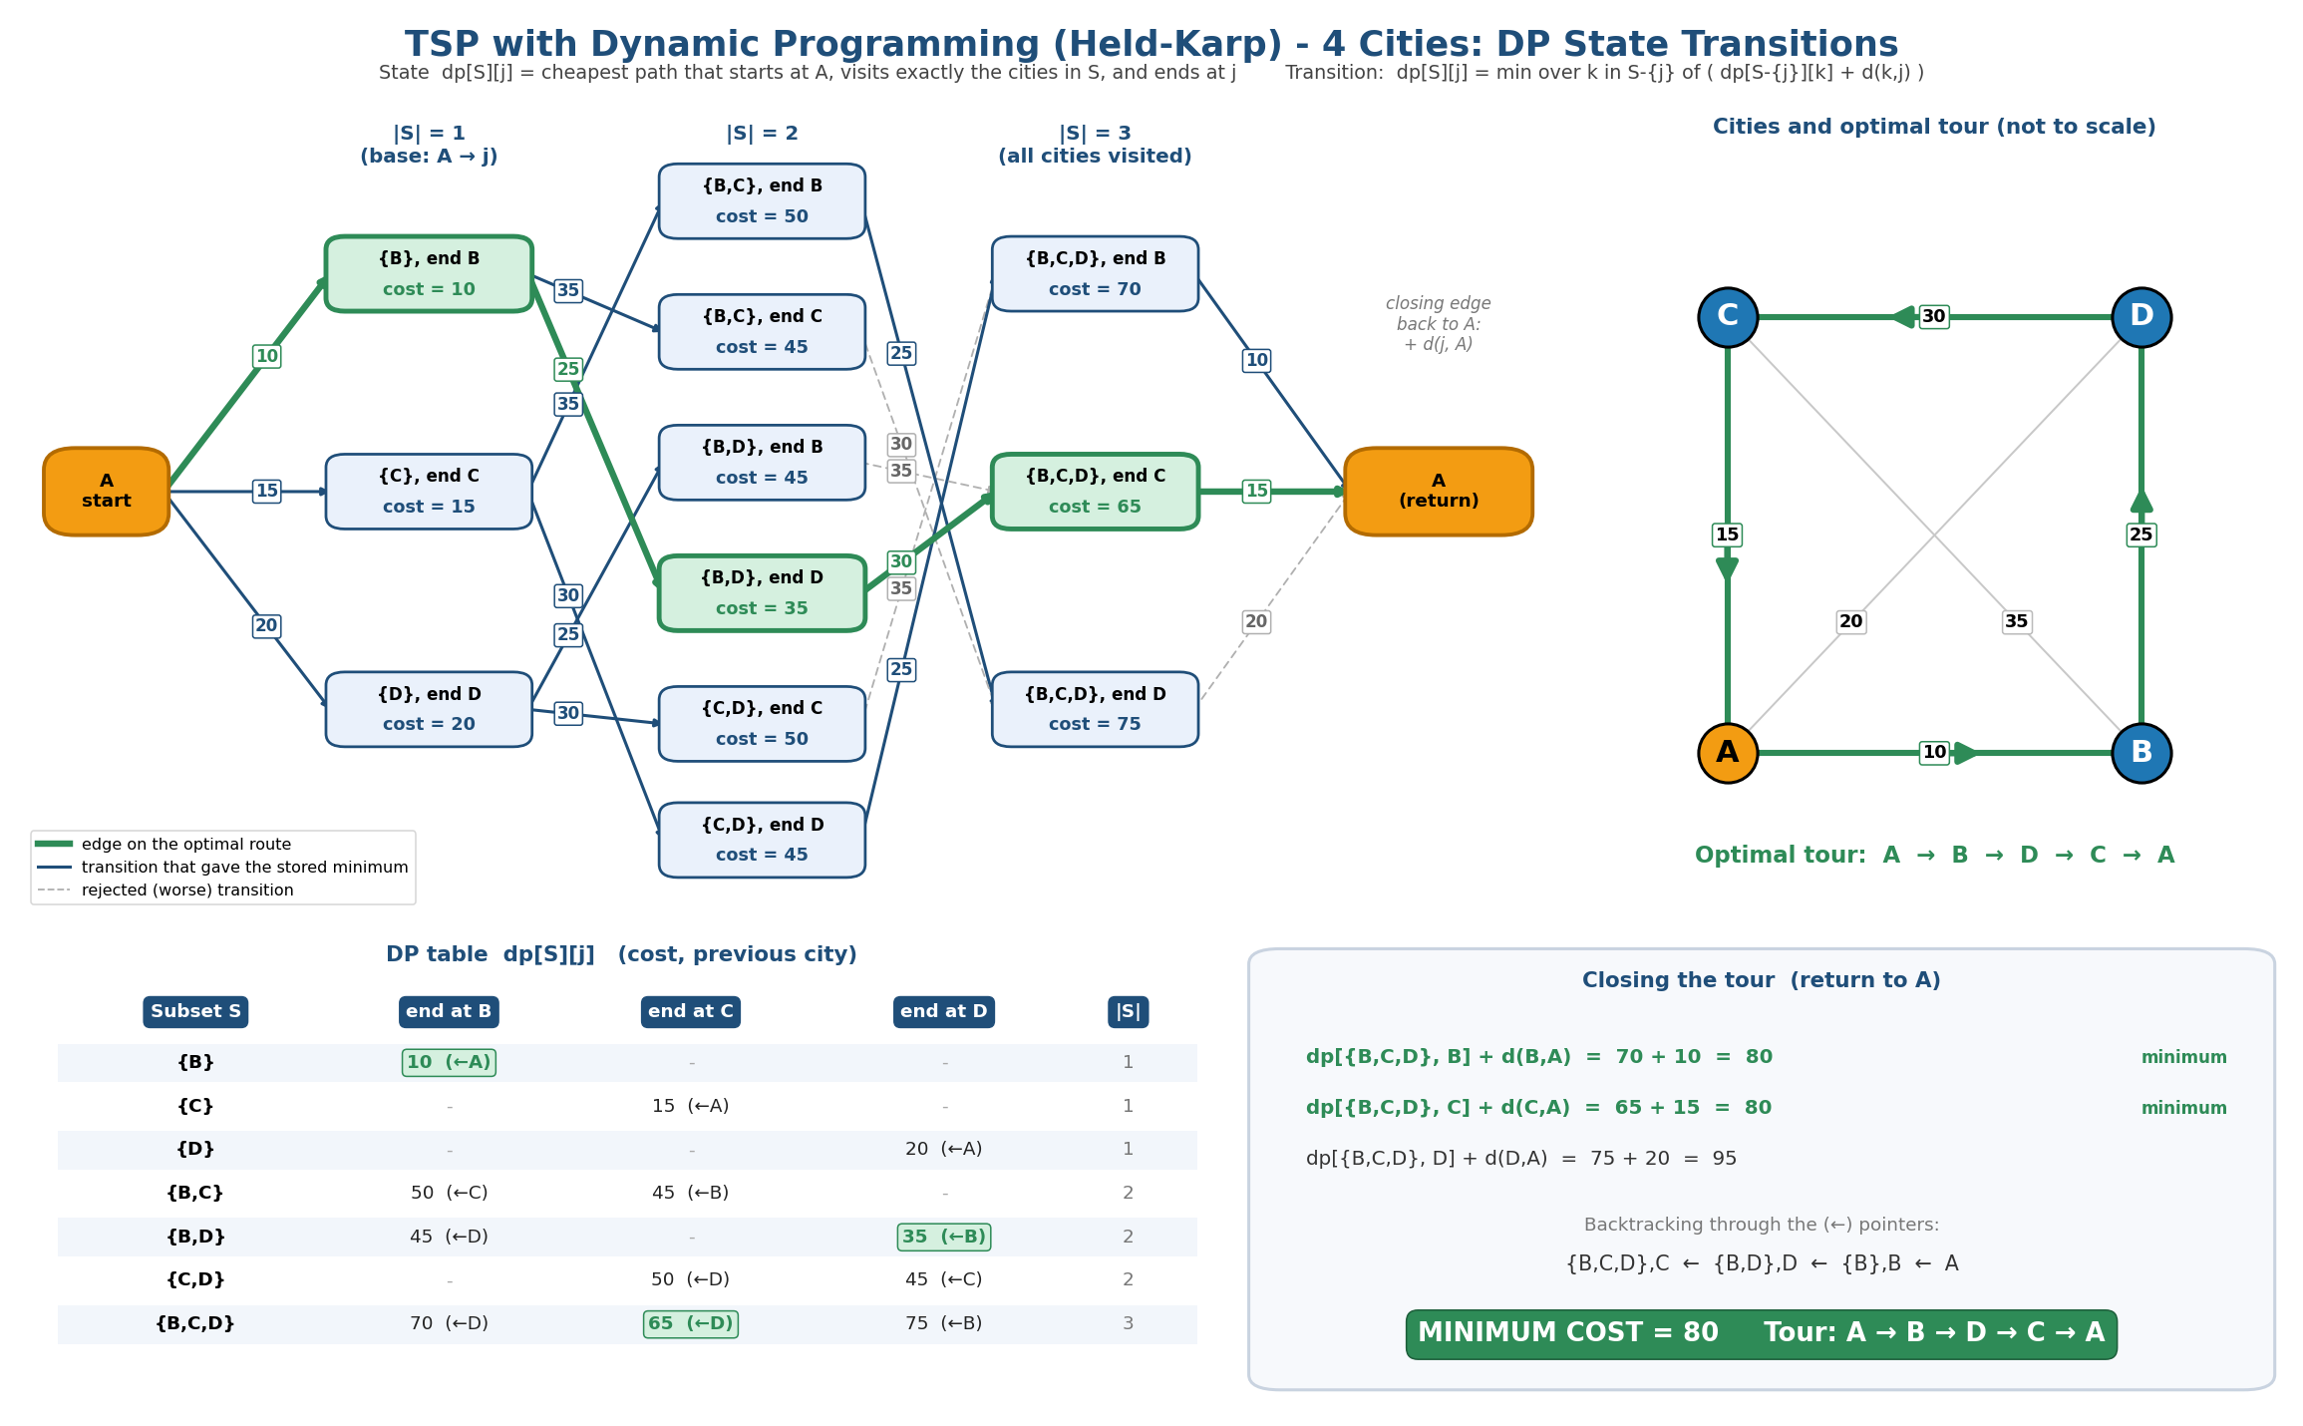
UNIT III – Visualization
Traveling Salesperson DP
What to notice
Graph: DP states by subset size with transition costs
Green path = optimal: {B} → {B,D},D → {B,C,D},C → A
Table: every dp[S][j] with predecessor
Min cost 80 (ties: 70+10 and 65+15)
DAA Macro Project | Design and Analysis of Algorithms
8

Slide 9
UNIT IV – N-Queens State Space Tree
Project 10
Problem
Pseudocode
4-Queens by backtracking: place one queen per row so that none attack each other.
SOLVE(row):
if row = N: record solution
for c = 0 .. N-1:
if IS-SAFE(row, c):
col[row] = c
SOLVE(row + 1)
else: prune
Key idea
Try columns left to right in each row
Safe = no same column, no same diagonal
Unsafe → prune; no safe column → backtrack
Java program prints trace, boards and counters
Result: 2 solutions | 60 placements tested (vs 4⁴ = 256)
DAA Macro Project | Design and Analysis of Algorithms
9

Slide 10
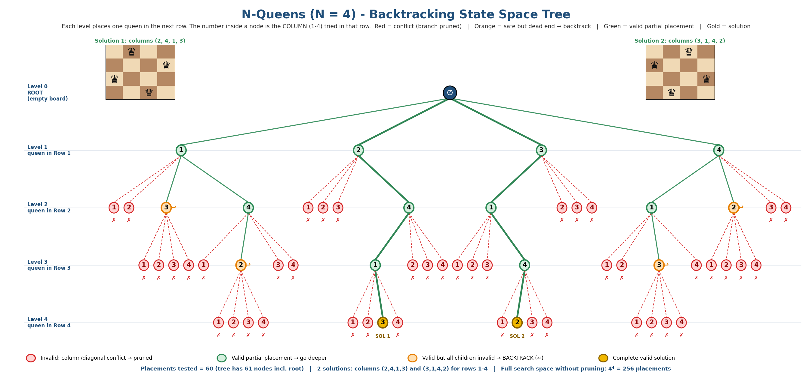
UNIT IV – Visualization
N-Queens State Space Tree
Red ✗ = invalid placement, pruned Orange = dead end, backtrack Green = valid Gold = solution
60 tested nodes + root = 61; solutions (2,4,1,3) and (3,1,4,2)
DAA Macro Project | Design and Analysis of Algorithms
10

Slide 11
UNIT V – Knapsack Branch and Bound
Project 13
Problem
Pseudocode
0/1 Knapsack by Branch and Bound. Weights [2,3,4,5], values [40,50,65,70], capacity 8.
PQ = max-heap ordered by bound
while PQ not empty:
u = PQ.pop()
if u.bound <= best: prune u
include item i:
w > W -> prune, else update best
exclude item i
push children with bound > best
Key idea
Node = (level, weight, value, upper bound)
Bound = fractional-knapsack fill of the remaining capacity
Branch: include / exclude the next item
Prune if weight > W or bound ≤ best value
Result: Optimal value = 120 (items 2, 4) | 25 of 31 nodes, 7 pruned
DAA Macro Project | Design and Analysis of Algorithms
11

Slide 12
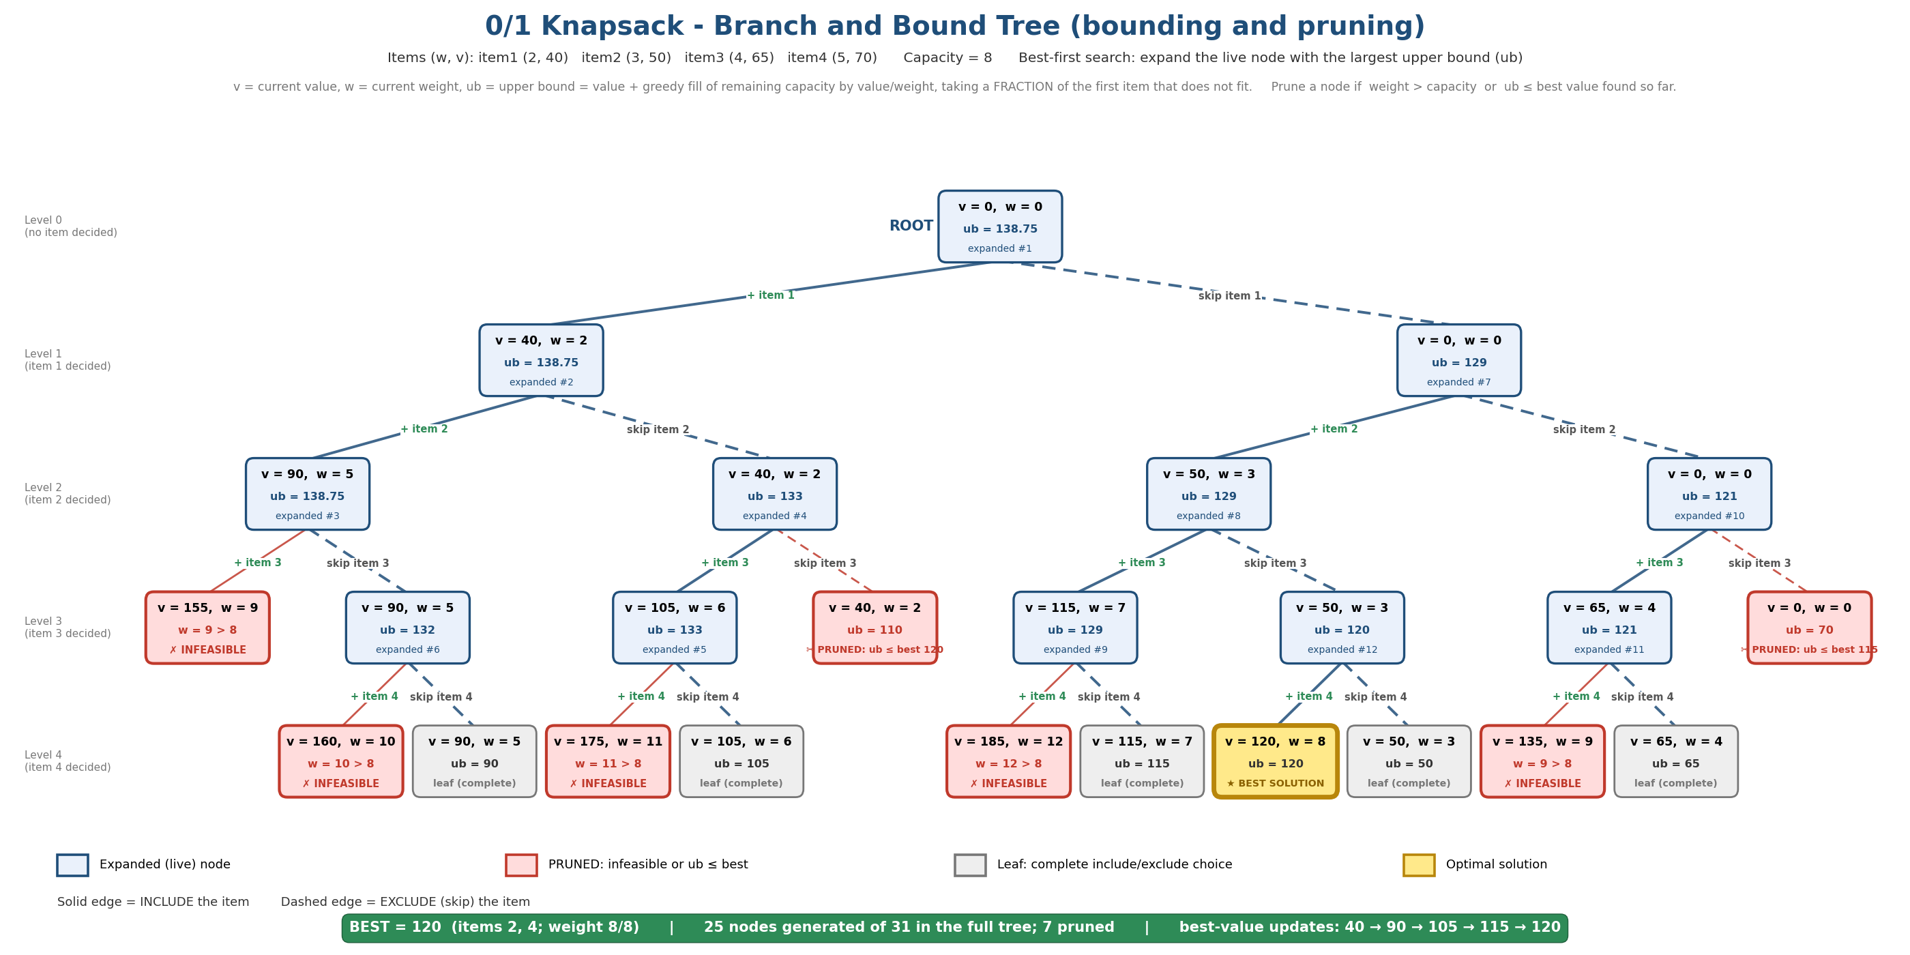
UNIT V – Visualization
Knapsack Branch and Bound
Red = pruned: infeasible (w > 8) or ub ≤ best (110, 70)
Blue = expanded in best-first order (#1 … #12)
Gold leaf = optimal 120; best improves 40 → 90 → 105 → 115 → 120
DAA Macro Project | Design and Analysis of Algorithms
12

Slide 13
Complexity Comparison
All five projects
Project | Technique | Time complexity | Space | Verified result
1 Sorting | Divide & conquer analysis | Merge O(n log n); Quick avg O(n log n), worst O(n²) | O(n) / O(log n) | n=1000: 9,966 vs 1,000,000
4 Job Sequencing | Greedy | O(n log n + n·D) | O(D) | Profit 142
7 TSP | Dynamic programming | O(n² · 2ⁿ) | O(n · 2ⁿ) | Min cost 80
10 N-Queens | Backtracking | O(N!) worst case | O(N) | 2 solutions, 60 nodes
13 Knapsack | Branch & bound | O(2ⁿ) worst case, pruned in practice | O(2ⁿ) | Value 120, 7 pruned
Pruning (backtracking, branch and bound) and memoisation (DP) attack exponential search spaces; the greedy method avoids search altogether when the greedy-choice property holds.
DAA Macro Project | Design and Analysis of Algorithms
13

Slide 14
Learning Outcomes
What we achieved
Unit I
Compare algorithms with Big-O and recurrences; separate theory from measured runtime
Unit II
Design and justify a greedy strategy with the greedy-choice property
Unit III
Define DP states, transitions and bit-mask subsets; rebuild optimal solutions
Unit IV
Use backtracking and state space trees with constraint-based pruning
Unit V
Apply bounding functions and best-first search in branch and bound
DAA Macro Project | Design and Analysis of Algorithms
14

Slide 15
Conclusion
One representative algorithm per DAA unit, implemented, run and verified
Every visualization matches its code output (142, 80, 2 solutions, 120)
Repository: pseudocode, AI prompts, visualizations and READMEs for each project
Thank You

