Slide 1
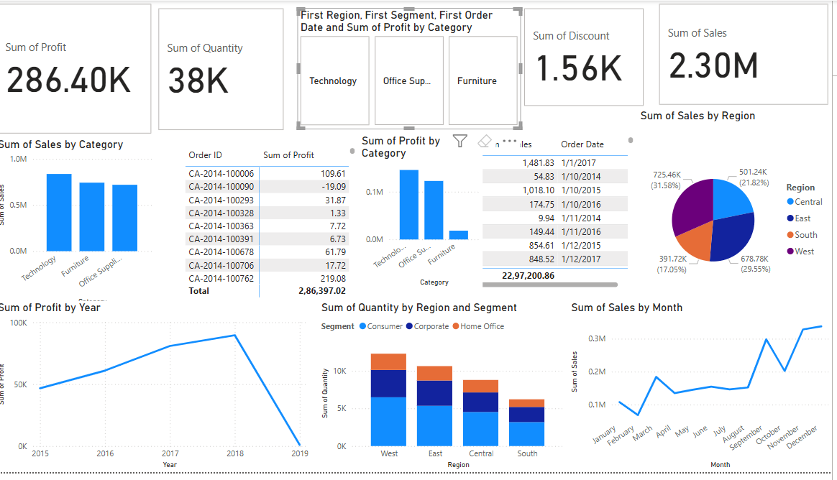
Dashboard Overview

Slide 2
Dashboard KPIs & Visuals
- Cards: Total Sales (2.30M), Profit (286.40K), Quantity (38K), Discount (1.56K)
- Sales by Category: Highest in Technology
- Profit by Year: Peaked in 2018
- Region Breakdown: West leads with 678.78K sales
- Monthly Sales Trend: Peaks in Q4
- Segment & Region Bar: Consumer dominates

Slide 3
Key Business Insights
- Technology category generates highest revenue
- Western region performs best across all KPIs
- Sales spike in November–December, indicating seasonal peaks
- Consumer segment has highest order volume

Slide 4
Tools & Dataset Used
- Tool: Power BI Desktop
- Dataset: Superstore Sales Dataset (Kaggle)
- Reason: Clean, realistic sales data for visual analysis
- Features: Time series, category breakdown, regional performance

