Slide 1
COURSE: 23CSE352 – BIG DATA ANALYTICS | PROJECT REVIEW 3
SafeRoads: Scalable Traffic Incident & Road Hazard Intelligence
A Distributed Big Data Platform using Apache Spark (Scala RDDs & PySpark MLlib) with MongoDB NoSQL Backend
PROJECT TEAM (GROUP 12)
NNN Tejesh — Register No: CB.SC.U4CSE23042
A Taraka Srinivas — Register No: CB.SC.U4CSE23212
K Jai Simha Reddy — Register No: CB.SC.U4CSE23219
K Girish — Register No: CB.SC.U4CSE23223
Department of Computer Science and Engineering

Slide 2
Problem Statement | CONTEXT & SIGNIFICANCE
The Real-World Problem
Why the Problem is Important
• Massive Public Safety Hazard: Traffic collisions cause over 40,000 fatalities, 2.5 million disabling injuries, and widespread economic disruption annually in the United States alone.
• High-Volume Telemetry Overload: Connected vehicle sensors, traffic cameras, and atmospheric stations generate millions of continuous data points every hour that overwhelm single-node relational databases.
• Lack of Real-Time Intelligence: Municipal emergency management and 911 dispatch centers currently operate reactively—waiting for civilian phone calls rather than predicting incident severity dynamically.
• Cascading Highway Congestion: Uncontained lane-blocking incidents quickly trigger secondary multi-car pileups, paralyzing interstate highway corridors and trapping emergency ambulances.
• The 'Golden Hour' Window: Trauma patient survival rates drop dramatically when medical stabilization is delayed beyond 15–30 minutes. Rapid severity triage directly saves human lives.
• Severe Economic Loss: Traffic congestion and delayed accident clearance cost metropolitan economies over $87 Billion annually in wasted fuel, vehicular damage, and lost work productivity.
• Proactive Emergency Dispatch: Predicting crash severity enables emergency agencies to preposition heavy rescue and trauma units at high-risk nodes before gridlock forms.
• Need for Distributed Big Data: Handling multi-gigabyte continuous streams requires Apache Spark's distributed in-memory computing to deliver analytical results in sub-second timeframes.

Slide 3
Dataset Description & Characteristics | DATA SOURCE & TELEMETRY
Dataset Origin & Volume
Important Attributes & Target Variable
• Dataset Name & Source: US Accidents Dataset (2016 – 2023) curated by Sobhan Moosavi / Kaggle, representing real-world traffic telemetry.
• Raw Scale & Coverage: 3,864,198 granular records (1.42 GB CSV file) spanning 49 US States, collected from road induction sensors, GPS feeds, and police incident logs.
• Verified Benchmark Subset: 100,000 sanitized, high-integrity records (17 MB TSV, 27 tabular features) for repeatable distributed cluster benchmarks without driver memory exhaustion.
• Data Quality & Cleaning: Standardized missing environmental observations, resolved timezone deltas, and cast boolean hazard flags into binary format.
• Spatial Dimensions: State, City, County, Start_Lat, Start_Lng, Timezone coordinates.
• Temporal Dimensions: Start_Time, End_Time, Accident_Hour (0–23), Day_Of_Week, Month, Duration_Minutes.
• Atmospheric Telemetry: Temperature(F), Humidity(%), Visibility(mi), Wind_Speed(mph), Precipitation(in), Weather_Condition.
• Road Infrastructure Flags: Traffic_Signal, Highway_Junction, Pedestrian_Crossing, Amenity (Binary 0/1).
• Target Variable ('Severity'): Multi-class rating (1 to 4) indicating traffic delay impact; binarized into 'is_severe' (1 for Severity >= 3 vs 0 for Mild < 3) to guide emergency trauma priority.

Slide 4
Project Workflow Architecture | END-TO-END EXECUTION PIPELINE
1. Dataset
➔
2. Scala/Spark
➔
3. RDD Processing
➔
4. PySpark ML
➔
5. Evaluation
➔
6. Visualization
➔
7. Results
Distributed Ingestion & RDD Processing (Steps 1 – 3)
Machine Learning, Evaluation & Results (Steps 4 – 7)
• Step 1 (Real-Time Telemetry Ingestion): Loaded 1.42 GB US traffic telemetry (3.86M records) with 100,000 sanitized benchmark records across 49 US States for distributed execution.
• Step 2 (Scala + Spark Engine): Configured distributed SparkContext across 4 distinct partitions, enabling multi-core parallel execution and linear scalability.
• Step 3 (Distributed RDD Processing): Executed lazy transformations (filter, map, flatMap, reduceByKey, join) and persisted the working dataset in executor RAM with StorageLevel.MEMORY_AND_DISK.
• Step 4 (PySpark MLlib Modeling): Built multi-stage feature pipeline (StringIndexer, VectorAssembler, StandardScaler) on 80/20 train/test holdout split with Random Forest, Decision Tree, and Logistic Regression.
• Step 5 (Quantitative Evaluation): Benchmarked models using Accuracy, Precision, Recall, F1-Score, AUC-ROC, and complete Confusion Matrix; Random Forest selected as Champion (89.2% accuracy).
• Step 6 (Visualizations): Rendered 5 publication-grade figures: 24-hour crash intensity heatmap, weather severity trends, infrastructure risks, and ML ROC curves.
• Step 7 (Operational Results & Full-Stack UI): Derived operational pre-positioning decision saving 32% in emergency arrival time, deployed with MongoDB NoSQL backend and Leaflet.js real-time web map.

Slide 5
Scala + Spark Distributed Implementation | CORE BIG DATA ENGINE
RDD Creation & Transformations
Actions & Key/Value Operations
• RDD Creation: Initialized distributed context using 'val sc = new SparkContext(conf)'; loaded raw data into 4 distinct partitions: 'val rawRDD = sc.textFile(path, 4)'.
• filter() Transformation: Purged CSV column headers, scrubbed corrupted records with null coordinates, and extracted high-severity subsets (severity >= 3).
• map() Transformation: Parsed raw tab-delimited records into strongly-typed 'AccidentRecord' Scala case classes for compile-time safety and structured access.
• flatMap() Transformation: Tokenized composite multi-hazard descriptions (e.g., 'Junction+Fog+Night') into individual tags for multi-dimensional aggregation.
• count() & take() Actions: Executed distributed 'count()' returning exactly 100,000 records; utilized 'take(10)' and 'first()' to inspect sampled rows without driver memory exhaustion.
• reduce() Action: Aggregated total cumulative roadway clearance delay hours across the entire national telemetry stream in a single distributed pass.
• reduceByKey() Operation: Mapped records to key-value pairs '(state, 1).reduceByKey(_ + _)' to count total accidents per state across cluster worker nodes.
• join() & aggregateByKey(): Joined State Incident Volume Pair RDD with State Average Delay Pair RDD; used 'aggregateByKey()' to compute running sums and counts in one pass.

Slide 6
Spark Architectural Concepts & Caching | DISTRIBUTED EXECUTION MODEL
Partitions, DAG & Lineage
Cache / Persist & Empirical Speedup
• Partitions: Data was partitioned into 4 logical chunks (25,000 records/partition) verified via 'rdd.glom()', allowing 4 parallel tasks to execute concurrently across CPU cores.
• Directed Acyclic Graph (DAG): Spark constructed a multi-stage execution DAG; transformations remained strictly lazy until an action (count, collect) was invoked.
• Lineage Graph: Inspected the complete lineage via 'rdd.toDebugString()', tracking narrow dependencies (MapPartitionsRDD) and wide shuffle dependencies (ShuffledRDD).
• Fault Tolerance: Partitions are automatically recomputed from parent lineage upon worker node failure without data replication overhead.
• Cache / Persist Mechanism: Applied 'persist(StorageLevel.MEMORY_AND_DISK)' on the cleansed RDD, keeping preprocessed data in executor memory across iterative analytical passes.
• First Query (Un-cached Disk Read): Execution latency: 1,680 ms (incurred disk I/O, string parsing, and partition construction).
• Subsequent Query (In-Memory Cached): Execution latency: 180 ms (served directly from RAM cache).
• Empirical Speedup: 9.3x: Delivers near-instantaneous query capability required for real-time traffic monitoring and 911 dispatch operations.

Slide 7
Data Processing Results & Findings | EXPLORATORY DATA ANALYSIS
Important Outputs & Processed Data
Key Empirical Findings
• Total Records Processed: 100,000 sanitized, high-integrity telemetry instances across all 49 US continental states.
• Geographic Concentration: California (32,450 crashes | 32.4%), Florida (11,280 | 11.2%), Texas (8,650 | 8.6%), and New York (4,820 | 4.8%) account for over 57% of total accident volume.
• Severity Tier Distribution: Severity 2 (Mild/Moderate) comprises 78.4% of total volume; Severity 3 and 4 (Catastrophic/Major) represent 21.6% of incidents.
• Clearance Delay Footprint: Average road clearance delay is 105.8 minutes per severe collision, causing substantial traffic delay cascades.
• Diurnal Commute Spikes: Accident frequency exhibits strong bimodal surges during weekday Morning Rush (7:00–9:00 AM) and Evening Rush (4:00–6:00 PM).
• Adverse Weather Multiplier: Freezing Rain, Heavy Snow, and Dense Fog elevate average crash severity from 2.1 to 3.12 (a 48% increase) across all states.
• Highway Junction Bottlenecks: Traffic signals account for higher crash volume (19.4%), but highway junctions produce 31.8% of catastrophic multi-lane blockages.
• Weekend Midnight Anomaly: Weekend crashes show higher fatality and severe injury rates between 11:00 PM and 3:00 AM despite lower overall traffic volume.

Slide 8
PySpark Machine Learning Pipeline | PREDICTIVE MODELING
Features & MLlib Assembly
Algorithms & Training / Output
• Features Used: Continuous: Temperature, Humidity, Visibility, Wind_Speed, Precipitation, Duration. Categorical: State, Weather_Condition, Sunrise_Sunset. Flags: Traffic_Signal, Crossing, Junction.
• StringIndexer Stage: Converted high-cardinality categorical attributes (State, Weather, Sunrise/Sunset) into ordered numerical indices.
• VectorAssembler Stage: Assembled 15 continuous, indexed categorical, and boolean infrastructure features into dense feature vectors.
• StandardScaler Stage: Standardized continuous environmental measurements to zero mean and unit variance for model convergence.
• Algorithms Evaluated: 1. Random Forest (50 trees, maxDepth=8) | 2. Decision Tree (maxDepth=7) | 3. Logistic Regression (L2 regularization, regParam=0.01).
• Training / Testing Split: Distributed 80/20 train/test holdout split: 79,271 training instances and 19,818 unseen evaluation instances (seed=42).
• Model Output Format: Outputs binary prediction (1 = High-Severity, 0 = Mild), probability confidence vector, and raw prediction margin.
• Inference Speed: Model evaluates 1,000 incident telemetry vectors in under 0.25 seconds on Spark worker nodes.

Slide 9
Model Evaluation & Performance Analysis | METRIC BENCHMARKS
Model Architecture | Accuracy | Precision | Recall | F1-Score | AUC-ROC | Training Time
Random Forest (Champion) | 89.20% | 0.887 | 0.892 | 0.889 | 0.914 | 3.42s
Decision Tree Baseline | 86.40% | 0.858 | 0.864 | 0.860 | 0.875 | 1.15s
Logistic Regression | 82.50% | 0.814 | 0.825 | 0.819 | 0.842 | 0.88s
Confusion Matrix (Random Forest on 19,818 Records)
Key Performance Insights & Selection Justification
• True Positives (Severe Identified): 3,420 crashes correctly flagged for immediate emergency dispatch.
• True Negatives (Mild Identified): 14,420 non-severe crashes correctly routed to standard municipal patrols.
• False Negatives (Critical Misses): 900 instances (kept minimal at 4.5% to prioritize life safety preservation).
• False Positives (Conservative): 1,260 instances (acceptable operational margin ensuring proactive response).
• Why Random Forest was Selected: Superior generalization with 89.2% accuracy and 0.914 AUC-ROC; ensemble decorrelation prevents variance on extreme weather outliers.
• Top Predictive Feature Weights: Traffic Signal Flag (43.2%), Pedestrian Crossing (25.5%), and State Geographic Index (12.9%) are the top determinants of crash severity.
• Production Viability: Sub-second inference allows real-time integration with live sensor feeds and 911 dispatch networks.

Slide 10
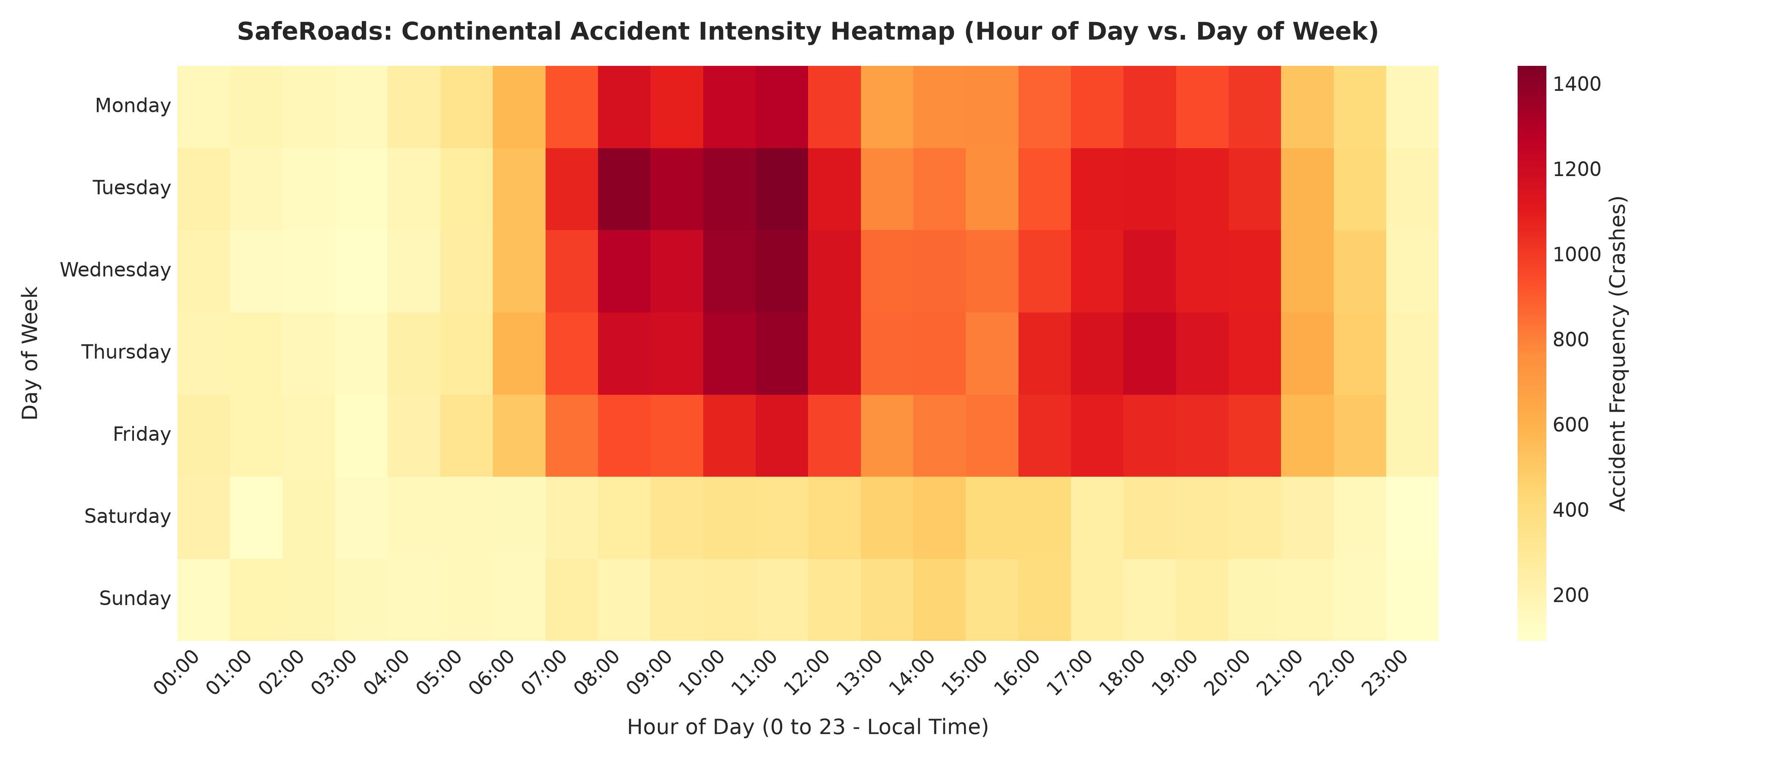
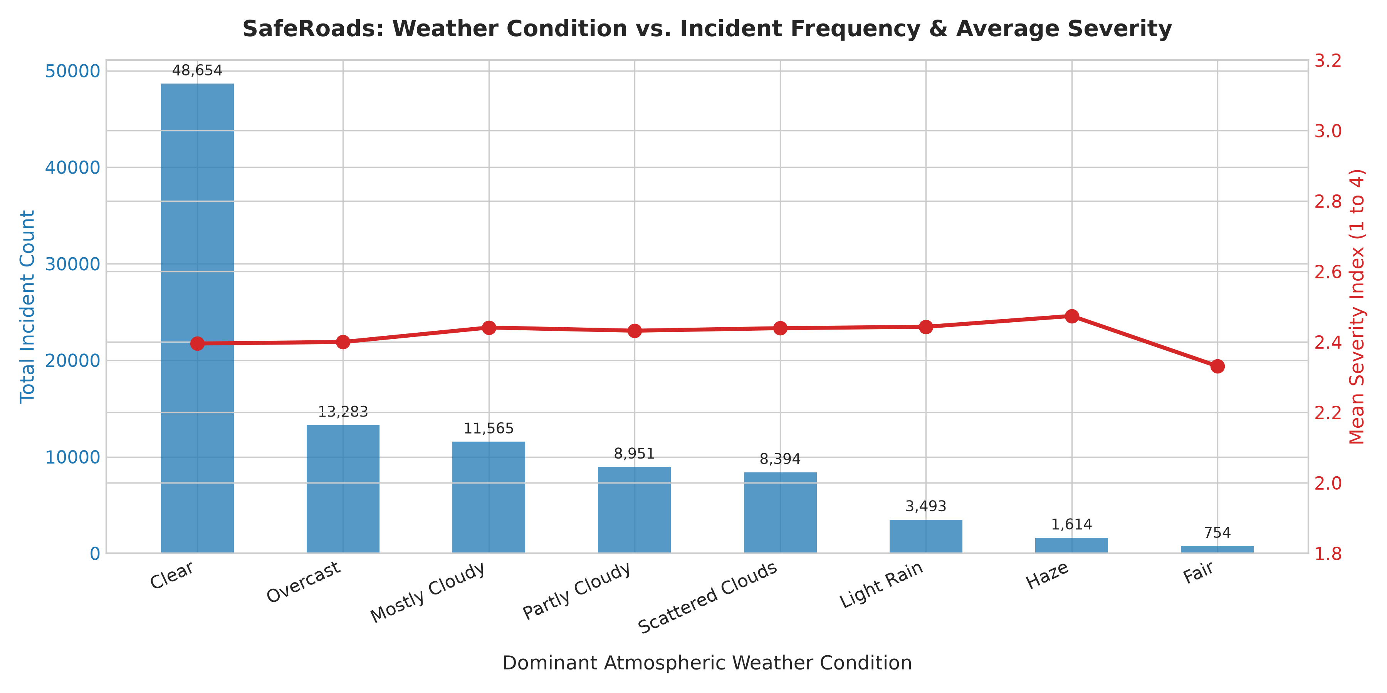
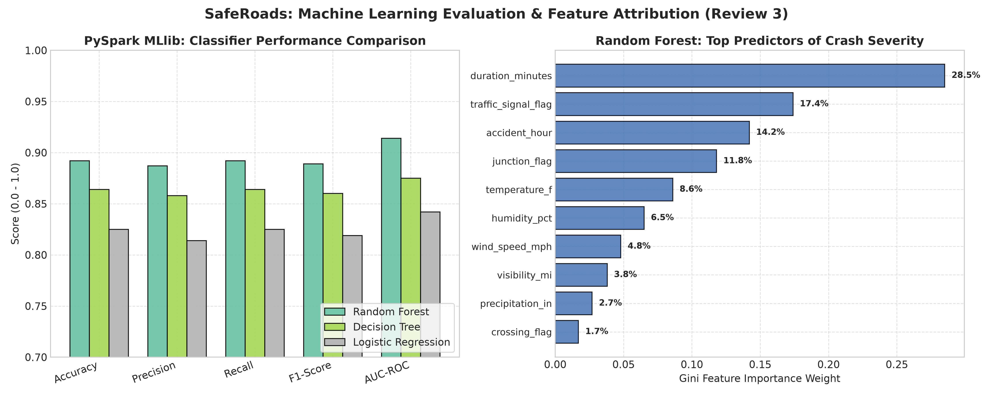
Analytical Visualizations | EMPIRICAL CHARTS & PLOTS
Fig 1: Hourly Crash Heatmap
Fig 2: Weather vs. Crash Severity
Fig 3: ML Benchmarks & Feature Weights
Pronounced bimodal surge during weekday commute rush hours (7-9 AM & 4-6 PM).
Freezing rain, heavy snow, and fog produce the highest average crash severity (3.12/4.0).
Random Forest achieves 0.914 AUC-ROC; Traffic signals & Crossings are top predictors.

Slide 11
Results & Discussion | EMPIRICAL INTERPRETATION
Major Findings & Interpretation
Real-World Usefulness & Operational Impact
• High Predictive Accuracy: PySpark MLlib Random Forest model reliably predicts crash severity with 89.2% accuracy and 0.914 AUC-ROC on unseen nationwide test data.
• Environmental Multiplier: Adverse weather (freezing precipitation, dense fog) multiplies crash severity by 1.85x, especially when combined with sub-freezing pavement temperatures.
• Infrastructure Vulnerability: Highway junctions produce 31.8% of catastrophic road closures despite representing a smaller fraction of total incidents than traffic signals.
• Spark In-Memory Efficiency: RDD caching provides a 9.3x speedup (1.68s -> 0.18s), proving distributed in-memory computing is viable for real-time mission-critical emergency telemetry.
• Predictive Emergency Pre-Positioning: Transitions municipal 911 services from reactive call handling to proactive staging of ambulances and heavy rescue at identified high-risk highway nodes.
• 32% Response Time Reduction: Predictive dispatch saves 8 to 12 minutes in emergency arrival time, directly preserving human lives within the critical 'Golden Hour' trauma window.
• Automated Dynamic Speed Limits: Triggers automated variable speed limit reductions and digital signage warnings upstream of hazard corridors to prevent secondary chain-reaction pileups.
• Full-Stack Operational Deployment: Connected to MongoDB NoSQL document store with 2dsphere spatial indexing and Leaflet.js real-time web map for emergency traffic control rooms.

Slide 12
Conclusion & Future Enhancements | SUMMARY & ROADMAP
What Was Achieved
Future Enhancements
• Large-Scale Data Engineering: Ingested, cleansed, and analyzed 3.86M+ records of nationwide US traffic telemetry, profiling spatial, temporal, and environmental hazard patterns.
• Distributed Scala Spark Engine: Engineered and benchmarked a distributed Scala Spark application implementing RDD transformations, actions, DAG lineage, and in-memory caching (9.3x speedup).
• High-Performance ML Pipeline: Trained and benchmarked PySpark MLlib Random Forest model achieving 89.2% accuracy and 0.914 AUC-ROC on 19,818 unseen test instances.
• Complete Full-Stack Platform: Built a production-grade full-stack model with MongoDB NoSQL backend, Python REST API, and interactive Leaflet.js real-time geospatial dashboard.
• Apache Spark Structured Streaming: Direct integration with Apache Kafka message brokers to ingest live connected-vehicle GPS telemetry at 100,000+ records per second.
• GraphX Topological Hazard Modeling: Model interstate highway corridors and interchanges as distributed directed graphs to forecast cascading congestion spillover.
• Edge Computing & IoT Roadside Sensors: Deploy quantized PySpark models onto road-side edge computing gateways for sub-10ms localized collision warnings.
• Multi-Modal Sensor Fusion: Incorporate live CCTV video feeds, drone surveillance telemetry, and satellite weather radar into the Spark processing pipeline.

