Slide 1
HOUSING : PRICE PREDICTION
BY
V TARAK RAM SAI

Slide 2
PROBLEM STATEMENT
This is regarding a client which used data analytics to purchase houses at a price below their actual values and flip them at a higher price. The focus of this project is to build a machine learning model that can accurately predict the price of a house.
This model will then be used by the management to understand how exactly the prices vary with the variables. They can accordingly manipulate the strategy of the firm and concentrate on areas that will yield high returns.
The purpose of this project is to determine the features of houses that decide the cost of the house. It aims to establish a house price evaluation model to predict the price that best matches the house by observing the data collected by the client.

Slide 3
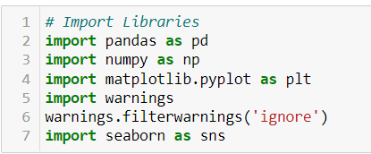
Data Pre-Processing
It entails converting raw data into comprehensible format that a machine learning model can understand. The data pre-processing involves data cleaning which involves handling missing values, transformation of data i.e. normalizing the data and data reduction which involves only required features.

Slide 4
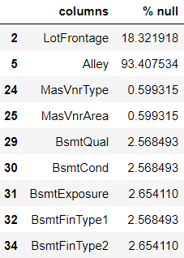
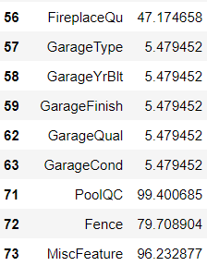
Data Cleaning
The first step of pre-processing is data cleaning by checking and eliminating any missing values because they affect the accuracy of the model. This is achieved by either filling the missing values with a mean or mode function or by dropping all the missing values. In this case, there are plenty of missing values in Alley, FireplaceQu, PoolQC, Fence and MiscFeature columns.

Slide 5
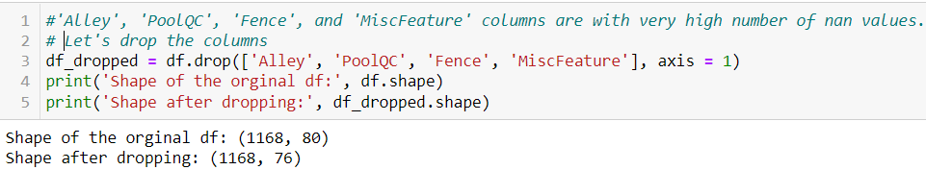
Data Reduction
The next step of data processing is data reduction. This is used to remove duplicate features present in the data i.e. unwanted features for prediction.

Slide 6
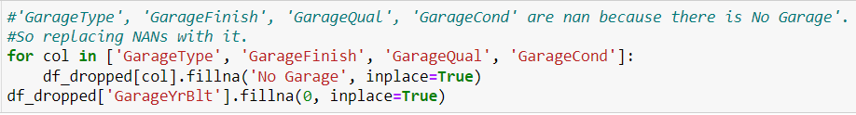
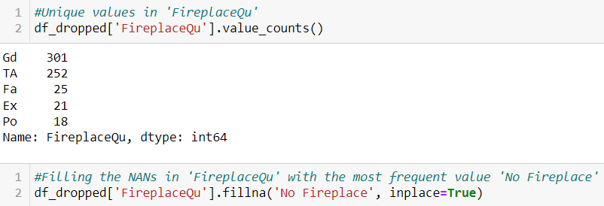
Cleaning of Data

Slide 7
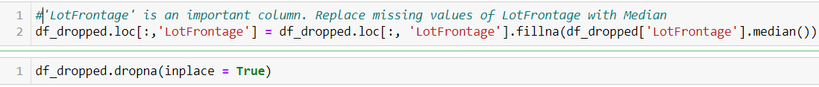
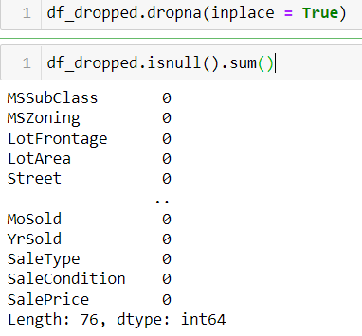
Handling Missing Values

Slide 8
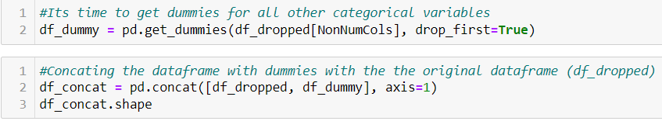
Encoding
Encoding categorical data is a process of converting categorical data into integer format so that the data with converted categorical values can be provided to the different models.

Slide 9
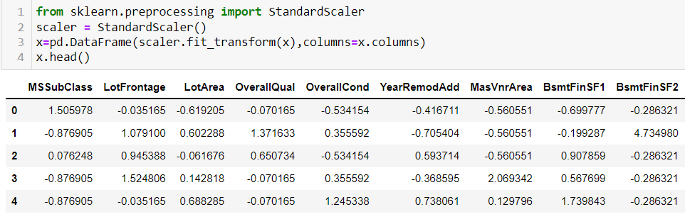
Scaling
Feature scaling is a method used to normalize the range of independent variables or features of data. To convert data into a distribution with a mean of 0 and standard deviation of 1, we will use a standard scalar.

Slide 10
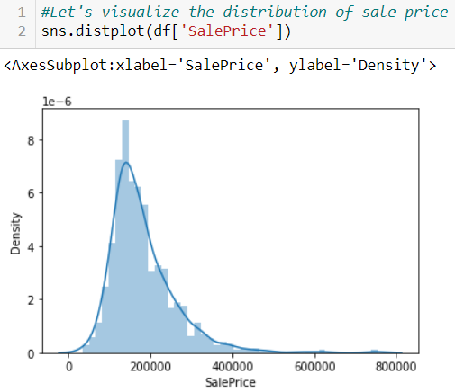
Data Inputs- Logic- Output Relationships
The Relation between all the features in the dataset are determined in the below graphs as follows
Our dataset contains a lot of variables, but the most important one for us to explore is the target variable. We need to understand its distribution.

Slide 11
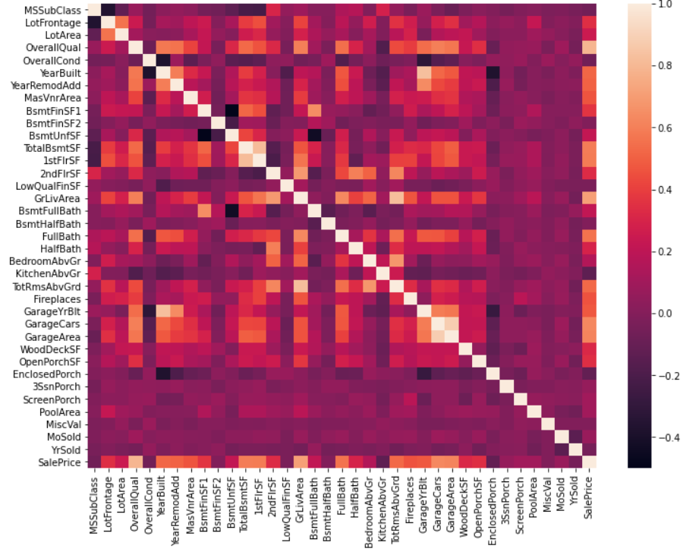
Data Inputs- Logic- Output Relationships
We can see that there are many correlated variables in our dataset. we notice that Garage Cars and Garage Area have high positive correlation which is reasonable because when the garage area increases, its car capacity increases too. We see also that Gr Liv Area and TotRms AbvGrd are highly positively correlated which also makes sense because when living area above ground increases, it is expected for the rooms above ground to increase too.

Slide 12
Data Inputs- Logic- Output Relationships
Regarding negative correlation, we can see that Bsmt Unf SF is negatively correlated with BsmtFin SF 1, and that makes sense because when we have more unfinished area, this means that we have less finished area. We note also that Bsmt Unf SF is negatively correlated with Bsmt Full Bath which is reasonable too.
Most importantly, we want to look at the predictor variables that are correlated with the target variable (SalePrice). By looking at the last row of the heatmap, we see that the target variable is highly positively correlated with Overall Qual and Gr Liv Area. We see also that the target variable is positively correlated with Year Built, Year Remod/Add, Mas Vnr Area, Total Bsmt SF, 1st Flr SF, Full Bath, Garage Cars, and Garage Area.

Slide 13
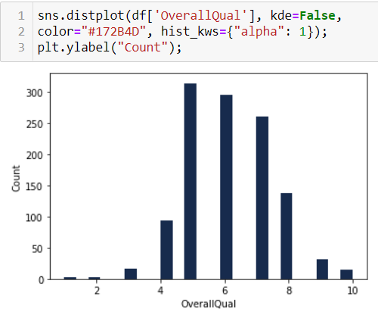
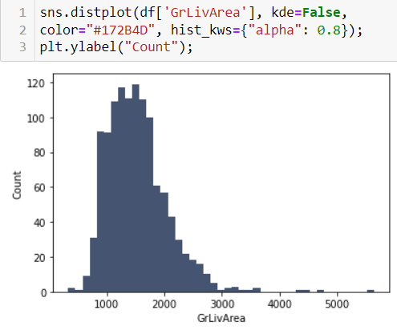
Data Inputs- Logic- Output Relationships
We see that Overall Qual takes an integer value between 1 and 10, and that most houses have an overall quality between 5 and 7.
We can see that the above-ground living area falls approximately between 800 and 1800 ft2.

Slide 14

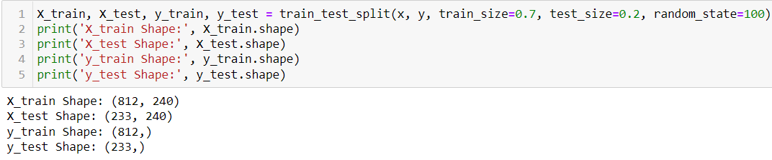
Model/s Development and Evaluation
The independent variables are declared in x and the dependent variable i.e. ‘SalePrice’ is declared in y as follows-

Slide 15
Hyper Parameter Tuning
In machine learning, hyper parameter optimization or tuning is the problem of choosing a set of optimal hyper parameters for a learning algorithm. A hyper parameter is a parameter whose value is used to control the learning process. By contrast, the values of other parameters (typically node weights) are learned.
Hyperparameter tuning is choosing a set of optimal hyperparameters for a learning algorithm. A hyperparameter is a model argument whose value is set before the learning process begins. The key to machine learning algorithms is hyperparameter tuning.

Slide 16
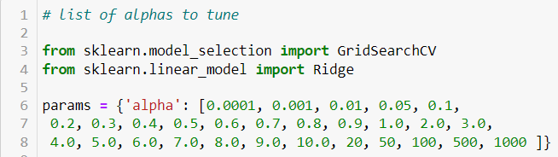
Lasso Regression
The “LASSO” stands for Least Absolute Shrinkage and Selection Operator. Lasso regression is a regularization technique. It is used over regression methods for a more accurate prediction. This model uses shrinkage. Shrinkage is where data values are shrunk towards a central point as the mean.
The lasso procedure encourages simple, sparse models (i.e. models with fewer parameters). This particular type of regression is well-suited for models showing high levels of multi-collinearity or when you want to automate certain parts of model selection, like variable selection/parameter elimination.

Slide 17
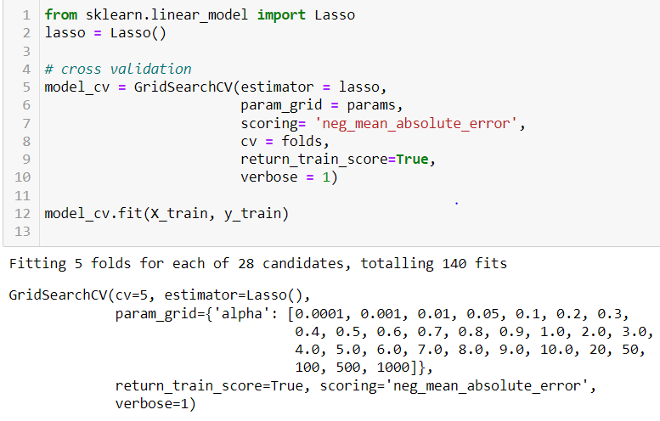
Lasso Regression

Slide 18
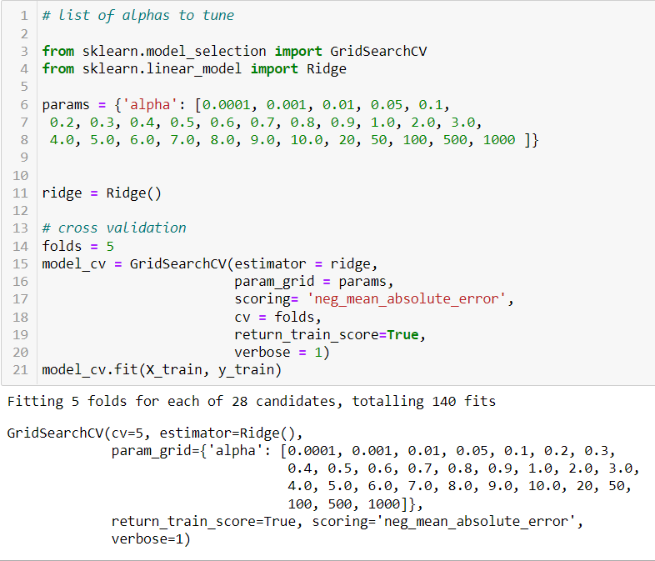
Ridge Regression
A Ridge regressor is basically a regularized version of Linear Regressor. The regularized term has the parameter ‘alpha’ which controls the regularization of the model i.e. helps in reducing the variance of the estimates.

Slide 19

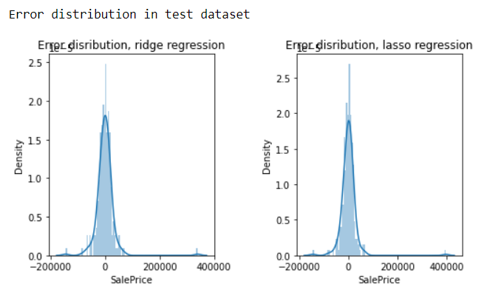
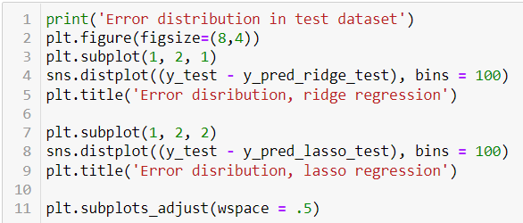
Predicting Test Data

Slide 20
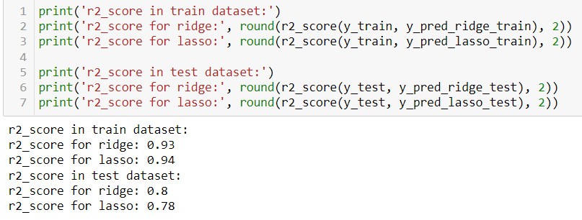
Evaluation Metrics
The R2 score is a very important metric that is used to evaluate the performance of a regression-based machine learning model. It is pronounced as R squared and is also known as the coefficient of determination. It works by measuring the amount of variance in the predictions explained by the dataset.

Slide 21
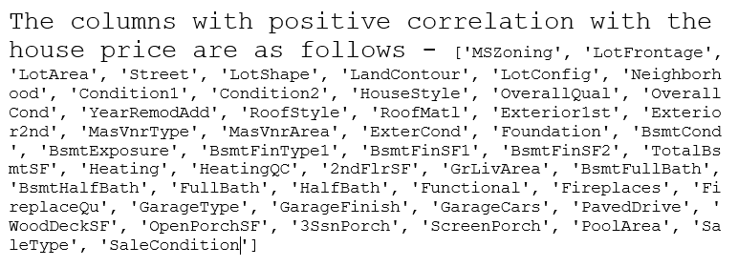
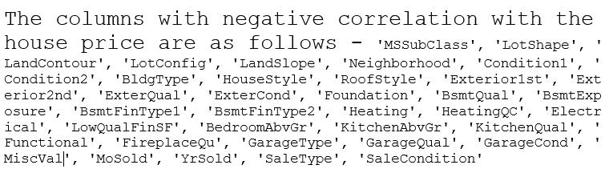

Slide 22
CONCLUSION
The company can purchase houses below the market value by highlighting the negative parameters. Afterwards, the company can work little bit on the negative parameters to decrease the magnitude of negative weight and sell the houses by mainly highlighting the positive features.
In this paper, we built several regression models to predict the price of some house given some of the house features. We evaluated and compared each model to determine the one with highest performance.
We also looked at how some models rank the features according to their importance. In this paper, we followed the data science process starting with getting the data, then cleaning and pre-processing the data, followed by exploring the data and building models, then evaluating the results and communicating them with visualizations.

Slide 23
CONCLUSION
As a recommendation, we advise to use this model (or a version of it trained with more recent data) by people who want to buy a house in the area covered by the dataset to have an idea about the actual price.
The model can be used also with datasets that cover different cities and areas provided that they contain the same features. We also suggest that people take into consideration the features that were deemed as most important as seen in the previous section; this might help them estimate the house price better.

