Slide 1
MALIGNANT COMMENT CLASSIFICATION
BY
V TARAK RAM SAI

Slide 2
PROBLEM STATEMENT
Sentiment Analysis is the task of analysing people’s opinions in textual data (e.g., product reviews, movie reviews, or tweets), and extracting their polarity and viewpoint. The task can be cast as either a binary or a multi-class problem. Binary sentiment analysis classifies texts into positive and negative classes, while multi-class sentiment analysis classifies texts into fine-grained labels or multi-level intensities.
The goal of this project is to use deep learning techniques to identify the level toxicity of a comment which could be used to help deter users from posting potentially hurtful comments, engage in more sophisticated arguments and make internet a safer place.

Slide 3
PROBLEM STATEMENT
Our dataset consists of 6 labels namely highly malignant, malignant, abuse, threat, loathe and rude. This project aims to implement various Machine Learning algorithms and deep learning algorithms like Multilayer perceptron(MLP), Long Short Term Memory Networks, Multinomial Naïve Bayes, Logistic Regression, Random Forest Classifier, Linear SVC and Adaptive Boosting.
This story demonstrates common Natural Language Processing tasks performed specifically to understand the relationship between low ratings and their corresponding comments. In the last years, interest in sentiment analysis in machine learning engineering domain has risen significantly.

Slide 4
Data Sources and their formats
Malignant: It is the Label column, which includes values 0 and 1, denoting if the comment is malignant or not.
Highly Malignant: It denotes comments that are highly malignant and hurtful.
Rude: It denotes comments that are very rude and offensive.
Threat: It contains indication of the comments that are giving any threat to someone.
Abuse: It is for comments that are abusive in nature.
Loathe: It describes the comments which are hateful and loathing in nature.
ID: It includes unique Ids associated with each comment text given.
Comment text: This column contains the comments extracted from various social media platforms.

Slide 5
Analytical Problem Framing
Any machine learning model should follow the below steps while dealing a business problem. They are:
i.) Business Understanding: The first step is to comprehend the research’s background, the problem description, and how the proposed project will achieve the goals.
ii.) Data Understanding: The second stage requires collection of data listed in the project resources. This involves in determining the data requirements and exploring key data attributes.
iii.) Data Preparation: The third stage involves data cleaning and should the handle the missing values in the data.
iv.) Modelling: This involves determining the modelling technique and testing the design.
v.) Evaluation: Here, we should evaluate the achieved results and should determine the performance of the model with best accuracy.
vi.) Deployment: The last stage is implementation of the model.

Slide 6
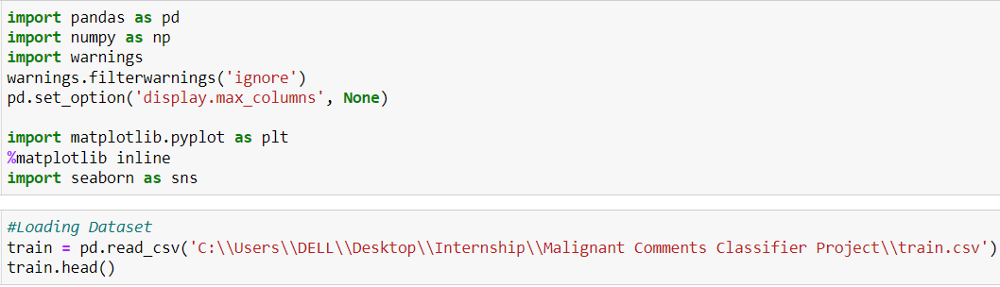
Data Pre-processing
It entails converting raw data into comprehensible format that a machine learning model can understand. The data pre-processing involves data cleaning which involves handling missing values, transformation of data.

Slide 7
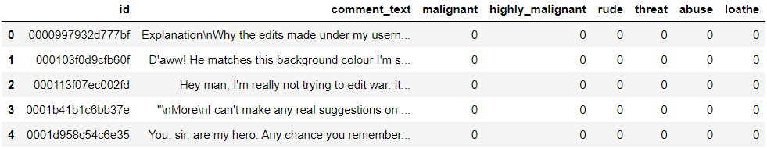
Data Pre-processing
The head of the primary table is as follows:

Slide 8

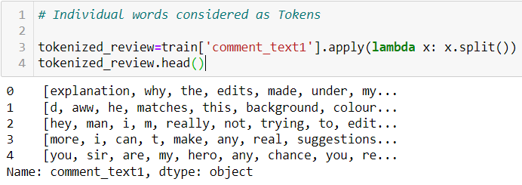
Data Pre-processing
Text Normalization — remove punctuations using Regular Expressions (Regex can be used to find basic and complex patterns in text).
Tokenize — tokenization is the process of splitting text into smaller pieces called tokens.

Slide 9
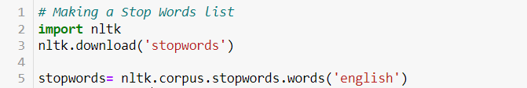
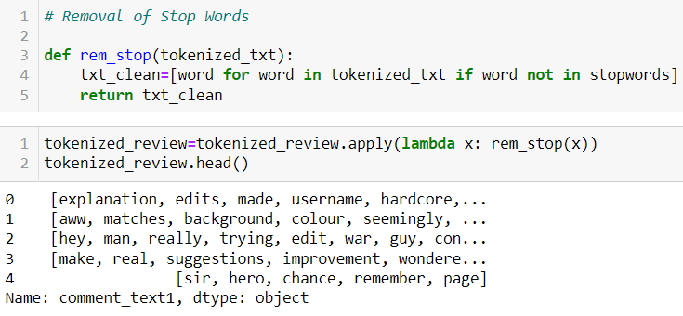
Data Pre-processing
Remove stop words — stop words are words that are usually filtered out before pre-processing of the text. They are generally the most common words in a language that search engines have been programmed to ignore such as personal pronouns (I, you, he, she, it, etc.).

Slide 10
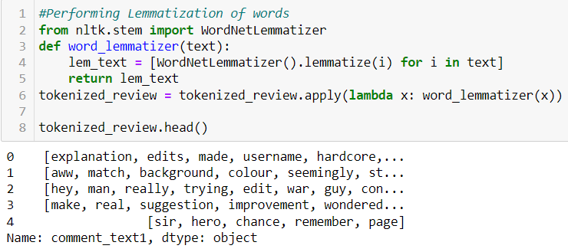
Data Pre-processing
Lemmatization — stemming is the process of removing a part of a word, or reducing a word to its stem or root. This might not necessarily mean we’re reducing a word to its dictionary root. We use a few algorithms to decide how to chop a word off.

Slide 11

Data Pre-processing
Vectorize the text — in order for the computer to understand the text data, they need to be converted into a numerical representation, which is commonly described as Word Embedding. The most intuitive form of this process can be done through a form of one-hot encoding known as the bag-of-words and it describes the occurrence of words. In a bag-of-words, the columns represent each of the unique words in the entire corpus of documents, the rows represent each document, sentence, or topic, and the cells capture the number of times each word appears in each row.

Slide 12
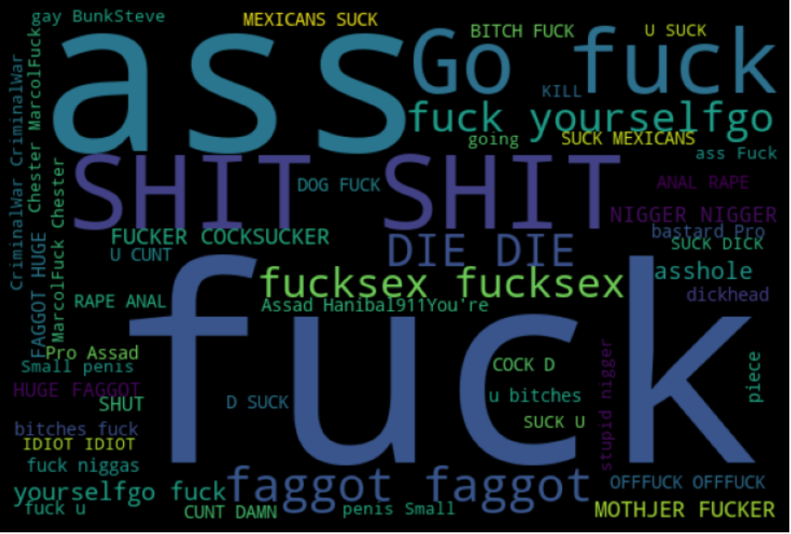
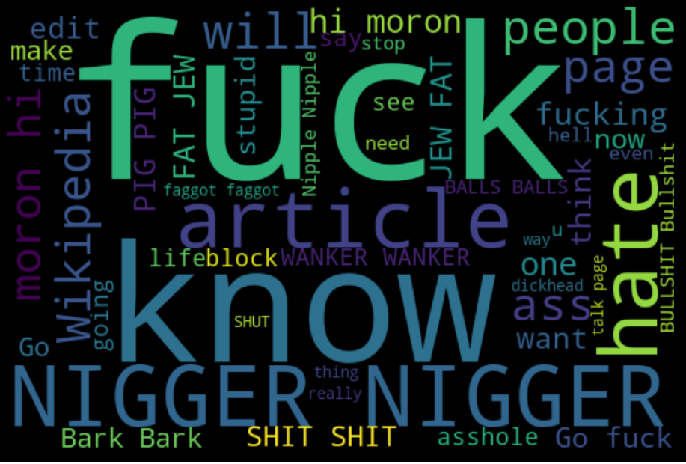
Data Inputs- Logic- Output Relationships
The Word Cloud for the highly malignant comments is as follows-
The Word Cloud for the malignant comments is as follows-

Slide 13
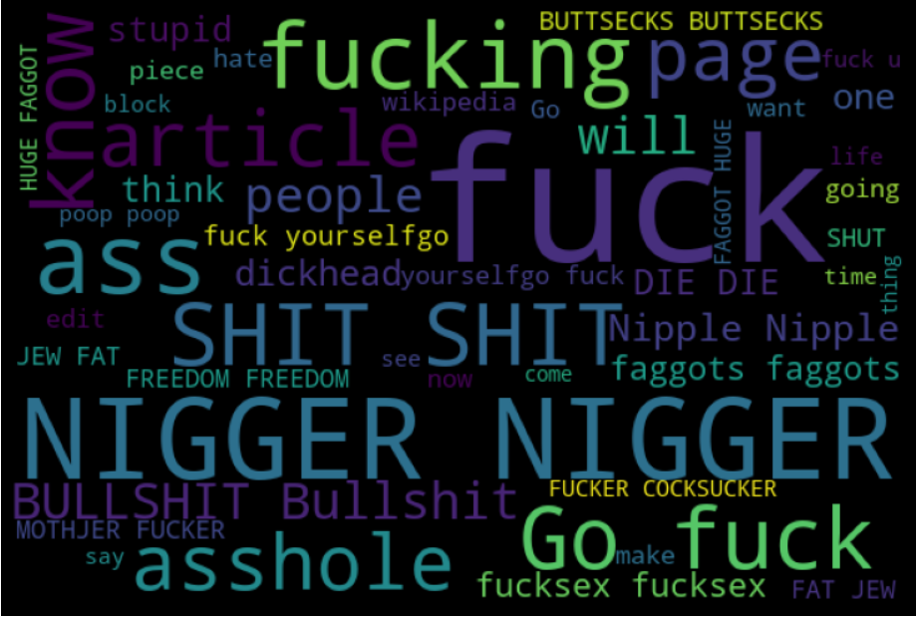
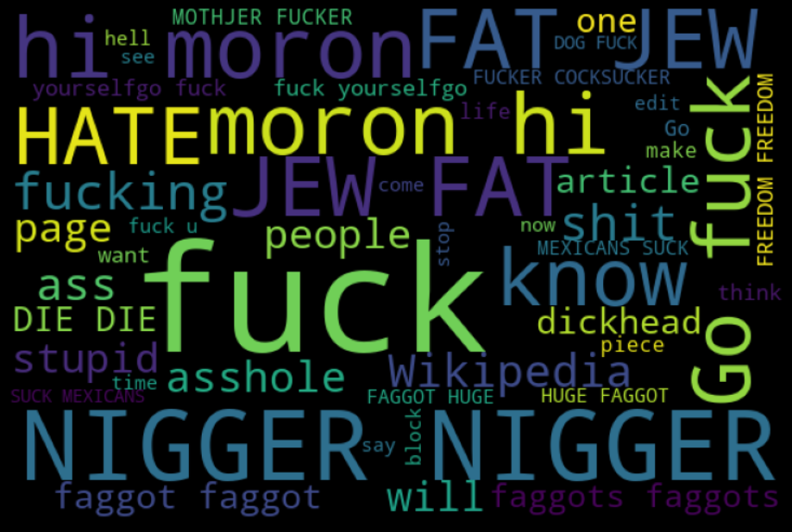
Data Inputs- Logic- Output Relationships
The Word Cloud for the Rude Comments is as follows-
The Word Cloud for the Abuse Comments is as follows-

Slide 14
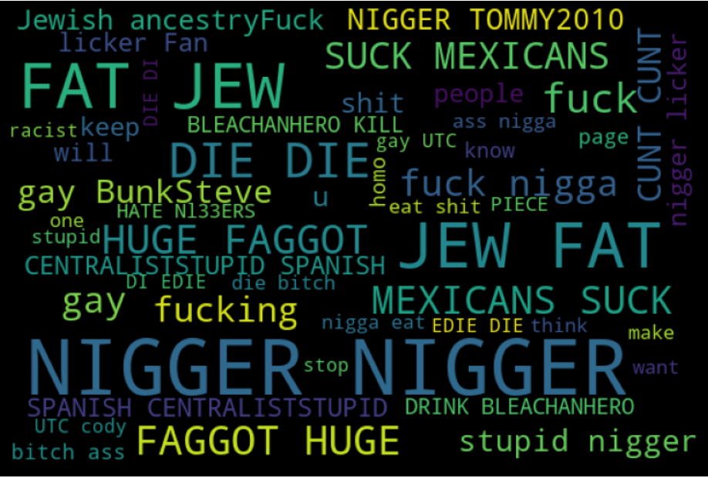
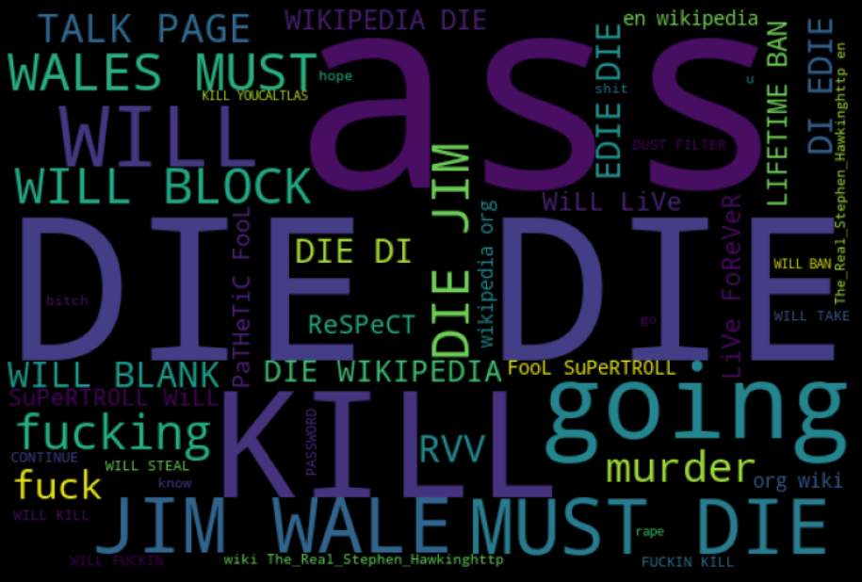
Data Inputs- Logic- Output Relationships
The Word Cloud for the Loathe Comments is as follows-
The Word Cloud for Threat Comments is as follows-

Slide 15
Model/s Development and Evaluation
The train-test split procedure is used to estimate the performance of machine learning algorithms when they are used to make predictions on data not used to train the model.

Slide 16
Logistic Regression
Logistic regression is named for the function used at the core of the method, the logistic function. The logistic function, also called the sigmoid function was developed by statisticians to describe properties of population growth in ecology, rising quickly and maxing out at the carrying capacity of the environment. It’s an S-shaped curve that can take any real-valued number and map it into a value between 0 and 1, but never exactly at those limits.
y = e^ (b0 + b1*x) / (1 + e^ (b0 + b1*x))
Where y is the predicted output, b0 is the bias or intercept term and b1 is the coefficient for the single input value (x). Each column in your input data has an associated b coefficient (a constant real value) that must be learned from your training data.

Slide 17
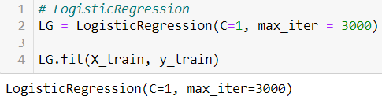
Logistic Regression
1 / (1 + e^-value),
Where e is the base of the natural logarithms (Euler’s number or the EXP () function in your spreadsheet) and value is the actual numerical value that you want to transform. Below is a plot of the numbers between -5 and 5 transformed into the range 0 and 1 using the logistic function. Input values (x) are combined linearly using weights or coefficient values (referred to as the Greek capital letter Beta) to predict an output value (y). A key difference from linear regression is that the output value being modelled is a binary value (0 or 1) rather than a numeric value.

Slide 18
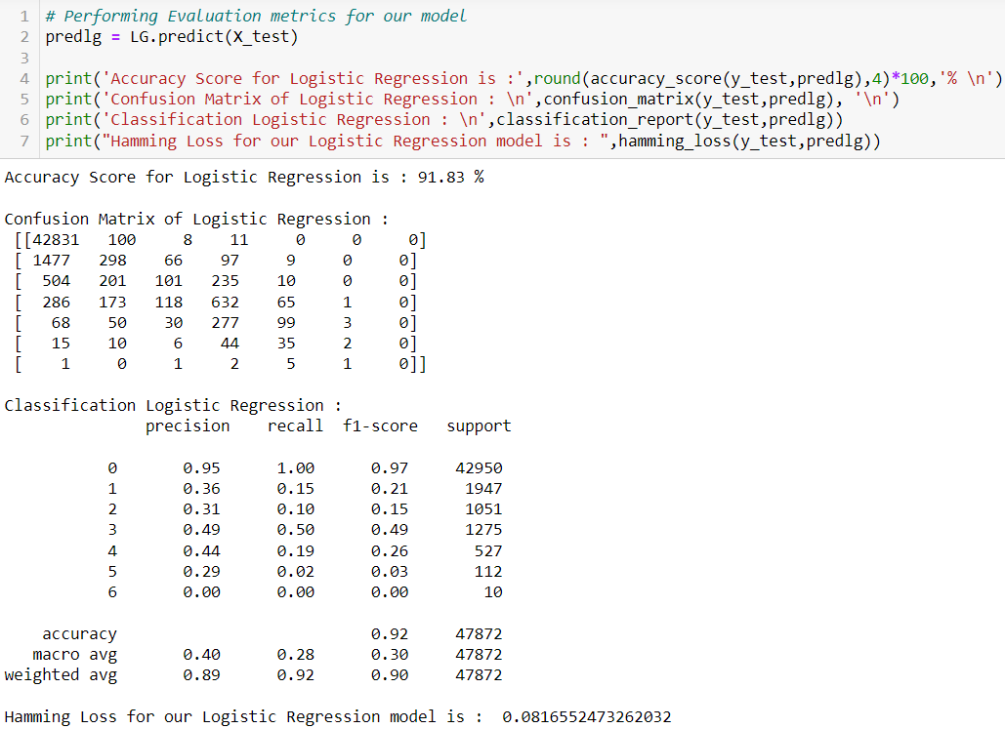
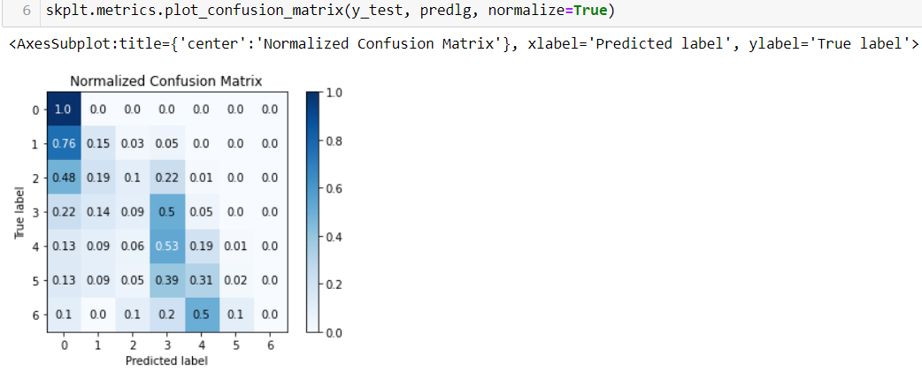

Slide 19
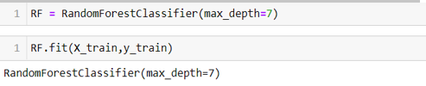
Random Forest Classifier
The random forest classifier is an ensemble method algorithm of decision trees wherein each tree depends on randomly selected samples trained independently, with a similar distribution for all the trees in the forest (Breiman 2001). Hence, a random forest is a classifier incorporating a collection of tree-structured classifiers that decrease overfitting, resulting in an increase in the overall accuracy (Geurts et al. 2006). As such, random forest’s accuracy differs based on the strength of each tree classifier and their dependencies.

Slide 20
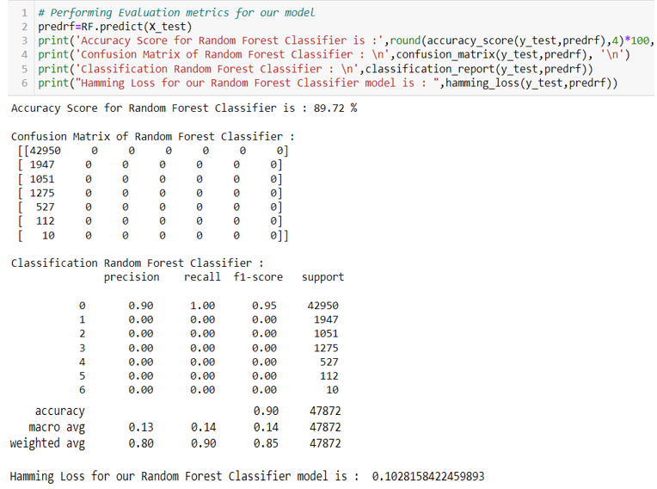
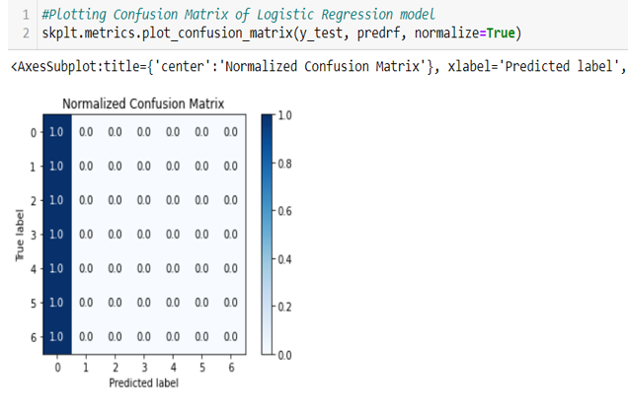

Slide 21
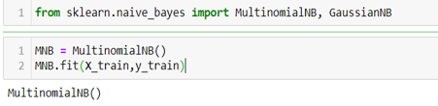
Multinomial Naïve Bayes
Multinomial Naive Bayes algorithm is a probabilistic learning method that is mostly used in Natural Language Processing (NLP). The algorithm is based on the Bayes theorem and predicts the tag of a text such as a piece of email or newspaper article. It calculates the probability of each tag for a given sample and then gives the tag with the highest probability as output.
Naive Bayes is a powerful algorithm that is used for text data analysis and with problems with multiple classes. To understand Naive Bayes theorem’s working, it is important to understand the Bayes theorem concept first as it is based on the latter. Bayes theorem, formulated by Thomas Bayes, calculates the probability of an event occurring based on the prior knowledge of conditions related to an event.

Slide 22
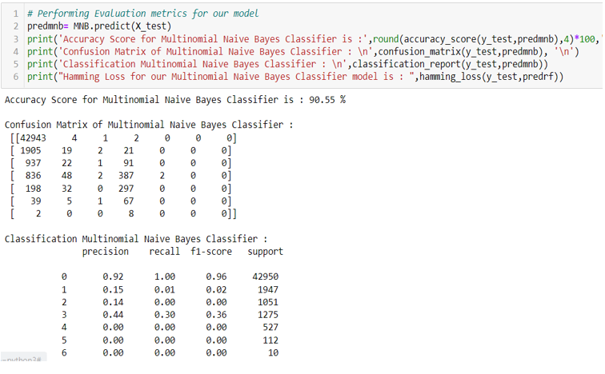
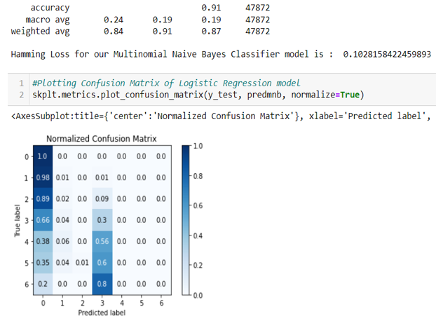

Slide 23
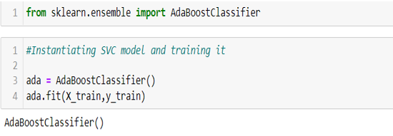
Ada Boost Classifier
Adaptive boosting (AdaBoost) is an ensemble algorithm incorporated by Freund and Schapire (1997), which trains and deploys trees in time series. Since then, it evolved as a popular boosting technique introduced in various research disciplines. It merges a set of weak classifiers to build and boost a robust classifier that will improve the decision tree’s performance and improve accuracy.

Slide 24
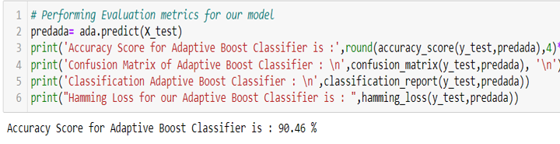
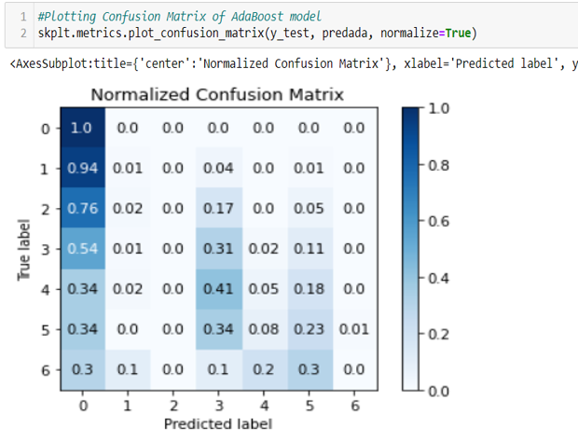
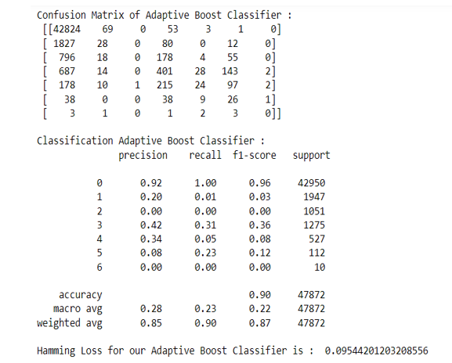

Slide 25
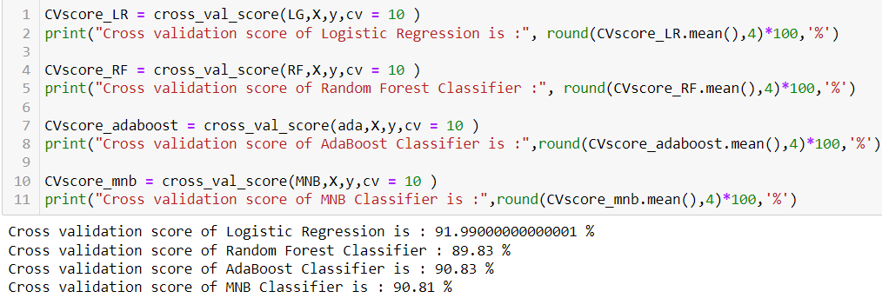
Cross Validation
Cross Validation is a very useful technique for assessing the effectiveness of your model, particularly in cases where you need to mitigate overfitting.
We can choose MNB as our model since its accuracy and cv score are almost same.

Slide 26
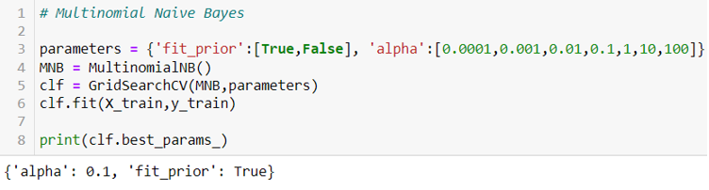
Hyper Parameter Tuning
In machine learning, hyper parameter optimization or tuning is the problem of choosing a set of optimal hyper parameters for a learning algorithm. A hyper parameter is a parameter whose value is used to control the learning process. By contrast, the values of other parameters (typically node weights) are learned.

Slide 27
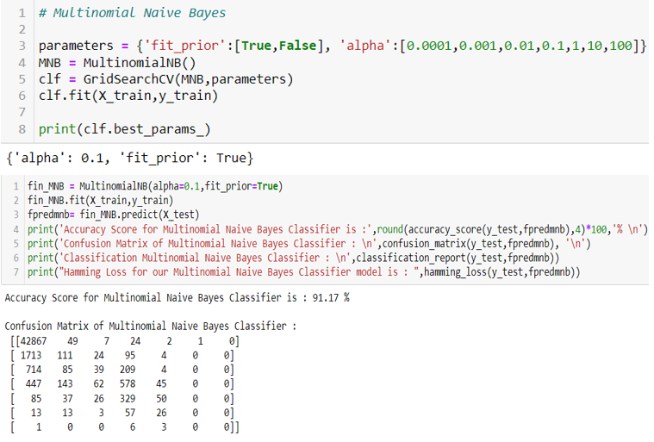
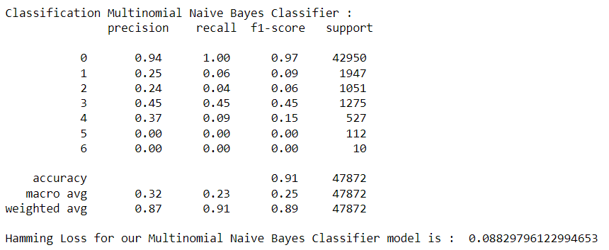
Hyper Parameter Tuning

Slide 28
CONCLUSION
This research evaluated the malicious comment text classification using machine learning techniques. Using real data, we compared the various machine learning algorithms’ accuracy by performing detailed experimental analysis while classifying the text into 7 categories.
Generally, Multinomial Naïve Bayes Classification machine learning algorithm has shown a better performance with our real-life data than others, and the most performing models are all ensemble classifiers. It was found that the Random Forest classifier generated the least accurate predictions.

