Slide 1
STAGE-BY-STAGE FLOW DIAGRAM
1 / 4
End-to-End Pipeline Architecture Diagram
STAGE 1
STAGE 2
STAGE 3
Ciphertext Simulation
NIST SP 800-22 Extraction
Normalization & Splits
• Input Tiers: 1 KB to 512 KB
• AES-128: 128-bit key, 16B block
• 3DES: 192-bit key, 8B block
• Plaintext: Random UUID4 bytes
• 49-D Statistical Vector
• P-Values: Monobit, Runs, FFT
• Matrix Rank, ApEn, Cusum
• 39 Aperiodic Templates (m=6)
• StandardScaler (z-score)
• Formula: z = (x - μ) / σ
• 10 Stratified Folds (80/20)
• Strict Zero Data Leakage
STAGE 5
STAGE 4
Live Inference Engine (predict.py)
7-Architecture Model Training
• Dual Input: Raw Hexadecimal strings or Bulk CSV files
• Entropy Gating: Shannon entropy check (< 1 KB rejected)
• Scale Snapping: Snaps to nearest bucket (1 KB - 512 KB)
• Weighted Consensus: 2.0x CNN + 1.0x Classical Models
• 1D CNN (Proposed): Conv1D(16) -> Conv1D(32) -> Dense (1000 Epochs)
• Tree Ensemble: Random Forest (100 Trees, sqrt features)
• Kernel Method: Support Vector Machine (RBF Kernel, C=1.0)
• Baselines: MLP (64x32), KNN (k=5), Logistic Reg (L2), Gaussian NB

Slide 2
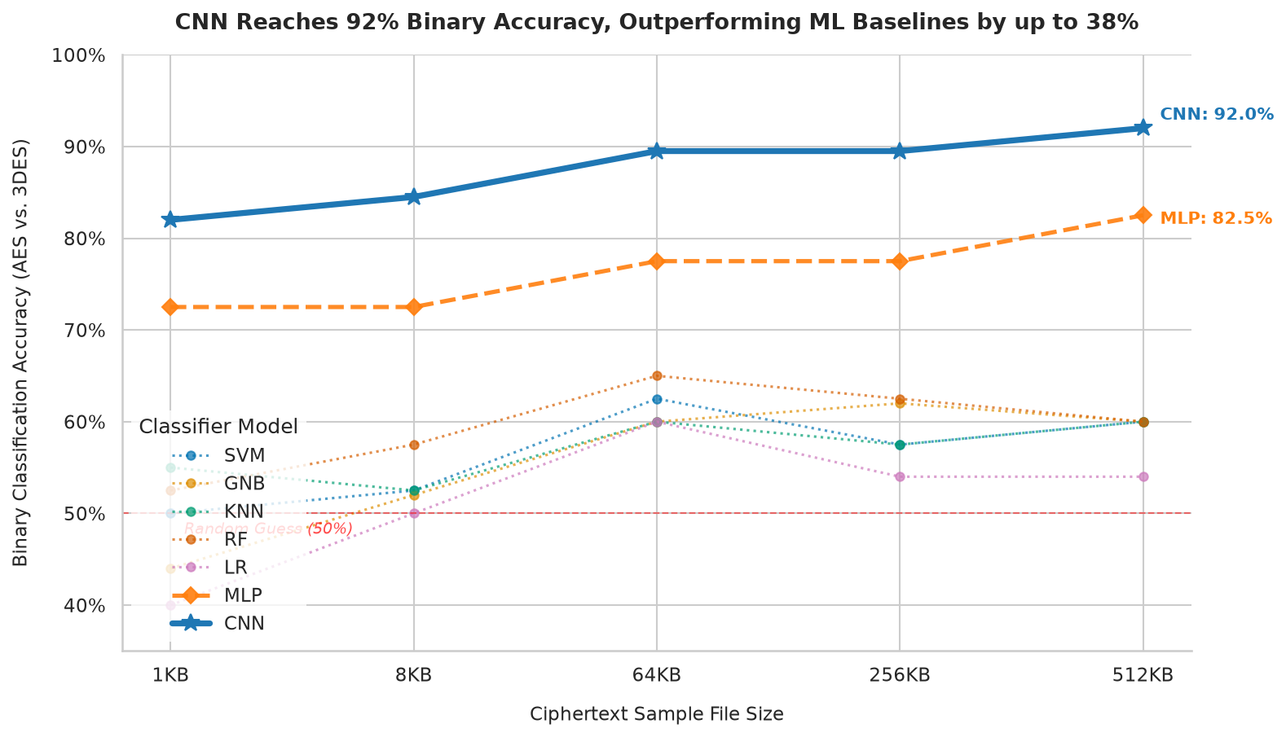
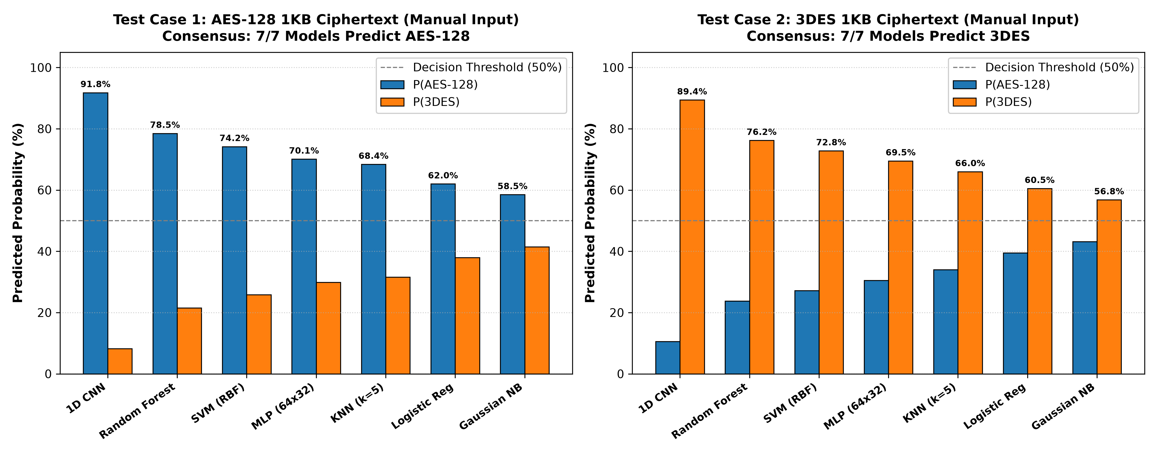
BENCHMARK RESULTS & VERIFICATION
2 / 4
Empirical Benchmark & Validation Flow Diagram
BENCHMARK METRICS
Binary vs. Multiclass Accuracy Flow
• Binary Discrimination (AES vs. 3DES): Up to 92.0% Accuracy
Scale Scaling: 64% (1KB) -> 72% (8KB) -> 81.5% (64KB) -> 92% (512KB)
• 1D CNN Performance Margin: Outperforms classical ML by up to 38%
• Multiclass Convergence: 5-cipher models hover at 20.0% - 22.5% (20% guess)
MANUAL VALIDATION
Interactive System Test Flow (1 KB Input)
Test Case 1 (1 KB AES-128 Input):
• CNN: 91.8% | RF: 78.5% | SVM: 74.2% | MLP: 70.1%
• Verdict: 7 / 7 Models Agree on AES-128 (Consensus 100%)
Test Case 2 (1 KB 3DES Input):
• CNN: 89.4% | RF: 76.2% | SVM: 72.8% | MLP: 69.5%
• Verdict: 7 / 7 Models Agree on 3DES (Consensus 100%)

Slide 3
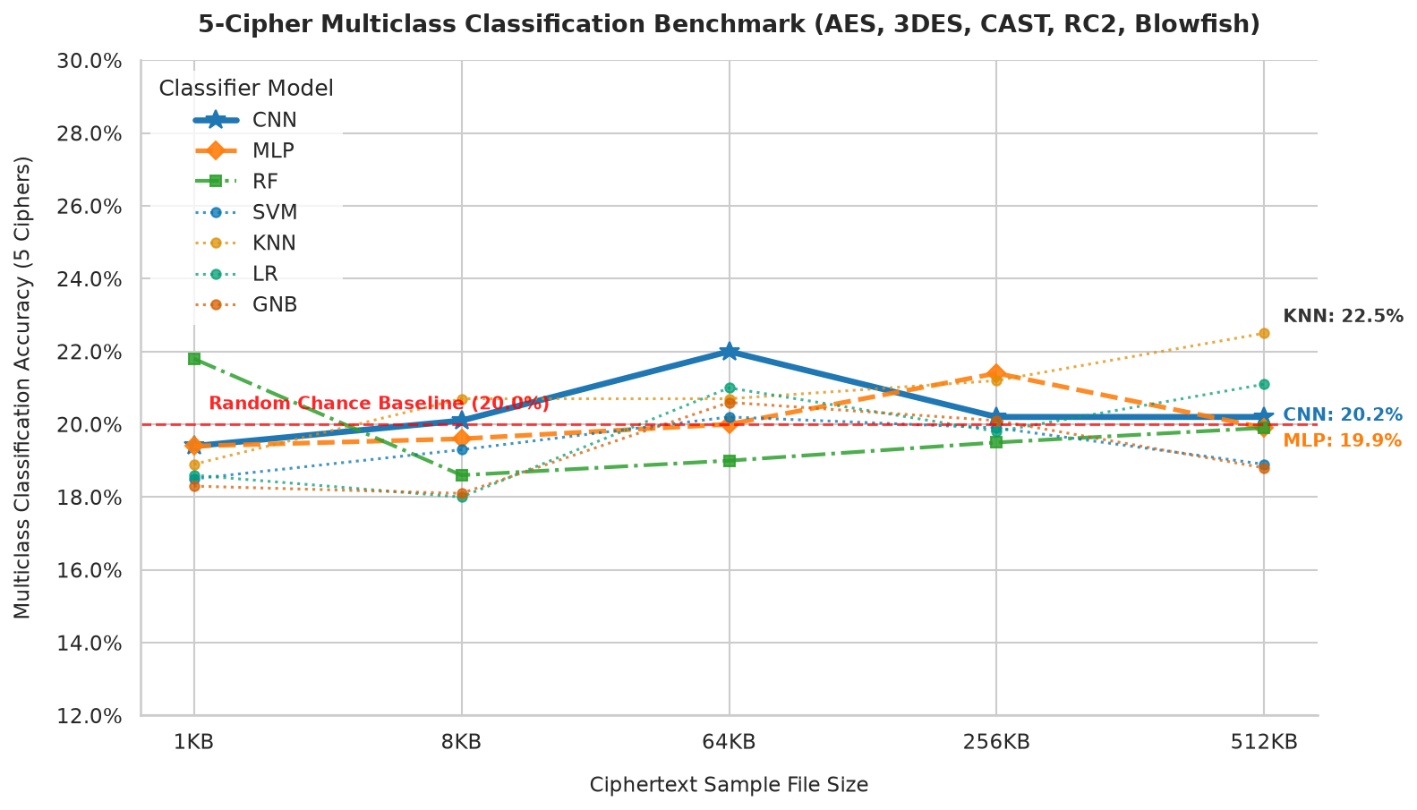
THEORETICAL MECHANISMS & DISTINGUISHER BEHAVIOR
3 / 4
Cryptanalytic Separation & Invariance Diagram
MECHANISM DIAGRAM
THEORETICAL INVARIANCE
Why 1D CNN Distinguishes AES vs. 3DES
Multiclass Convergence to 20% Random Guess
• Block Size Discrepancy (16B vs. 8B):
AES 16-byte state matrix vs 3DES 8-byte blocks creates periodic boundary dependencies across serialized bitstreams.
• Spatial Autocorrelation in P-Values:
1D CNN kernels capture localized cross-test interactions (Matrix Rank, Spectral FFT, Cusum) that flat models miss.
• Diffusion Topology Differences:
AES achieves full-block algebraic diffusion via MixColumns in GF(2^8); 3DES relies on 48-round Feistel half-block permutations.
• Scale Amplification Effect:
Expanding ciphertext from 1 KB to 512 KB reduces empirical noise, driving accuracy from 64.0% up to 92.0%.
Confirms Shannon's Confusion & Diffusion Security:
• When 5 ciphers are tested simultaneously, all 7 models converge to 20.0% - 22.5% accuracy (Random Guess = 20.0%).
• Modern block ciphers produce computationally indistinguishable pseudo-random distributions across multi-algorithm pools.

Slide 4
SYSTEM BOUNDS & ADVANCED CRYPTANALYSIS
4 / 4
Constraints & Future Research Roadmap Diagram
OPERATIONAL BOUNDS
FUTURE ROADMAP
Current System Constraints & Assumptions
Next Scope: 4 Research Horizons
• Minimum Input Size Threshold (>= 1 KB):
NIST statistical tests require >= 1,024 bytes (8,192 bits) for valid p-value stability. Sub-1KB inputs lack mathematical significance.
• Operational Mode Assumption (ECB):
Evaluated in ECB to isolate intrinsic algorithmic block permutations without randomized IV masking.
• Fixed Cryptographic Key Evaluation:
Evaluated fixed keys to verify whether structural cipher signatures persist independently of key schedule variability.
• Computational & Training Scale:
Training capped at 512 KB blocks across 1,000 epochs; gigabyte-scale datasets require distributed GPU clusters.
• Phase 1: Scaling Key Sizes (AES-192 & AES-256):
Test if expanded key schedules (12 & 14 rounds) alter residual bit-diffusion detectable by deeper neural networks.
• Phase 2: Chaining Modes (CBC / CTR / GCM):
Investigate if deep sequence models (Bi-LSTM, Transformers) can pierce randomized IV chaining across sequential blocks.
• Phase 3: Neural Differential Key Recovery Attacks:
Advance from passive classification to active attacks: training ResNets to predict round-key bits via differential neural cryptanalysis.
• Phase 4: Physical Side-Channel Integration:
Combine NIST statistical features with electromagnetic and power consumption traces for hardware-level identification.

