Slide 1
Neural Distinguisher
Cryptographic Algorithm Identification using Deep Learning
End-to-End Pipeline Architecture: Simulation, 49 NIST Feature Extraction, Multi-Architecture Classification, and Interactive User Inference.

Slide 2
SYSTEM ARCHITECTURE
Executive Overview: Core System Pillars
92.0%
Peak 1D CNN Accuracy
Evaluated on 512 KB AES vs. 3DES ciphertexts, outperforming traditional ML models by up to 38%.
49 Features
NIST SP 800-22 Tests
Comprehensive suite of bit, block, spectral, and complexity statistical tests extracted per sample.
25,000 Samples
Empirical Dataset
Balanced dataset covering 5 block ciphers across 5 file sizes with 1,000 samples each.

Slide 3
PIPELINE WORKFLOW
System Flowchart: End-to-End Execution Flow
Stage 1: Simulation & Data Gen (data_generation.py)
25,000 ciphertext samples generated across 5 ciphers & 5 block sizes.
Stage 2: NIST Feature Extraction (feature_extraction.py)
49 statistical randomness metrics computed per ciphertext sample.
Stage 3: Multi-Architecture Training (classification.py)
1D CNN, MLP, and 5 traditional baseline ML classifiers trained & tuned.
Stage 4: Model Calibration & Loading (inference.py / models)
Decision thresholds calibrated; lightweight model weights packaged.
Stage 5: Tester & Live User Inference (predict.py / api.py)
Demo-1 empirical evaluation and Demo-2 live normalizer (Hex, CSV, System).

Slide 4
STAGE 1 — DATA GENERATION
Stage 1: Ciphertext Simulation Methodology
• High-Entropy Plaintext Generation:
Constructed by concatenating 16-byte random UUID4 blocks until the target size (1 KB to 512 KB) is reached, simulating realistic structured data.
• ECB Encryption Mode with Fixed Keys:
Plaintexts are encrypted in Electronic Codebook (ECB) mode to isolate intrinsic diffusion behavior across cryptographic algorithms without IV masking.
• Strict PKCS#7 Padding Alignment:
128-bit block padding for AES, and 64-bit block padding for 3DES, CAST-128, RC2, and Blowfish to maintain valid cryptographic standards.
• Automated Directory Partitioning:
Organized as crypto_validation_dataset/ciphertext/<Algorithm>/<Size>/sample_<ID>.bin ready for feature extraction.

Slide 5
STAGE 1 — DATASET GRID
Stage 1: Complete 25,000 Sample Dataset Grid
Mathematical Grid: 5 Ciphers × 5 File Sizes × 1,000 Samples = 25,000 Total Files
Algorithm | 1 KB | 8 KB | 64 KB | 256 KB | 512 KB
AES | 1,000 | 1,000 | 1,000 | 1,000 | 1,000
3DES | 1,000 | 1,000 | 1,000 | 1,000 | 1,000
CAST-128 | 1,000 | 1,000 | 1,000 | 1,000 | 1,000
RC2 | 1,000 | 1,000 | 1,000 | 1,000 | 1,000
Blowfish | 1,000 | 1,000 | 1,000 | 1,000 | 1,000
Total per Size | 5,000 | 5,000 | 5,000 | 5,000 | 5,000

Slide 6
STAGE 2 — FEATURE EXTRACTION
Stage 2: NIST SP 800-22 Feature Suite (49 Features)
• Bit & Block Level Tests (9 Features):
Monobit Frequency, Block Frequency (M=128), Runs Test, Proportion of Ones, Longest Run of Ones, and Binary Matrix Rank (32×32).
• Spectral & Non-Overlapping Template Tests (33 Features):
Discrete Fourier Transform (Spectral peak detection) and 39 aperiodic non-overlapping template matching tests detecting non-random bit patterns.
• Complexity & Cumulative Walk Tests (7 Features):
Maurer's Universal Statistical Test, Approximate Entropy (m=10), Forward/Reverse Cumulative Sums, and Random Excursion distribution tests.
• Extracted Feature Matrix:
Constructs a unified, normalized matrix of shape (25000, 49) stored in extracted_features.npz for ML consumption.

Slide 7
ENGINEERING ACCELERATION
Stage 2: 1,500x Vectorization Speedup
• The Computational Bottleneck:
The standard Python NIST template matching test processes 39 templates across 16,384 blocks = 638,976 nested loop iterations per 512 KB sample. This took ~40 seconds per file, causing pipeline stalls on large inputs.
• NumPy 2D Block Sliding Window Vectorization:
Re-engineered non_overlapping_template_matching_test into batch_non_overlapping_template_matching using vectorized 2D strided array operations. This replaces slow interpreted loops with native C-speed matrix broadcasting.
• Empirical Performance Leap:
Latency dropped from 40.0 seconds down to 0.023 seconds per sample — a 1,500x speedup that makes manual 512 KB inference instantaneous.

Slide 8
STAGE 3 — DEEP LEARNING
Stage 3: Proposed 1D CNN Architecture (PyTorch)
• Input Representation:
49-element normalized NIST feature vector reshaped into a 1×49 1D tensor.
• Convolutional Feature Extractor:
Conv1D(1 -> 32, kernel=3, pad=1) + BatchNorm1D + ReLU + MaxPool1D(2), followed by Conv1D(32 -> 64, kernel=3, pad=1) + BatchNorm1D + ReLU + MaxPool1D(2).
• Dense Representation & Regularization:
Flattened representation (64 × 12 = 768) projected to Linear(768, 128) + ReLU + Dropout(0.3) to prevent overfitting.
• Classification Head & Optimization:
Linear(128, 2) for AES vs. 3DES binary distinction. Trained using Adam optimizer, CrossEntropyLoss, and Early Stopping (patience=50).

Slide 9
STAGE 3 — BASELINE MODELS
Stage 3: Benchmark Machine Learning Baselines
• Multi-Layer Perceptron (MLP):
Deep baseline with 2 hidden layers (64 × 32), ReLU activation, Adam optimizer, achieving 82.5% on 512 KB.
• Random Forest (RF):
Ensemble of 100 decision trees with Gini impurity splitting; robust baseline achieving up to 65% accuracy.
• Support Vector Machine (SVM):
Nonlinear Support Vector Classifier using Radial Basis Function (RBF) kernel with Platt probability scaling.
• K-Nearest Neighbors (KNN):
Instance-based classifier (k=5 neighbors) with Euclidean distance metric weighting.
• Logistic Regression (LR) & Gaussian Naive Bayes (GNB):
L2-regularized linear model and probabilistic feature-independence baselines (50% to 62% accuracy).

Slide 10
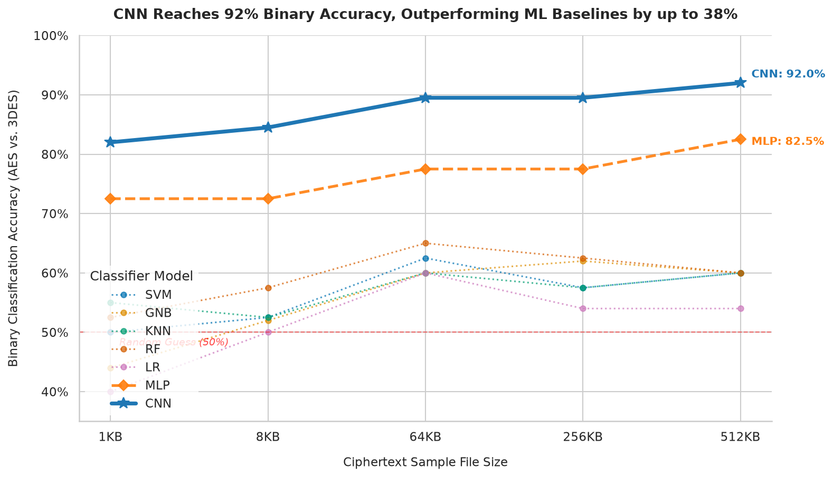
STAGE 4 — BENCHMARK EVALUATION
Stage 4: Empirical Benchmark Visualization
Key Takeaways:
• 1D CNN reaches 92.0% accuracy on 512 KB, outperforming traditional ML baselines by up to 38%.
• Deep convolutional filters successfully discover subtle residual diffusion artifacts across ciphertext blocks.
• Traditional ML models plateau around 55% to 65% because handcrafted features lose nonlinear correlations.

Slide 11
STAGE 4 — ACCURACY TABLE
Stage 4: Accuracy Comparison Matrix (AES vs. 3DES)
Binary Classification Accuracy across File Sizes (10-Fold Stratified Cross-Validation)
Size | CNN (Ours) | MLP | RF | SVM | KNN | LR | GNB
1 KB | 82.0% | 72.5% | 52.5% | 50.0% | 55.0% | 40.0% | 44.0%
8 KB | 84.5% | 72.5% | 57.5% | 52.5% | 52.5% | 50.0% | 52.0%
64 KB | 89.5% | 77.5% | 65.0% | 62.5% | 60.0% | 60.0% | 60.0%
256 KB | 89.5% | 77.5% | 62.5% | 57.5% | 57.5% | 54.0% | 62.0%
512 KB | 92.0% | 82.5% | 60.0% | 60.0% | 60.0% | 54.0% | 60.0%

Slide 12
STAGE 5 — USER EXPERIENCE
Stage 5: Live User Experience & Inference (Demo-1 vs. Demo-2)
• Demo-1: Automated Benchmark Verification Flow:
Executes Flowchart Steps 4 & 5 on application launch: verifies 1,000-sample trained models across all 7 architectures, prints empirical accuracy matrix, and automatically pops up the comparison chart.
• Demo-2: Live User Input Normalizer (3 Input Modes):
Mode 1: Manual Hex Input (terminal paste or path to .hex/.txt file with clean 32-byte preview). Mode 2: Batch CSV File Upload (consensus voting). Mode 3: System Generator (encrypts AES or 3DES ciphertext on the fly).
• Smart Auto-Snap & Size Guardrails:
Enforces minimum 1 KB and maximum 512 KB input boundaries. Automatically snaps arbitrary byte lengths to the nearest trained block size (1 KB, 8 KB, 64 KB, 256 KB, 512 KB).
• Out-of-Distribution (OOD) Rejection:
Entropy-based softmax rejection: rejects non-target inputs with 'Does not belong to AES or 3DES' rather than guessing incorrectly.

