Slide 1






Final project
Environment project using Python

Slide 2
The flowchart
Environment project: reduce water use in agriculture

Slide 3
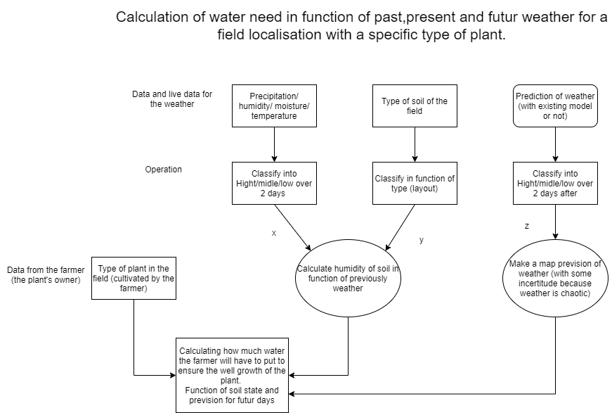
Farmer lat and long

Slide 4
Api weather
Have live weather constants using an API

Slide 5

Give live weather conditions for a city using its name or the localisation.
Using python library pyowm to ask at API the weather
OpenWeatherMap:
+40000 weather stations
Give a free API with weather conditions
Work with smartphone, web page or python project
Data given: temperature, wind speed & direction, cloud coverage, humidity, rain amount, forcast weather for 5 days.

Slide 6
The python code flowchart
How the python code working

Slide 7
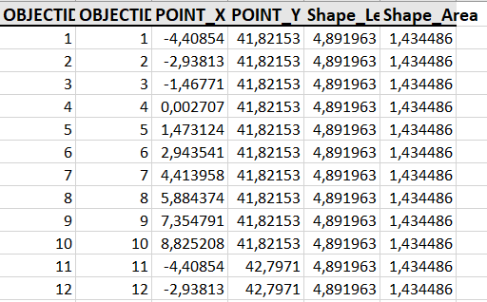
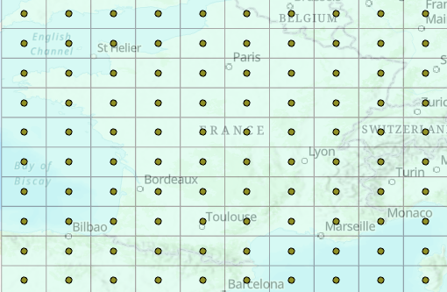
File with XY coordinates of each point
Fishnet of France map with points

Slide 8
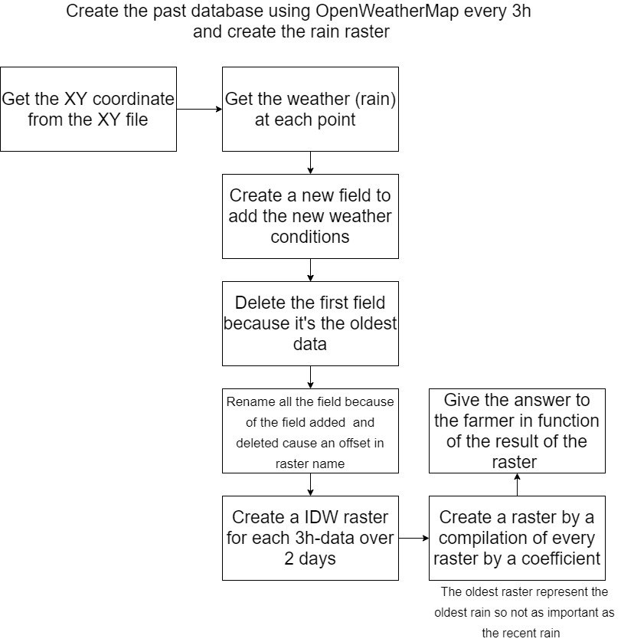
API OWM
Arcpy

Slide 9
The python code
How the python code is written

Slide 10
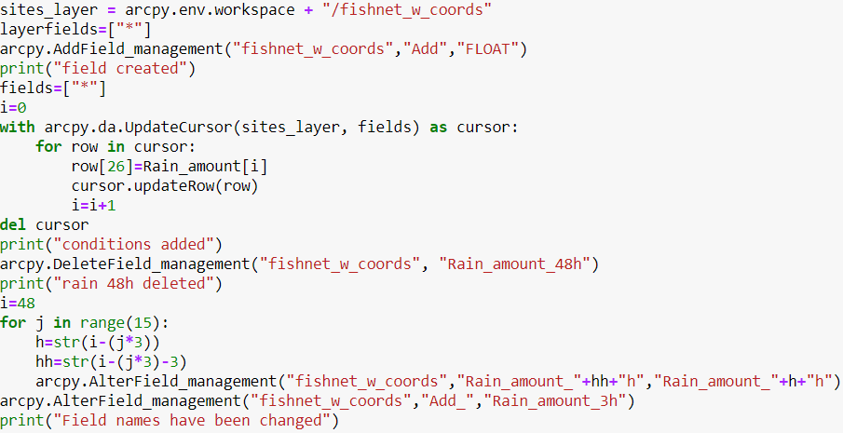
Add « Add field » to save new weather conditions
Fill the « Add field » with the most recent datas
Delete the oldest data (48h ago)
Shift all the data with its good name:
6h become the 9h, 9h->12h
And « add » field is the « Rain amount 3h »
Field with the time of the data (48h for 48 hours ago …) and rain amount in mm

Slide 11
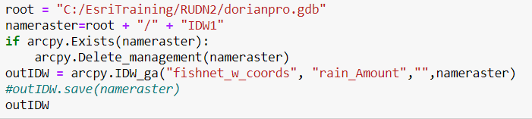
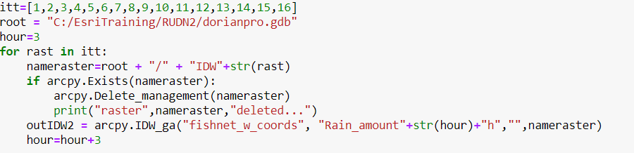
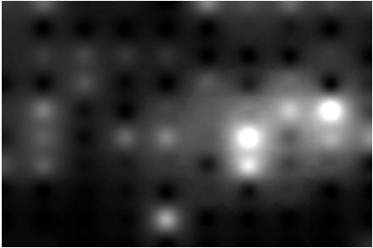
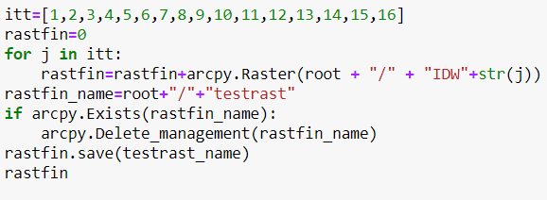
IDW Raster création
Name of each field (one rater/field)
Final raster with coefficient in function of the time
Create 16 raster of each fields
Final raster without coefficients

Slide 12
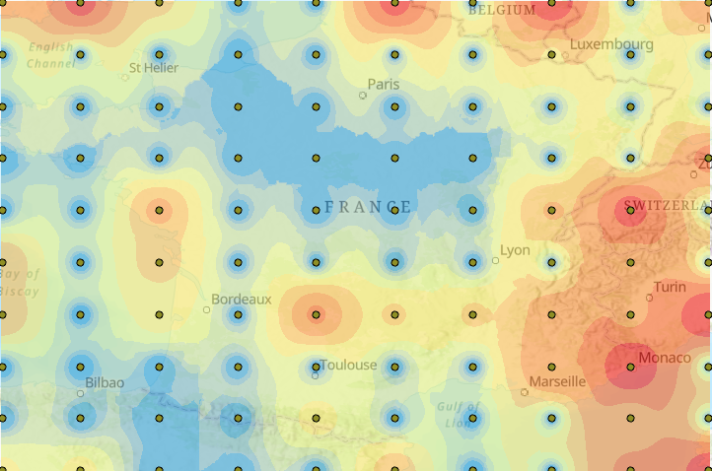
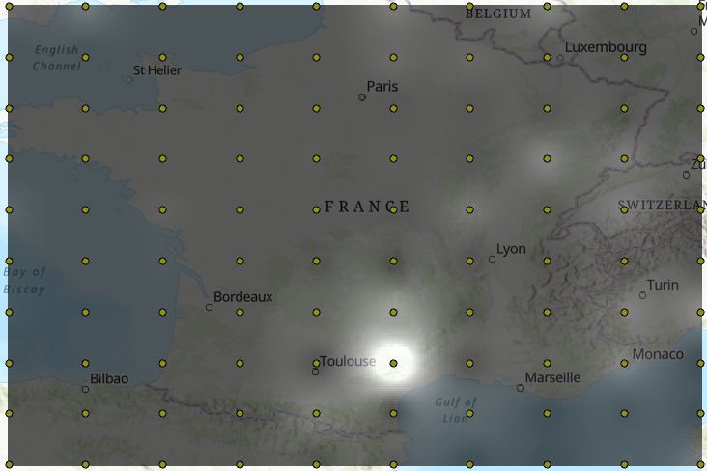
Final raster with coefficients, the more is white, the more humid is the soil
Raster of an rain amount in France for one field
Raster of an rain amount in France for one field

Slide 13
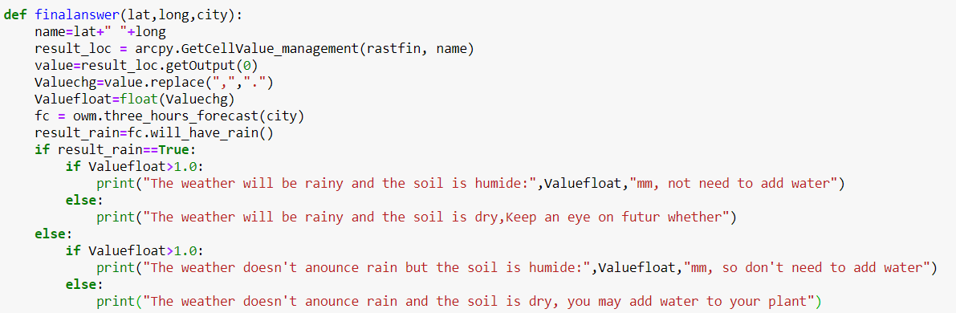
Give the final answer to the farmer
Get the pixel value corresponding of the farmer location to say the state of the soil in function of the final value of amount_rain
Different cases:
Rain announced : keep an eye to weather, farmer knows if it will be rainy and water may not be needed
No rain:
If the soil is humid it’s OK and need not to add water
If the soil is dry it necessary to add water to the plant

Slide 14
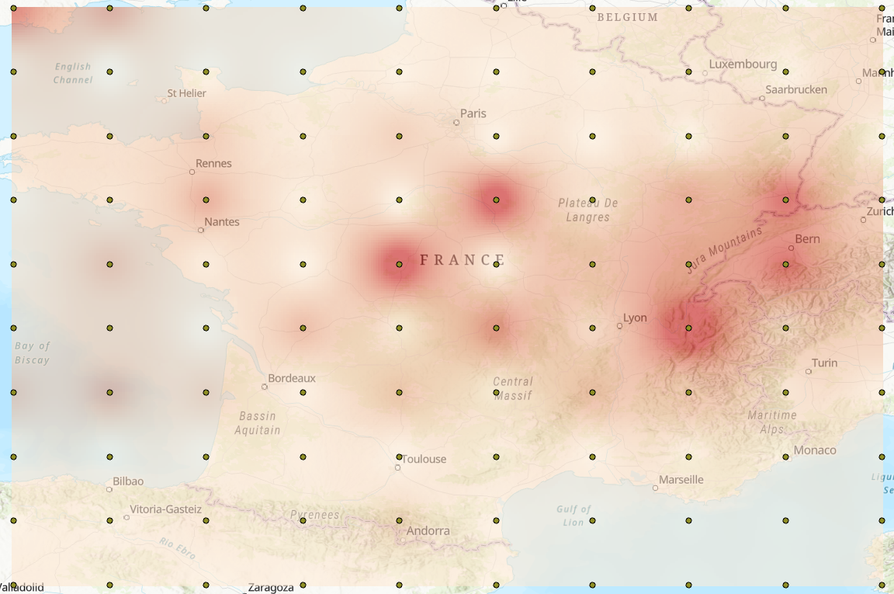
Conclusion and update:
Create a code to create a database of rain amount in France
Create a code to get the result in function of localisation of farmer’s field

Slide 15


