Slide 1


Vehicle to Grid (V2G) Smart Grid for Power Overload within Grid Network Timothy Rampiaray Assignment 1 EEL 6257

Slide 2
Problem Statement
Grid systems will be introduced to increased demands due to the rise in Electric Vehicles
Many more renewable energy generation systems will also need to be balanced in the coming years
How can a Grid network balance the different types of loads throughout an average day?
If a dynamic pricing algorithm were to be introduced would this help the way energy is balanced throughout the network?

Slide 3
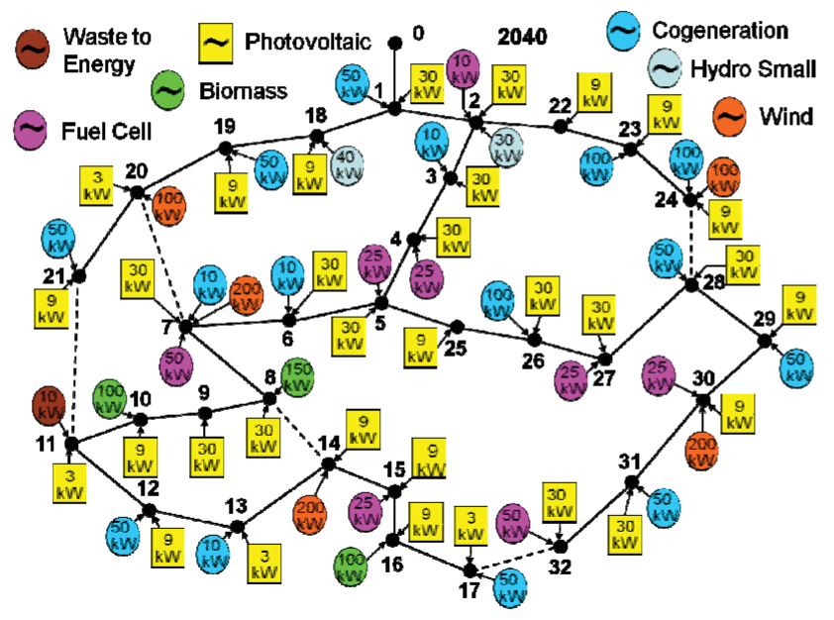
33-Bus Network
Peak Load = 4.36 MVA
33 points for EVs, PHEVs and EREVs
Distributed Generation
Renewable Energy
Figure 1. Configuration of network in 2040

Slide 4
Performance Metrics
 | Original | Dropping velocity and Charge difference time (min) | Dropping Velocity and Trip time(min) | Original (trained for 3/4 of data instead of half)
 | ----------LinearRegression | ----------LinearRegression | ----------LinearRegression | ----------LinearRegression
mean absolute error (MAE) | 0.082486224 | 0.083835671 | 0.083702805 | 0.079090689
mean squared error (MSE) | 0.011469584 | 0.01150075 | 0.011474417 | 0.009881557
mean squared error (RMSE) | 0.107096145 | 0.107241549 | 0.107118703 | 0.099406022
 | -----------RidgeRegression | -----------RidgeRegression | -----------RidgeRegression | -----------RidgeRegression
mean absolute error (MAE) | 0.089336625 | 0.089338022 | 0.089338135 | 0.086005182
mean squared error (MSE) | 0.012822929 | 0.012823285 | 0.012823319 | 0.011156965
mean squared error (RMSE) | 0.113238374 | 0.113239944 | 0.113240094 | 0.105626536
 | ----------LassoRegression | ----------LassoRegression | ----------LassoRegression | ----------LassoRegression
mean absolute error (MAE) | 0.089341991 | 0.089341991 | 0.089341991 | 0.086012378
mean squared error (MSE) | 0.01282442 | 0.01282442 | 0.01282442 | 0.0111588
mean squared error (RMSE) | 0.113244957 | 0.113244957 | 0.113244957 | 0.105635222

Slide 5
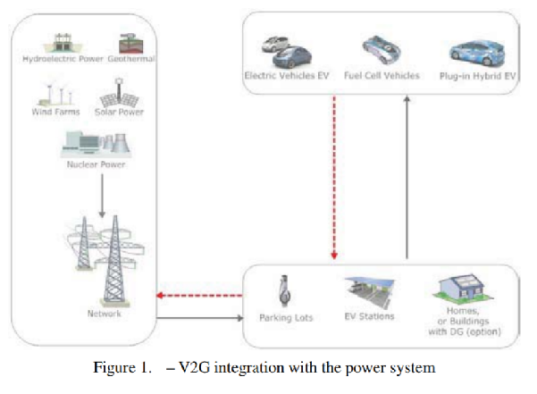

Slide 6

1800 Vehicles

Slide 7
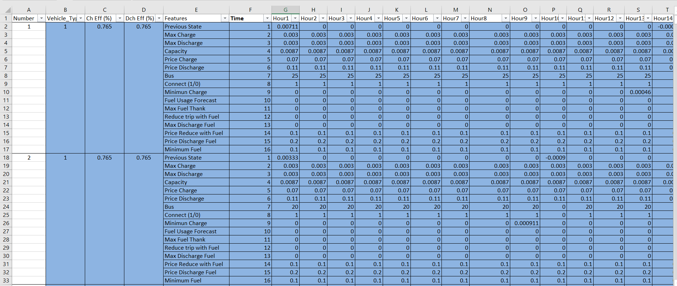
Data

Slide 8
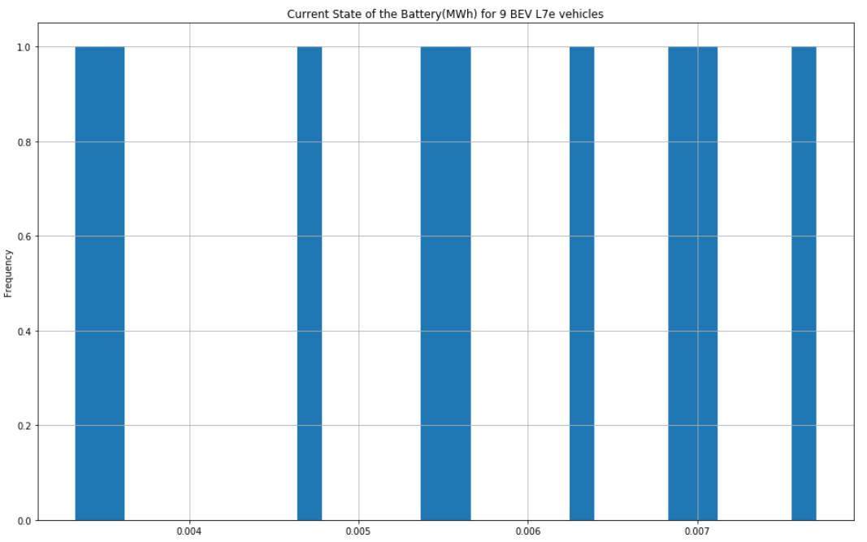
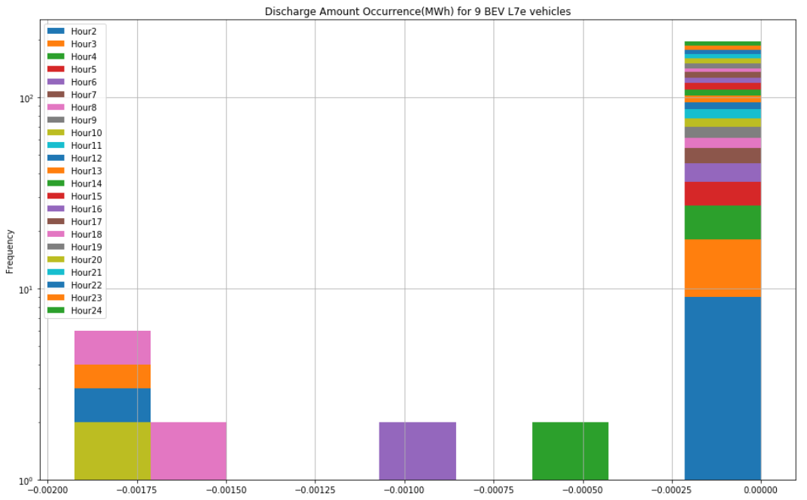
Starting Battery Capacity to Discharge Frequency

Slide 9
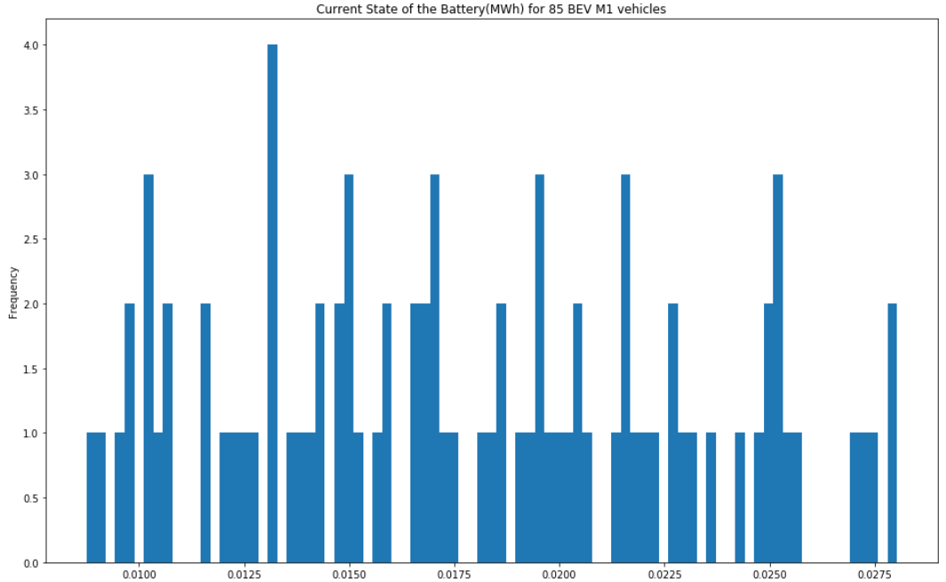
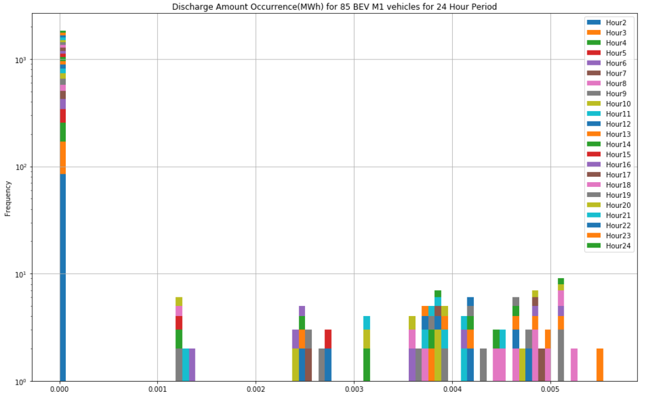

Slide 10
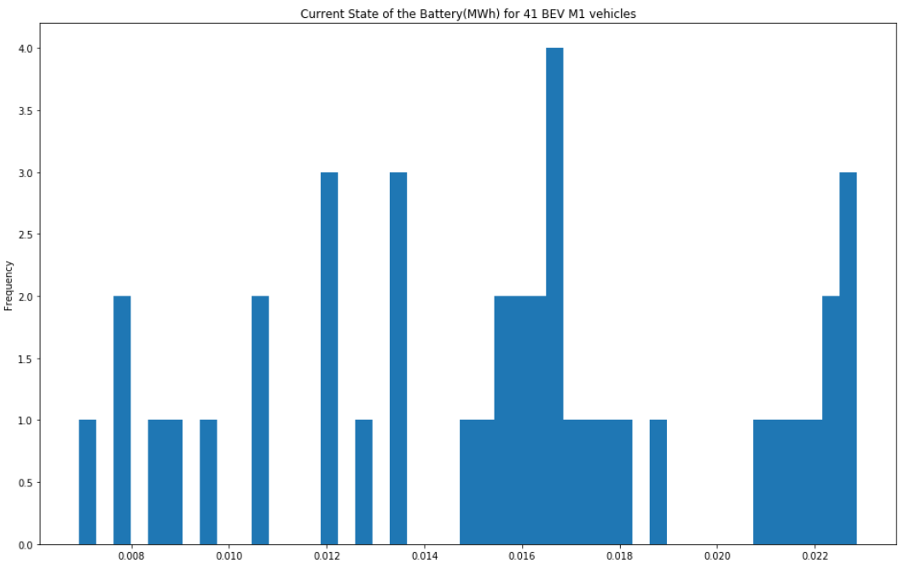
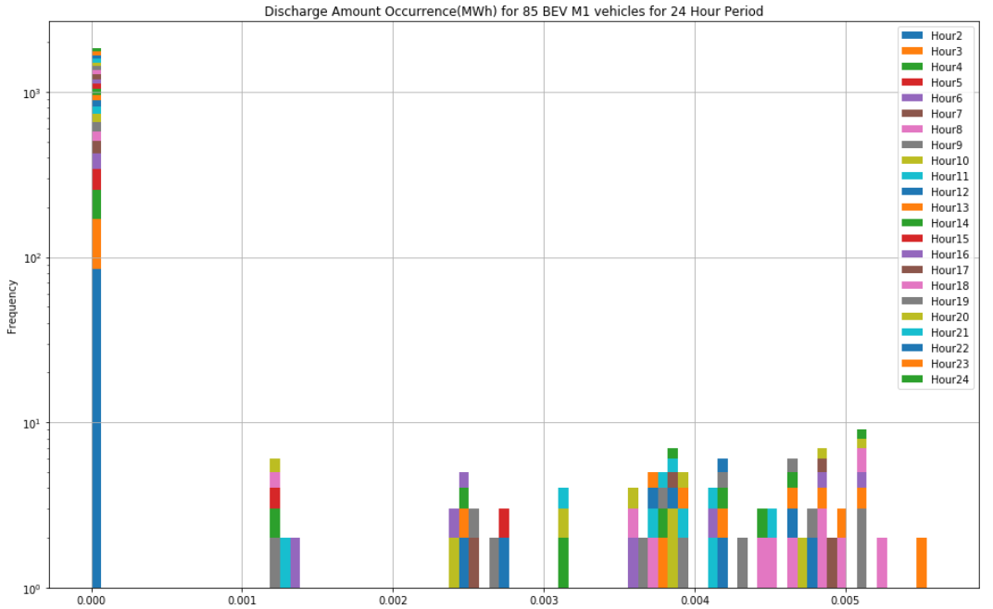

Slide 11
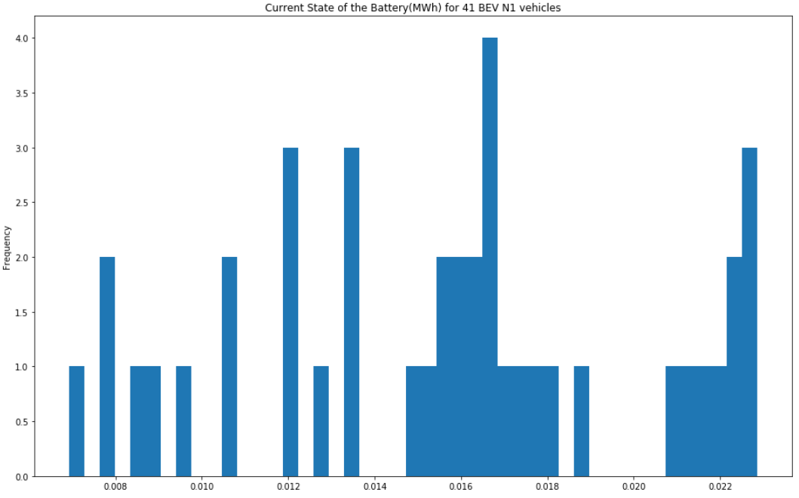
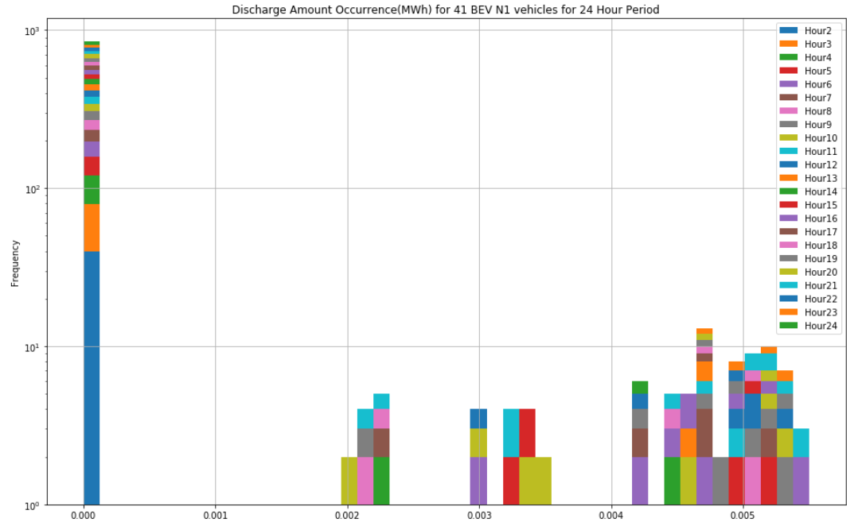

Slide 12
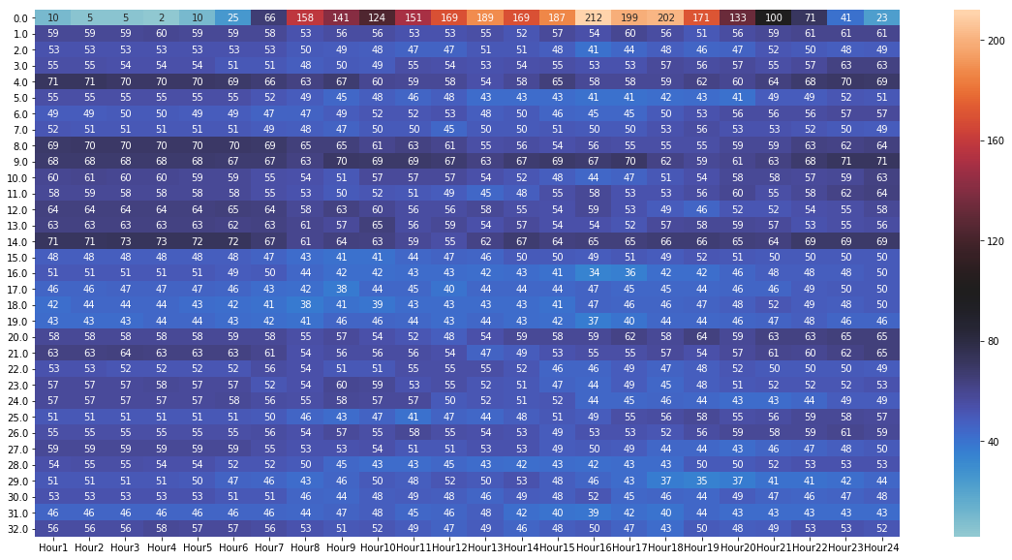
Heatmap

Slide 13
Next Steps
Find Real-time pricing data for model
Investigate areas of high power discharge
Integrate Predictive Price model
Find best-fit model

Slide 14

Comments/Questions tarampia@knights.ucf.edu
Soares, J., Sousa, T., Morais, H., Vale, Z., & Faria, P. (2011). An optimal scheduling problem in distribution networks considering V2G. 2011 IEEE Symposium on Computational Intelligence Applications In Smart Grid (CIASG). doi:10.1109/ciasg.2011.5953342
Faria, P., Vale, Z. and Baptista, J. (2015). Demand Response Programs Design and Use Considering Intensive Penetration of Distributed Generation. Energies, 8(6), pp.6230-6246.
Soares, J., Canizes, B., Lobo, C., Vale, Z., & Morais, H. (2012). Electric Vehicle Scenario Simulator Tool for Smart Grid Operators. Energies,5(6), 1881-1899. doi:10.3390/en5061881

