Slide 1


EV2G (Electric Vehicle to Grid) Price Forecasting using Regression and PCA Timothy Rampiaray Assignment 3 EEL 6257

Slide 2
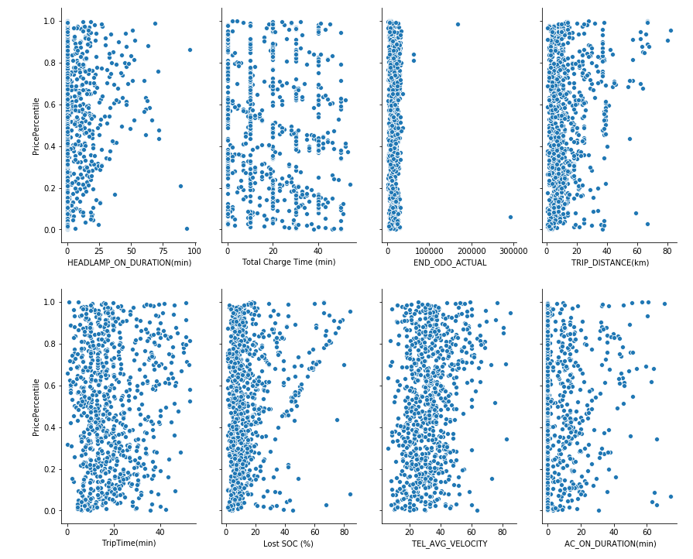
Feature Data

Slide 3
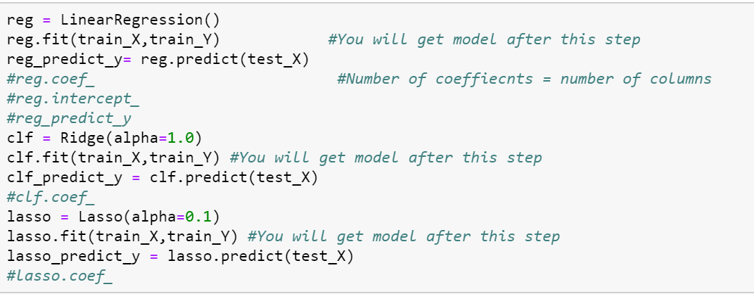
Regression
Normalize Data
Create training data set
Create testing data set

Slide 4
PCA (Principal Component Analysis)
Principal Components
Principal components are a sequence of projections of the data, mutually uncorrelated and ordered in variance.
Principal components are linear subspace approximating a set of N points
Principal components provides a sequence of best linear approximations to the data, but with ranks q<=p (reducing dimensions)
Transformed data are uncorrelated with the first component has the largest variance.
Dimensionality reduction

Slide 5
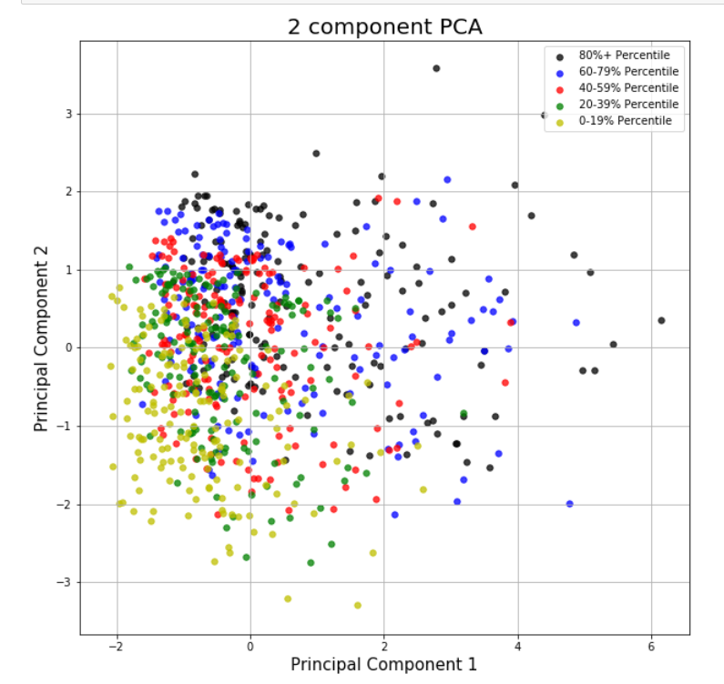

Slide 6
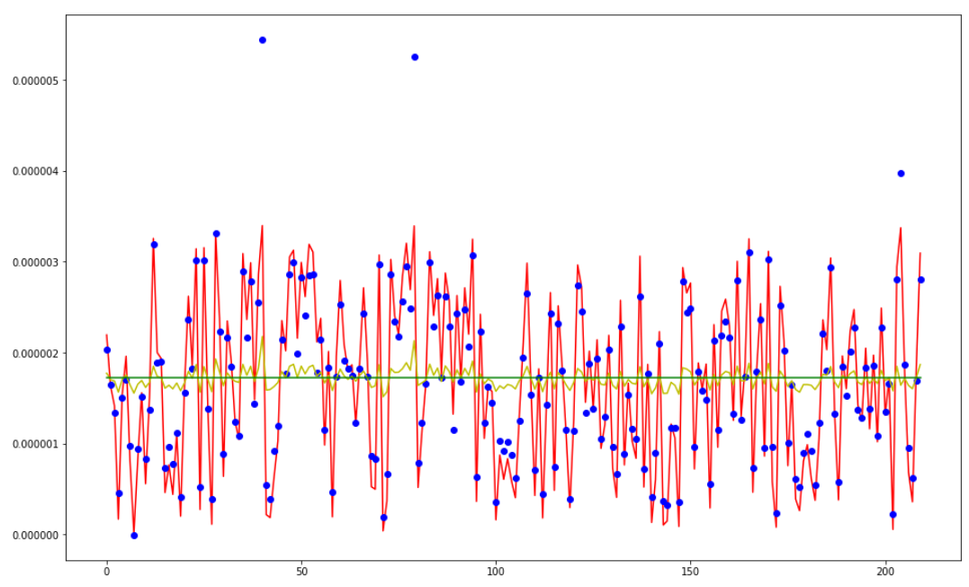
PCA – All 9 features
 | ALL 9 FEATURES
 | ----------LinearRegression
MAE | 1.88E-07
MSE | 7.49E-14
RMSE | 2.74E-07
 | Variance score: 0.92
 | -----------RidgeRegression
MAE | 7.51E-07
MSE | 7.62E-13
RMSE | 8.73E-07
 | Variance score: 0.18
 | ----------LassoRegression
MAE | 8.28E-07
MSE | 9.33E-13
RMSE | 9.66E-07
 | Variance score: -0.00

Slide 7
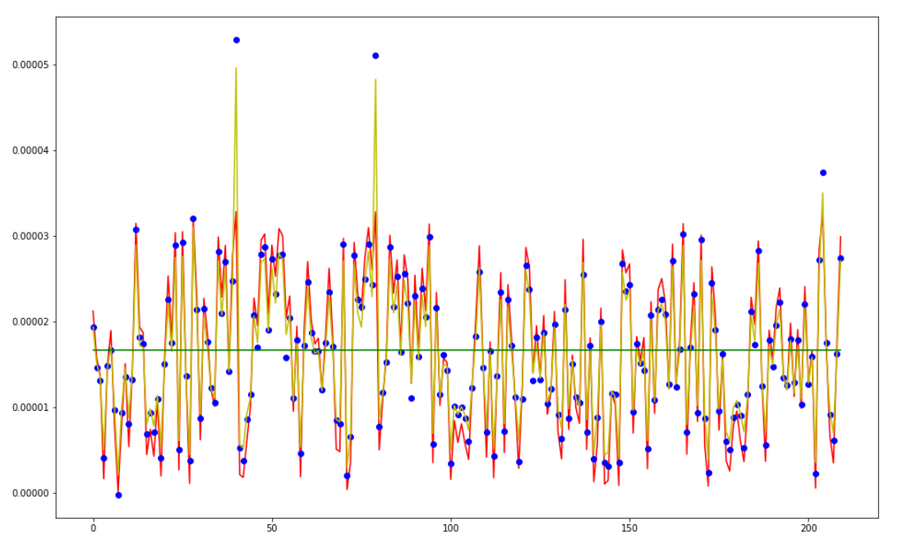
PCA – 7 features (dropped headlamp & odo)
 | 7 FEATURES (dropped headlamp and odo)
 | ----------LinearRegression
MAE | 1.83E-06
MSE | 7.09E-12
RMSE | 2.66E-06
 | Variance score: 0.92
 | -----------RidgeRegression
MAE | 2.23E-06
MSE | 7.99E-12
RMSE | 2.83E-06
 | Variance score: 0.91
 | ----------LassoRegression
MAE | 8.00E-06
MSE | 8.71E-11
RMSE | 9.33E-06
 | Variance score: -0.00

Slide 8
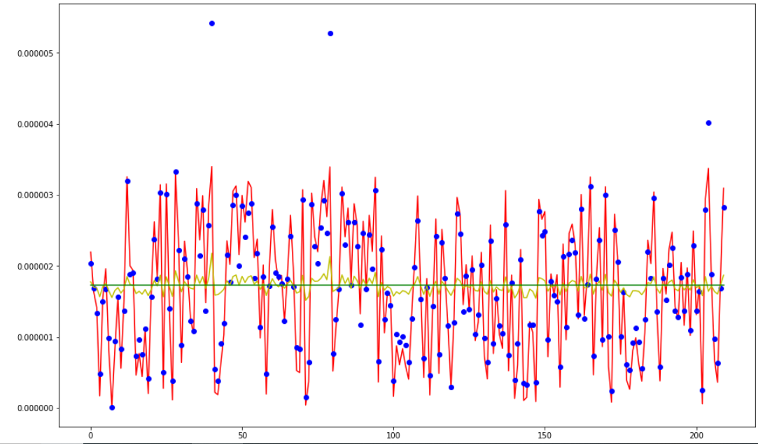
PCA – 7 features (dropped SOC & Avg Vel)
 | 7 FEATURES (dropped LostSOC and AVG VEL)
 | ----------LinearRegression
MAE | 1.91E-07
MSE | 7.66E-14
RMSE | 2.77E-07
 | Variance score: 0.92
 | -----------RidgeRegression
MAE | 7.51E-07
MSE | 7.62E-13
RMSE | 8.73E-07
 | Variance score: 0.18
 | ----------LassoRegression
MAE | 8.28E-07
MSE | 9.33E-13
RMSE | 9.66E-07
 | Variance score: -0.00

Slide 9
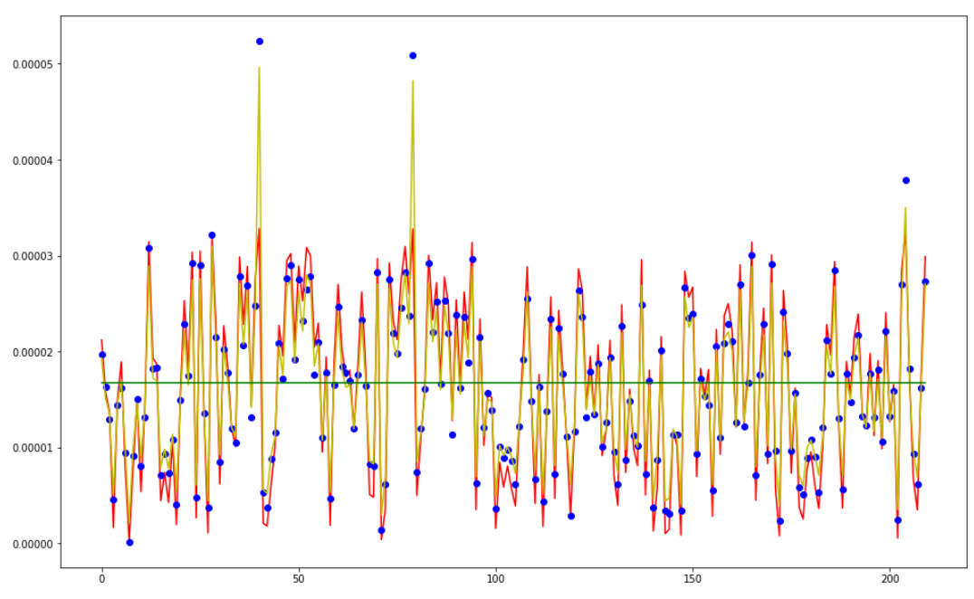
PCA – 6 features (dropped SOC/Avg Vel/Odometer)
 | 6 FEATURES (dropped LostSOC/AVG VEL/end odo)
 | ----------LinearRegression
MAE | 1.85E-06
MSE | 7.13E-12
RMSE | 2.67E-06
 | Variance score: 0.92
 | -----------RidgeRegression
MAE | 2.23E-06
MSE | 7.99E-12
RMSE | 2.83E-06
 | Variance score: 0.91
 | ----------LassoRegression
MAE | 8.00E-06
MSE | 8.71E-11
RMSE | 9.33E-06
 | Variance score: -0.00

Slide 10
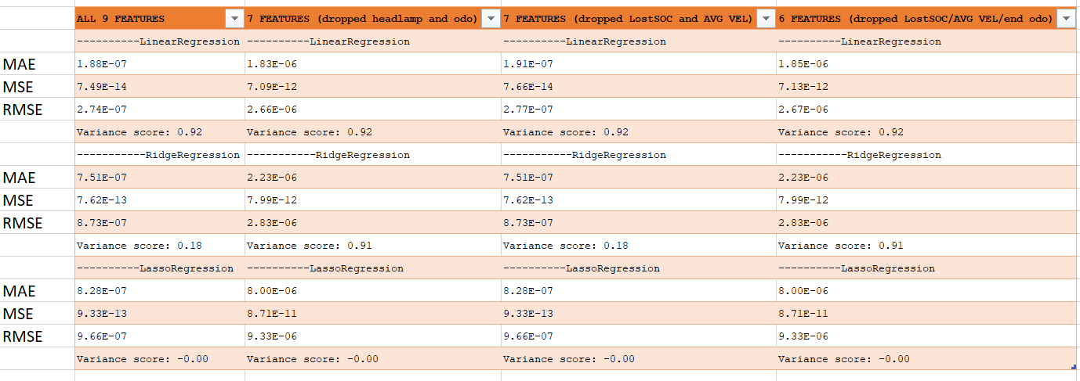
PCA - Selection

Slide 11

Comments/Questions tarampia@knights.ucf.edu
References
Soares, J., Sousa, T., Morais, H., Vale, Z., & Faria, P. (2011). An optimal scheduling problem in distribution networks considering V2G. 2011 IEEE Symposium on Computational Intelligence Applications In Smart Grid (CIASG). doi:10.1109/ciasg.2011.5953342
Faria, P., Vale, Z. and Baptista, J. (2015). Demand Response Programs Design and Use Considering Intensive Penetration of Distributed Generation. Energies, 8(6), pp.6230-6246.
Soares, J., Canizes, B., Lobo, C., Vale, Z., & Morais, H. (2012). Electric Vehicle Scenario Simulator Tool for Smart Grid Operators. Energies,5(6), 1881-1899. doi:10.3390/en5061881
Data.gov.au. (2019). Search. [online] Available at: https://data.gov.au/dataset/ds-dga-87f276c3-5fba-4f31-9032-199793d6f4a7/details [Accessed 18 Feb. 2019].

