Slide 1


EV2G (Electric Vehicle to Grid) Price Forecasting using Clustering Timothy Rampiaray Assignment 4 EEL 6257

Slide 2
Clustering Methods-
K-means Clustering
unsupervised learning, which is used when you have unlabeled data (i.e., data without defined categories or groups). The goal of this algorithm is to find groups in the data, with the number of groups represented by the variable K.
Hierarchical Clustering
Agglomerative: This is a "bottom-up" approach: each observation starts in its own cluster, and pairs of clusters are merged as one moves up the hierarchy.
DBSCAN (Density-based spatial clustering of applications with noise)
It groups together points that are closely packed together (points with many nearby neighbors), marking as outliers points that lie alone in low-density regions (whose nearest neighbors are too far away).

Slide 3
Performance Evaluation Coeffs-
Silhouette Score
The silhouette value is a measure of how similar an object is to its own cluster (cohesion) compared to other clusters (separation).
The silhouette ranges from −1 to +1, where a high value indicates that the object is well matched to its own cluster and poorly matched to neighboring clusters.
Calinski-Harabaz Score
It is also known as the Variance Ratio Criterion.
The score is defined as ratio between the within-cluster dispersion and the between-cluster dispersion.
Higher the better
Davies-Bouldin Score
Evaluates the optimal number of clusters

Slide 4
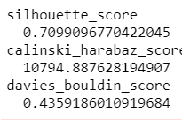
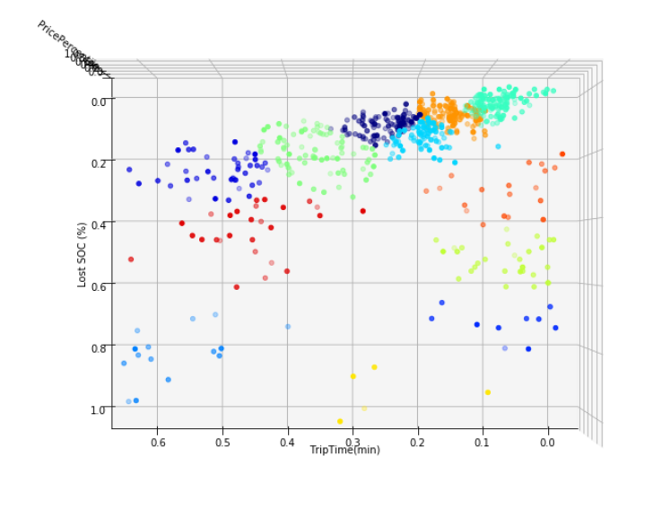
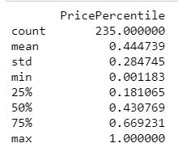
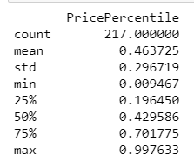
KMeans Clustering -
12 clusters

Slide 5
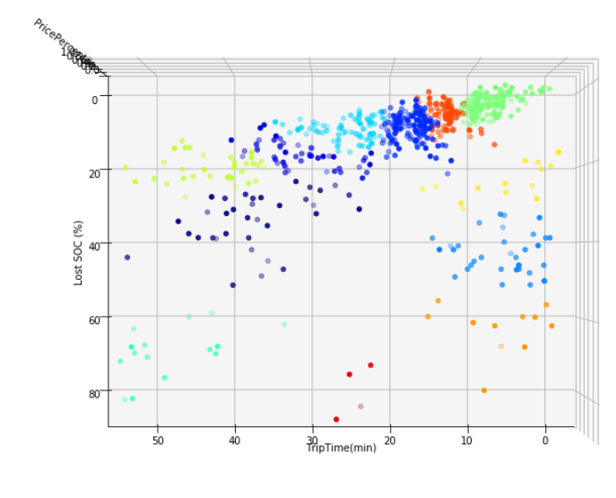
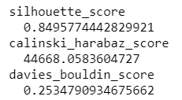
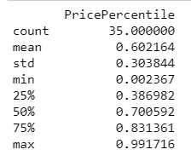
Hierarchy Clustering -
12 clusters

Slide 6
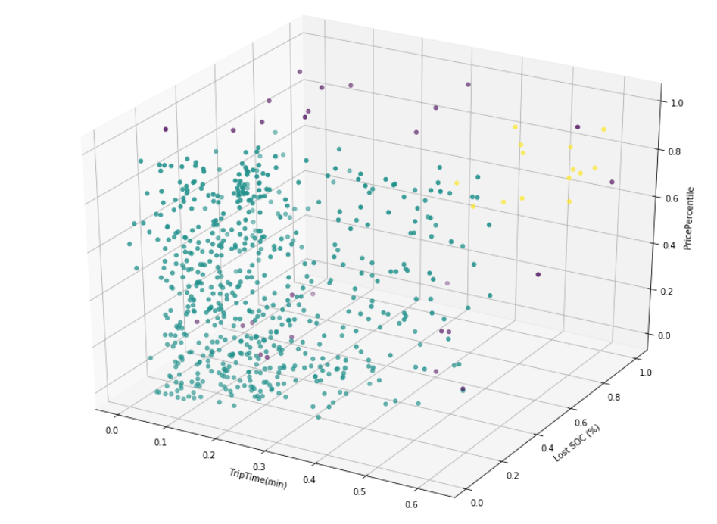
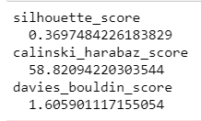
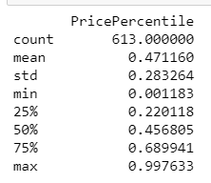
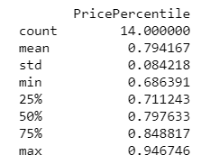
DBSCAN Clustering -
dbscan = DBSCAN(eps=.14, min_samples = 6)
3 Clusters

Slide 7
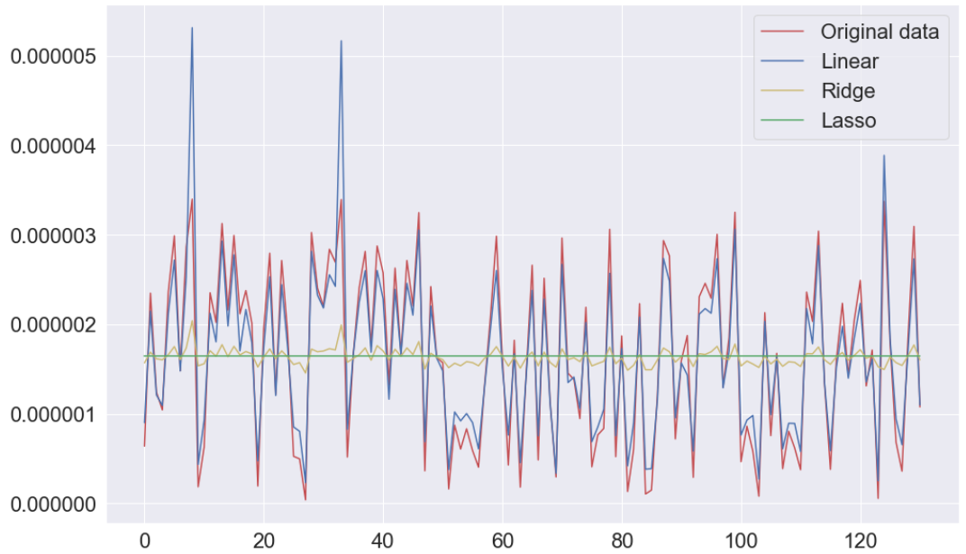
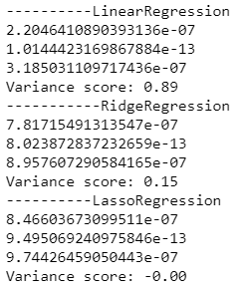
Original without clustering

Slide 8
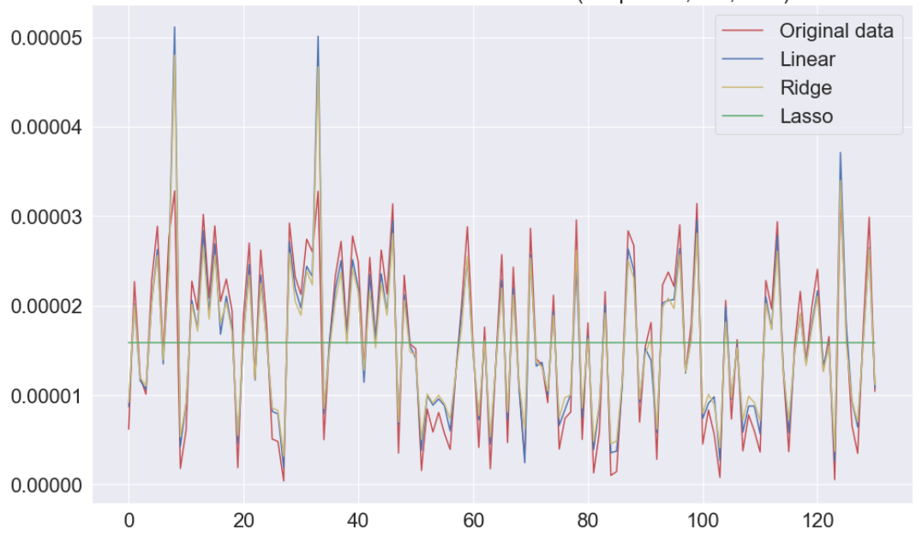
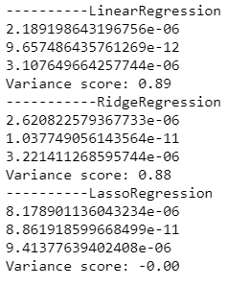
KMeans Clustering -

Slide 9
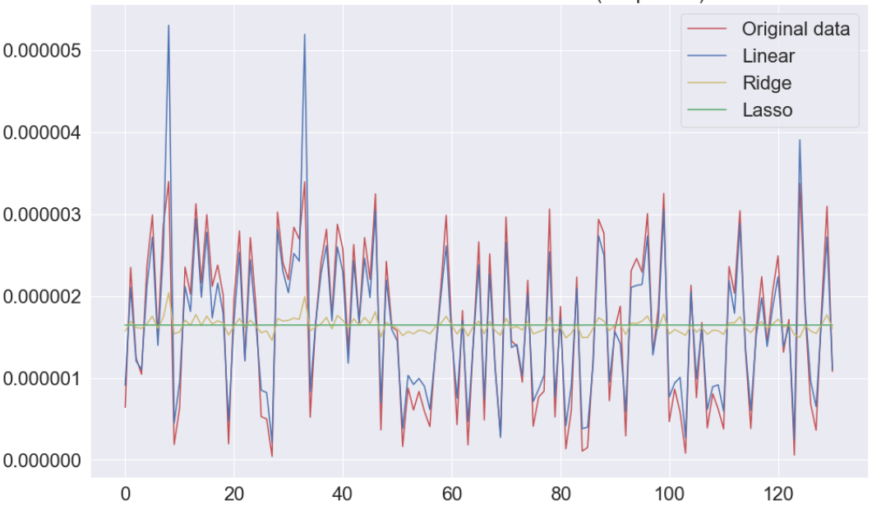
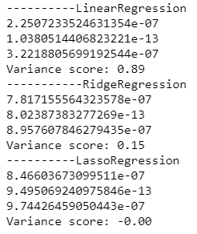
Hierarchy Clustering -

Slide 10
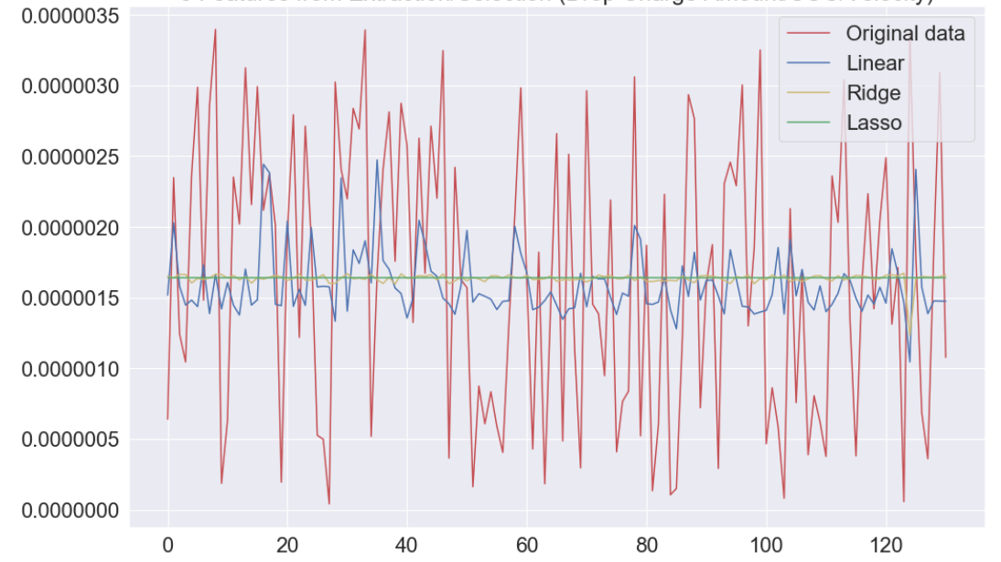
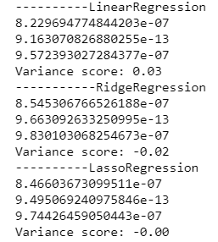
DBSCAN Clustering -

Slide 11
Notes-
Dataset may not be ideal for clustering
It is possible the further data cleaning may need to be done

Slide 12

Comments/Questions tarampia@knights.ucf.edu
References
Soares, J., Sousa, T., Morais, H., Vale, Z., & Faria, P. (2011). An optimal scheduling problem in distribution networks considering V2G. 2011 IEEE Symposium on Computational Intelligence Applications In Smart Grid (CIASG). doi:10.1109/ciasg.2011.5953342
Faria, P., Vale, Z. and Baptista, J. (2015). Demand Response Programs Design and Use Considering Intensive Penetration of Distributed Generation. Energies, 8(6), pp.6230-6246.
Soares, J., Canizes, B., Lobo, C., Vale, Z., & Morais, H. (2012). Electric Vehicle Scenario Simulator Tool for Smart Grid Operators. Energies,5(6), 1881-1899. doi:10.3390/en5061881
Data.gov.au. (2019). Search. [online] Available at: https://data.gov.au/dataset/ds-dga-87f276c3-5fba-4f31-9032-199793d6f4a7/details [Accessed 18 Feb. 2019].

