Slide 1
Enhanced Image Inpainting using Transformer-GAN Hybrid Models
Group - 32
Presenters:
Veera Saiva Sai Lakshmi Kalyan (50595073)
Taran Mamidala (50604177)
Jupalli Sai Abhisekh Reddy (50604117)
CSE 676-B: Deep Learning
Instructor: Dr. Alina Vereshchaka, Spring 2025

Slide 2
Problem Statement
The objective of our Project image inpainting using GAN models is to realistically fill in any damaged or missing areas of an image. While traditional models like BIG-GAN perform well, they frequently fall short in maintaining fine details or achieving results that are smooth and realistic-looking.
Key Challenges:
Blur Images:
GAN-based models may generate blurry or inconsistent textures, especially in large missing regions.
Loss & Poor Structural consistency:
It's hard to maintain the original shape, symmetry, or geometry of objects in the image..
Models may lose fine textures, making the inpainted regions look artificial or mismatched
Purpose:
  To Build a Transformer-GAN hybrid model that combines:
  Transformers for capturing the global structure of the image
  GANs for generating fine, detailed textures

Slide 3
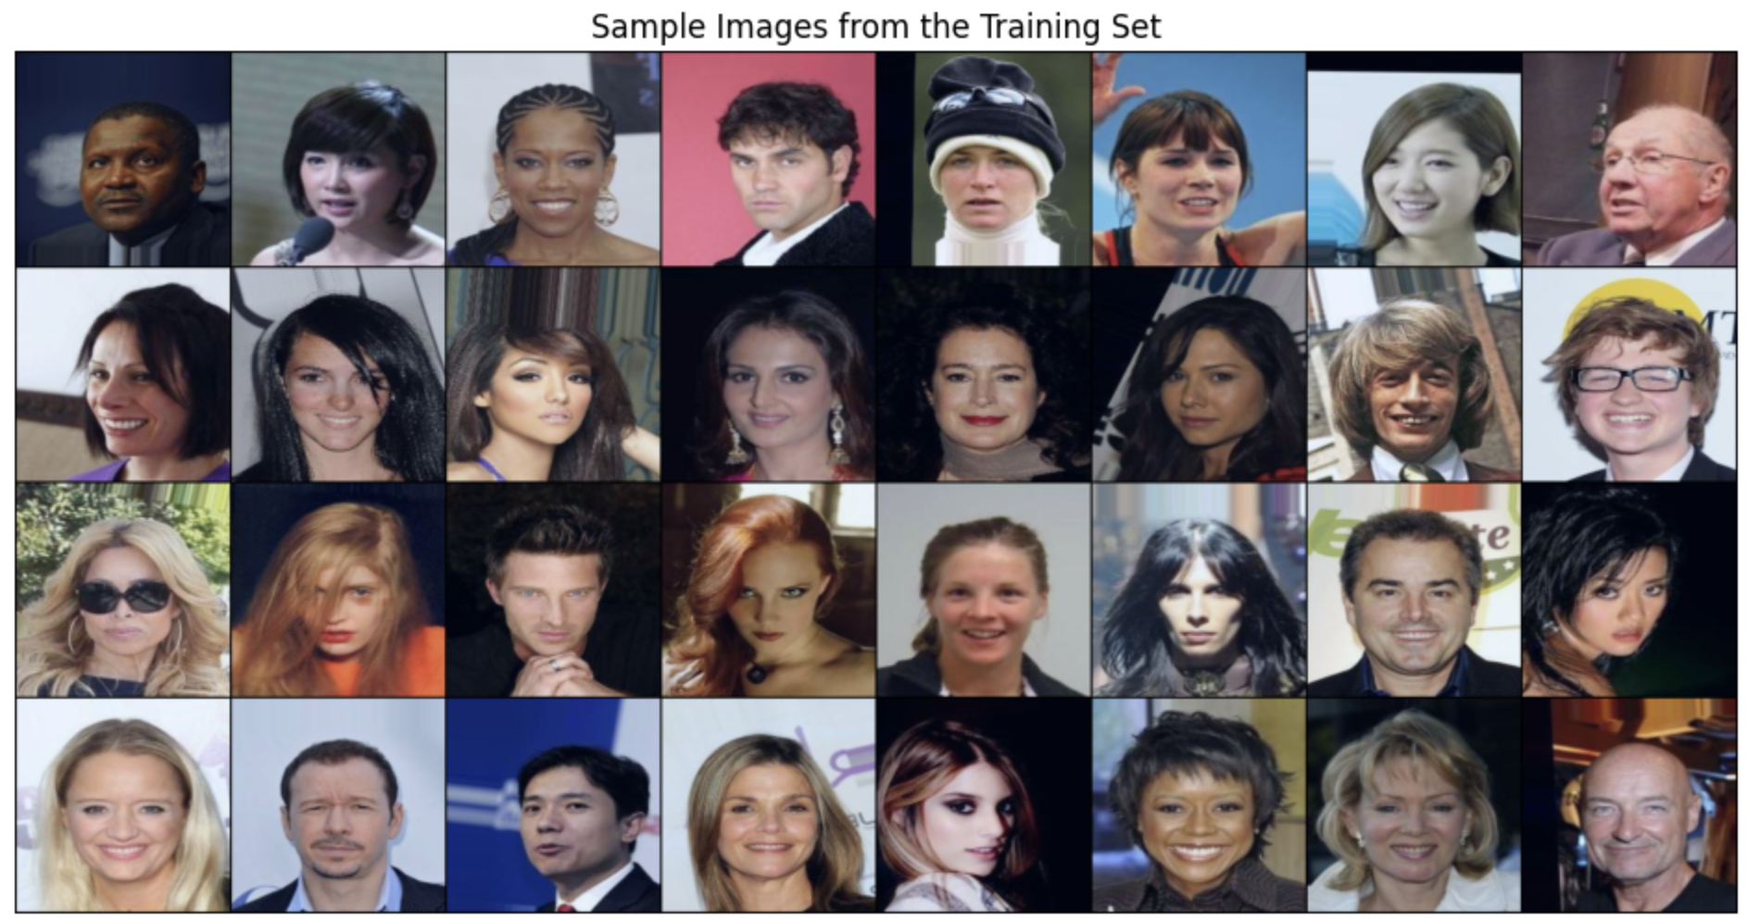
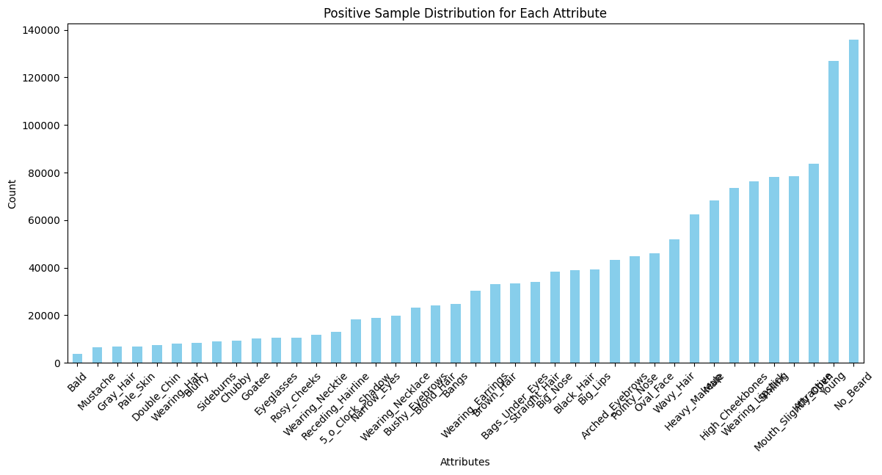
Background
Introduction to Image inpainting:
What is Image Inpainting?
The process of restoring damaged or missing areas of an image is known as image inpainting. Making the finished image appear natural and fit in perfectly with the original information is its aim.
Importance:
Useful in photo restoration.
Helps in removing unwanted objects from images.
Supports medical imaging by reconstructing missing or noisy data.
Powers AI-based creative tools.
Real world Applications:
Fixes old or damaged photographs by filling in missing or scratched parts so the image looks complete and fresh.
Removes unwanted things from images (like people in the background or watermarks) and fills the gap naturally.
Reconstructs missing parts in medical scans like MRIs or X-rays, helping doctors get a clearer view of organs or tissues.

Slide 4
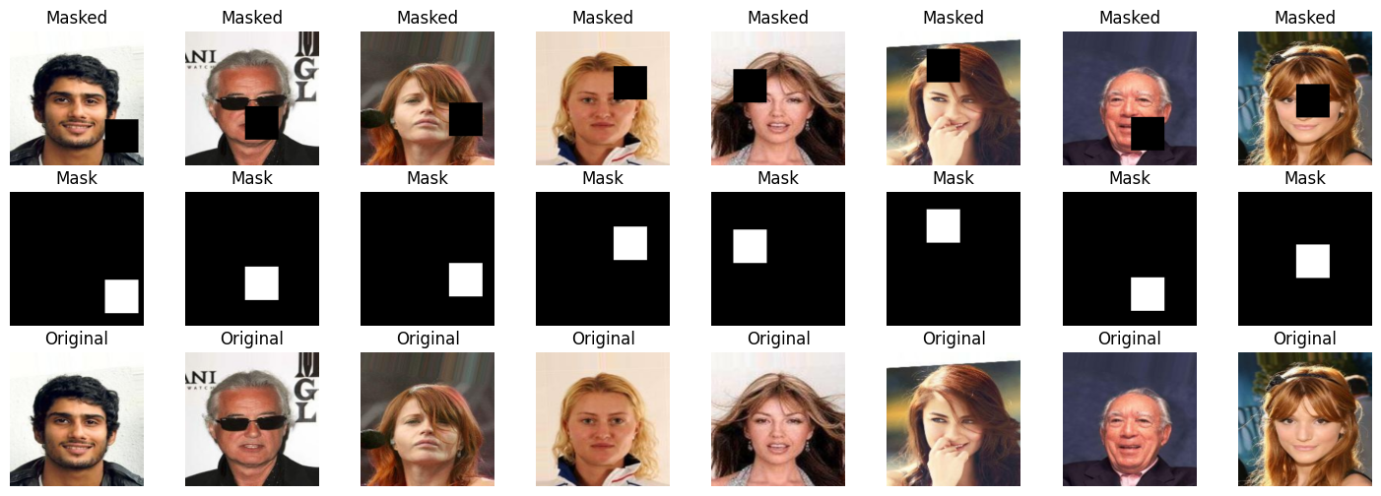
Dataset Used:
Dataset:
Contains over 200,000 celebrity face images.
Each image is cropped and resized to 224×224 resolution.
With 40 binary attributes (e.g. Smiling, Eyeglasses)
Train: 162 770 samples, Val: 19 867 samples Test: 19 962 samples
Preprocessing Steps applied:
Image Normalization to scale pixel values to [-1, 1].
Applied random square masking and also freehand random masking to simulate missing image regions (56×56).
Generated input pairs: (masked image, original image).
Used PyTorch DataLoader for efficient batching and shuffling.
Why?
We did these preprocessing steps to teach the model how to fill in missing parts of an image. By randomly masking parts of faces, the model learns to guess what should be there. Normalizing images helps the training go faster and stay stable. Creating consistent input-output pairs ensures the model can compare its guess with the correct answer.

Slide 5
GAN:
What is GAN?
A GAN is a type of deep learning model with two parts:
Generator: Tries to create realistic images.
Discriminator: Tries to tell the difference between real and fake images.
They compete with each other, and this "game" helps the generator get better over time.
Why GAN?:
GANs are great at generating realistic textures and fine details, which is critical when filling in missing parts of images.
They can learn the global structure and local patterns of faces, making the inpainted region blend naturally.
Unlike traditional CNN's or autoencoders, GANs focus on realism—not just reconstruction accuracy.

Slide 6
How GAN works?
Random Input to Generator
The process starts with random input like usually either noise (random numbers) or a partially masked image.
This is fed into the Generator, which tries to create a full, realistic image from it.
  Generator Creates a Fake Image
    The Generator is like an artist that’s learning to draw realistic faces. At first, the output is not very good, but With feedback, it keeps improving. It produces a fake image that tries to look like a real image from the training data.
  Discriminator Evaluates the Image
    The Discriminator is like a judge. It looks at both real images (from the dataset) and fake images and tries
    to classify them as “real” or “fake.”
    If it identifies the fake correctly, it improves its judging skills.
    If it is fooled by the Generator, it updates its parameters to become more accurate.
Feedback for Both Models
Both models learn from this the Generator improves so it can better fool the Discriminator.
The Discriminator improves so it can better detect fakes.

Slide 7
Method
We implemented and compared three different GAN-based architectures for image inpainting:
DCGAN-Based Generator with Mask-Augmentation
Uses a custom encoder-decoder structure improved by explicit mask processing to guide inpainting.
Mask and image features are encoded separately and fused before decoding.
Losses: Binary Cross-Entropy (BCE) for adversarial loss + L1 pixel loss.
BigGAN-Inspired Residual Generator with Attention
Employs a deeper encoder-decoder network with residual blocks and attention layers to retain global and local features.
Aims to improve semantic consistency in large masked regions.
Uses PatchGAN-style discriminator with residual attention for realism.

Slide 8
Method
Transformer-GAN Hybrid with Perceptual Loss
Builds on a U-Net backbone with residual blocks and a PatchGAN discriminator.
Optimized using a combination of:
  Adversarial loss (BCE),
  L1 loss for reconstruction,
  Perceptual loss (VGG features),
  SSIM loss for structural similarity.
Focuses on improving texture realism and structural integrity.

Slide 9
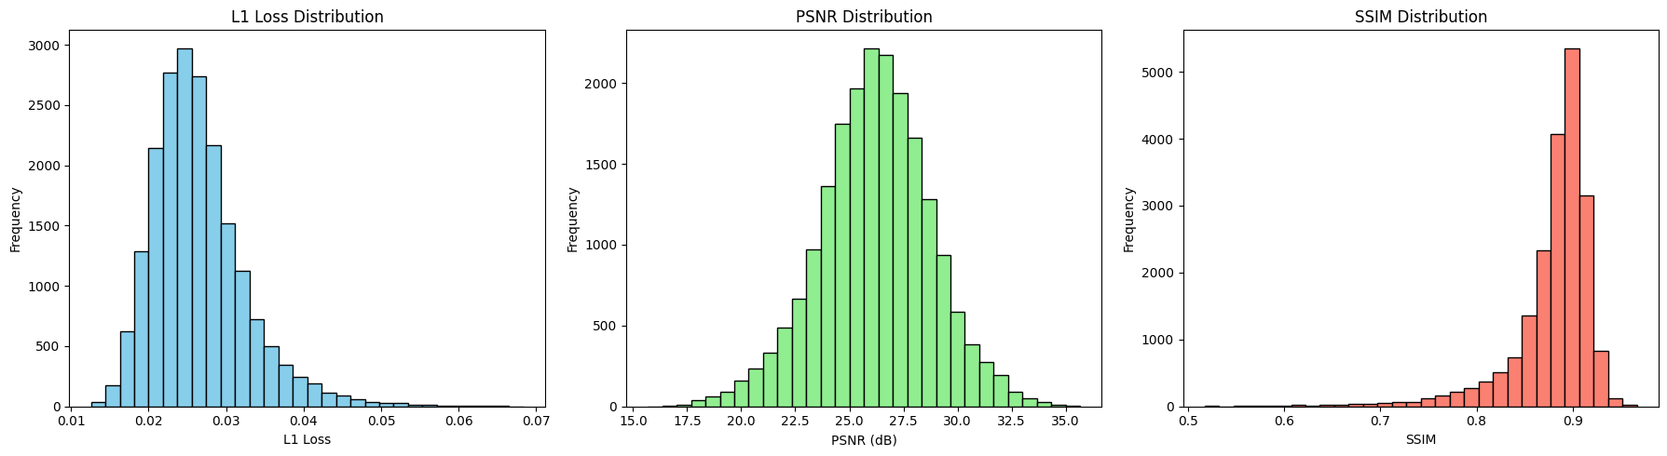
Results
The L1 Loss distribution shows that the majority of inpainted images have very low pixel-wise error, with most values clustered around 0.025 to 0.035. This suggests that the generator is accurately restoring missing regions.
The PSNR distribution peaks around 26 dB, which indicates that the reconstructed images maintain good overall fidelity and clarity compared to the originals.
The SSIM distribution is skewed toward higher values (mostly above 0.85), showing that the model is successful in preserving structural and perceptual similarity, which is crucial for realistic inpainting.

Slide 10
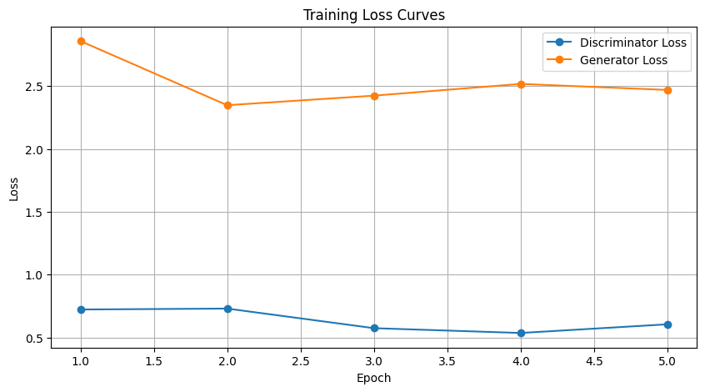
Results
The training loss curve shows that the discriminator loss remains relatively stable across epochs, hovering around 0.6 to 0.7, which indicates balanced adversarial training. The generator loss initially decreases, suggesting early learning, but then slightly rises and stabilizes, which is typical in GANs as the generator tries to improve against a strengthening discriminator. Overall, both networks converge without signs of mode collapse or instability.

Slide 11
Observation
The Transformer-Gain Hybrid model received the best performance among all three models, with the lowest L1 loss and the highest PSNR and SSIM values. It was particularly effective in restoring large missing areas.
Adding attention mechanisms and residual connections, as seen in the Biggun-inspired model and transformer-song, improved the generation of fine texture and spatial continuity.
The use of advanced loss functions, including conceptual loss and SSIM loss, helps the model produce innapted images that are visually realistic and structurally accurate.
The transformer-gain model displayed that the global reference capabilities of the transformer by combining the GANS with the normal power of the GANS leads to more effective and natural image reconstruction.
Compared to DCGAN and Biggan models, Transformer-Gain Hybrid got better performance, with the SSIM score 0.88, which indicates a high structural similarity for the original unwanted images.

Slide 12
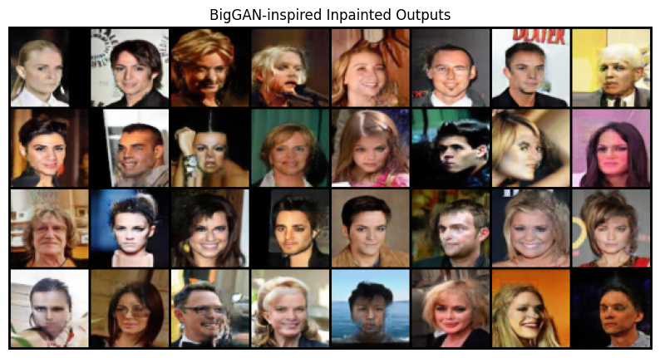
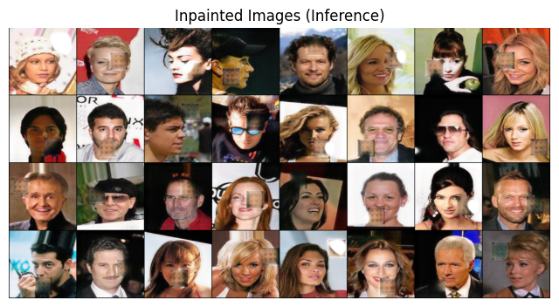
Key Observations/ Summary
Innovative Representation:
  Bipartite Graph model captures the entire structure of MILP nodes.
Siamese GNN Benefits:
  A strong node rankings learns function, which reduces the number of discovered nodes.
Performance Gains:
  Better than traditional SCIP heroistics and other ML models with the time of rapid solution.
Generalization:
  Effective on both training and large transfer examples.
Future Directions:
  End-to-end learned to integrate node selection with variable selection for Milp Solver
  Explore more advanced copy learning strategies or include reinforcement learning.
Real-World Impact: - Potential benefits in industries such as logistics, energy, and finance. - Improved solver efficiency can lead to significant cost and time savings.

Slide 13
Contribution Summary
Team Member | Presentation Part | Contribution %
Taran Mamidala | Transformer-GAN Hybrid with Perceptual Loss | 33.3%
Veera Saiva Sai Lakshmi Kalyan | BigGAN-Inspired Residual Generator with Attention | 33.3%
Jupalli Sai Abhisekh Reddy | DCGAN-Based Generator with Mask-Augmentation | 33.3%

Slide 14
THANK YOU
We look forward to your questions and discussions

