Slide 1
Capstone
Project
Review-2
Under the Guidance of
Dr.Arikumar k s

Slide 2
Team-Matrix
TEXT GENERATION USING LSTM and Integration with Flask
-K.Mohan Vikas Reddy(19BCI7101)
- A.Sai Hruthik Yadav(19BCI7046)
-G.Gayathri(19BCN7034)

Slide 3
Objective
Main Objective is By the End of the project we will Create an Front end Application(Flask Application) having two html pages one is Home.html page and one for predicting results(predict.html page). And in Back end we do training and save the Model file(Training.ipynb).
So in Predictions page when we enter the sequence of text our model will be able to predict the next sequence of words or characters and show it as a result.

Slide 4
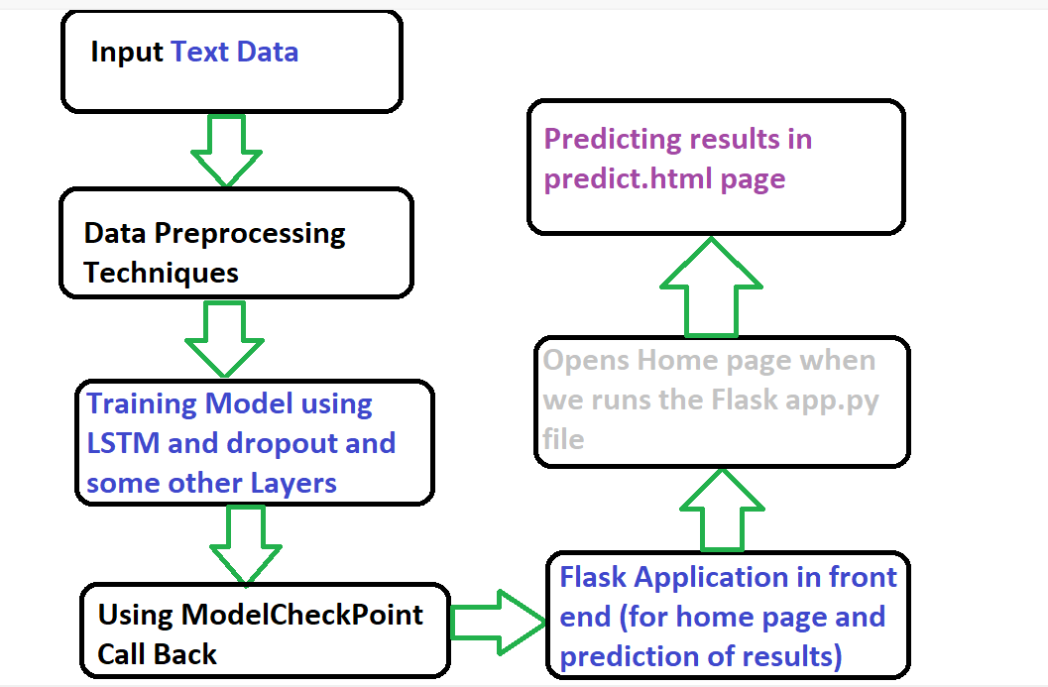
Methodology

Slide 5
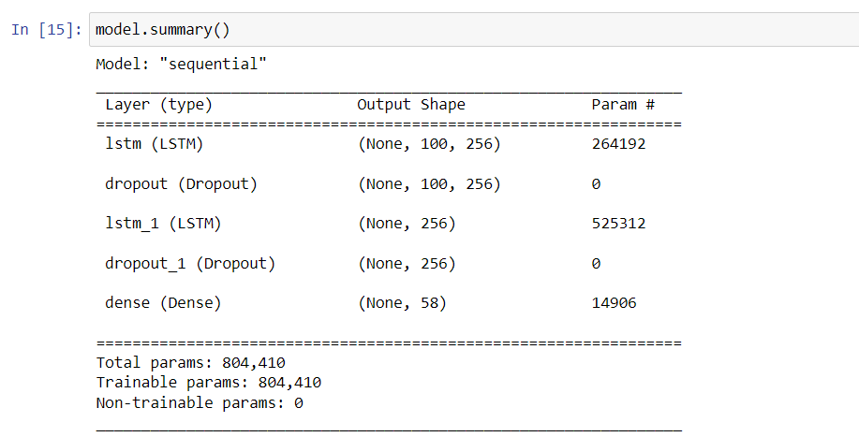
Originality
We tried with 2 Lstm layers and dropout layers and one dense layer in training part as our Text Data contains Large amount of Text it takes half of the Day Time to run the Epochs.

Slide 6
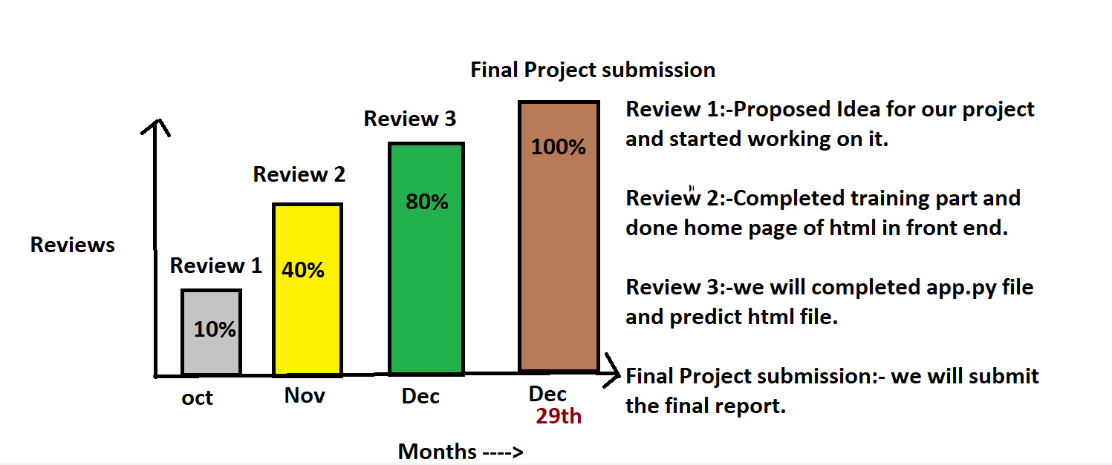
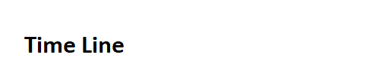

Slide 7
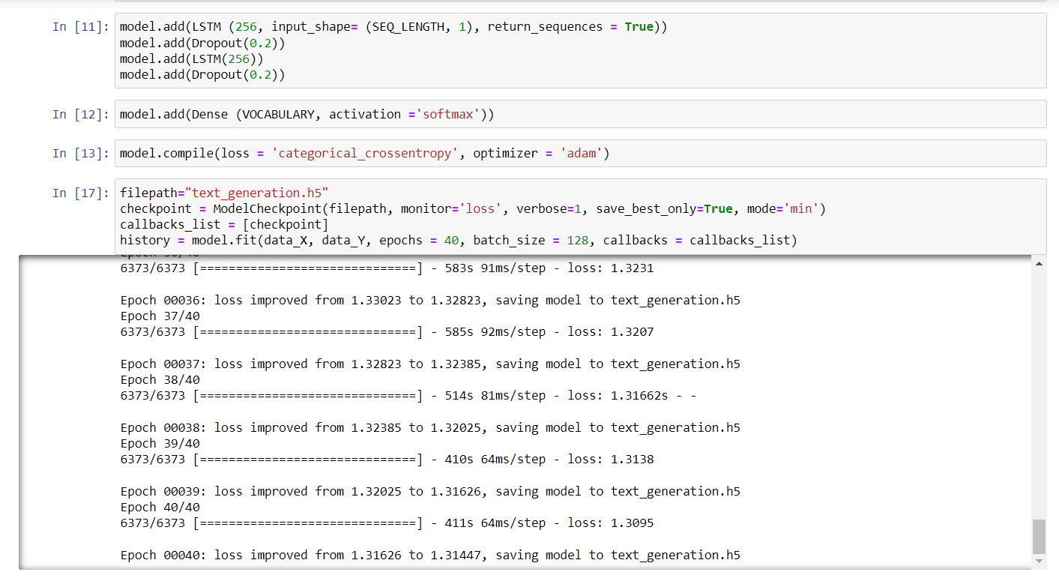
Results

Slide 8
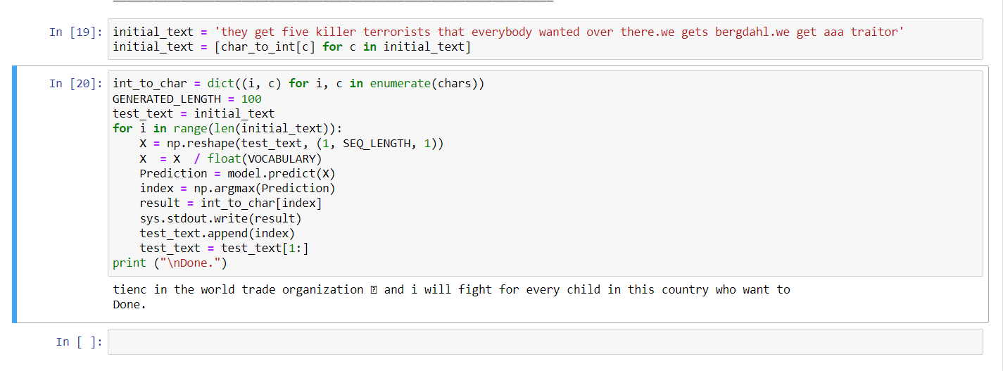

Slide 9
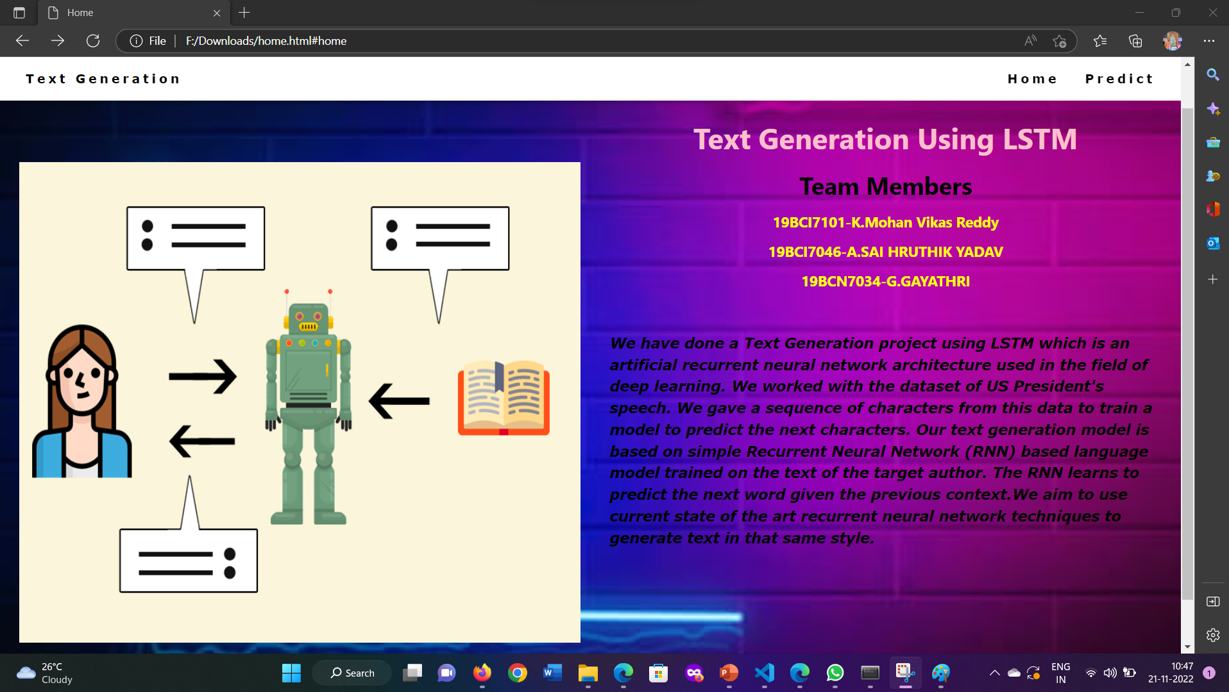

Slide 10
What is done in review 2 and what to be done in review3
In review 2 We had done with the training part (Back end side) and created a home page for our project in front end.
Still need to do the app.py(Flask Application file) and predict.html file for prediction of result. we will show it in Review 3.
Thank you.

