Slide 1
GROUP 4 · PROJECT MANAGEMENT
CareerCompass AI
An AI-Powered Placement Preparation Platform
Final Project Deck | Business Process & Project Management
TEAM
Luv Singhal
P2512037
Umang Parakh
P2514072
Prateek Raj Dubey
P2513050
Tanisha Bhola
P2514067
Harshul Gupta
P2514030
Priyanka
P2512052
Tarana Bansal
P2513070

Slide 2








PROJECT INTRODUCTION
The Problem
CareerCompass AI
MBA students lack a single, AI-assisted platform to prepare for placements — leaving preparation fragmented, inconsistent, and invisible to the Placement Cell.
An AI-Powered Placement Preparation Platform for MBA Students
CareerCompass AI consolidates 13 fragmented placement-preparation activities — resume building, JD interpretation, ATS scoring, interview prep, and progress tracking — into one AI-native platform. It replaces a workflow currently spread across ChatGPT, LinkedIn, Glassdoor, Excel, and email/calendar tools, converting placement preparation from an unstructured activity into a measurable, institutionally governed process. Delivery is governed under a hybrid Agile-Predictive model, aligned to PMBOK 7 and the PMI Agile Practice Guide.
Fragmented Workflow
No single source of truth linking resume, JD, and application status
Inconsistent Prep Quality
Readiness depends on individual initiative, not a structured process
PROJECT SNAPSHOT
No Institutional Visibility
Placement Cell has no real-time view of batch-wide readiness
8 Months
₹58.40L
13
7
Duration (34 wks incl. buffer)
Budget at Completion
Integrated Modules
Cross-Functional Team
Manual, Non-Scalable Tracking
Excel-based tracking causes data lag and duplicated effort
Expected outcome: ~60–70% reduction in per-student preparation time, replacing 7 fragmented tools with 1 platform.

Slide 3









PROJECT CHARTER
BUSINESS CASE (OBJECTIVES)
CareerCompass AI
Fragmented, tool-hopping placement prep leaves student readiness inconsistent and the Placement Cell without real-time visibility. CareerCompass AI consolidates 13 workflows into one AI-native platform — targeting a 60–70% cut in per-student preparation time and a reusable institutional data asset for future placement-training decisions.
AI-Powered Placement Preparation Platform for MBA Students
SMART OBJECTIVES : BINDING CHARTER COMMITMENTS
O1
O2
O3
8 Months
All 13 Modules Live
≥80% Match Precision
≥70% Adoption
Timeline: 34 weeks incl. schedule buffer
Production deployment, Month 8
Resume–JD engine, validated at UAT
Active cohort within 4 weeks of launch
₹58.40L
O4
O5
O6
Total Budget at Completion (BAC)
CPI ≥ 0.95
≥99% Uptime
Zero Critical Findings
7
Cost performance index at closure
Peak season; AI latency <5 sec (p95)
Data-privacy audit, pre-launch
Cross-functional delivery team members
APPROVAL AUTHORITY (STAKEHOLDERS)
Project Sponsor
Steering Committee
Project Manager
Placement Cell
Placement Cell + Institute IT
Assigned PM
GOVERNANCE MODEL
Final approval on scope, budget, and Go-Live decision
Monthly governance; approves changes above ₹1,00,000 impact
Day-to-day scope, schedule, and resource decisions within charter bounds
Hybrid Predictive-Charter / Agile-Execution: governed under PMBOK 7 + PMI Agile Practice Guide
Confidential - Internal Governance Document | This Charter formally authorizes the Project Manager to apply organizational resources, per PMBOK guidance.

Slide 4
PROJECT SCOPE
Scope: In, Out & Under Control
Release 1.0 delivers 13 modules across 4 clusters — with a firm, change-controlled boundary.
13
OUT OF SCOPE → FUTURE
CHANGE CONTROL
Integrated modules, v1.0
• Native mobile apps → Phase 2
Any Future/Out-of-Scope pull-in becomes a formal Change Request.
AI Intelligence
Resume analyzer, JD matching, ATS score
• Recruiter portal → post-legal review
• Live human interviews → AI-simulated only
1
Requested
Preparation
Company research, interview prep, roadmap
• ERP/SIS integration → automated sync later
2
Formal CR filed
Student Management
Tracker, scheduler, prep dashboard
• Multi-language → English only in v1.0
3
Impact assessed (cost/schedule/AI path)
Placement Cell
Learning recs, analytics dashboard
Scope discipline: v1.0 = committed delivery. Future scope = roadmap, not hidden scope.
4
Steering Committee approves
5
Implemented
8 Months · ₹58.40L · Hybrid governance

Slide 5
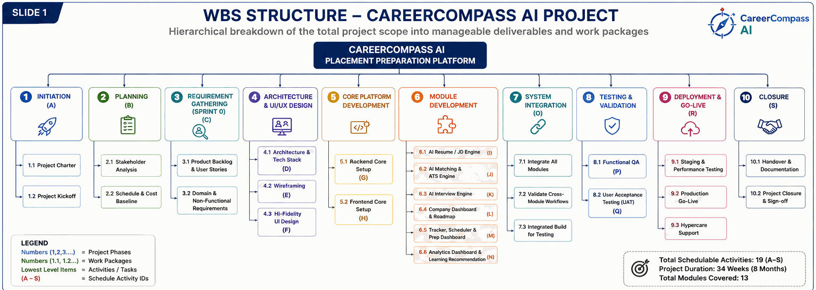
WORK BREAKDOWN STRUCTURE
WBS: 10 Phases, 19 Activities, 31 Weeks
Scope broken into manageable deliverables; every work package maps to one schedule Activity ID (A–S).
Full WBS-to-schedule activity mapping available in appendix.

Slide 6
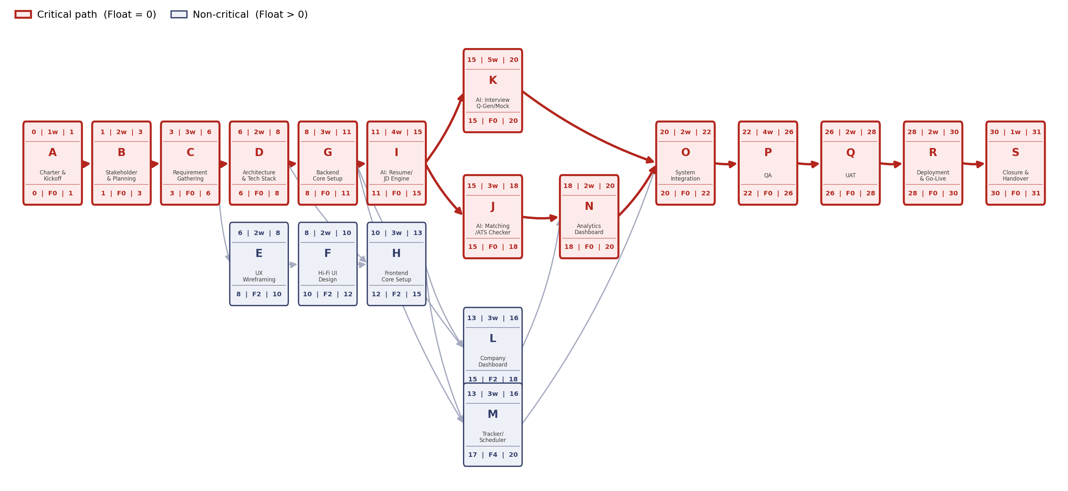
SCHEDULE ANALYSIS
Critical Path, Confidence & Reality Check
19 activities, finish-to-start — one shared bottleneck drives the whole schedule risk.
Activity Network & Critical Path
31 weeks, 14/19 activities zero-float — two paths converge at System Integration (O).

Slide 7
PROJECT SCHEDULE · MICROSOFT PROJECT EXPORT
CareerCompass AI — Master Project Schedule
19 tasks · 12 Aug 2026 – 03 Jun 2027 · ~31 weeks · Critical path shown in red
ID
Task Name
Dur.
Start
Finish
Pred.
Aug'26
Sep'26
Oct'26
Nov'26
Dec'26
Jan'27
Feb'27
Mar'27
Apr'27
May'27
Jun'27
1
Charter & Kick Off
7 days?
12/08/26
20/08/26
7d
2
Stakeholder Analysis & Planning
8.75 days
21/08/26
02/09/26
1
8.75d
3
Requirement Gathering
21 days
02/09/26
01/10/26
2
21d
4
Architecture & Tech Stack Finalization
14 days
01/10/26
21/10/26
3
14d
5
UX Wireframing
14 days
01/10/26
21/10/26
3
14d
6
Hi-Fi UI Design
14 days
21/10/26
10/11/26
5
14d
7
Backend Core Setup
21 days
21/10/26
19/11/26
4
21d
8
Frontend Core Setup
21 days
10/11/26
09/12/26
4;6
21d
9
AI: Resume Analyzer
28 days
19/11/26
29/12/26
7
28d
10
AI: Matching Score
21 days
29/12/26
27/01/27
9
21d
11
AI: Interview Question Gen
35 days
29/12/26
16/02/27
9
35d
12
Company Dashboard
21 days
09/12/26
07/01/27
7;8
21d
13
Tracker/ Prep Dashboard
21 days
09/12/26
07/01/27
7;8
21d
14
Analytics Dashboard
14 days
27/01/27
16/02/27
10;12
14d
15
System Integration
14 days
16/02/27
08/03/27
11;13;14
14d
16
QA (Functional + AI Accuracy)
28 days
08/03/27
15/04/27
15
28d
17
UAT (Students + Placement Cell)
14 days
15/04/27
05/05/27
16
14d
18
Deployment & Go-Live
14 days
05/05/27
25/05/27
17
14d
19
Closure & Handover
7 days
25/05/27
03/06/27
18
7d
Critical task
Non-critical (float)

Slide 8
Resource Planning
19
Activities
7
Resource roles
1.8
Max activity FTE
1.0
Single-role capacity
ACTIVITY
PM
BA
UI/UX
Frontend
Backend
AI/ML
QA
TOTAL FTE
ACTIVITY LOAD
Charter & Kickoff
1
0.5
1.5
Total FTE | highest first
Stakeholder & Planning
0.5
1
1.5
Requirement Gathering
0.5
1
0.2
1.7
Hi-Fi UI Design
Architecture & Tech Stack
0.3
0.2
0.8
1.3
UX Wireframing
0.2
1
1.2
AI: Resume Analyzer
Hi-Fi UI Design
0.2
0.8
0.8
1.8
AI: Matching Score
Backend Core Setup
0.1
0.3
1
1.4
Frontend Core Setup
0.1
0.9
0.4
1.4
QA (Functional + AI
AI: Resume Analyzer / JD Simplifier
0.1
0.4
0.3
1
1.8
Requirement Gathering
AI: Matching Score / ATS Checker
0.1
0.5
0.2
1
1.8
AI: Interview Q-Gen / Mock Module
0.1
0.5
1
1.6
AI: Interview Q-Gen
Company Dashboard / Roadmap
0.1
0.9
0.2
1.2
Tracker / Scheduler / Prep Dashboard
0.1
0.9
0.2
1.2
Charter & Kickoff
Analytics Dashboard / Learning Reco
0.1
0.8
0.3
1.2
Stakeholder & Planning
System Integration
0.2
0.5
0.4
0.4
1.5
QA (Functional + AI Accuracy)
0.2
0.2
0.4
1
1.8
System Integration
UAT (Students + Placement Cell)
0.3
0.4
0.8
1.5
Deployment & Go-Live
0.2
0.2
0.3
0.7
1.4
UAT (Students + Placem
Closure & Handover
0.5
0.3
0.2
1
Planning insight | AI, UI and QA-heavy activities create the key capacity peaks that resource levelling must smooth.

Slide 9
Resource Levelling
3.3 FTE
Peak demand
1.0 FTE
Role capacity
W16
Peak week
W31
CPM finish
Before
Per resource
Highest load
Protected
BEFORE — RESOURCE DEMAND
LEVELLING ACTIONS
4
3.3 FTE peak
01
Use float
Shift M within its available float
W14–16 → W18–20
3
02
Redistribute
Split Frontend / Backend workload
across overlapping activities
2
03
Sequence AI
Control J/K overlap + QA support
for AI test-harness work
1
04
Protect path
Do not move critical-path completion
beyond Week 31
0
W1
W8
W16
W24
W31
AFTER
Demand peaks are smoothed
without changing W31 completion.
PM DECISION | Level first using float + workload redistribution; crash only if management values earlier completion.

Slide 10
Project Crashing
Selective compression of critical-path activities to accelerate completion — without compromising the Week 34 deadline
31 → 29
Weeks
₹1.05L
Incremental cost
₹52.5K
Cost / week saved
5 WEEKS
Remaining buffer
2 weeks faster
Crash investment
Average crash cost
Against Week 34
1 | WHERE DID WE CRASH?
2 | CRASHING PATH
O
System Integration
NORMAL
O
P
RESULT
2 → 1 wk
1 wk saved
₹50K
Common post-merge critical path
31 WEEKS
→
−1 WK
→
−1 WK
→
29 WK
Baseline CPM
₹50K
₹55K
−2 WK
P
QA (Functional + AI Accuracy)
COST IMPACT
4 → 3 wk
1 wk saved
₹55K
Common post-merge critical path
O
₹50K
+
₹55K
=
₹1.05L
SELECTION LOGIC
Crash activities that sit on the common critical path — otherwise the time saved may not reduce project duration.
3 | SCHEDULE IMPACT
W29
Crashed
W31
Normal
W34
Deadline
5-week buffer to deadline
PM TAKEAWAY | We crash O and P because each saves 1 week on the common critical path; ₹1.05L buys 2 weeks of acceleration.

Slide 11
RISK, QUALITY & COMMUNICATION
The governance rhythm that keeps the AI-heavy critical path under control
TOP RISKS (P × I)
QUALITY GATES
COMMUNICATION CADENCE
R1
16 High
Zero Sev-1 defects open at Go-Live
Daily
Standup
Dev Team
AI Hallucination in generated interview content
≥80% AI matching-engine precision
Bi-weekly
Sprint Review & Retro
Prompt guardrails + human-reviewed fallback bank
Team + Placement Cell
12 Medium
< 5 sec AI response latency (p95)
Bi-weekly
Risk & Issue Review
R8
PM + Risk Owners
AI-module schedule risk (dual critical path)
≥4.0/5 User satisfaction (CSAT)
Monthly
Steering Committee Report
de-scope AI polish features if needed
Sponsor + College Admin
R6
10 Medium
QA PRACTICE
Data privacy breach (student PII)
Shift-left QA from Sprint 3, peer code review on every PR, and a Definition-of-Done gate before any story ships.
Encryption, RBAC, pre-launch security audit
Governance rhythm | weekly risk reviews, shift-left QA and monthly steering keep R1/R8 contained without slowing sprints.

Slide 12
MONITORING & CLOSURE
Budget Performance, Course Correction & Closure
Week-20 CPI dip triggered a targeted correction; project closes with zero Sev-1 defects.
CPI
SPI
CV
EAC
0.94
0.95
−₹2.20L
₹62.13L
BAC ₹58.40L · Target CPI ≥0.95 · Snapshot: Week 20 of 34
Course Correction
Closure Checklist
Lessons Learned
• Crash O→P: 31→29 wks for ₹1.05L
• Functional + UAT sign-off, zero Sev-1
• Single-skill dependency = top risk
• Level resources: smoothed 3.3 FTE peak
• Handover, docs & privacy audit filed
• PERT variance flagged it before it hit
• Crash only the common critical path
• Queue AI/ML backup for J/K repeat risk
• 3-week hypercare, then formal sign-off
• Hybrid governance kept scope disciplined

