Slide 1

FAKE NEWS CLASSIFICATION
MACHINE LEARNING PROJECT
Binary Classification using NLP & Traditional ML Models
Text Classification • TF-IDF • Model Comparison

Slide 2
Project Overview
OBJECTIVE
Design a model to indicate fake news headlines
DATASET
Training Samples
34.2K
Duplicates
1.9K
Real News (Class 0)
16K
GOAL
Fake News (Class 1)
16.2K
Achieve high F1-score and select the best performing model
Binary Classification Problem • Balanced Dataset

Slide 3
Data Preprocessing Pipeline
STEP 1
STEP 2
STEP 3
Lowercasing
URL Removal
Special Chars
Convert all text to lowercase for uniformity
Remove URLs and web links from text
Remove special characters and punctuation
STEP 4
STEP 5
STEP 6
Tokenization
Stop Words
TF-IDF
Split text into individual word tokens
Remove common words (the, is, at, etc.)
Vectorize using TF-IDF (1,2)-grams
VECTORIZATION PARAMETERS
N-gram Range
Max Features
Min DF
Max DF
(1, 2)
15,000
2
0.95
Text Cleaning • Feature Engineering • TF-IDF Vectorization

Slide 4
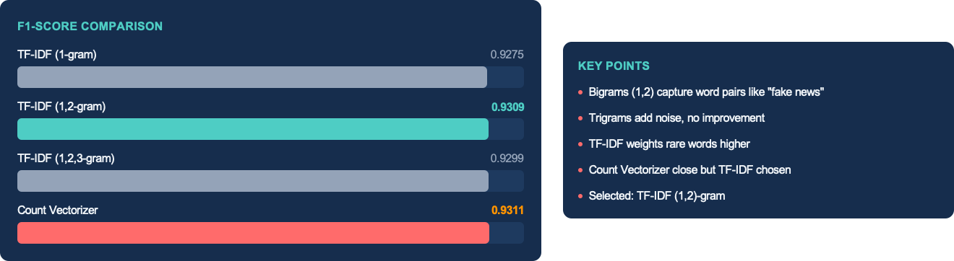
Vectorizer Comparison
Four different algorithms tested with default and tuned hyperparameters

Slide 5
Models Tested
Logistic regression
  Fast training, interpretable coefficients, good baseline for text classification.
Random forest
  Handles non-linear relationships, robust to overfitting, feature importance.
Linear Support vector machine
  Excellent for high-dimensional data, maximum margin classifier.
Multinomial Naive Bayes
  Fast, works well with word counts, good for text with many features.
Four different algorithms tested with default and tuned hyperparameters

Slide 6
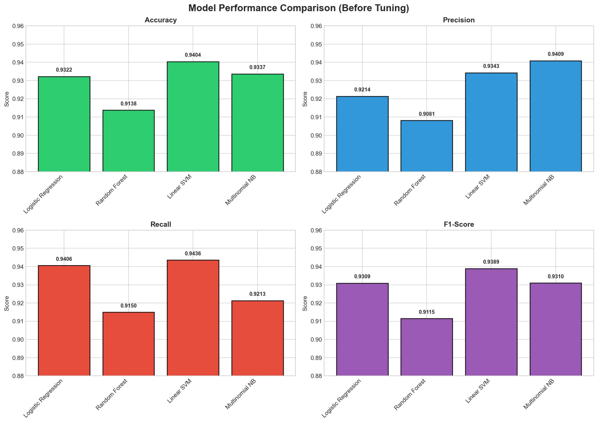
Baseline Model Comparison
KEY POINTS
Linear SVM leads with 93.89% F1
Random Forest lowest at 91.15%
Chart
MNB has best precision (94.09%)
SVM has highest recall (94.36%)
All models above 91% accuracy

Slide 7
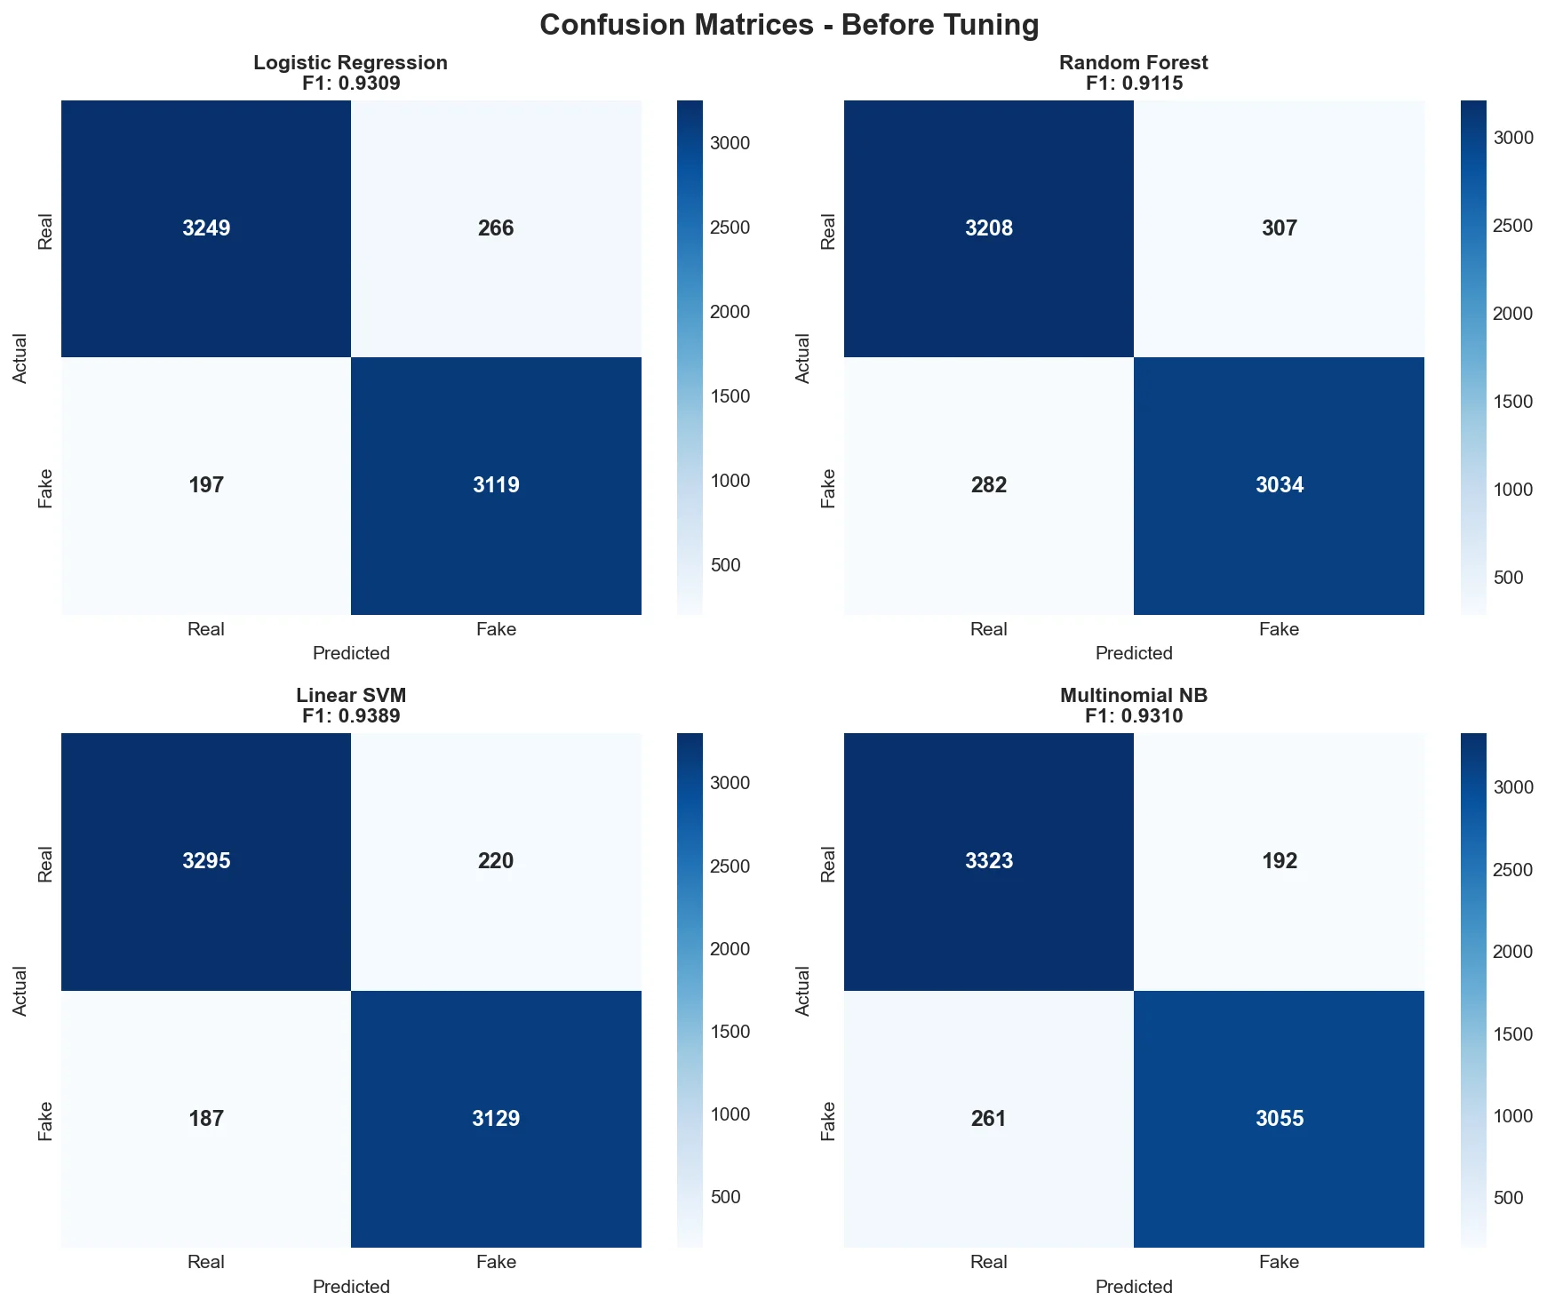
Confusion Matrices - Before Tuning
KEY POINTS
SVM: 3295 TP, 187 FP - best balance
Matrices
MNB: Fewest FN (192) on real news
RF: Most FN (282) - misses fake news
LR: Good balance, 197 FP/266 FN
Total test: 6,831 samples

Slide 8
Hyperparameter Tuning
TUNING METHOD
GridSearchCV with 3-fold cross-validation, optimizing for F1-Score
LOGISTIC REGRESSION
LINEAR SVM
MULTINOMIAL NB
C (Regularization)
C (Regularization)
Alpha (Smoothing)
[0.1, 1.0, 10.0]
[0.1, 1.0, 10.0]
[0.01, 0.1, 0.5, 1.0]
Solver
Loss Function
Fit Prior
['lbfgs', 'liblinear']
['hinge', 'squared_hinge']
[True, False]
Best: C=10.0, lbfgs
Best: C=1.0, squared_hinge
Best: alpha=0.5, fit_prior=True
Notes:
We used GridSearchCV with 3-fold cross-validation to find the best settings for each model.
For Logistic Regression, we tested different regularization strengths (C) and solvers - the best was C=10 with lbfgs.
For Linear SVM, we tried different C values and loss functions - C=1.0 with squared_hinge worked best.
For Naive Bayes, we tested smoothing parameters - alpha=0.5 was optimal.
This systematic search helps us find the sweet spot for each algorithm.

Slide 9
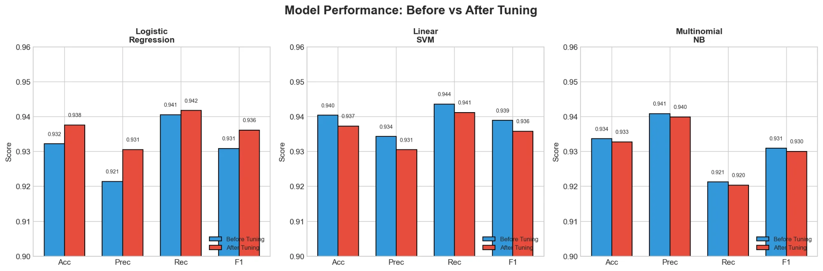
Before vs After Tuning
Comparison
KEY POINTS
LR improved: F1 0.931 → 0.936
SVM slight drop: 0.939 → 0.936
MNB decreased: 0.931 → 0.930
Precision vs recall trade-offs
Default SVM still best overall
Notes:
This chart shows what happened after tuning.
Logistic Regression actually improved - F1 went from 0.931 to 0.936.
But interestingly, Linear SVM and Multinomial NB got slightly worse after tuning. This teaches us an important lesson: tuning doesn't always help, and sometimes default parameters are already well-optimized.
The trade-off between precision and recall shifted differently for each model.

Slide 10
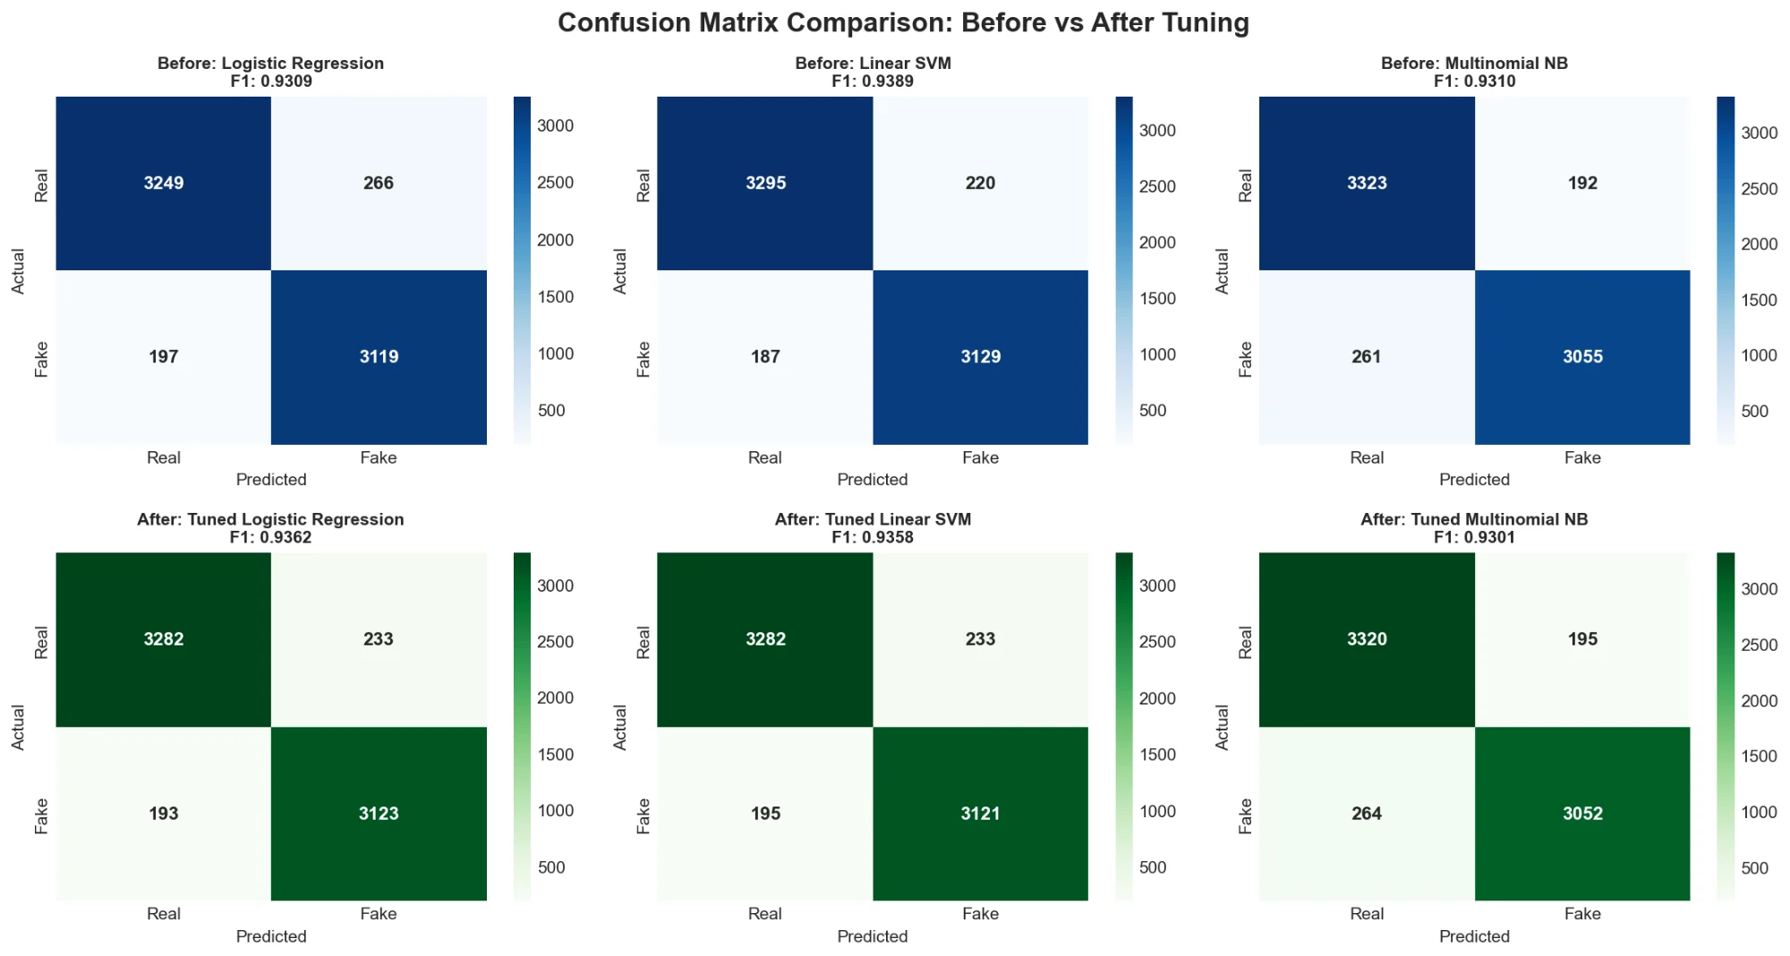
Confusion Matrix Comparison
KEY POINTS
LR TP improved: 3249 → 3282
Comparison
LR FN reduced: 197 → 193
SVM stable: slight FP increase
MNB: More FP after tuning (264)
Tuning balances precision/recall
Notes:
Here we see the actual prediction counts before and after tuning.
For Logistic Regression, we correctly identified more real news (3249→3282 true positives) and reduced false negatives (197→193).
SVM stayed stable with just a slight increase in false positives.
But Multinomial NB got more false positives after tuning (261→264).
These matrices help us understand exactly where each model makes mistakes.

Slide 11
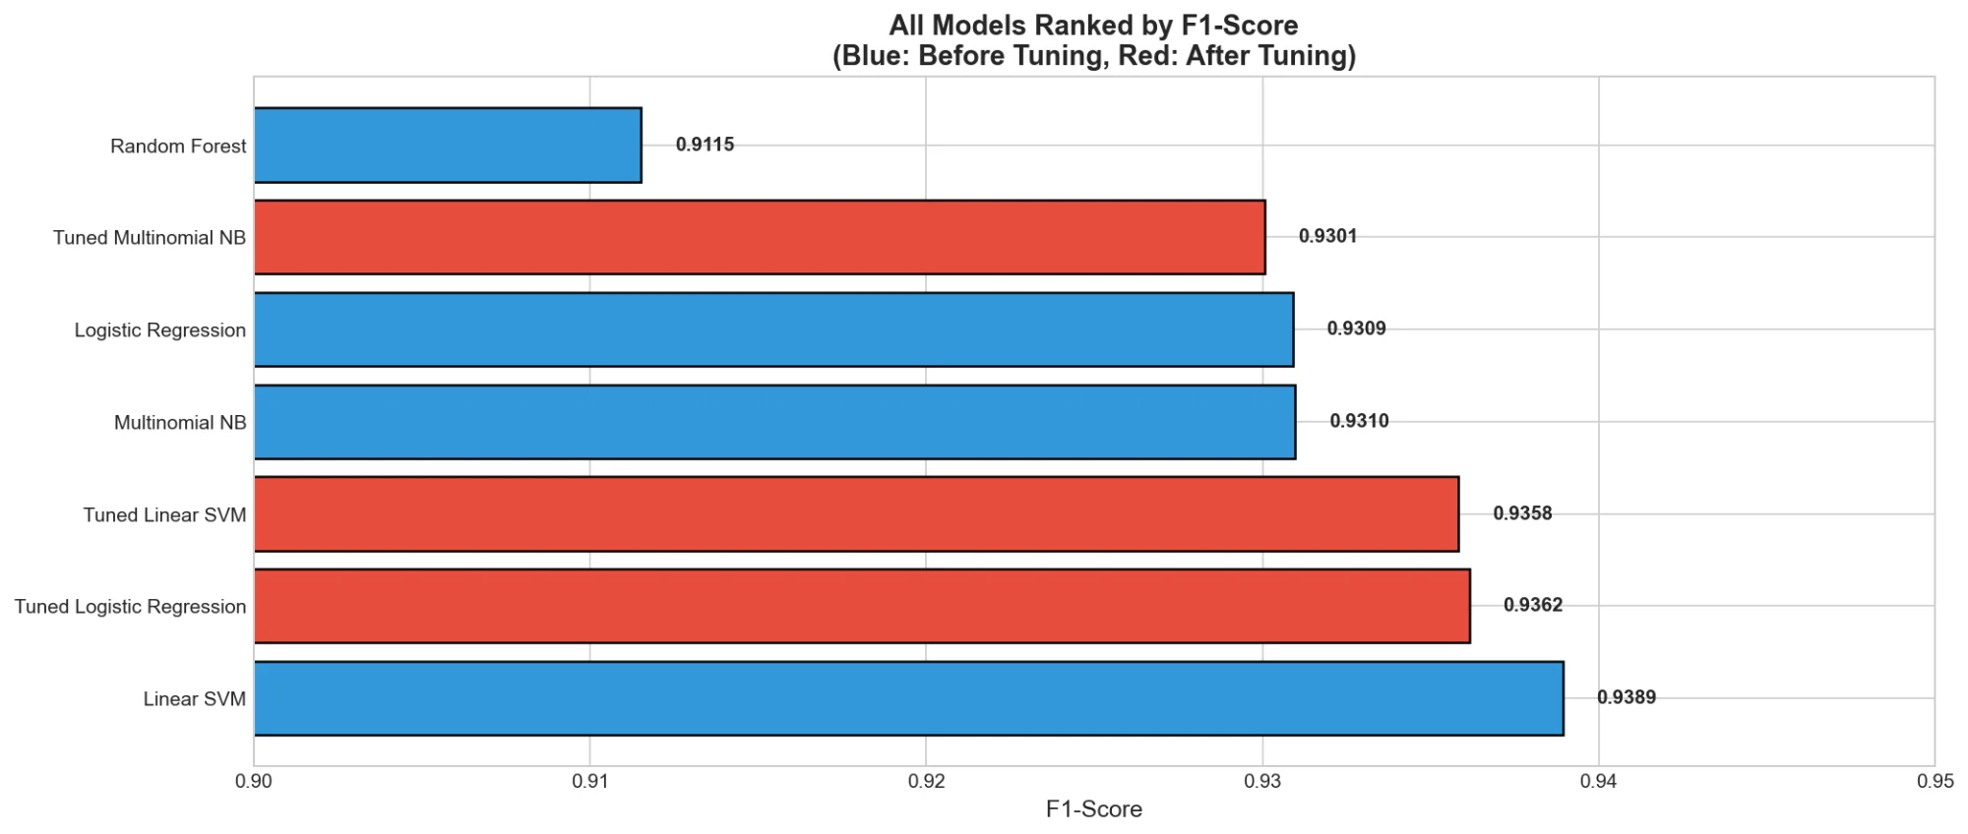
Final Model Rankings
KEY POINTS
Winner: Linear SVM (0.9389)
Rankings
2nd: Tuned LR (0.9362)
3rd: Tuned SVM (0.9358)
Default params beat tuned SVM
RF lowest: 0.9115
Notes:
This is our final leaderboard ranked by F1-score.
The winner is Linear SVM with default parameters at 93.89%.
Second place goes to Tuned Logistic Regression at 93.62%, and third is Tuned Linear SVM at 93.58%.
Notice that the default SVM actually beat its tuned version - proving that more tuning isn't always better.
Random Forest came last at 91.15%, showing it's not ideal for this high-dimensional text data.

Slide 12
Test Set Predictions
PREDICTION DISTRIBUTION
SELECTED MODEL
Real News (Class 0)
3.3k
Linear SVM
Retrained on full 27,321 samples
Fake News (Class 1)
3.1k
MODEL PERFORMANCE
Accuracy
94.04%
TOTAL PREDICTIONS
F1-Score
93.89%
6,831
Precision
93.43%
Recall
94.36%
samples classified
Output saved to: testing_data_predictions.csv
Notes:
Using our best model (Linear SVM), we classified 6,831 test articles.
The results show 3.3k predicted as real news and 3.1k as fake news - roughly a 47/53 split.
The model was retrained on all 27,321 training samples before making these final predictions.
Our model achieved 94% accuracy and 93.89% F1-score, with balanced precision (93.43%) and recall (94.36%).
This means we're catching most fake news while keeping false alarms low.

Slide 13
Deep Learning: BERT Model
BEFORE FINE-TUNING
MODEL USED
Precision
93.86%
Fake-News-Bert-Detect
Accuracy
63.86%
Pre-trained BERT for fake news detection
F1-Score
44.25%
Recall
28.55%
FINE-TUNING SETUP
Learning Rate
2e-5
AFTER FINE-TUNING
Batch Size
16
Accuracy
98.62%
Epochs
3
F1-Score
98.63%
Max Length
512 tokens
Precision
98.34%
Hardware
RTX 3060 GPU
Recall
98.92%

Slide 14
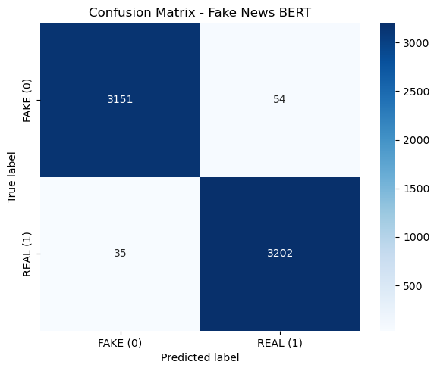
BERT vs Traditional ML
METRIC
LINEAR SVM
BERT (Fine-tuned)
F1-Score
93.89%
98.63%
Accuracy
94.04%
98.62%
Training Time
~1 min
~58 min
Hardware Req.
CPU
GPU
Conclusion: BERT achieves 4.7% higher F1-score but requires GPU and 58x longer training. For production with limited resources, Linear SVM offers excellent accuracy with minimal compute.

Slide 15
Conclusion
BERT achieved 98.63% F1-score but requires GPU and 58-minute training time
Linear SVM delivered 93.89% F1-score with CPU-only inference and fast training
Trade-off identified: 4.7% accuracy gain vs 58x longer training and GPU dependency
Both models production-ready - choice depends on accuracy needs and available resources
KEY TAKEAWAYS

Slide 16
THANK YOU
Questions & Discussion
Fake News Classification • ML Project

Slide 17
Challenges & Business Insights
GPU requirement: BERT fine-tuning needed RTX 3060 with limited batch size (16)
Pre-trained BERT baseline was poor (44.25% F1), requiring full fine-tuning
Hyperparameter tuning: Traditional ML showed minimal gains; default Linear SVM outperformed tuned version
Deployment trade-off: SVM enables rapid CPU deployment; BERT justifies cost only for high-stakes applications

