Slide 1
BLACK FRIDAY SALES ANALYSIS
Group Members -
1 – Sagar Vasaikar
2 – Saachi Shah
3 – Tarang Haria

Slide 2
Introduction
Black Friday is the Friday after Thanksgiving, and it's one of the major shopping days of the year in the United States, falling anywhere between November 23 and 29.
The term "Black Friday" originated in Philadelphia. In the 1960's, police in Philadelphia griped about the congested streets, clogged with motorists and pedestrians, calling it “Black Friday.” In a non-retail sense, it also describes a financial crisis of 1869.
“Black” refers to stores moving from the “red” to the “black,” back when accounting records were kept by hand, and red ink indicated a loss, and black a profit.

Slide 3
Dataset Description
The dataset is a sample of the transactions made in a retail store. The store wants to know better the customer purchase behavior against different products. We are trying to predict the amount of purchase with the help of the information contained in the other variables.
The dataset contains 538k rows and 12 columns.

Slide 4
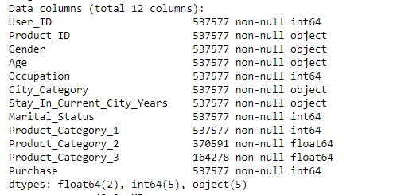
Dataset Description

Slide 5
Plots
We plotted a heatmap to check if there are any missing values
We can see that there are missing values only in "Product_Category_2"and "Product_Category_3""

Slide 6
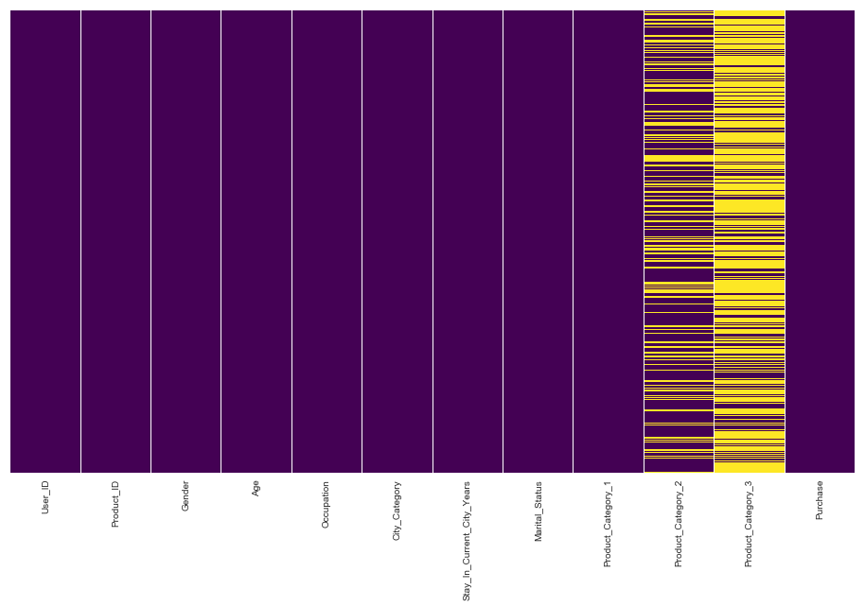

Slide 7
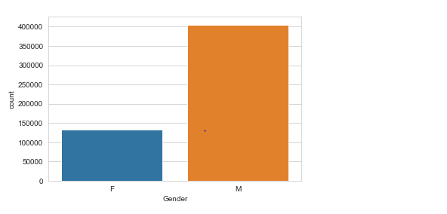
Plots
Men attended the Black Friday sale more than Women.

Slide 8
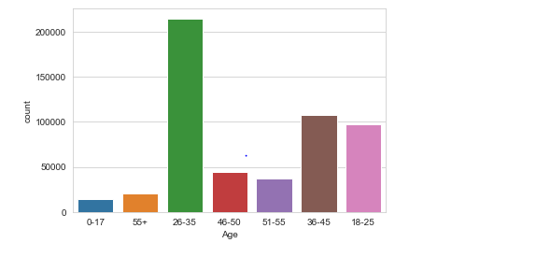
Plots
People in the age group 26-35 participate in Black Friday sale much more than others.

Slide 9
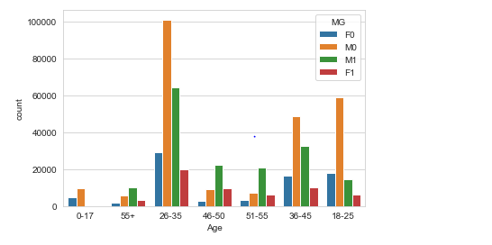
Plots
Unmarried people in the age group 26-35 participate in Black Friday sale much more than others.

Slide 10
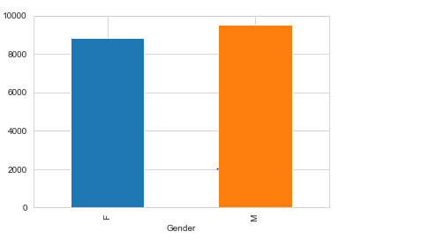
Plots
We see that Males spend more than Females on average.

Slide 11
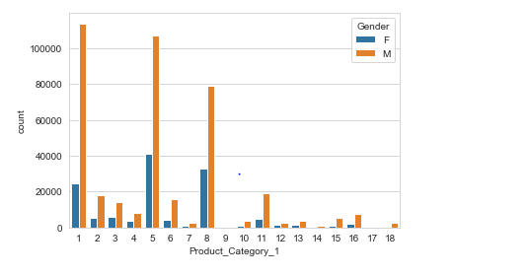
Plots
We can see that there are 18 unique products in the Product_Category_1 amongst which Product 1, Product 5 and Product 8 have maximum sales.

Slide 12
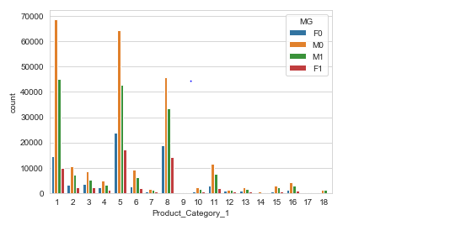
Plots
Total purchases of different products in the Product category 1 among Married and Unmarried customers.

Slide 13
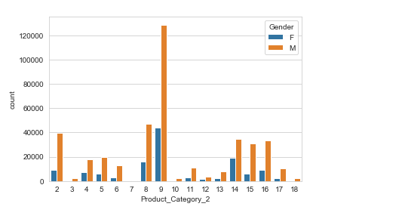
Plots
We can see that there are 18 unique products in the Product_Category_2 amongst which Product 9 resulted in the maximum sale.

Slide 14
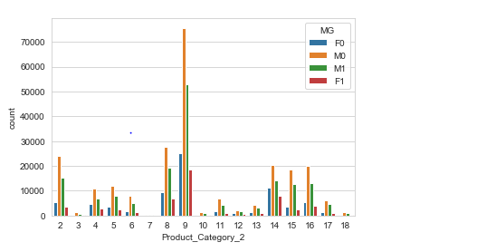
Plots
Total purchases of different products in the Product category 2 among Married and Unmarried customers.

Slide 15
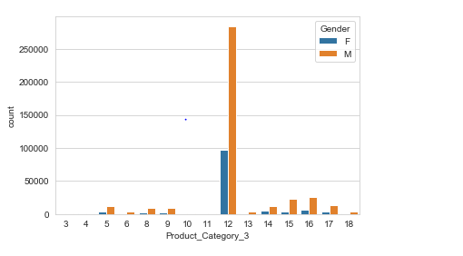
Plots
We can see that there are 16 unique products in the Product_Category_3 amongst which Product 12 resulted in the maximum sale and there are no sales for the Products 3,4,10 and 11.

Slide 16
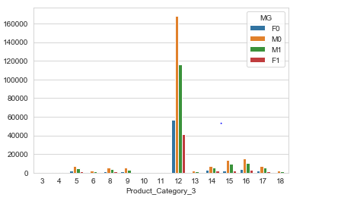
Plots
Total purchases of different products in the Product category 3 among Married and Unmarried customers.

Slide 17
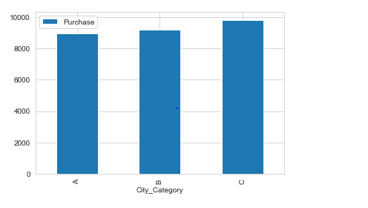
Plots
Comparing total purchase amounts w.r.t city, we see that city C has the highest purchase.

Slide 18
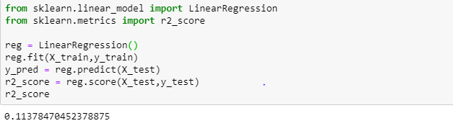
Linear Regression Model

Slide 19
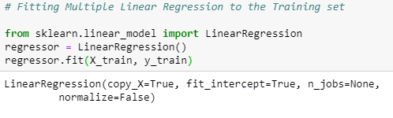
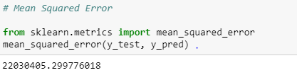
Multiple Linear Regression Model

Slide 20
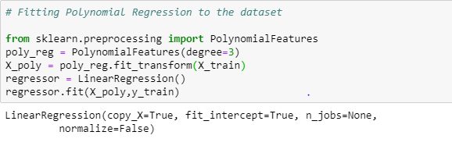
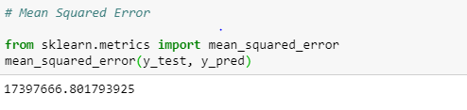
Polynomial Regression Model

Slide 21
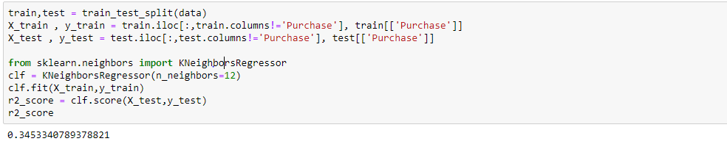
KNN Classifier

Slide 22
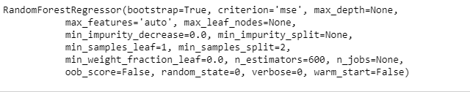
Random Forest Model

Slide 23
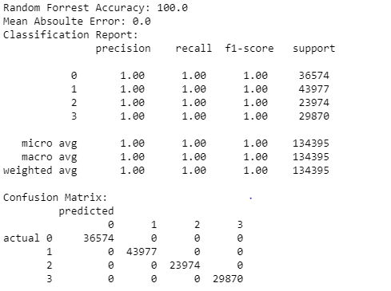
Random Forest Results

Slide 24
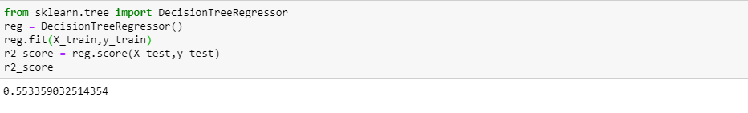
Decision Tree

Slide 25
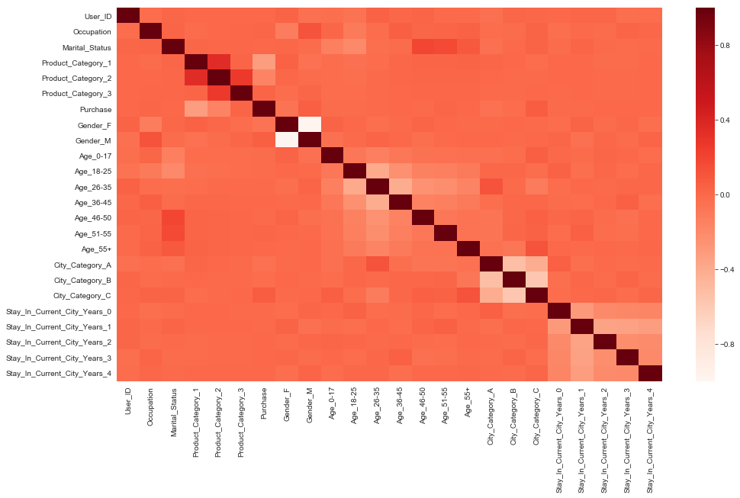
Heat Map
We found out the important features using heatmap visualization. City_Category and Gender seem to give positive correlation.

Slide 26
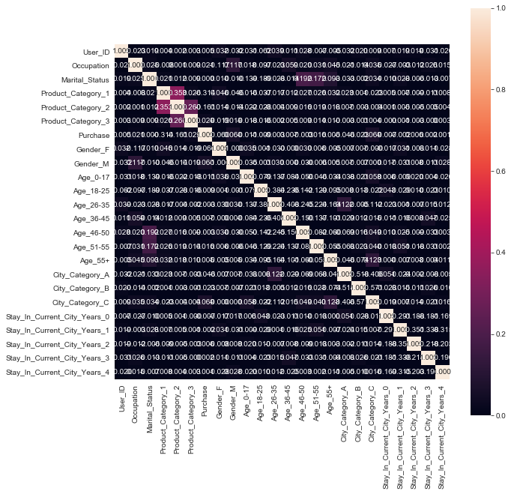
Correlation matrix & Heatmap

Slide 27
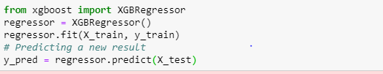
XGBoost Model

Slide 28
Conclusion
Men attended the Black Friday sale more than Women.
People in the age group 26-35 participate in Black Friday sale much more than others.
We see that Males spend more than Females on average.
We see that the Product Category 1 has maximum sales.
We see that city C has the highest purchase.
XGBoost is the most optimal model with an accuracy of 0.99.

