Slide 1


Slide 2
RUID: 190004326
Submitted by: Tarang Haria
Supervised by: Prof. Sergei Schreider
Telecom’s Churn Reduction

Slide 3
1. What is 'Churn Rate'?
2. Why is churn so important?
3 - The objective of this case is to predict the customer behaviour.
Problem Statement

Slide 4
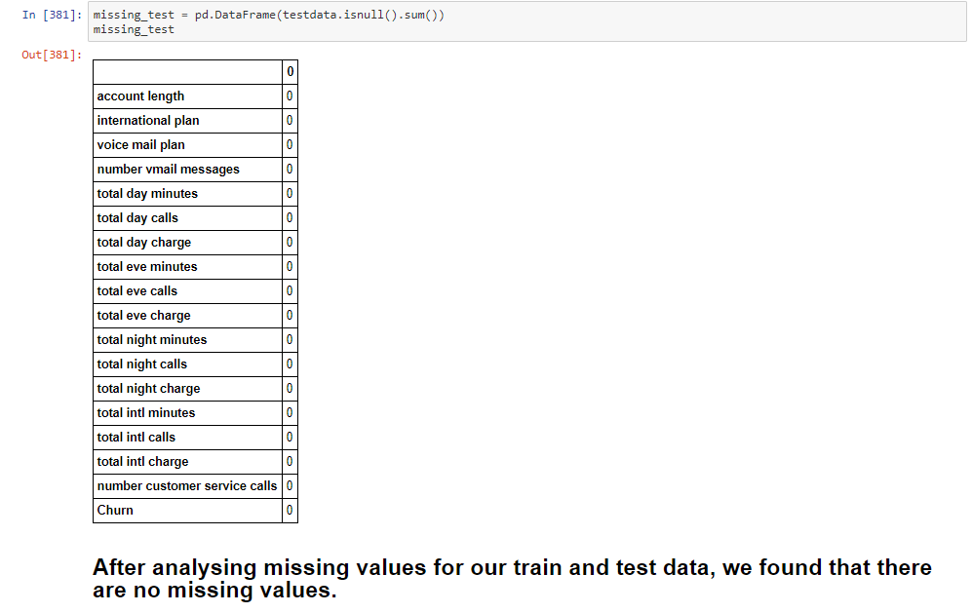
Data Preprocessing

Slide 5
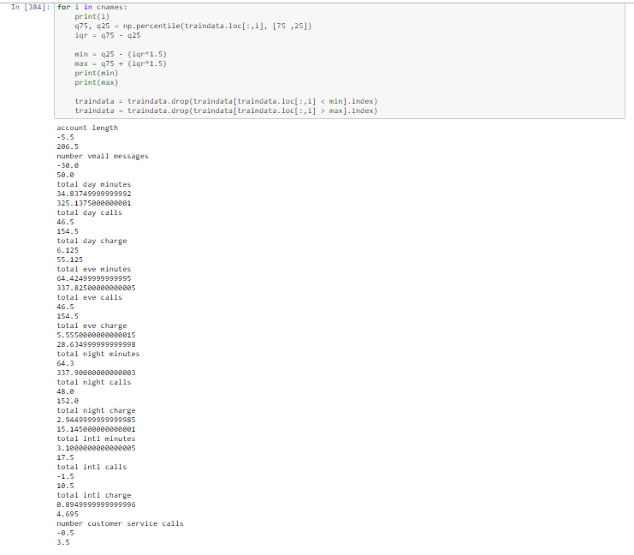
Minimum and Maximum Values of Each Variable
Data Preprocessing

Slide 6
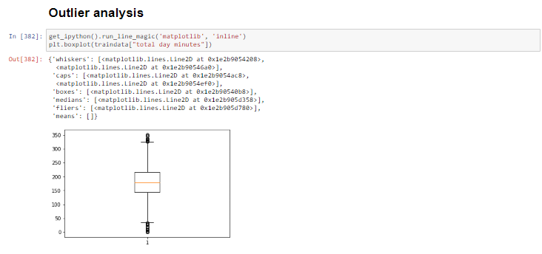
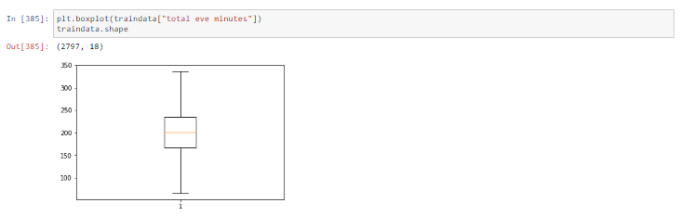
Data Preprocessing

Slide 7
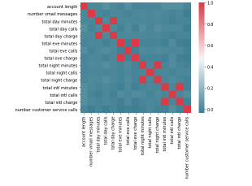
Correlation Analysis
From this correlation plot, we observed that total day, evening and night minutes as well as international minutes are highly correlated.

Slide 8
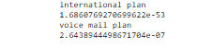
Chi-square test of Independence
The p-value is less than 0.05, so we can use both the categorical variables – International and Voice Mail Plan

Slide 9
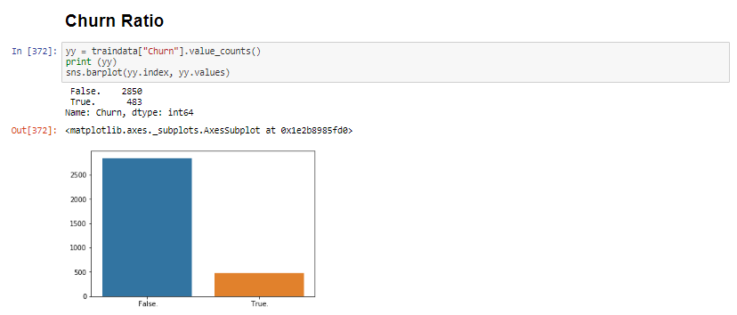
Exploratory Data Analysis
Churn Ratio, the number of users that have moved or not. We can observe that 500 users have moved from their subscription plan.

Slide 10
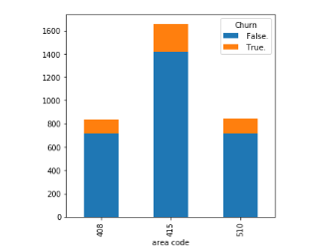
Exploratory Data Analysis
From the above analysis, we found that maximum users from area code 415 moved from the subscription plan.

Slide 11
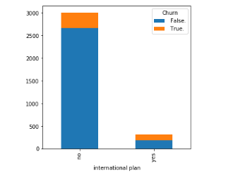
Exploratory Data Analysis
From the above analysis, we found that very few people have an International plan and half of them have moved from the subscription plan.

Slide 12
Model Development
C5.0
Random Forest
Logistic Regression
K-Nearest Neighbor
Naïve Bayes Classifier
We are here expected to develop a Model, on our data which will predict whether a customer will Move or no.
So here we have to develop model on our train data then implement this model over test data and predict the target variable of test data.the above analysis, we found that very few people have an International plan and half of them have moved from the subscription plan.

Slide 13
Conclusion
Models | Accuracy | FNR
C5.0 | 92.98 | 4.20
Random Forest | 94.05 | 5.62
Logistic Regression | 91.51 | 7.2
KNN | 88.56 | 10.07
Naïve Bayes | 87.82 | 8.53

