Slide 1
M.TECH AIML — MINI PROJECT · GROUP 16
ContextLens
Does More Context Make RAG Smarter?
• Investigating how retrieval depth K affects answer quality in a local RAG system
• Documents: IIT Roorkee PG + PhD admission brochures (62 pages)
• Conditions compared: No-RAG, Top-1, Top-3, Top-5, Top-10, Gold-page oracle
1

Slide 2
REAL-WORLD PROBLEM
RAG systems assume “more context = better”
• A RAG pipeline retrieves the Top-K most similar chunks and feeds them to the LLM
• Common practice: raise K to improve coverage of the answer
• But a larger context window can also add:
– Irrelevant or off-topic passages (noise)
– Contradictory or redundant chunks
– Longer prompts → higher latency and cost
– More room for the LLM to misread or ignore the right passage
• Teams tune K by instinct, rarely by measurement
PDF
↓
Chunks
↓
Top-K retrieval
↓
LLM answer
Does a bigger K
always help?
2

Slide 3
RESEARCH QUESTION
Does increasing retrieved chunks always improve answer quality?
• H1 — Accuracy improves with K up to a point, then shows diminishing returns
• H2 — Context relevance and hallucination both move with K: more facts retrieved, but also more unsupported-claim risk at very low K
• H3 — Response time grows with K, roughly linearly through generation cost
• Metrics: Answer Accuracy · Context Relevance (fact recall) · Hallucination Rate · Response Time
• Experimental validity: K is the only variable — same documents, chunks, embeddings, prompt, model and questions across all conditions
3

Slide 4
DATASET
IIT Roorkee official admission brochures
• Information_Brochure_2026.pdf — 25 pages, 57 PG programmes, eligibility, sponsored categories
• PhD_IB_A2026.pdf — 37 pages, FTRS / PTRS / Golden Girl schemes, MEQ, departments
• Total: 2 documents, 62 pages
•
• Benchmark: 50 questions
– 15 direct factual, 10 procedural, 10 eligibility,
– 5 conditional, 5 numerical, 5 multi-part
• Each question has a ground truth, required facts, source document and page
• Gold-page validation (automatic):
– 25 questions — fact supported on cited page
– 18 questions — fact found on another page
– 7 questions — fact not found in document text
•
• The benchmark file states plainly that questions were generated from the PDFs, not written by domain experts — the gold-page check exists to catch bad references rather than assume the file is perfect.
4

Slide 5
METHODOLOGY
RAG pipeline, built for controlled experimentation
• 1. Preprocessing — PyMuPDF extraction, hyphenation fix, paragraph-preserving cleanup → pages.jsonl
• 2. Chunking — 500-word chunks, 80-word overlap, paragraph-aware; the same chunk set is reused for every K so only retrieval depth changes
• 3. Embedding + index — all-MiniLM-L6-v2 (384-d), FAISS exact inner-product index (cosine similarity)
• 4. Retrieval — Top-K chunks per question, K ∈ {1, 3, 5, 10}, plus No-RAG and Gold-page baselines
• 5. Generation — local MLX LLM (Qwen3-4B-Instruct), fixed prompt and generation parameters across conditions, must cite sources or abstain
• 6. Evaluation — rule-based: fact-coverage accuracy (0–2), context fact recall, claim-level support checking (hallucination), citation validity, latency
5

Slide 6
EXPERIMENTAL SETUP
Paired design — K is the only variable
• Independent variable: K ∈ {no_rag, 1, 3, 5, 10, gold}
• Dependent variables: accuracy, context relevance, hallucination rate, response time
• Held constant: documents, chunking, embedding model, FAISS index, similarity metric, question set, ground truth, LLM, prompt, generation parameters, evaluation method
• Design: every question answered under every condition (paired) → Wilcoxon signed-rank test per pair, Holm-corrected across comparisons
• Completed run: 275 question×condition answers (50 questions × 5 conditions + 25 gold-eligible)
• Run ID: full-50q-2026-10-12
• Outputs: runs.jsonl (raw), summary.json (aggregates + significance tests), results.csv, comparison_table.csv, figures/
6

Slide 7
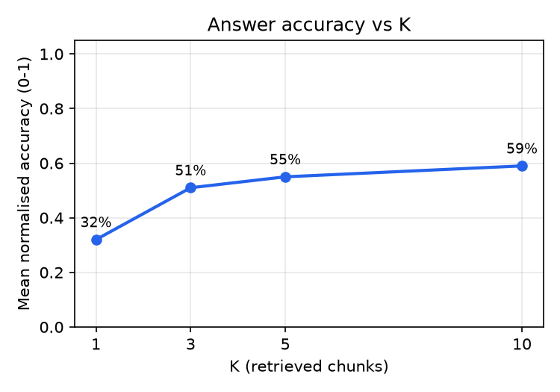
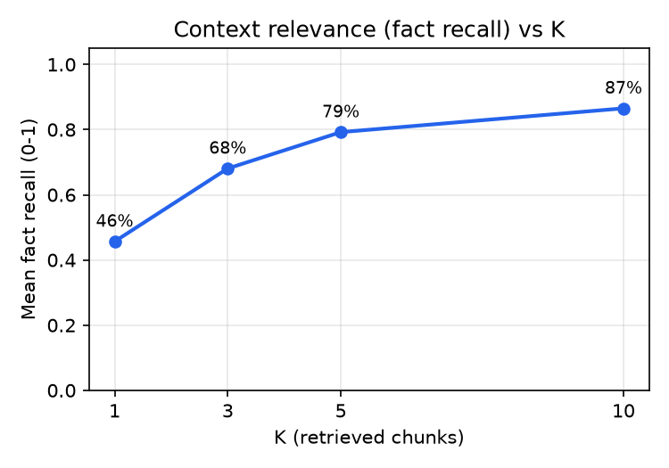
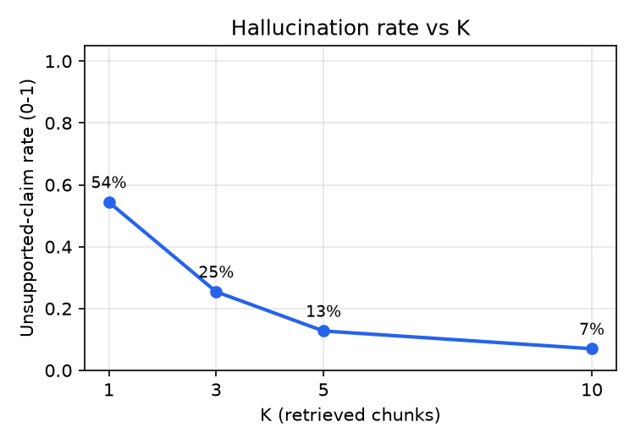
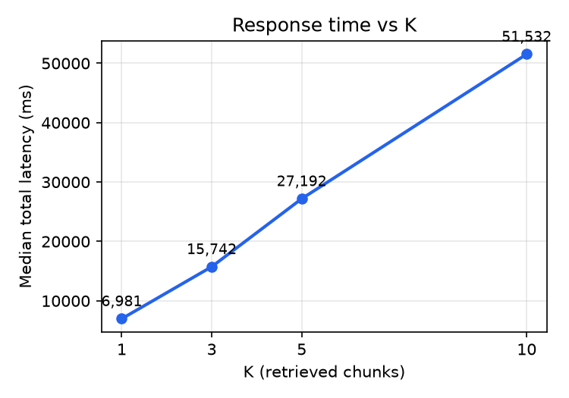
RESULTS
Observed results — real run, no fabricated numbers
• Top-1: accuracy 32% · context recall 46% · hallucination 54% · median latency 7.0s
• Top-3: accuracy 51% · context recall 68% · hallucination 25% · median latency 15.7s
• Top-5: accuracy 55% · context recall 79% · hallucination 13% · median latency 27.2s
• Top-10: accuracy 59% · context recall 87% · hallucination 7% · median latency 51.5s
7

Slide 8
INTERESTING / FAILURE CASES
Where more context helped — and where it didn't
• Top-1 under-retrieves: abstention rate 46% at K=1 vs 10% at K=10 — the single best-matching chunk often doesn't contain the required fact
• Accuracy rises sharply from K=1 (32%) to K=3 (51%), then flattens toward K=10 (59%) — diminishing returns, matching H1
• Hallucination (unsupported claims) falls as K grows: 54% at K=1 down to 7% at K=10 — more evidence per answer, fewer unsupported statements
• Latency grows roughly linearly with K: 7.0s at K=1 → 51.5s at K=10, a direct cost of longer prompts
• The Gold-page oracle (ground-truth page only) reaches 72% accuracy in 3.7s — faster and more accurate than Top-10, showing retrieval precision still bounds Top-K quality more than raw K does
• Full per-question detail: results/results.csv; aggregate significance tests: results/benchmark/full-50q-2026-10-12/summary.json (paired_tests)
8

Slide 9
FINDINGS & LIMITATIONS
More context helps — up to a point, and at a cost
• Findings
– Accuracy: rises sharply K=1→3, then plateaus (H1 supported)
– Context relevance: increases monotonically with K
– Hallucination: decreases monotonically with K — opposite of the naive “more noise” intuition for this dataset
– Latency: increases ~linearly with K (H3 supported)
– Statistically significant gains for accuracy and latency between most K pairs after Holm correction (see summary.json)
• Limitations
– 2 documents, 62 pages — single narrow domain
– MiniLM is a lightweight embedding model
– Evaluation is rule-based (lexical heuristics), not human-judged
– Benchmark questions were generated from the PDFs, not written by domain experts
– Fixed chunking (500/80 words) not swept
– 50 questions — moderate statistical power
9

Slide 10
CONCLUSION
K is a tuned hyperparameter, not “as much as fits”
• Conclusion
– More retrieved context did improve this system, but with diminishing accuracy gains after K=3 and a near-linear latency cost
– Retrieval precision (the Gold-page condition) matters more than raw K
– Experimental validity came from holding everything but K constant
• Future work
– Adaptive K based on query complexity or retrieval confidence
– Stronger embeddings (E5, BGE) and re-ranking
– Context compression / summarisation at high K
– Human evaluation alongside the lexical heuristics
– Multi-hop questions, larger K, more domains
10

