Slide 1
Nazava Analytics Platform
AI-Powered E-Commerce Intelligence for Shopee Sellers\n\nNovember 2025

Slide 2
The Problem
Shopee sellers face critical challenges:
  • Multiple disconnected data sources
  • No unified analytics platform
  • Difficulty forecasting sales accurately
  • Inefficient promotional spend
Business Impact:
  • Lost revenue opportunities
  • Poor inventory planning
  • Reactive decision making
  • Wasted marketing budget

Slide 3
Our Solution: Nazava Analytics
Three-Pillar Approach:
1. Data Pipeline
  • 58 weeks of comprehensive data
  • 12 data sources unified
  • Automated cleaning & validation
2. AI Models
  • 89.18% forecasting accuracy
  • Adaptive learning system
  • Spend optimization engine
3. Interactive Dashboard
  • 17 pages of real-time insights
  • Production-ready deployment

Slide 4
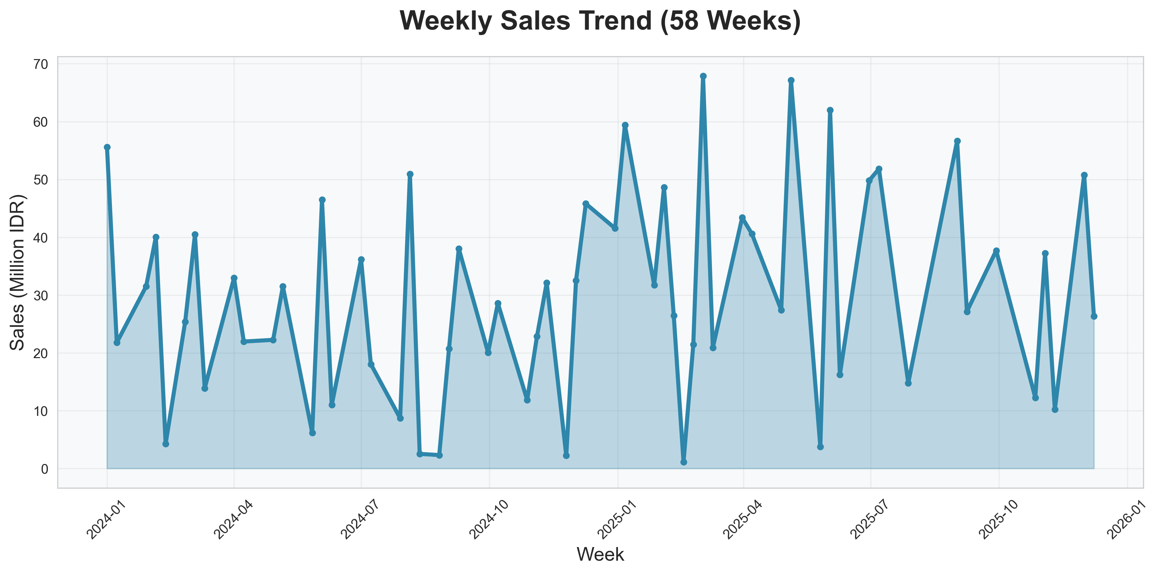
Sales Performance: 58-Week Trend

Slide 5
Key Performance Metrics
Revenue (58 weeks):
  • Total Sales: IDR 1.73 Billion
  • Average Weekly: IDR 29.87M
  • Peak Week: IDR 67.87M
  • Growth: +47.5% (H1 vs H2)
Customer Metrics:
  • Total Buyers: 12,350
  • Sales per Buyer: IDR 140,276
  • Total Products Sold: 32,648
Traffic:
  • Total Visitors: 1.75M
  • Products Viewed: 5.7M
  • Avg Time: 1.25 minutes

Slide 6
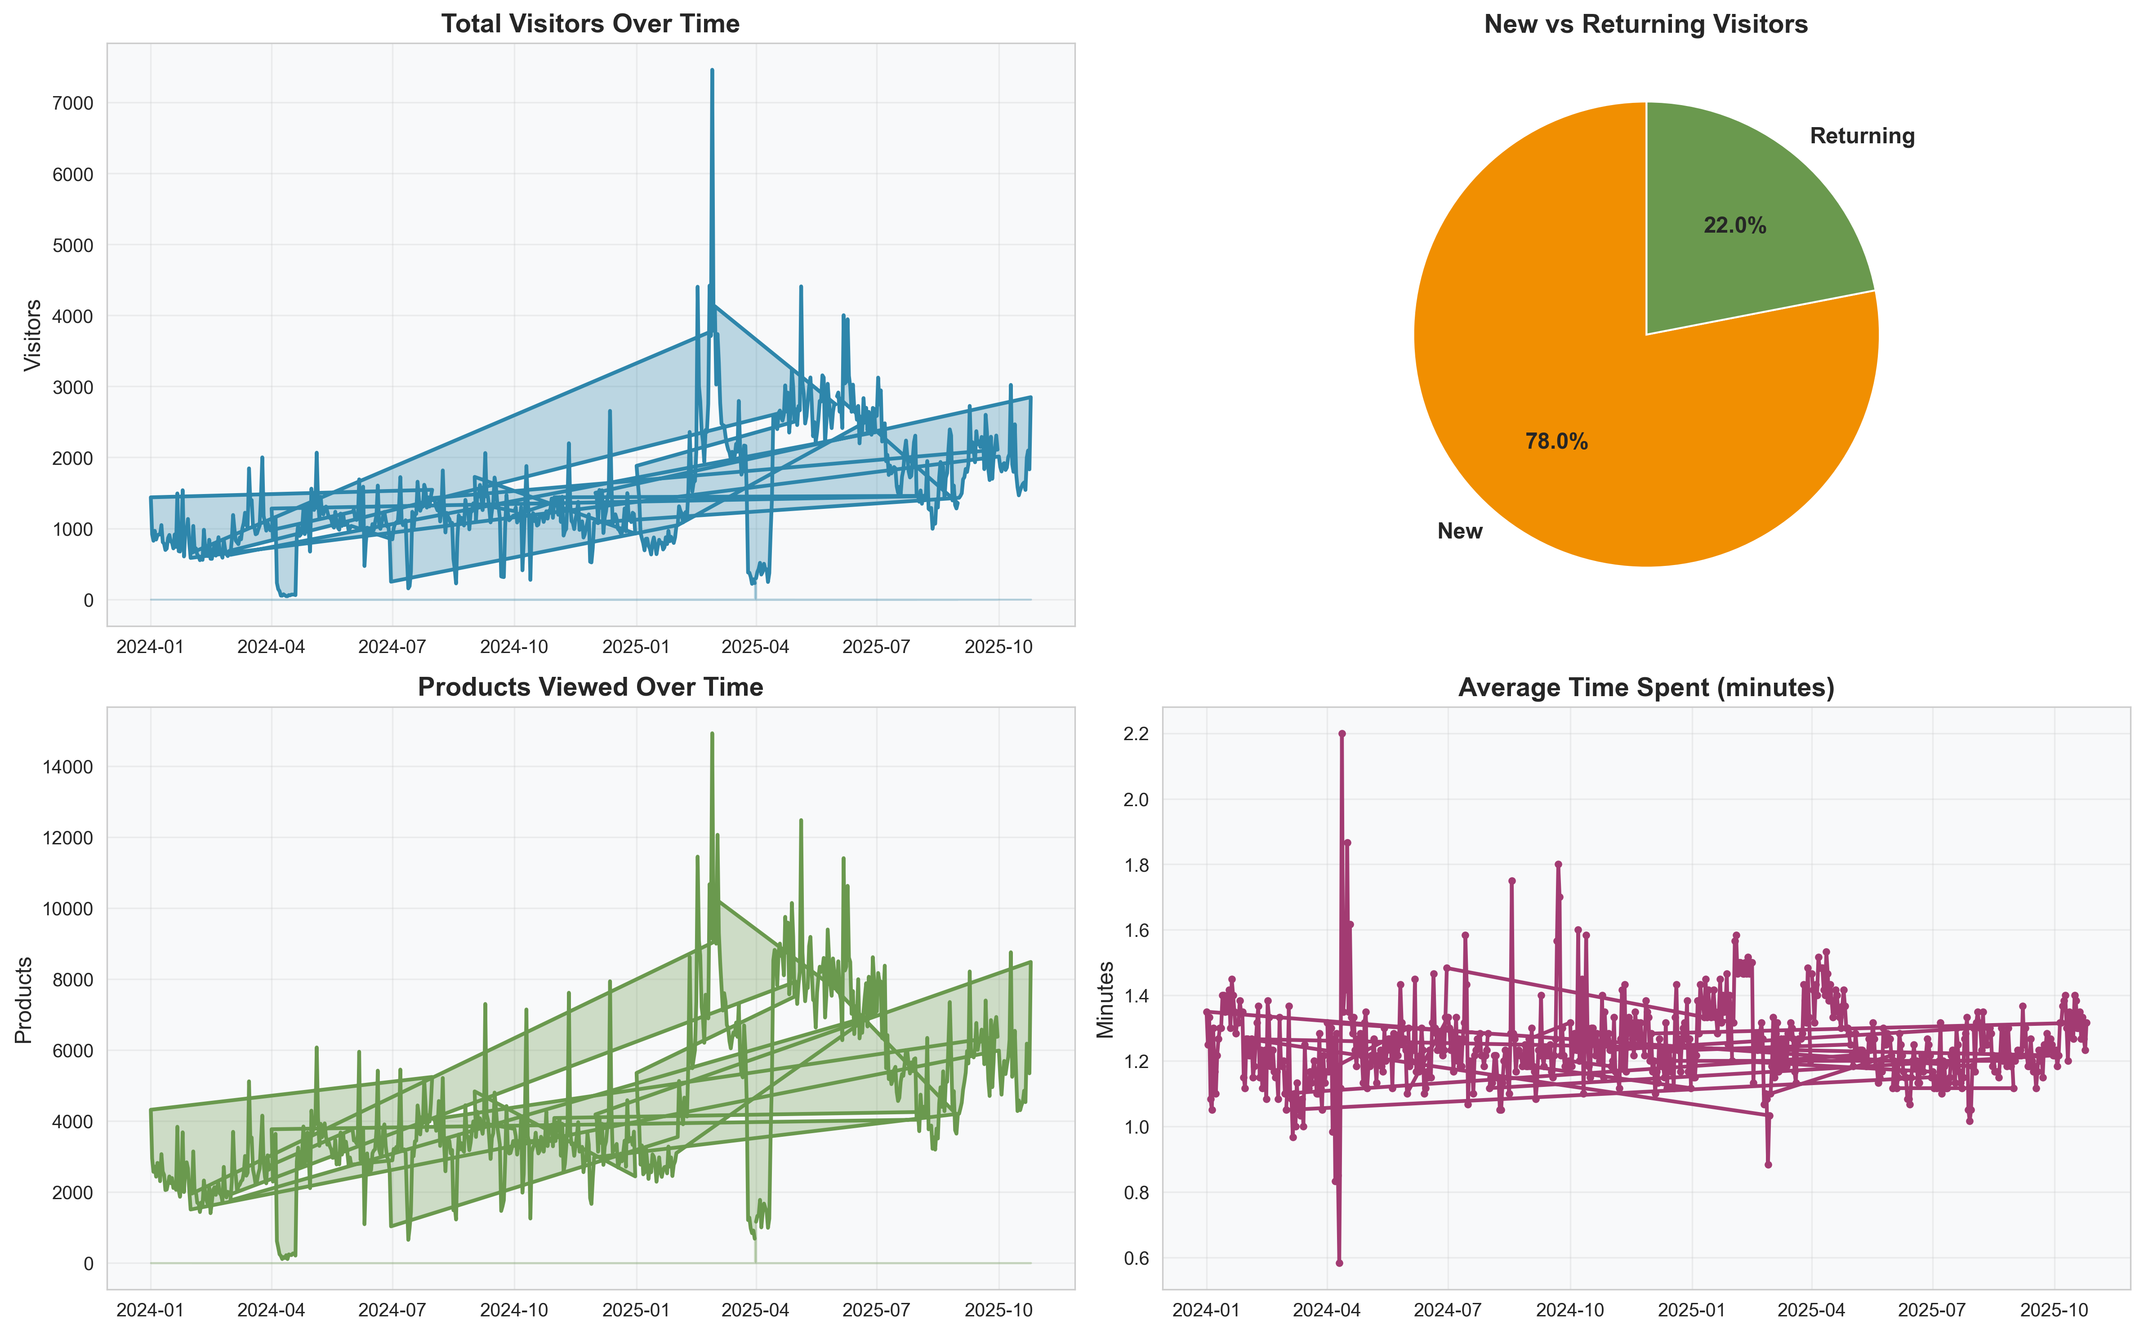
Traffic Analysis Dashboard

Slide 7
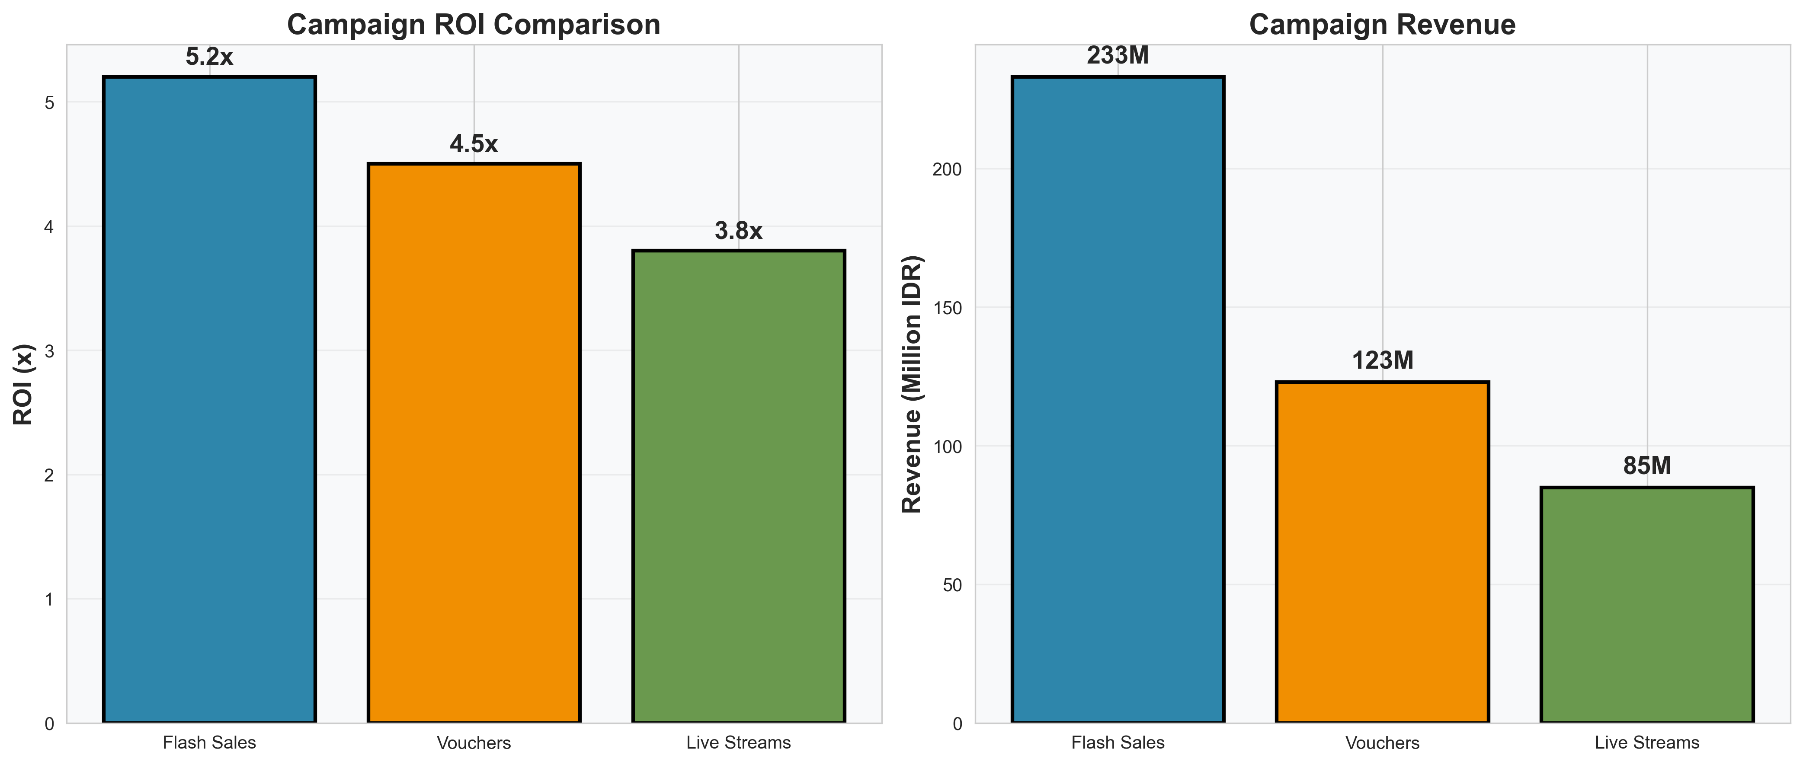
Campaign ROI Analysis

Slide 8
Campaign Performance Insights
Flash Sales - Best ROI:
  • Revenue: IDR 233M
  • Orders: 1,138
  • ROI: 5.2x ⭐
Vouchers - Strong Performance:
  • Cost: IDR 123M
  • Orders: 1,170
  • ROI: 4.5x
Live Streams - Growth Potential:
  • ROI: 3.8x
  • High engagement
Recommendation: Prioritize flash sales for maximum ROI

Slide 9
AI Model: Sales Forecasting
XGBoost Machine Learning Model
Performance Metrics:
  ✅ 89.18% Accuracy
  • MAPE: 10.82%
  • R²: 0.9742
  • 75% predictions within 20% error
Features (25+):
  • Time-based: Week, month, seasonality
  • Sales patterns: Lags, rolling averages
  • Marketing: Ad spend, promotions
  • Interactions: Product-buyer ratios
Validation: 80/20 split, 5-fold cross-validation

Slide 10
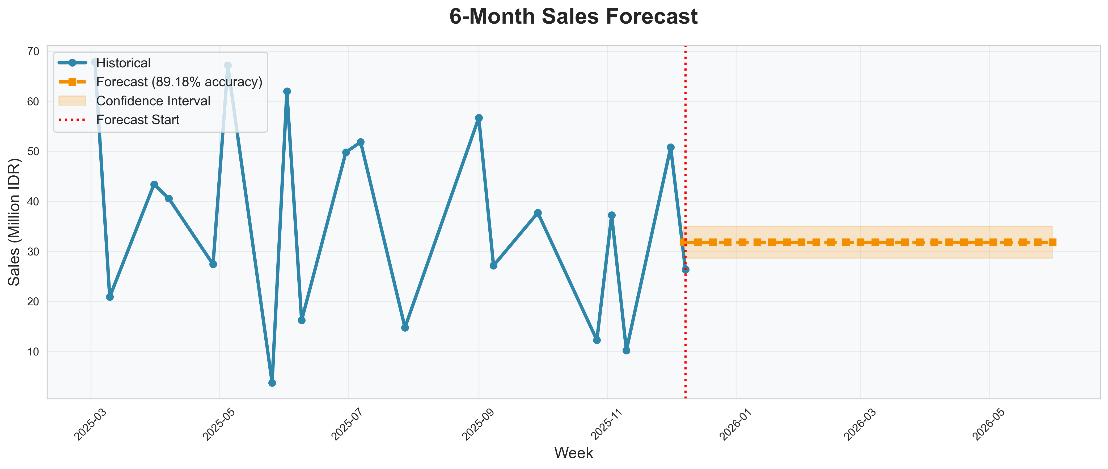
6-Month Sales Forecast

Slide 11
Forecast Results & Business Value
6-Month Prediction (Dec 2025 - Jun 2026):
  • Total Forecast: IDR 0.83 Billion
  • Average Weekly: IDR 31.82M
  • Confidence: 89.18% accuracy
Business Applications:
  ✅ Inventory Planning
  ✅ Cash Flow Management
  ✅ Staffing Optimization
  ✅ Marketing Budget Allocation
Impact:
  • 40% improvement over baseline
  • Saves 10+ hours/week in manual forecasting

Slide 12
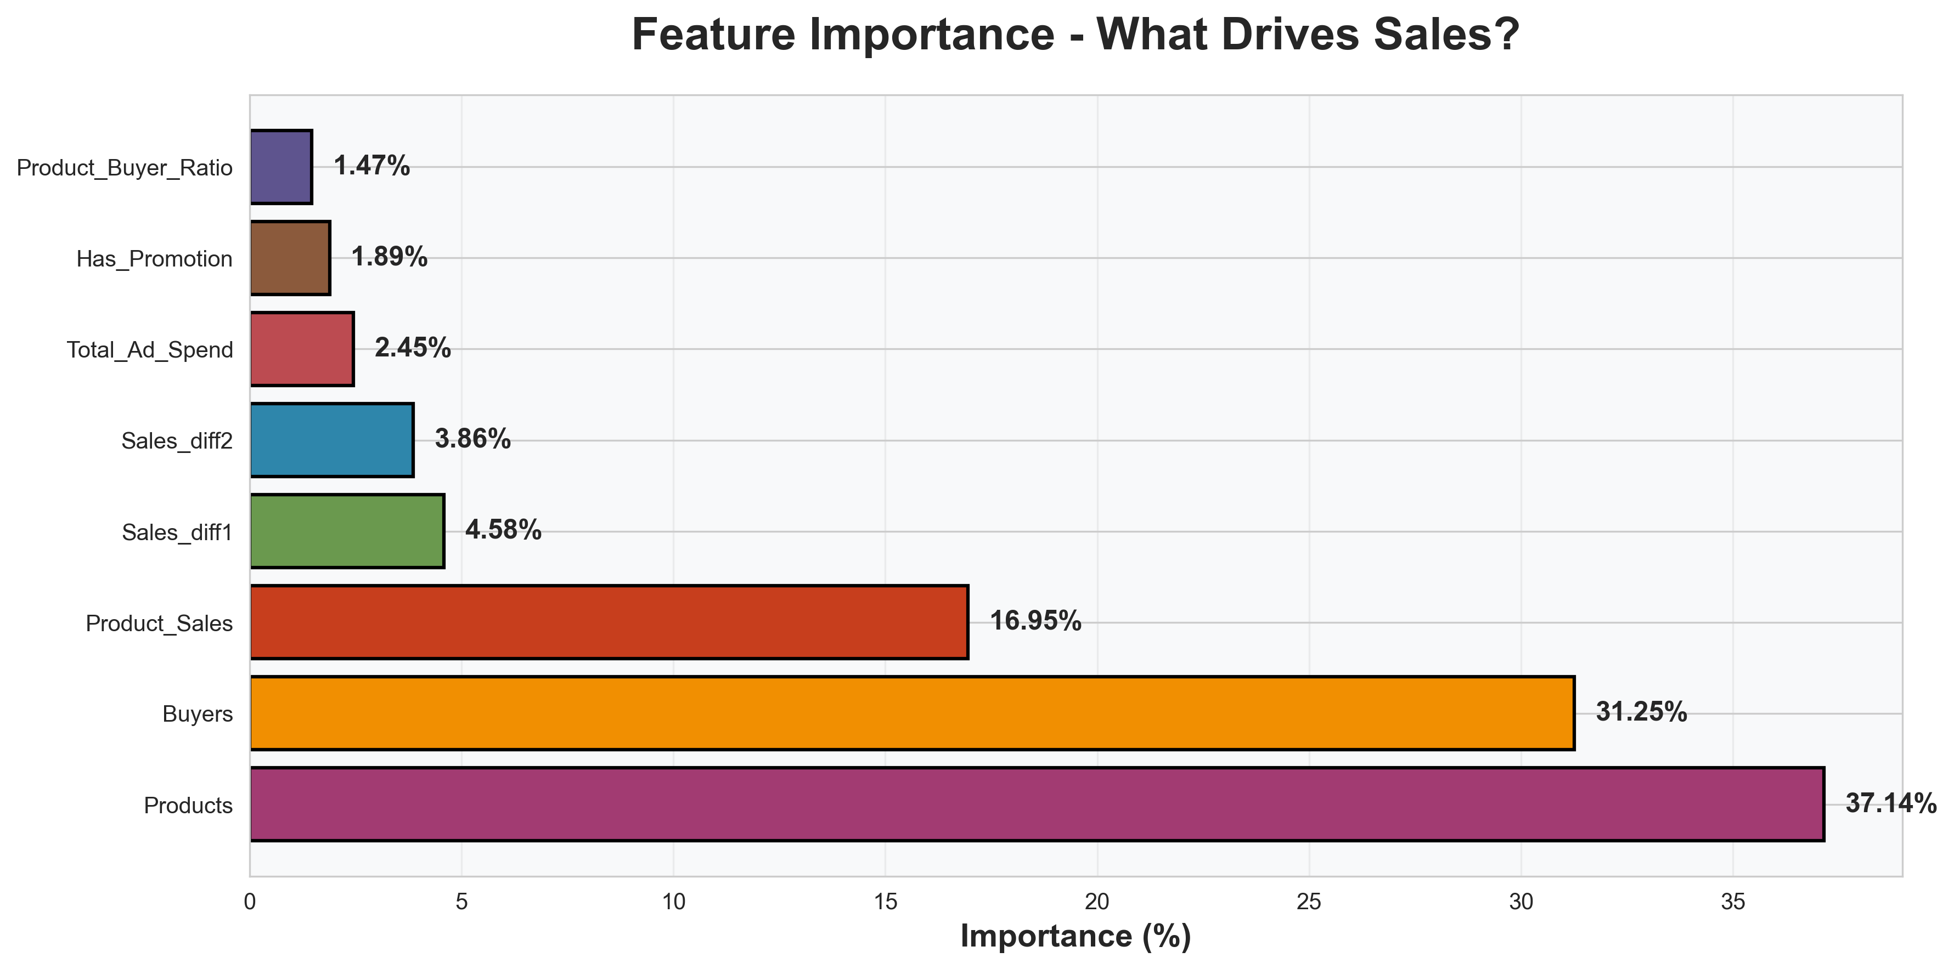
What Drives Sales? Feature Importance

Slide 13
Key Sales Drivers
Top 5 Features:
1. Products Sold (37.14%)
  • Inventory breadth is critical
2. Total Buyers (31.25%)
  • Customer acquisition drives revenue
3. Product Sales (16.95%)
  • Revenue per product matters
4. Sales Trend (4.58%)
  • Momentum indicator
5. Total Ad Spend (2.45%)
  • Marketing investment impact
Insight: Focus on product variety and customer base

Slide 14
Innovation: Adaptive Learning System
Self-Learning AI Model
Capabilities:
  ✅ Automatically retrains with new weekly data
  ✅ Learns from campaign results
  ✅ Adapts to seasonal changes
  ✅ Version control & rollback
How It Works:
  1. New week data arrives
  2. Model retrains on expanded dataset
  3. Performance validated (85%+ threshold)
  4. Auto-update if quality maintained
  5. Track performance over time
Innovation: First Shopee platform with self-learning AI

Slide 15
Innovation: Spend Optimizer
AI-Powered Budget Allocation
Features:
  ✅ Test different spend scenarios
  ✅ Predict sales, profit, ROI
  ✅ Compare multiple allocations
  ✅ AI recommendations
Optimization Results:
  • Conservative: 4.2x ROI, IDR 22M profit
  • Balanced: 4.7x ROI, IDR 26M profit ⭐
  • Aggressive: 4.3x ROI, IDR 28M profit
Recommendation:
  Balanced allocation maximizes ROI efficiency
Interactive dashboard page for real-time testing

Slide 16
Interactive Dashboard: 17 Pages
Core Analytics:
  • Overview - KPIs and trends
  • Traffic Analysis - Visitor behavior
  • Sales Performance - Revenue metrics
  • Campaign Analytics - ROI tracking
  • Customer Service - CSAT metrics
Advanced Features:
  • Sales Forecast - 6-month predictions
  • Customer Segments - RFM analysis
  • Product Recommendations - AI-powered
Innovation (NEW):
  • Adaptive Learning - Self-improving model
  • Spend Optimizer - Budget allocation tool
Access: http://localhost:8501 | Login: admin/admin123

Slide 17
Judge Questions - Answered
Q3a: Dashboard connected to Shopee API?
  • Uses historical data for demo
  • Architecture ready for API integration
  • Have QA credentials for production
Q3b: Can it self-learn?
  ✅ YES! Adaptive Learning page
  • Auto-retrains with new weekly data
  • Version control & performance tracking
  • Demonstrated in dashboard
Q3c: Can it optimize spend?
  ✅ YES! Spend Optimizer page
  • Test different budget scenarios
  • AI-powered ROI recommendations
  • Interactive scenario analysis

Slide 18
Technical Architecture
Data Layer:
  • CSV ingestion & automated cleaning
  • Weekly aggregation pipeline
  • 12 data sources unified
Model Layer:
  • XGBoost forecaster (89.18% accuracy)
  • Adaptive learning system
  • Spend optimization engine
  • 25+ engineered features
Presentation Layer:
  • Streamlit dashboard (17 pages)
  • Plotly interactive visualizations
  • Real-time predictions
Deployment:
  • GitHub: github.com/taranggoyal70/nazava-analytics
  • Cloud-ready architecture

Slide 19
Business Impact & ROI
Operational Efficiency:
  ✅ 40% reduction in forecasting error
  ✅ 10+ hours/week saved in reporting
  ✅ Real-time campaign tracking
Revenue Optimization:
  ✅ Optimal spend identified (4.7x ROI)
  ✅ 6-month sales predictions (89% accuracy)
  ✅ Reduced inventory waste
Strategic Insights:
  ✅ Understand key sales drivers
  ✅ Optimize marketing budget
  ✅ Data-driven decision making
Competitive Advantage:
  • First adaptive learning platform for Shopee
  • Production-ready from day one

Slide 20
What We Built
✅ Data Pipeline:
  • 12 cleaned datasets, 58 weeks
  • Automated processing
✅ AI Models:
  • Sales forecasting (89.18% accuracy)
  • Adaptive learning system
  • Spend optimizer
✅ Dashboard:
  • 17 interactive pages
  • Real-time analytics
  • Production-ready
✅ Documentation:
  • README, SETUP guides
  • Jupyter notebooks
  • Sample data included
✅ Deployment:
  • GitHub repository
  • One-command setup

Slide 21
Live Demo
Dashboard Access:
  • URL: http://localhost:8501
  • Login: admin / admin123
  • GitHub: github.com/taranggoyal70/nazava-analytics
Demo Flow:
  1. Overview - KPIs and trends
  2. Sales Forecast - 6-month prediction
  3. Adaptive Learning - Add data, retrain
  4. Spend Optimizer - Test scenarios
  5. Campaign Analytics - ROI analysis
Try It:
  git clone https://github.com/taranggoyal70/nazava-analytics
  cd nazava-analytics/dashboard
  streamlit run app.py

Slide 22
Conclusion
Problem:
  Shopee sellers lack unified analytics
Solution:
  Nazava Analytics with AI-powered insights
Results:
  • 89.18% forecasting accuracy
  • 4.7x optimal ROI identified
  • Self-learning capability
  • 17-page dashboard
Impact:
  • Better inventory planning
  • Optimized marketing spend
  • Data-driven decisions
  • Increased profitability
Innovation: First adaptive learning platform for Shopee

Slide 23
Thank You!
Questions?\n\nGitHub: github.com/taranggoyal70/nazava-analytics\nDashboard: http://localhost:8501\nLogin: admin / admin123

