Slide 1

ZenTime: Minimalist Productivity, Maximum Focus
ZenTime is a lightweight productivity app. It's designed to enhance focus and efficiency. It uses minimal system resources. ZenTime combines essential tools. These include to-do lists and quick-access utilities. It tracks screen time in real-time. All this is in a distraction-free interface.

Slide 2
The Problem: Digital Distraction & Overwhelm
Constant Notifications
Information Overload
Multitasking Myth
Endless pings disrupt deep work. Notifications pull you away. They make sustained focus hard.
Too much content creates stress. It leads to decision fatigue. Reduce the noise. Simplify your digital space.
Switching tasks hurts productivity. ZenTime helps stay on track. Achieve more by focusing.

Slide 3
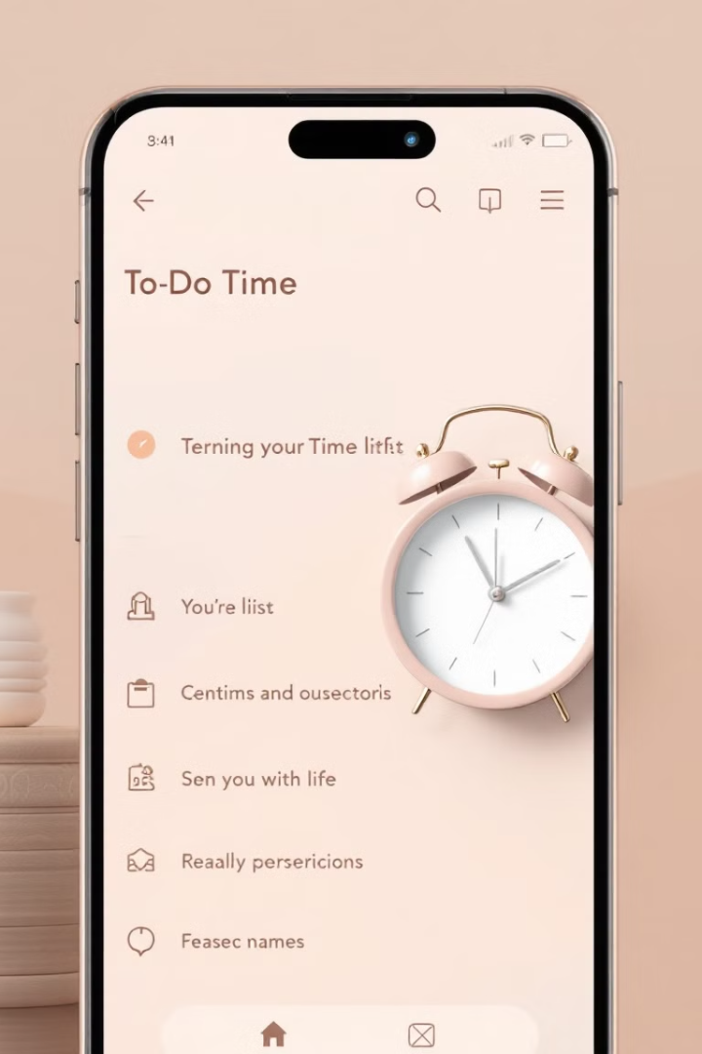
Introducing ZenTime: Simplicity Redefined
1
Streamlined Interface
2
Essential Tools
Focus on what matters most. To-do lists and utilities help you achieve goals.
ZenTime offers a clean layout. It removes unnecessary complexity.
3
Mindful Productivity
Be intentional with your time. Cultivate focus and reduce stress.

Slide 4
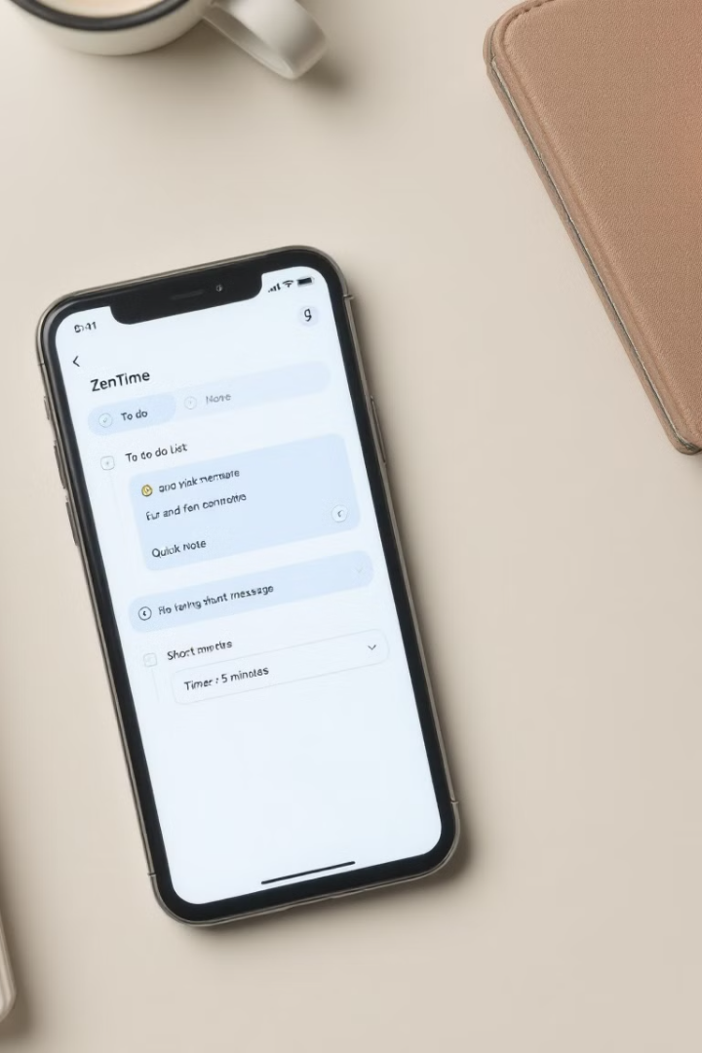
Core Features: To-Do Lists & Quick Utilities
Intuitive To-Do Lists
Quick Notes
Easily create, organize, and track tasks. Prioritize effectively.
Capture ideas instantly. Never lose your train of thought.
Timer & Stopwatch
Stay on schedule. Manage time efficiently.

Slide 5
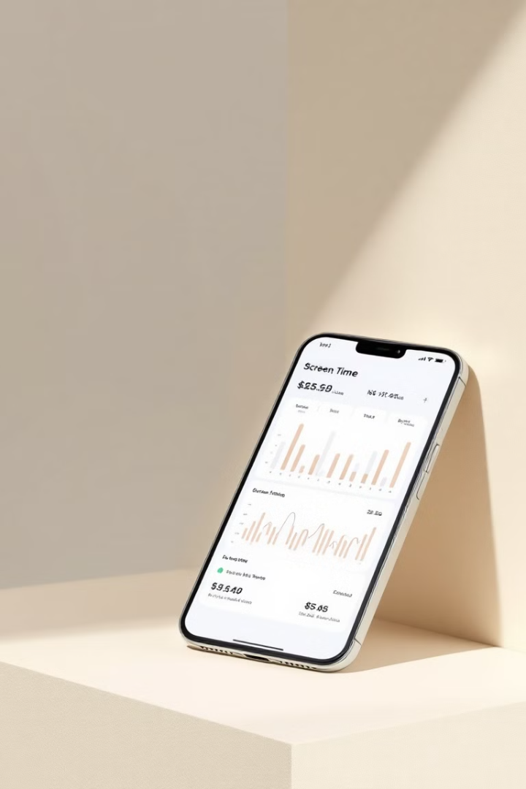



Real-Time Screen Time Tracking: Awareness is Key
Monitor Usage
Track how you spend your time. Understand your digital habits.
Set Limits
Establish healthy boundaries. Reduce unproductive screen time.
Improve Focus
Gain control over your day. Achieve a better work-life balance.

Slide 6
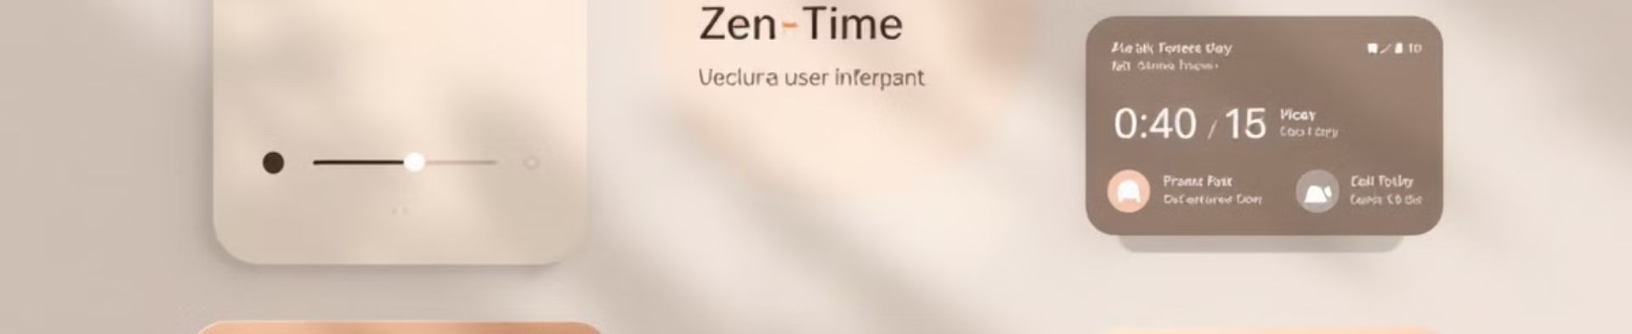



Design Philosophy: Elegant & Distraction-Free
Visual Clarity
Minimal Notifications
Intuitive Design
Clean typography and clear icons. Easy on the eyes.
Reduce interruptions. Focus on essential alerts.
Easy navigation. Enjoy a seamless user experience.

Slide 7




Customization & Personalization: Your Zen, Your Way : Future Goals
Theme Selection
1
Font Choices
2
4
Layout Preferences
3
Sound Options

Slide 8
ZenTime: Reclaim Your Focus, Boost Productivity
1
Download ZenTime
2
Customize Your Workspace
3
Achieve Your Goals
Take control of your time and focus. Download ZenTime today. Start your journey to mindful productivity.

