Slide 1
HOUSE PRICE PREDICTION
CAPSTONE PROJECT
Presented By:
TARANG VERMA
Noida Institute of Engineering & Technology (NIET), Gr. Noida
Computer Science Engineering in Artificial Intelligence

Slide 2
OUTLINE
Problem Statement
Proposed System/Solution
System Development Approach (Technology Used)
Algorithm & Deployment
Result
Conclusion
Future Scope
References

Slide 3
PROBLEM STATEMENT
Determining the optimal price for residential properties in today's real estate market is challenging due to the diverse factors influencing house prices, such as type of dwelling, lot size, condition, and construction year.
In today's real estate market, determining the appropriate price for a home is a difficult task. A variety of factors influence the price of a house, including the type of dwelling, lot size, overall condition, year built, and so on.
Accurate price prediction is critical for both buyers who want to avoid overpaying and sellers who want to get the highest possible price. It is also important for real estate agencies and online property listing platforms, which require accurate price estimates.
However, because of the high variability and complexity of these factors, forecasting house prices remains a difficult task. The critical part is predicting house prices based on various features to provide a stable, reliable estimate.

Slide 4
PROPOSED SOLUTION
The proposed system seeks to address the challenge of predicting house prices based on a variety of factors. This entails using data analytics and machine learning techniques to accurately predict house prices. The solution will include the following components:
Data Collection: Collect historical information on house sales, such as the type of dwelling, lot size, overall condition, year built, and other relevant factors.
Data preprocessing: Clean and preprocess the collected data to remove missing values, outliers, and inconsistencies. Feature engineering involves extracting relevant features from data that may have an impact on house prices.
Machine Learning Algorithm: Implement a variety of machine learning algorithms, including Random Forest Regressor, Decision Tree Regressor, Gradient Boosting Regressor, and K-Nearest Neighbours (KNN). These models will be trained and tested on a subset of the dataset to forecast house prices based on past trends.

Slide 5
PROPOSED SOLUTION
Deployment: Create a user-friendly interface or application that predicts real-time house prices. Deploy the solution on a scalable and reliable platform, taking into account server infrastructure, response time, and user accessibility.
Evaluation: Evaluate the model's performance using the Mean Absolute Percentage Error (MAPE) metric. Fine-tune the model using feedback and continuous monitoring of prediction accuracy.
Result: Present each model's MAPE and discuss which performed best. All real estate market stakeholders will benefit from this reliable estimate of house prices.

Slide 6
SYSTEM APPROACH
The system approach outlines the overall strategy and methodology for developing and implementing the House Price Prediction system.
System Requirements:
A computer with a Python environment installed.
Access to the house price dataset.
Sufficient memory and processing power to handle data preprocessing, model training, and prediction.
Libraries Required to Build the Model:
Pandas: Used for data manipulation and analysis. It provides data structures and functions needed to manipulate structured data.
Matplotlib and Seaborn: Used for data visualization. They provide a flexible and powerful declarative framework for creating static, animated, and interactive visualizations in Python.
Scikit-learn: Used for machine learning and statistical modeling including classification, regression, clustering, and dimensionality reduction.
NumPy: Used for numerical computations and working with arrays.

Slide 7
SYSTEM APPROACH
Data Collection: The dataset is collected and loaded into a pandas DataFrame.
Data Preprocessing: The data is cleaned and preprocessed. This includes handling missing values, outliers, and inconsistencies. Feature engineering is performed to extract relevant features from the data that might impact house prices.
Model Building: Several machine learning algorithms are implemented including Support Vector Regressor (SVR), Random Forest Regressor, Decision Tree Regressor, Gradient Boosting Regressor, and K-Nearest Neighbors (KNN). These models are trained and tested on a split of the dataset to predict house prices based on historical patterns.
Model Evaluation: The model’s performance is assessed using the Mean Absolute Percentage Error (MAPE) as the evaluation metric.
Deployment: The final model is deployed to make real-time prediction

Slide 8
ALGORITHM & DEPLOYMENT
Algorithm Selection:
Random Forest Regressor: This is a meta estimator that fits several classifying decision trees on various sub-samples of the dataset and uses averaging to improve the predictive accuracy and control over-fitting.
Decision Tree Regressor: This algorithm builds regression models in the form of a tree structure and breaks down our dataset into smaller subsets while at the same time an associated decision tree is incrementally developed.
Gradient Boosting Regressor: This algorithm produces a prediction model in the form of an ensemble of weak prediction models, typically decision trees. It builds the model in a stage-wise fashion, and it generalizes them by allowing optimization of an arbitrary differentiable loss function.
K-Nearest Neighbors (KNN): This algorithm assumes that similar things exist in close proximity and predicts the value of any given point in the dataset by averaging the values of the ‘k’ closest points.

Slide 9
ALGORITHM & DEPLOYMENT
Data Input: The input features used by the algorithms include type of dwelling, lot size, overall condition, year built, and other relevant factors.
Training Process: The algorithms are trained using the historical house price data. The data is split into a training set and a test set, with the training set used to train the model and the test set used to evaluate its performance. The models are trained to find the best parameters that minimize the difference between the predicted and actual house prices.
Prediction Process: Once trained, the models make predictions for house prices based on the input features of the dataset. The output is a continuous value representing the predicted price of the house.
Deployment: The final model is deployed to make real-time predictions. This could be in the form of a web application or a software component in a larger system, depending on the specific requirements of the project.

Slide 10
RESULT
Model Performance:
Random Forest Regressor: The Random Forest model achieved a MAPE of 19.20%. This shows that the Random Forest model’s predictions were on average 19.20% different from the actual prices.
Decision Tree Regressor: The Decision Tree model achieved a MAPE of 22.96%. This means that the Decision Tree model’s predictions were on average 22.96% different from the actual prices.
Gradient Boosting Regressor: The Gradient Boosting model achieved a MAPE of 19.16%. This indicates that the Gradient Boosting model’s predictions were on average 19.16% different from the actual prices.
K-Nearest Neighbors (KNN): The KNN model achieved a MAPE of 20.58%. This shows that the KNN model’s predictions were on average 20.58% different from the actual prices.

Slide 11
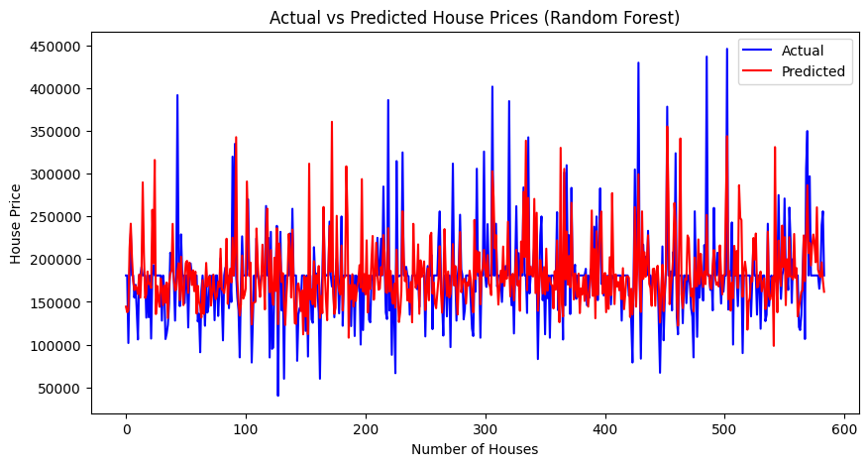
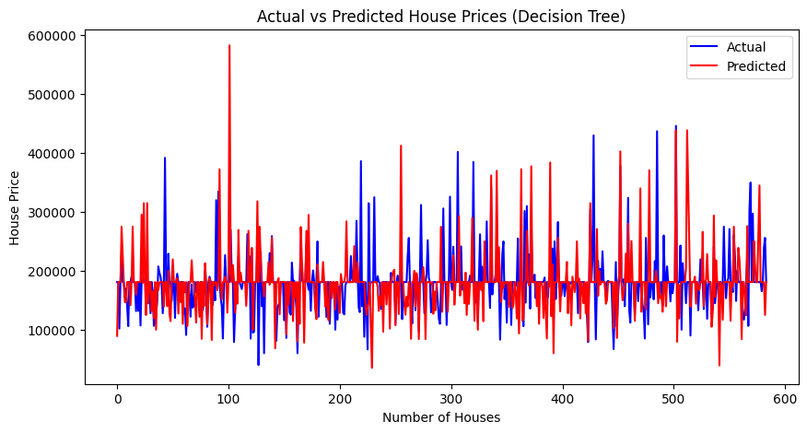

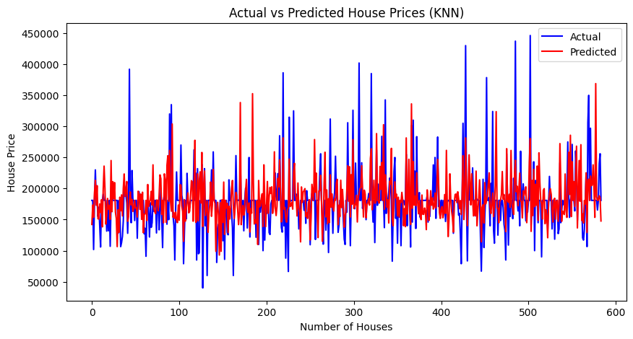
RESULT

Slide 12
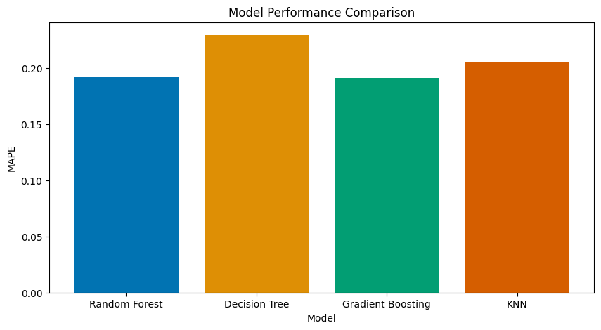
RESULT
Visualizations: includes line graphs to compare the predicted and actual house prices for each model
Model Comparison: Based on the performance comparison of the models, the Gradient Boosting Regressor has the lowest Mean Absolute Percentage Error (MAPE).

Slide 13
CONCLUSION
Finally, the project 'House Price Prediction using Machine Learning' demonstrated the efficacy of various machine learning algorithms for predicting house prices. The Gradient Boosting Regressor model outperformed all others.
The findings of this project demonstrate the potential of machine learning in the real estate industry. The Gradient Boosting Regressor model accurately predicted house prices with a MAPE of 19.16%.
Several challenges arose during project implementation, including dealing with missing values and outliers in the data, as well as selecting the most relevant features for prediction. However, these issues were addressed using data preprocessing techniques and feature engineering.
This project's potential improvements include investigating more advanced machine learning models, incorporating additional features into the dataset, and fine-tuning the models to improve their performance.
The value of accurate house price predictions cannot be overstated. It ensures that buyers get a fair deal, while it assists sellers in properly pricing their property. It gives real estate agencies and online property listing platforms a reliable estimate to present to their users.

Slide 14
FUTURE SCOPE
The 'House Price Prediction using Machine Learning' project has a bright future ahead. Here are some potential improvements and expansions for the system.
Incorporating Additional Data Sources The model's performance could be improved by including more data sources. For example, data about the neighbourhood, such as the distance to schools, hospitals, and public transportation, could be included. Furthermore, macroeconomic factors such as interest rates, inflation, and housing market trends may provide useful context.
Optimising the Algorithm for Better Performance: Machine learning models can always be improved. Advanced techniques such as hyperparameter tuning, ensemble methods, and deep learning could be used to improve the model's performance.
Expanding the System to Cover Multiple Cities or Regions: The model is currently being trained on a specific dataset. However, house prices can vary greatly between cities and regions. Expanding the system to include data from multiple cities or regions may improve the model's robustness and applicability.
Emerging technologies, such as edge computing, could be used to bring the model closer to the data source, reducing latency and improving real-time prediction capabilities. Advanced machine learning techniques, such as reinforcement learning or neural networks, could be used to improve prediction accuracy.

Slide 15
REFERENCES
Pedregosa et al., “Scikit-learn: Machine Learning in Python”, JMLR 12, pp. 2825-2830, 2011.
McKinney & others, “pandas: powerful Python data analysis toolkit”, 2010.
Hunter, J. D., “Matplotlib: Visualization with Python”, 2007.
Waskom M., “Seaborn: statistical data visualization”, 2021.
Jain, A., & Kumar, A. M., “House price prediction: a comparison of multiple linear regression and artificial neural networks”, Journal of AI and Data Mining, 2018.

Slide 16
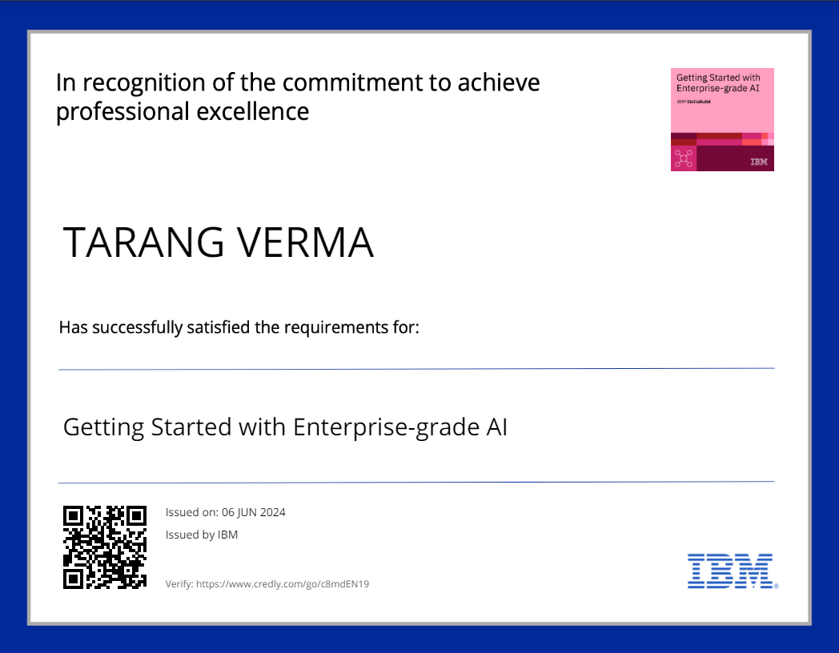
course certificate 1

Slide 17

course certificate 2

Slide 18
THANK YOU

