Slide 1
ARM TRUST ZONE
Presented By N.Tarani

Slide 2
1) understanding why we need trustzone and basics of trustzone.
2) Understanding trust zone API’s.
3) Builded application and integrated with trustzone.
4) Tested this application on raspberrypi3.
Contribution for July

Slide 3
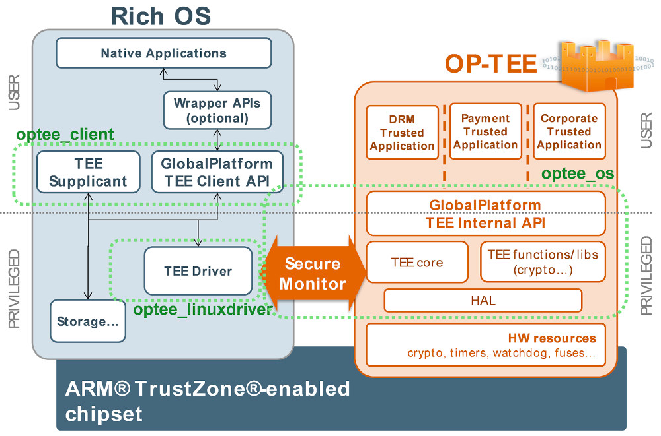

Slide 4
1.TEEC_Result TEEC_InitializeContext(constchar*name,
TEEC_Context* context)
2.TEEC_Result TEEC_OpenSession (
TEEC_Context* context,
TEEC_Session* session,
const TEEC_UUID* destination,
uint32_t connectionMethod,
const void* connectionData,
TEEC_Operation* operation,
uint32_t* returnOrigin)
Client API’s

Slide 5
Client API’s
3.TEEC_Result TEEC_InvokeCommand(
TEEC_Session* session,
uint32_t commandID,
TEEC_Operation* operation,
uint32_t* returnOrigin)
4.void TEEC_CloseSession (TEEC_Session* session)
5.void TEEC_FinalizeContext(TEEC_Context* context)

