Slide 1
Digital Rights Mangement

Slide 2
EME overview
The W3C HTML working group is developing media extension specifications for HTML5 to enable the delivery of commercial video to consumers over the Web.
HTML Media Extensions:
Media Source Extensions(MSE)
Encrypted Media Extensions (EME)
EME-compliant Content Decryption Module (CDM), providing access to a platform DRM component which supports Content Decryption Module interface (CDMi).

Slide 3
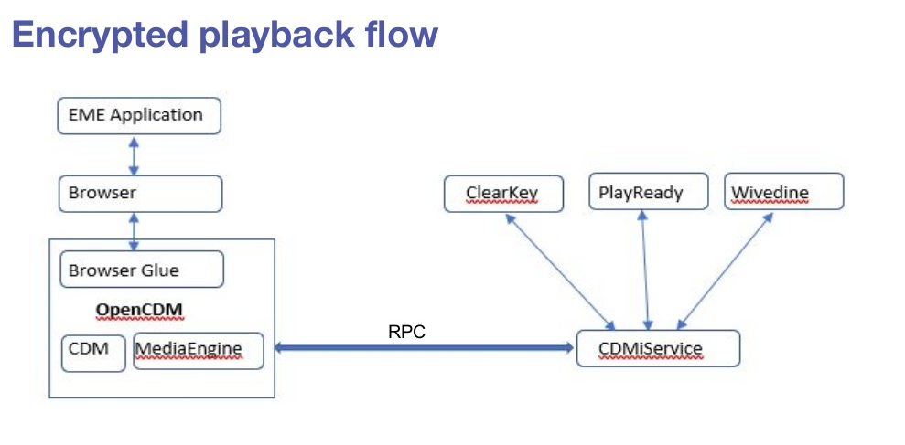
OCDM overview
ClearKey
PlayReady
Widevine

Slide 4
Demo overview
Open Content Decryption Module(OCDM) added as a plugin to Chrome browser.
It is validated with ClearKey DRM contents on the Chrome browser.
It uses Open Portable Trusted Execution Environment(OPTEE) for secure decryption, decoding and playback.
Used an embedded target Dragonboard 410c as a reference platform.

Slide 5
Votarytech Solution- Downloadable DRM
Objectives of Multimedia Secure Streaming solution based on downloadable DRM:
Ability to identify DRM type and to extend support for client side media player.
Multimedia streaming solution should able to download custom DRM plugin to support playback
This solution will help an existing media player to extend for new DRM types.
Ensures the media playback, abides with secure measures to maintain data integrity.
The design of this DRM framework is agnostic and abstracts specific DRM scheme.

Slide 6
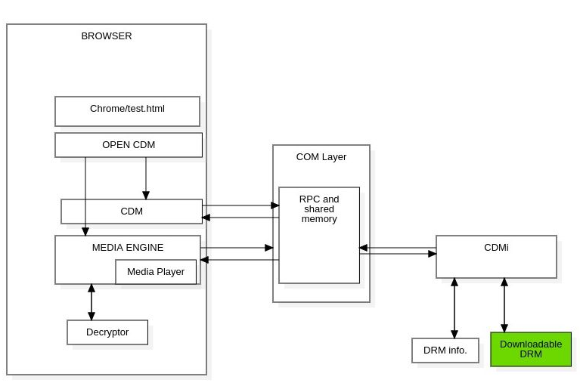
Downloadable DRM Solution

Slide 7
Downloadable DRM Solution
CDN
DRM Plugins Server
LICENSE SERVER
WEB SERVER
License
Get License
Get License
License
APPLICATION
Fetch_InstallDRM_Plugin()
CreateSession()
NeedKey
Message
CreateSession()
IsTypeSupported()
Message
Update()
Update()
Browser
NET
Media Stack
MediaKeySession
MediaKeySession
Generate Request
Frame
Content
Encrypted Key
Command/ Event
Optional
License Request
Provide License
Provide License
Decrypt Frame
Generate Request
License Request
Content Decryption Module
Platform capabilities
Platform
NotifyDRM()
Downloadable DRM

Slide 8


