Slide 1
BUILD OUR OWN APPLICATIONS USING TRUST ZONE
Presented By Sahithi.S

Slide 2
Objective
To Create a Image with Trust zone for raspberrypi3.

Slide 3
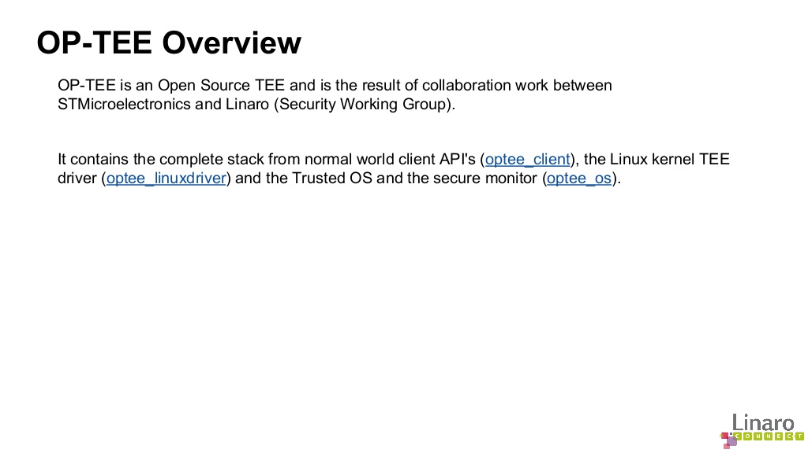

Slide 4
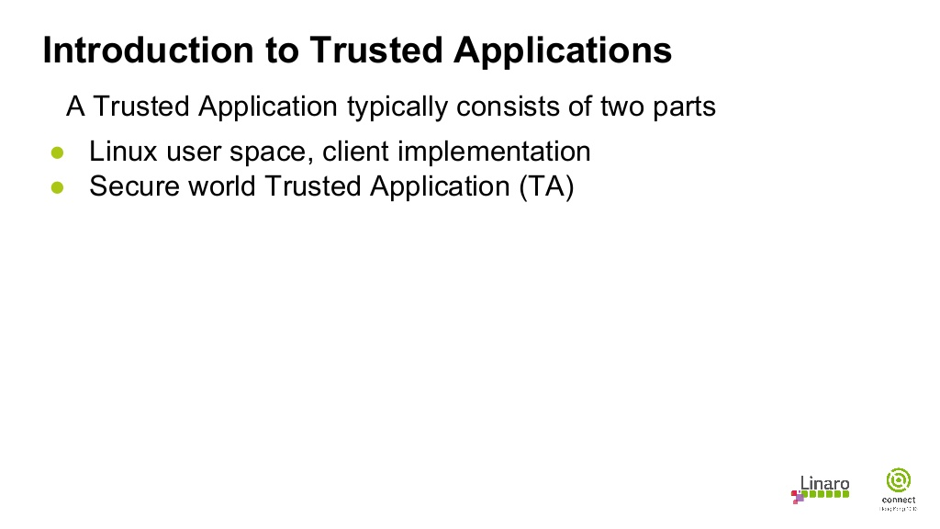

Slide 5
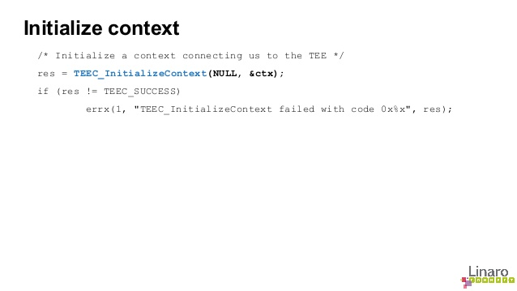

Slide 6
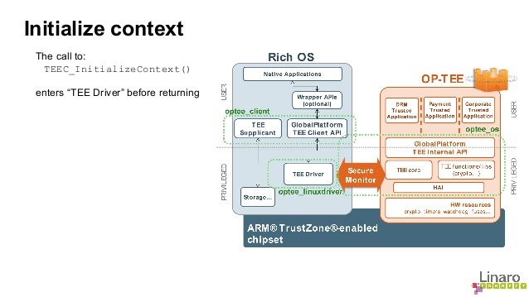

Slide 7
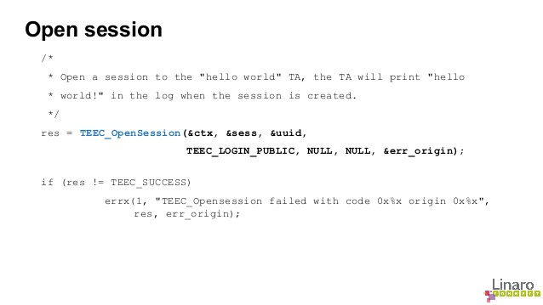

Slide 8
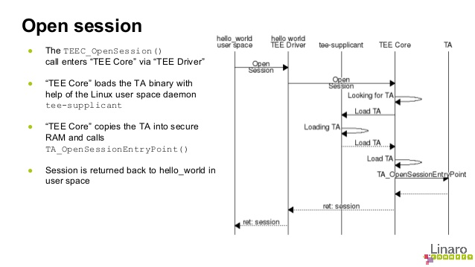

Slide 9
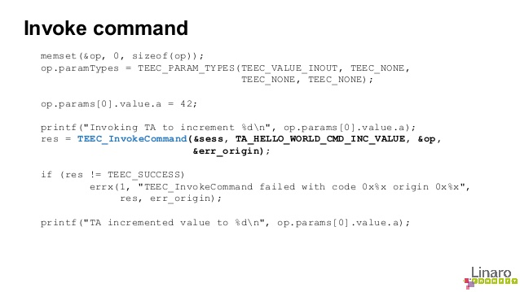

Slide 10
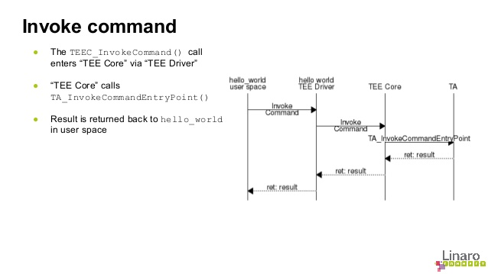

Slide 11
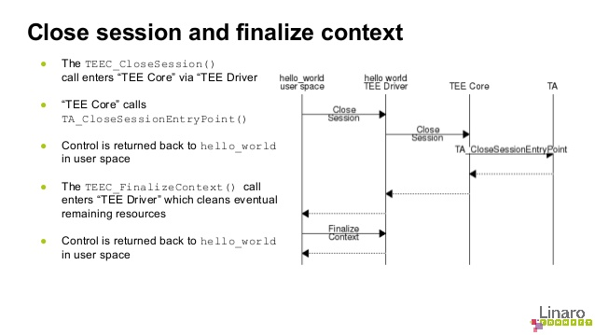

Slide 12
1) Understanding the code flow of trust zone.
2) Understanding trust zone API.
3) Builded our own application and integrated with trustzone
4) Tested this application on raspberrypi3.
5) Build Document.
Contribution for June

Slide 13
Thank u

