Slide 1
Bispectrum analysis using the python toolkit
Tarandeep Kalra

Slide 2
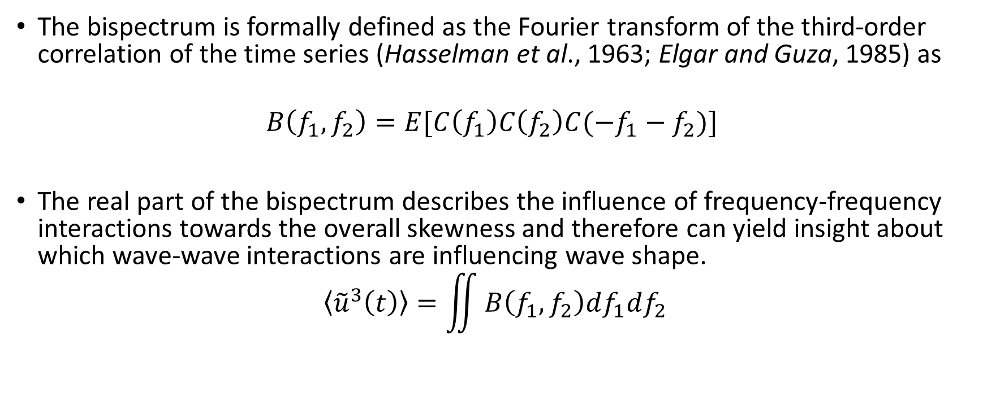
What is bispectra
The bispectrum is formally defined as the Fourier transform of the third-order correlation of the time series (Hasselman et al., 1963; Elgar and Guza, 1985) as
$$\begin{aligned}B\left(f_{1},f_{2}\right)=E[C\left(f_{1}\right)C\left(f_{2}\right)C(−f_{1}−f_{2})] \end{aligned}$$
The real part of the bispectrum describes the influence of frequency-frequency interactions towards the overall skewness and therefore can yield insight about which wave-wave interactions are influencing wave shape.
$$\begin{aligned}〈{\tilde{u}}^{3}\left(t\right)〉=\iint{B\left(f_{1},f_{2}\right)df_{1}df_{2}} \\ \end{aligned}$$
Real part of the bispectrum and skewness

Slide 3
My understanding (From Crawford & Hay)
Real part of bispectra in
Freq- freq space
-> under the diagonal
Positive or negative skewness – integrate under the diagonal
Notes:
Examining the real part of the bispectrum in freq-freqspace reveals the interactions
At pairs of frequencies that contribute towards total skewness
Third moment can be obtained from the real part of bispectrum

Slide 4
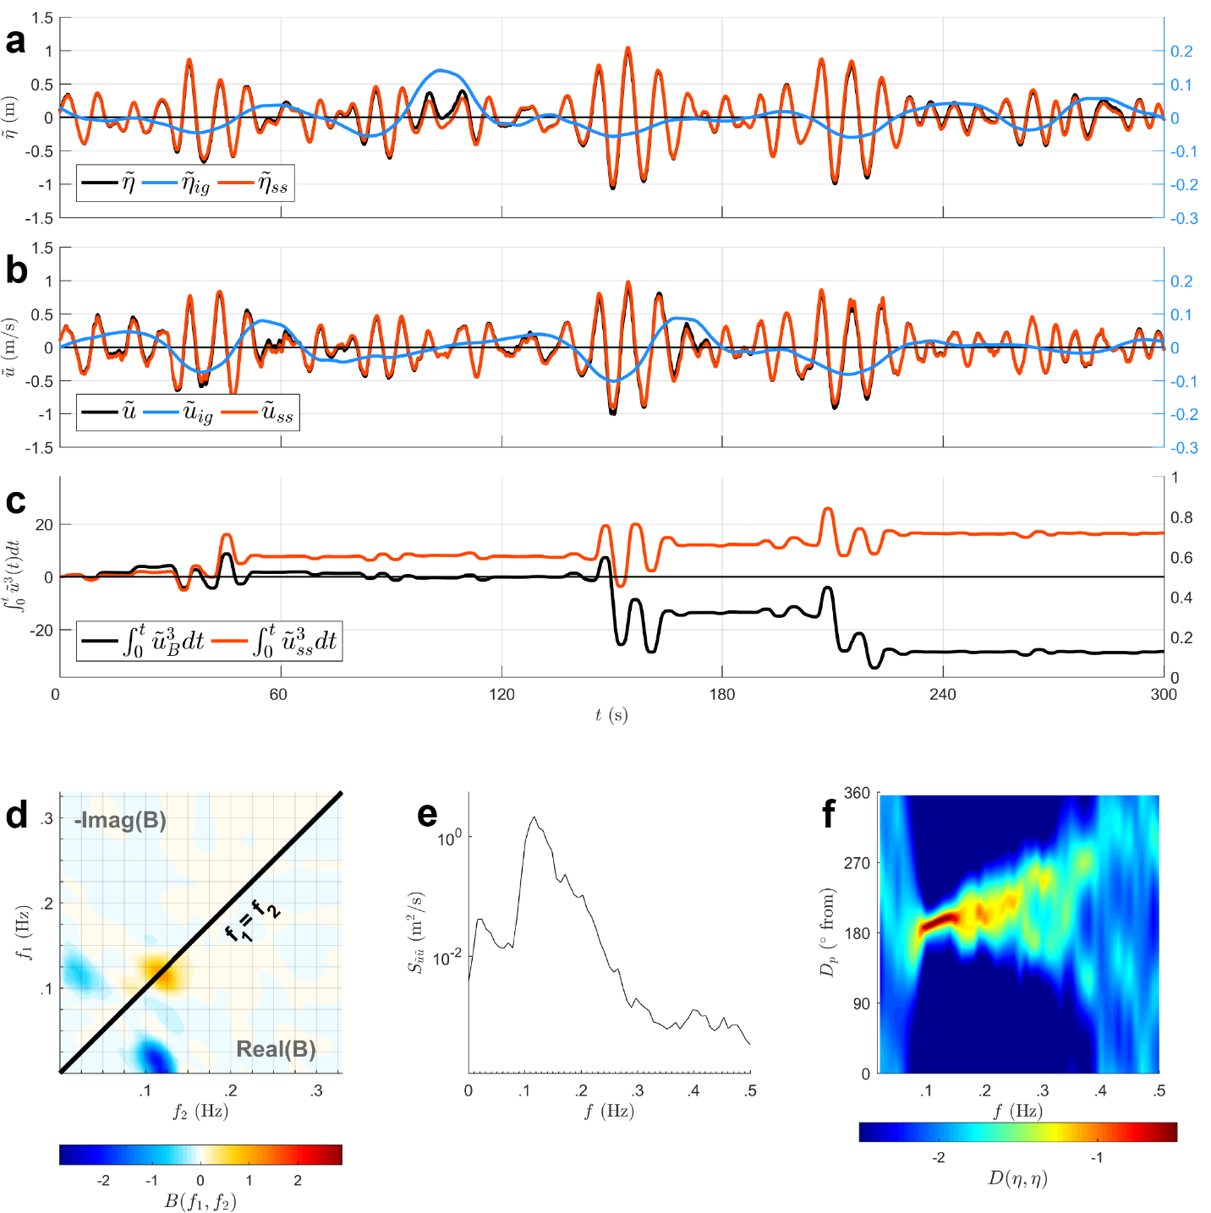
Shawns bispectrum analysis

Slide 5
What Python Provides
https://stingray.readthedocs.io/en/latest/notebooks/Bispectrum/bispectrum_tutorial.html#Another-Example

Slide 6
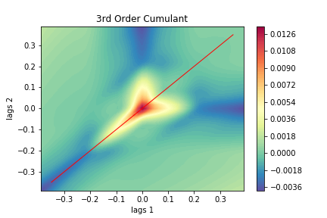
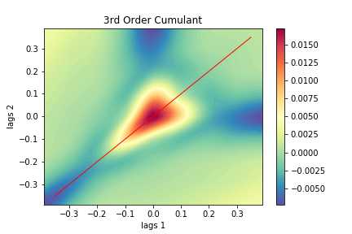
What we can get out of Python toolkit
Fire Island

Slide 7
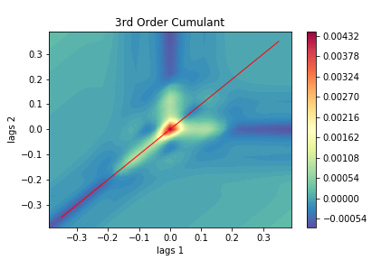
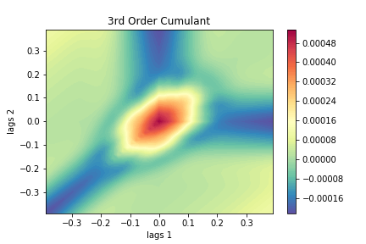
MVCO

Slide 8
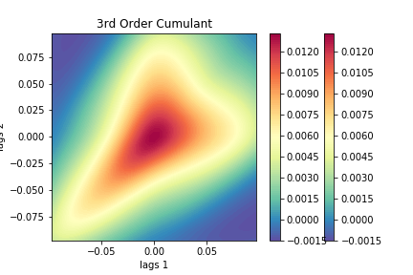
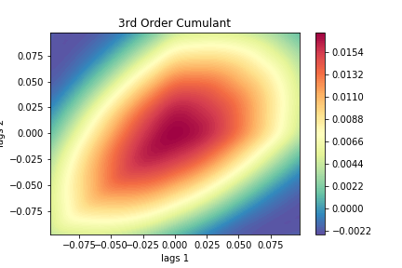
Matanzas Inlet

Slide 9
# find the sum of elements under the principal diagonal
# along principal diagonal
 | Poistive | Negative
FI | -0.0959506028181321 | -0.18275204937181808
MVCO | -0.015344823136320579 | -0.005706610128953656
MI | 5.085998639653247 | 9.074009486681927

Slide 10
Discuss about Chris’s idea and Johns inwave sims point

