Slide 1
Snobley
By: Péter & Károly Taraszovics

Slide 2
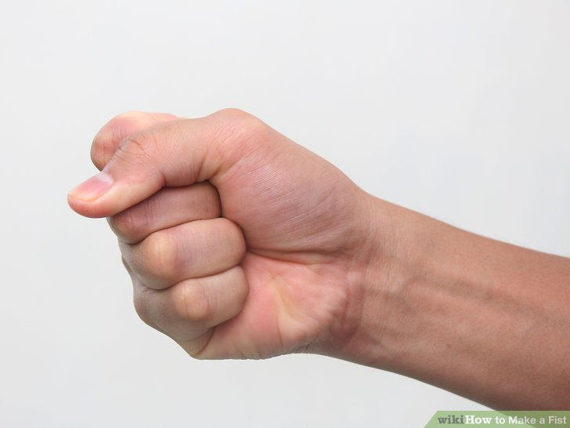
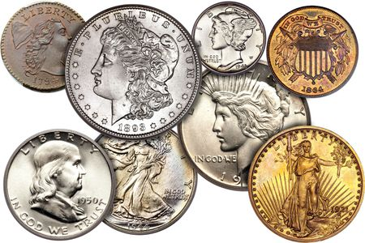
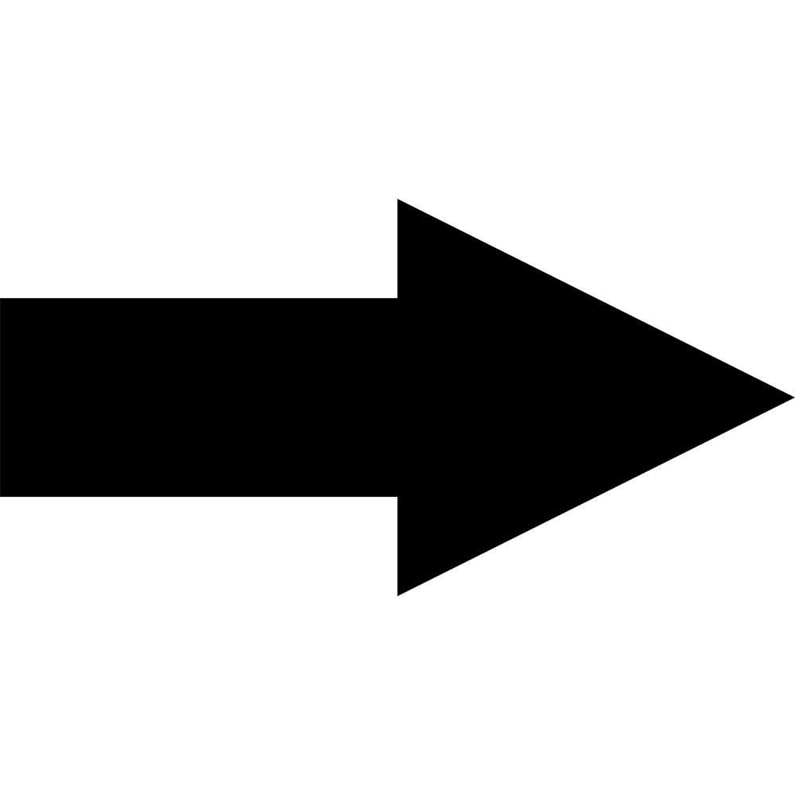
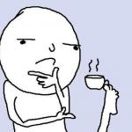

Slide 3
Last week’s version
The game ran stable with minor weaknesses
Point counting feature
The code had no unique functions

Slide 4
New features
Better code (functions)
Menu
  Play
  Leaderboard
  Credits
  Quit

Slide 5
Weaknesses & planned features
Errors those only known by us : - )
Emojis instead of coins (started, but haven't finished)
Nicer look
Multiple player mode

Slide 6
How we did it
Every day we talked through what we achieved and what to do next day
Share tasks

