Slide 1


Slide 2


Crash Course in Practical Performance Testing
Lorena Jinchuk
Senior Services Engineer

Slide 3
Theory without practice is empty; practice without theory is blind.
-- Immanuil Kant

Slide 4
AGENDA
Setup Tools
Scripting
Load Profiles
Analyzing Results
Going Cloud

Slide 5
Motivation
We have excuses to not do perf testing
80/20 principle works well, effort is small for 80%
Tooling have caught up with market’s needs

Slide 6

Exploratory Performance Testing
When you know nothing about your app performance
You have to know the basic theory of perf testing
All tests are pretty short and simple
Gives baseline for automation
Notes:
Might spot important diagnostic “unknowns”

Slide 7
People Waste Time On...
Doing all types of performance tests
Running tests for hours and hours
Doing tests that give misleading results
Not knowing what is the app’s bottleneck

Slide 8
Realistic vs Synthetic
Realistic requires soooooooooooooo much time
Complex scripting: effort to write, effort to maintain
Synthetic is on the technical side of things, like UT
Realistic testing is for later stages of SDLC

Slide 9
Tool Setup

Slide 10

Text-based configuration file format,
executed by the command-line tool,
which uses other popular testing tools inside,
and connects to cloud services for extra features.

Slide 11
Taurus Open Source Tool
Common ground for multiple OSS tools
Simplified scripting
Instant reporting, built-in failure criteria
Typical pre/post actions
Connects to cloud platform for reporting & scale
Func/Perf script reuse for some tool types
Python, Open Source under permissive license

Slide 12
Installing Taurus
http://gettaurus.org => “Installation”, platform on the right
Installer for Windows
MacOS:
Java needs to be installed for default JMeter
> brew install bzt

Slide 13
Check it Works
Open Command Prompt or Terminal
Check with:
Docker image available, “examples/bztdocker” script
> bzt http://blazedemo.com

Slide 14
Choosing Target for Testing
Don’t test something you don’t own
Be careful with production envs
http://blazedemo.com/
https://www.demoblaze.com/
It’s great to have APM
Notes:
Sad to not have APM, but it takes separate effort to set it up

Slide 15
Interactive Reports
or permanently via .bzt-rc file:
> bzt http://blazedemo.com -report
--- reporting: - blazemeter

Slide 16
Scripting

Slide 17
Scripting Concepts
Save time by not testing unnecessary cases
Choose the most covering flow or “suspect” flow
More complexity = harder to troubleshoot + maintain

Slide 18
Script Languages
JMeter JMX files
Taurus YAML
Existing scripts for any Taurus-supported tool
Java, Python, JavaScript, Ruby
Functional testing scripts, reused for load

Slide 19
A Word on YAML
Indentation matters (no TABs!)
Key-value maps
List items with “-”
Automatic data types
Tutorial: http://gettaurus.org/docs/YAMLTutorial/
If you have proper IDE, use it

Slide 20
BlazeMeter Chrome Extension
Install extension
Open target
Start recording
Go through flow
Stop recording
Click “Edit”
Click “Taurus” on top
Review downloaded file

Slide 21
Running the Script
“-gui” if you want to review JMeter script
> bzt jmeter_script.jmx
> bzt config_file.yml

Slide 22
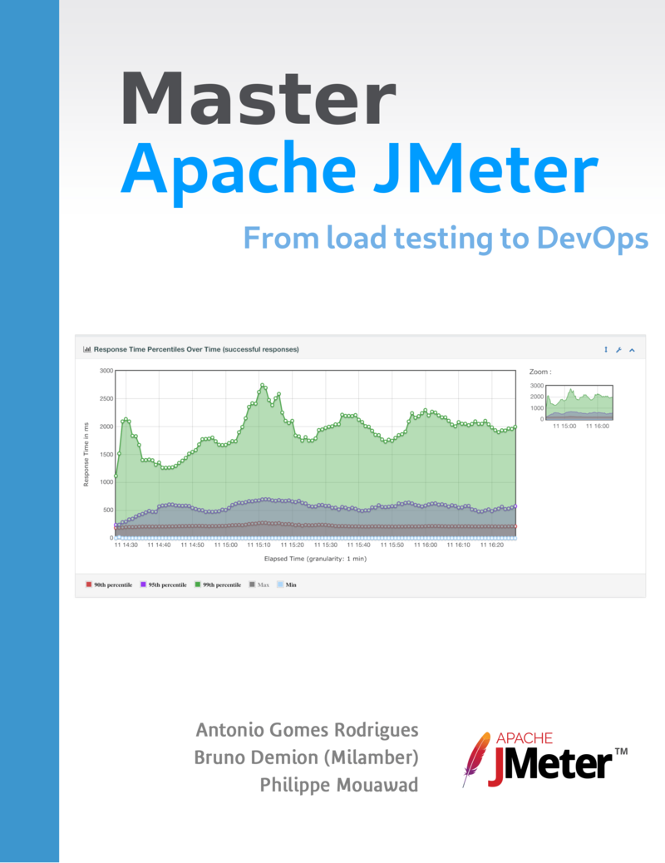

Slide 23
Load Profiles
Notes:
How to test efficiently, by focusing on practical outcomes

Slide 24


Slide 25
Universal Scalability Law
Ideal
Throughput
Amdahl’s Law
USL
Concurrency
Notes:
Everything after hump is underperforming

Slide 26
Response Times
USL
Resp. Time
Amdahl’s Law
Ideal
Concurrency

Slide 27
Test to Answer Questions
“How much?” => capacity => stress tests
“How good?” => response time => load tests
Hard to measure both in single test run
Leave other perf test types for later (or others)

Slide 28
“Stress” Test – First Thing to Do
Ramp-up only, can be stepping
Throughput to show USL curve (or failures explode)
How much throughput at which concurrency
Don’t be satisfied with “it survives planned load”
No think-times, as we are synthetic and technical!

Slide 29
“Stress” Test
Response Times or Failures
Throughput,
Response Time,
Failures
Concurrency
Throughput
Time

Slide 30
“Load” Test
Pick the load lower than capacity (from stress test)
How long is enough?
Need for ramp-up, ignored in resulting KPIs
How good and stable are response times?
(Are there any resource leak patterns?)

Slide 31
“Load” Test
Throughput,
Response Time,
Failures
Concurrency
Throughput
Response Times or Failures
Time

Slide 32
Taurus Load Profile Syntax
execution: concurrency:
ramp-up:
hold-for:
throughput:
steps:
iterations:

Slide 33
Taurus Syntax for Stress Test
execution: concurrency: 100
ramp-up: 3m
# steps: 10
# throughput: 100
Run the test
How many VUs before TPS goes flat? 30

Slide 34
Taurus Syntax for Load Test
execution: concurrency: N # less than capacity
ramp-up: 1m # required, but short
hold-for: 3m # this much longer
Run the test
What are values for error% and RT percentiles?

Slide 35
Analyzing Results

Slide 36
Pick the Right KPIs
0% 50% 75% 90% 95% 100%
Look at throughput!
Averages are bad and also they’re good
Reality shows multimodal distributions & outliers
The solution is ~5 percentiles, including 0% and 100%

Slide 37
Kinds of Bottlenecks (Short Version)
Found via “stress” test
Load Gen. => Frontends => Backends => 3rd Parties
Resource exhaustion (active and passive)
Synchronization locks are tricky
Add missing KPIs to monitoring
Notes:
Types of Bottlenecks,

Slide 38
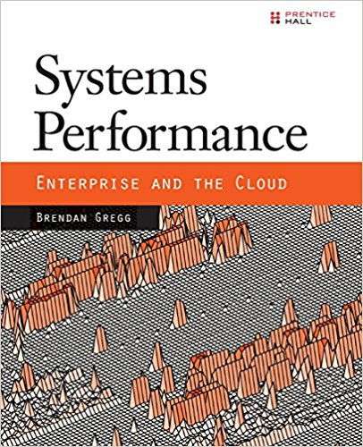
Notes:
USE method, TSA method.

Slide 39
Reporting in Taurus
Artifacts folders per run
Aggregate result export
Pass/Fail criteria syntax
Reports on BlazeMeter: comparison, sharing, more

Slide 40
Pass/Fail Criteria
reporting:
module: passfail criteria: - fail > 1% for 2s, stop
- avg-rt > 1s # end-of-test

Slide 41
Going Cloud

Slide 42

BlazeMeter SaaS Application
When you need good reporting
When organization needs collaboration platform
When you have grown and need scale
Enterprise-grade features and support

Slide 43
Prerequisites
Sign Up for Free Account
Profile => Settings => API keys = > (+)
Copy the “key:secret” pair
Insert into config file

Slide 44
Driving BlazeMeter from Taurus
API key in .bzt-rc file:
> bzt http://blazedemo.com -cloud
--- modules: blazemeter: token: <key>:<secret>

Slide 45
Load and Geo-Locations
execution:
- scenario: abc concurrency: local: 50 cloud: 50000 locations: europe-west1-b: 75 ap-southeast-2: 25

Slide 46
KEY TAKEAWAYS
Don’t chase “realistic tests”
Stress test first, then load test
Have proper tooling
Mind the scale

Slide 47
Thank you! (Q&A Time)

Slide 48

Perf Tests Automated
Synthetic tests 99.9%!
Have short and simple tests
Automate pass/fail criteria checks, too
Trap of aggregate KPIs missing important details
Notes:
Ancombe’s quadrant

