Slide 1
buffer_coordinates:
Buffers to one other random coordinate
point_extraction:
Retrieve values and return for each individual point
Coordinate buffering
skiba
Point extractions from GEE
buffer_and_sample:
Buffers coordinates to n-specified points
aggregated_point_extraction:
Retrieve values averaged over common plot ID values

Slide 2
Plot IDs | GEE Extracted Values
1 | 1
1 | 2
2 | 3
2 | 4
3 | 5
Plot IDs | [Variable]
1 | 1
1 | 2
2 | 3
2 | 4
3 | 5
point_extraction
Plot IDs | GEE Extracted Values
1 | 1
1 | 2
2 | 3
2 | 4
3 | 5
aggregated_point_extraction
Plot IDs | [Variable]
1 | 1.5
2 | 3.5
3 | 5

Slide 3
Plot IDs | Lat | Long
1 | 35.13840 | -84.1800
2 | 35.05636 | -83.6507
3 | 35.79585 | -82.2298
4 | 35.80452 | -82.3504
5 | 35.89833 | -81.8107
Plot IDs | Lat | Long
1 | 35.13414 | -84.1669
2 | 35.05425 | -83.6422
3 | 35.78975 | -82.2444
2 | 35.79726 | -82.3424
4 | 35.89902 | -81.8106
buffer_coordinates
Plot IDs | Lat | Long
1 | 35.1384 | -84.18
2 | 35.05636 | -83.6507
3 | 35.79585 | -82.2298
4 | 35.80452 | -82.3504
5 | 35.89833 | -81.8107
Plot IDs | Lat | Long
1 | 35.13414 | -84.1669
1 | 35.13019 | -84.172
2 | 35.13935 | -84.1802
2 | 35.05425 | -83.6422
3 | 35.05923 | -83.6538
buffer_and_sample
(n = 2, r = 5280 ft)

Slide 4
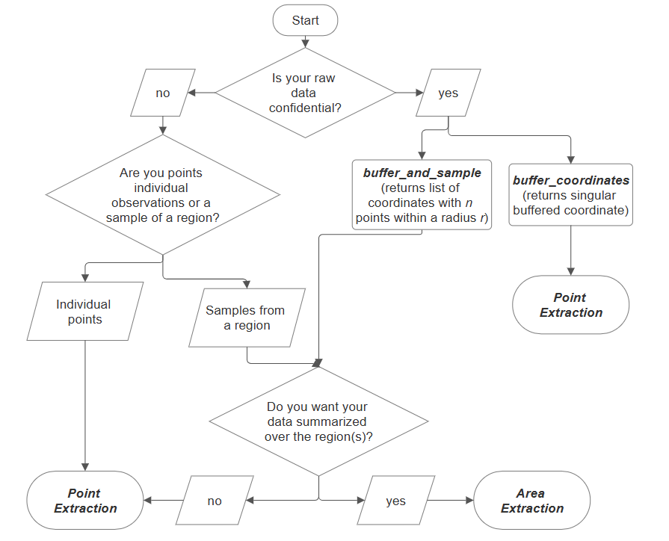
Are plot coordinates
sensitive?
Are the points treated as individual observations or samples from regions?
Samples from
region(s)
Should returned data be aggregated over the regions(s)?

Slide 5
Point extractions
Buffer coordinates
1. Upload CSV of coordinates
1. Upload CSV of coordinates
2. Select GEE dataset to use
2. Set radius for buffering area
3. Apply date filters if necessary
3. Set number of coordinates to generate
4. Run program
4. Run program

Slide 6
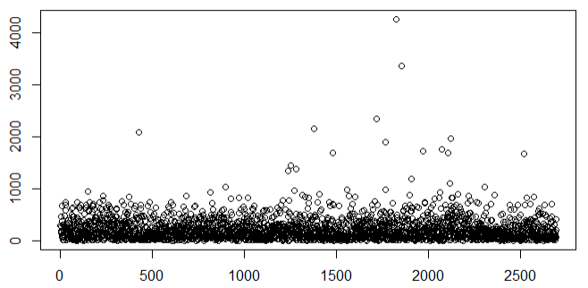
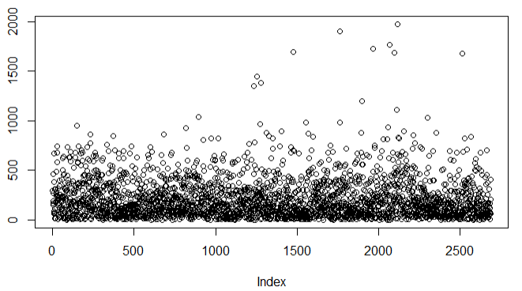
Absolute differences
Uncleaned data
Cleaned data
CSV Columns | Accepted Names
latitude | lat, latitude, y, LAT, Latitude, Y
longitude | log, long, longitude, x, LON, Longitude, Long, X
plot ID | id, ID, plot_ID, plot_id, plotID, plotId

