Slide 1
“renv” package in R

Slide 2
renv package
1. Run rstudio
2. enter:
install.packages("renv")
3. Press “y”
4. Close rstudio and open it again
5. Create new project

Slide 3
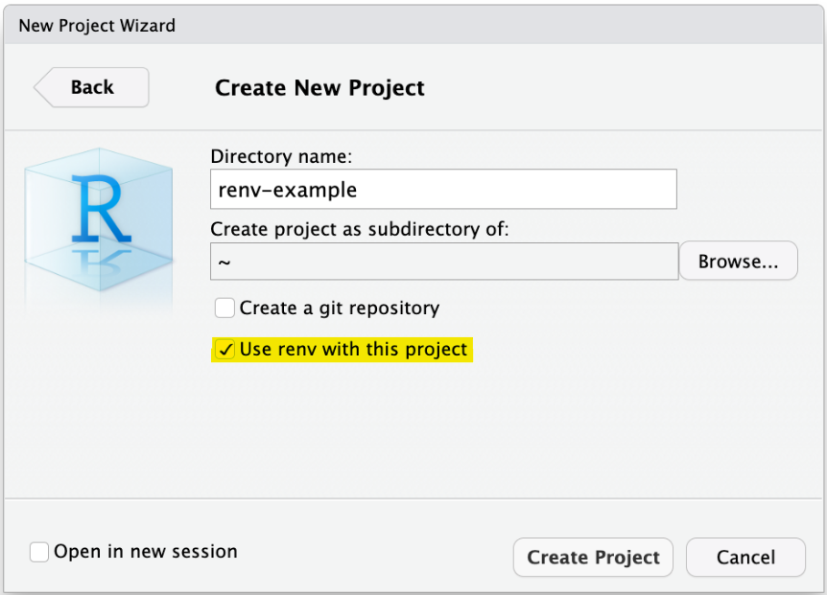
Using renv

Slide 4
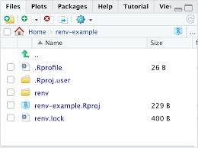
Using renv

Slide 5
Using renv

Slide 6
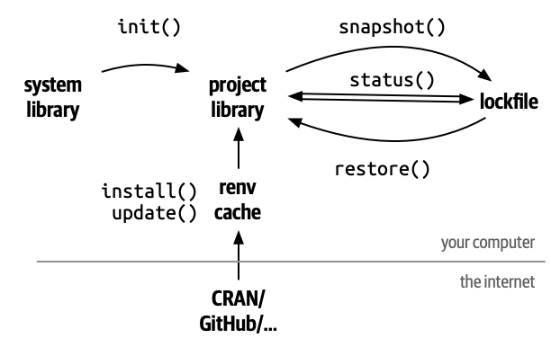
Using renv

Slide 7
renv package
1. Run rstudio
2. enter:
install.packages("renv")
3. Press “y”
4. Close rstudio and open it again
5. Create new project

Slide 8
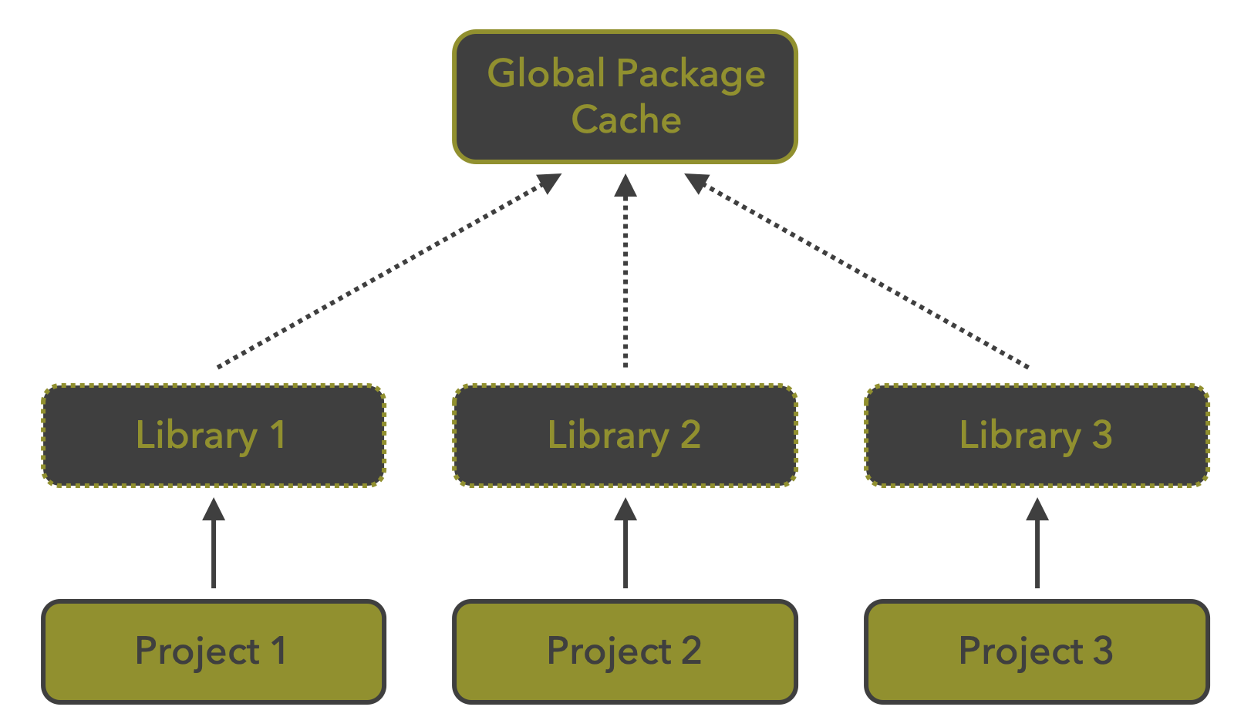
System library (folder)

Slide 9
Using renv

Slide 10
Creating project with renv

Slide 11
Tracking all package versions

Slide 12
System library (folder)

Slide 13
Local library

Slide 14
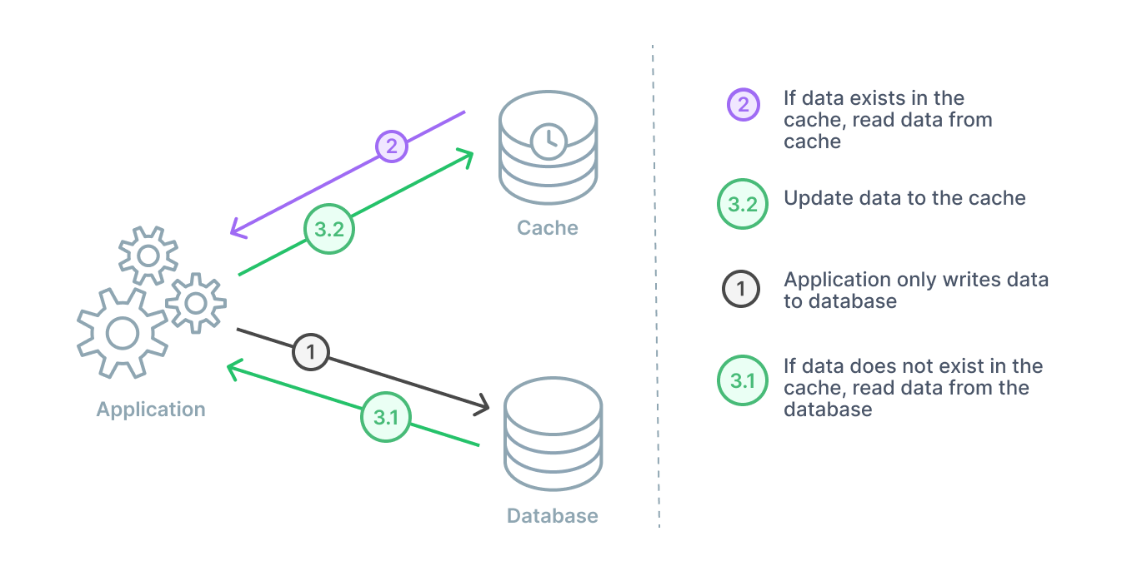
Local library
Global or local library
Rstudio
CRAN

Slide 15
System library (folder)
renv::isolate()

